Slide 1
Maryland NextGen Testbank: Medical Surgical
Mini-Review

Slide 2
NextGen Test Bank
Disclosures
This review uses items in the Maryland NextGen Test Bank accessed with a Qualtrics link or QR Code.
The Maryland Testbank contains peer-reviewed items written by faculty across the State of Maryland that attempt to align with publicly available information about Next Generation NCLEX.
The Maryland NextGen Test Bank Project was funded by the Maryland Nursing Workforce Center as part of a grant from the Maryland Higher Education Commission Nurse Support Program II # 20-125.
This review will take approximately 4 to 5 hours to complete.
For best result, use a laptop, notebook, or desktop to answer the questions.

Slide 3
About The NextGen NCLEX
Starting April 1, 2023, graduates will take an updated version of the National Council Licensure Exam referred to as Next Generation NCLEX.
Next Generation NCLEX (NGN) will continue to test a candidate’s ability to provide safe client care while incorporating new methods to better test clinical judgment.
The testing methods will include using new item response types in clinical judgment case studies and stand-alone questions to test the NCSBN Clinical Judgment Measurement Model(NCJMM) (https://www.ncsbn.org/exams/next-generation-nclex/NGN+Resources/clinical-judgment-measurement-model.page)

Slide 4
The Five New Item Response Types
Extended multiple response items with increased answer options.
Drag-and-drop items that involve moving options to placeholders.
Drop-down items where candidates select the missing words from sentences, paragraphs, or tables.
Highlight items that require candidates to identify parts of the medical record to answer questions.
Matrix/grid items that involve completing tables of information.

Slide 5
Case Studies
Unfolding case studies use approved NGN item types to answer questions about evolving real-world nursing scenarios.
Case studies present 6 linked questions to test the 6 steps of the NCJMM in order:
  Recognize cues
  Analyze cues
  Prioritize hypotheses
  Generate solutions
  Take action
  Evaluate outcomes
Candidates should expect to complete 3 to 5 case studies in a minimum length 85 question NCLEX exam.

Slide 6
Stand-alone Item Types
Stand-alone (single) items test either client needs or clinical judgment
  Client needs items test knowledge of the 8 client needs using traditional or new item types.
  Clinical judgment items present information in a clinical scenario specifically targeting one or more NCJMM clinical judgment step.
There are 2 unique types of clinical judgment stand-alone items:
  Bow-tie
  Trend
Clinical judgment stand-alone items make up approximately 10% of stand-alone items.

Slide 7
Stand-alone Item: Bowtie
A bowtie is a drag-and-drop response item variation.
After reading a clinical scenario, candidates move response options (tokens) to placeholders (targets).
  On NCLEX the placeholders are arranged in the shape of a bowtie.
Candidates must select:
  1 condition the client is most likely experiencing from 4 options.
  2 actions to take to address the condition from 5 options.
  2 parameters to monitor the client’s progress from 5 options.

Slide 8
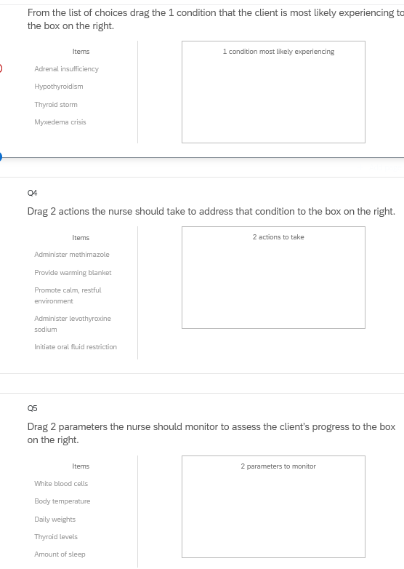
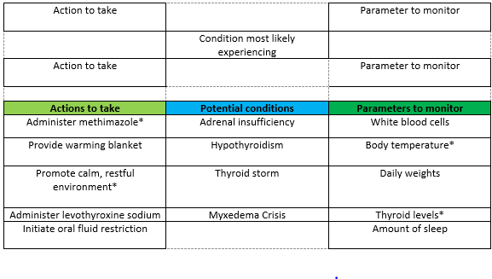
Bowties in Qualtrics
Bowties in Qualtrics are 3 drop and drag question- but they don’t make a “bowtie” shape.

Slide 9
Stand-alone Item: Trends
Trend items require the candidate to make clinical judgments based on client data presented at different time points.
Trend items may address one or more clinical judgment steps but do not follow the six-item sequence like case studies do.
Trend items can feature any item response type except bowtie.

Slide 10
About This Review
Your instructor will provide a QR code or link to answer a series of case studies, bowtie items and trends across a lifespan
While questions throughout the test bank use all 5 new item response, not all specific variations that might be used on NCLEX are not included such as drop-down items formatted as a table.
Information needed to answer questions will be displayed in a medical record, but the medical record will display differently on the actual NCLEX.
To see how items will exactly appear on NCLEX see tutorials at https://nclex.com/next-generation-nclex.page

Slide 11
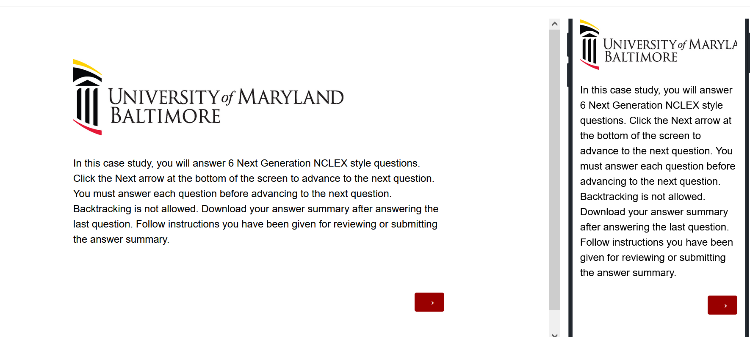
The First Screen Provides Instructions
Use the arrow to advance the screens
There is no backtracking

Slide 12
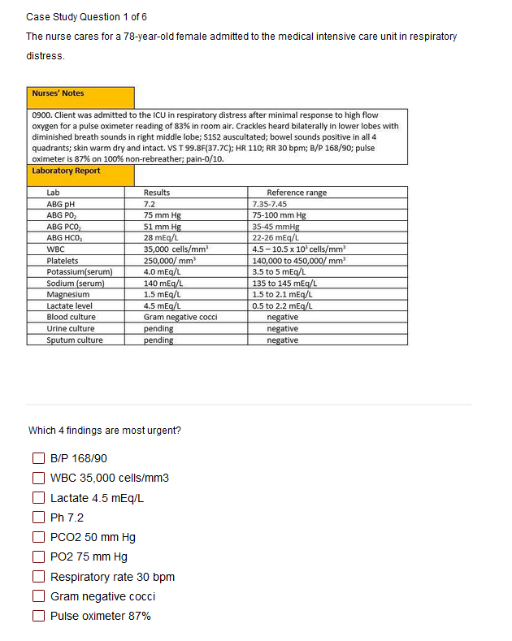

Answer the Questions
Read the instructions carefully.
Sometimes the question tells how many options to pick.
Other times you select all that apply.
Some questions will not allow you to advance if they have not answered enough options.
Use the arrow to advance to the next question if doing a case study

Slide 13
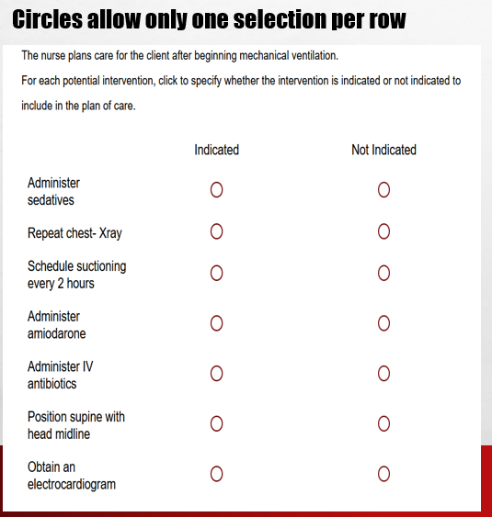
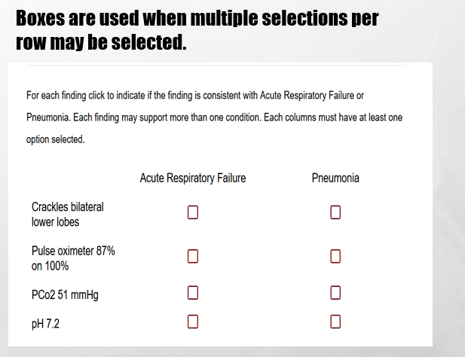
In Tables, Follow Instructions for How Many Options May be Selected in a Row.

Slide 14
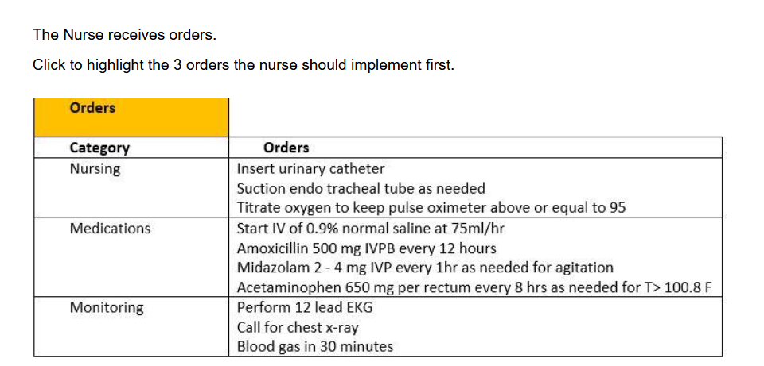
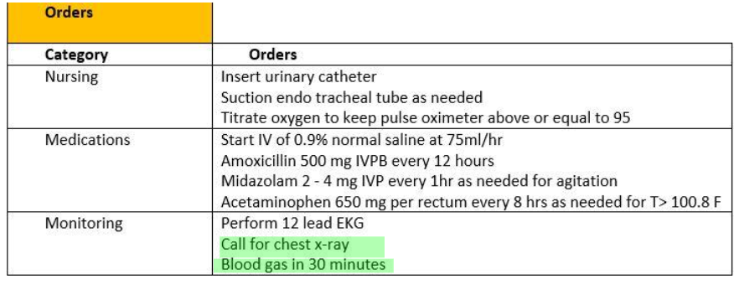
Highlight Questions
Questions first show a plain EMR page
Hovering curser makes boxes appear around selectable data
Click the box to apply the highlight; A second click removes it.

Slide 15
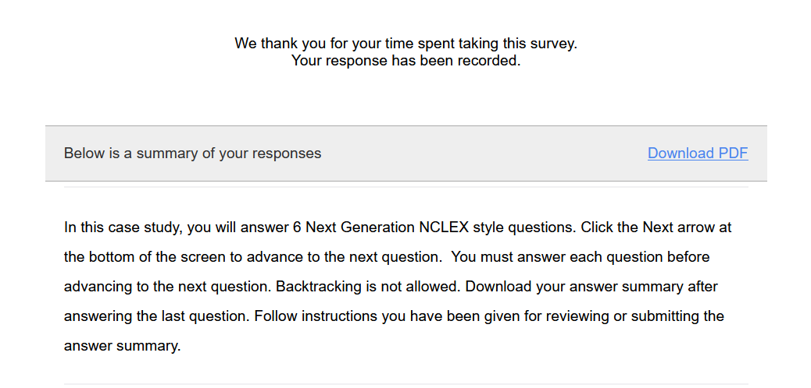
Submit the Final Question and Click Download PDF from Thank You Screen
It is the only way to save your answers.
This step is critical!

Slide 16
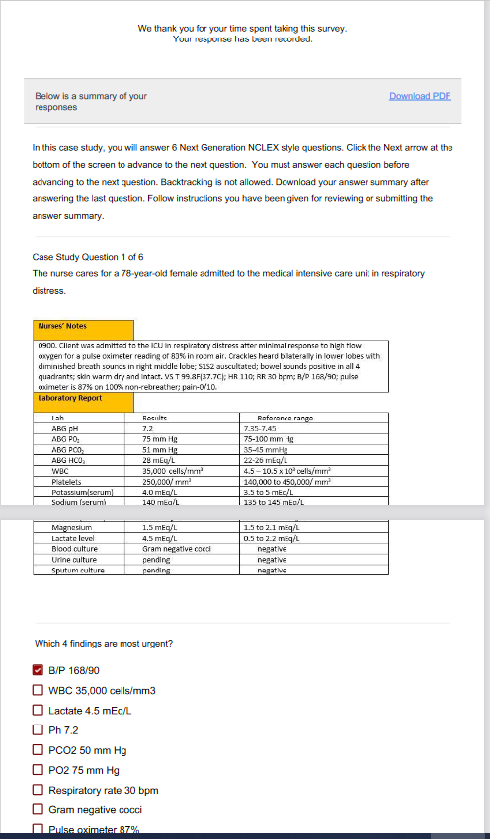
The Response Summary Shows Your Answers
Follow your faculty’s instructions for saving the response summary.
They may have you print it out, save it to computer, or upload it to a learning management system.
The response summary DOES NOT give you the correct answers.
Answers will appear on subsequent slides with information on how to score the item and a rationale for the answer.

Slide 17
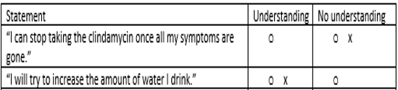
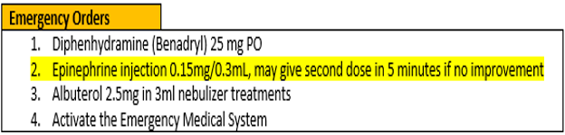
Correct Answers
Correct answers may be indicated 1 of 4 ways
Asterisk appears after correct option*
Option may be underlined with or without an *
Option may appear as an X or * in a table
Correct answer may appear as highlight

Slide 18
New Scoring Rule: +/-
Used when takers may pick unlimited options
Possible points are number of keyed correct items
Earn 1 point for each correct item selected
Loose 1 point for each incorrect item selected
Guessing penalty prevents takers from gaming system by selecting all
Minimum score =0
Which items are viruses? Select all that apply.
■ Chlamydia
■ Influenza[✓]
■ Hepatitis B [✓]
Lyme disease
Pertussis
Tuberculosis
Varicella [✓]
+/- Scoring rule
3 points possible
+2 correct
-1 incorrect
-----------------
1 points

Slide 19
New Scoring Rule: 0/1
Used when takers may select limited options
Possible points are number of keyed correct items
Earn 1 point for each correct item selected
Earn 0 points for incorrect responses
Minimum score 0
Which 3 items are viruses?
■ Chlamydia
■ Influenza[✓]
■ Hepatitis B [✓]
Lyme disease
Pertussis
Tuberculosis
Varicella [✓]
0/1 Scoring rule
3 points possible
+2 correct
-----------------
2 points

Slide 20
Same Answers: Different Scores
Select all that apply
Which 3 items are viruses?
■ Chlamydia
■ Influenza[✓]
■ Hepatitis B [✓]
Lyme disease
Pertussis
Tuberculosis
Varicella [✓]
Which items are viruses? Select all that apply
■ Chlamydia
■ Influenza[✓]
■ Hepatitis B [✓]
Lyme disease
Pertussis
Tuberculosis
Varicella [✓]
0/1 Scoring rule
3 points possible
+2 correct
-----------------
2 points
+/- Scoring rule
3 points possible
+2 correct
-1 incorrect
-----------------
1 point

Slide 21
Rationale Scoring Rule
Complete the sentence from list of dropdown options.
To prevent night blindness the nurse would recommend
because they are rich in vitamin
Used when question has linked concept and a justification in the same sentence
  Example: The client most likely has an asthma exacerbation as evidenced by the breath sounds.
Dyad worth 1 point
  One cause and one effect
  Both parts must be correct for credit
Triad worth 2 points
  One cause 2 effects
  Cause must be right for any credit
  Partial credit given (1 point) if only 1 effect is correct
almonds
carrots✓
orange juice
A
B
C✗
Right condition,
Wrong justification =0 points

Slide 22
Keep track of your score as you move through the review
Case study | My score | Standalone | My score
Case study 1 |  | Trend 1
Case study 2 |  | Bowtie 1
Case study 3 |  | Bowtie 2
Case study 4 |  | Trend 2
Case study 5 |  | Bowtie 3
Case study 6 |  | Trend 3
Case Study7 |  | Trend 4
 |  | Bowtie
Total Possible |  | Possible
TOTAL |  | My Score

Slide 23
Final Link
The final link in the review takes you to the course evaluation.
This anonymous information will be used to help us understand how this review is being used and how to improve the experience.

Slide 24
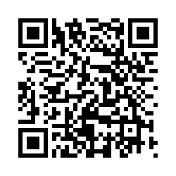
Case Study # 1
URL
QR Code
https://umaryland.az1.qualtrics.com/jfe/form/SV_eX9s0hwdlD6QpBI
Take about 10 minutes

Slide 25
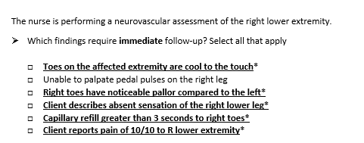
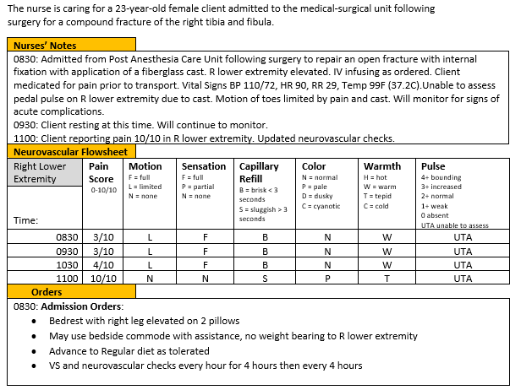
Screen 1 of 6
+/-. This question is worth 5 points.
Give yourself 1 point for each correct response AND subtract 1 point for every incorrect answer you picked. The worst you can score is 0.

Slide 26
Rationale
Primary signs of compartment syndrome include the “5 P’s,” Pain (out of proportion/not relieved with pain medication), Pallor, Pulses (diminished or absent), Paresthesia, Paralysis. Additionally, fullness, cool or cold extremity, and weakness may occur. Any of these symptoms are indicative of neurovascular compromise. If untreated could result in tissue death and loss of limb. The pedal pulse will not be able to be assessed due to the cast.

Slide 27
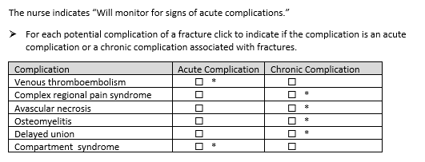
Screen 2 of 6
0/1. This question is worth 6 points. Give yourself a point for each row you got right.

Slide 28
Rationale
The nurse should differentiate between acute complications of a fracture and chronic or late complications. Acute complications include deep vein thrombosis or pulmonary embolism, fat embolism, and compartment syndrome. Late, or chronic complications include complex regional pain syndrome, avascular necrosis, osteomyelitis, and delayed union.

Slide 29
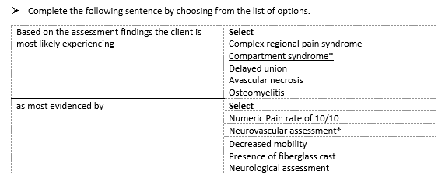
Screen 3 of 6
Rationale. This question is worth 1 point
Give yourself 1 point only if you answered BOTH parts correctly

Slide 30
Rationale
Compartment syndrome is suspected based on the abnormal findings in the neurovascular assessment. While some of the vital signs are abnormal, and the client is tachycardic there can be causes other than compartment syndrome for these findings.

Slide 31
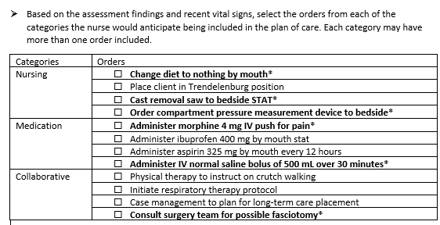
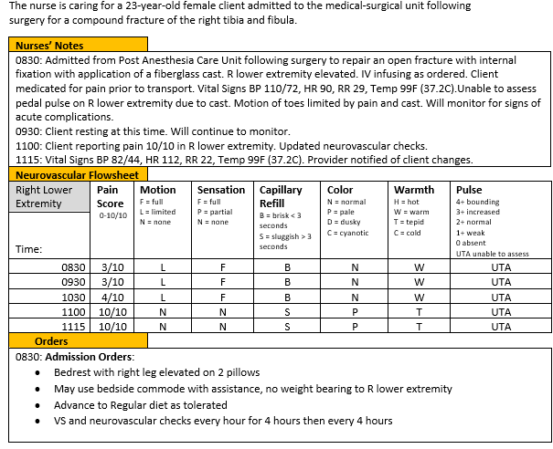
Screen 4 of 6
+/1. This question is worth 6 points. Score each group separately first then add together. Earn 1 point each correct item selected AND subtract 1 point for each incorrect option you select. The worst you can score is 0 per group.
Nursing- 3 points
Medications – 2 point
Collaborative- 1 point

Slide 32
Rationale
The nurse should prioritize interventions that would relieve pressure within the compartment, monitor for improving or declining condition, and treat potential life or limb threatening conditions. This would include frequent neurovascular assessments and preparing to remove the cast as soon as possible by getting the cast removal saw to the bedside. The provider is likely to insert a compartment pressure measurement manometer to assess compartmental pressures. Client should be kept NPO in the event surgery is required. Pain medication such as morphine is indicated, and due to hypotension an IV fluid bolus is indicated. Ibuprofen is not effective for the pain rate of 10/10, and 400 mg would not be a therapeutic dose. Aspirin is contraindicated due to the anticoagulation component if the client needs surgery. The surgical team should be consulted. Client would not be instructed on crutch walking at this time until the compartment syndrome is resolved. Respiratory and Case Management for long-term care are not indicated at this time.

Slide 33
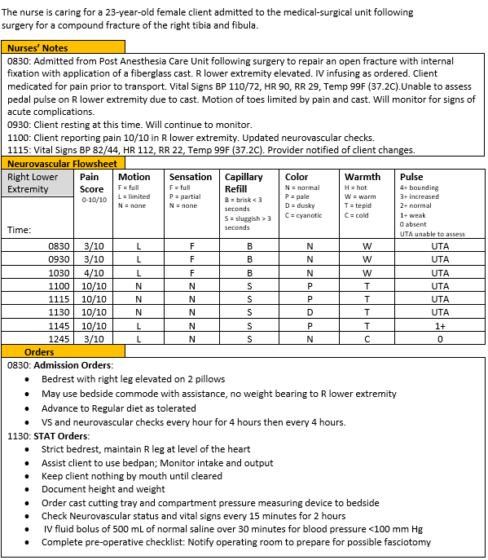
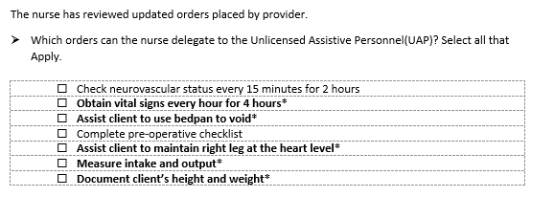
Screen 5 of 6
The
+/-. This item is worth 5 points. Give yourself 1 point for every correct option you picked AND subtract 1 point for every incorrect item you selected. The worst you can score is 0.

Slide 34
Rationale
To accomplish all the tasks needed to care for this client the nurse may delegate some tasks to the UAP. The UAP is unable to perform assessments or monitor neurovascular status. t is the nurses’ responsibility to ensure client is ready for surgery. The pre-operative checklist may be used to ensure all pre-operative criteria is met. Measuring and documenting VS, Intake and Output, height and weight may all be done by the UAP. The UAP may also help the client to maintain the extremity in the proper position as instructed by the Nurse.

Slide 35
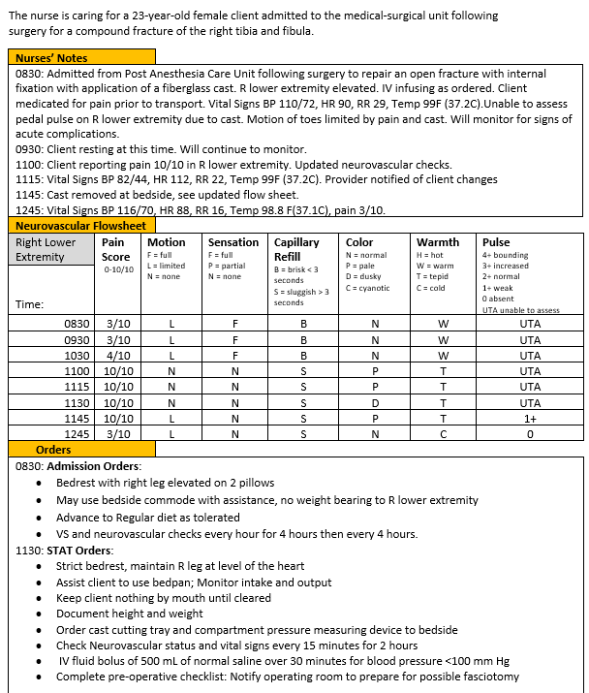
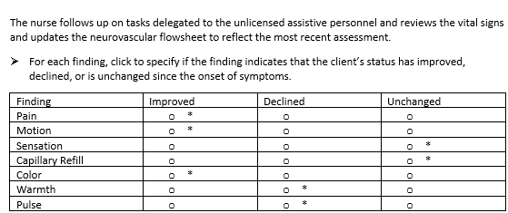
Screen 6 of 6
The
0/1. This item is worth 7 points. Give yourself 1 point for every row you got right.

Slide 36
Rationale
The nurse determines the client’s Pain rate, motion and color are improving since the onset of symptoms (1100) as evidenced by the data in the neurovascular assessment. The pulse and temperature declined, and the sensation and capillary refill remained unchanged.

Slide 37
Case Study 1 Score
Question | Possible | My score
1 | 5
2 | 6
3 | 1
4 | 6
5 | 5
6 | 7
Total | 30

Slide 38
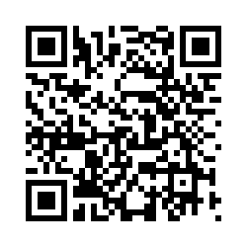
Trend # 1
URL
QR Code
https://umaryland.az1.qualtrics.com/jfe/form/SV_0DSrwqlb366JHx4
Take 2-3 minutes

Slide 39
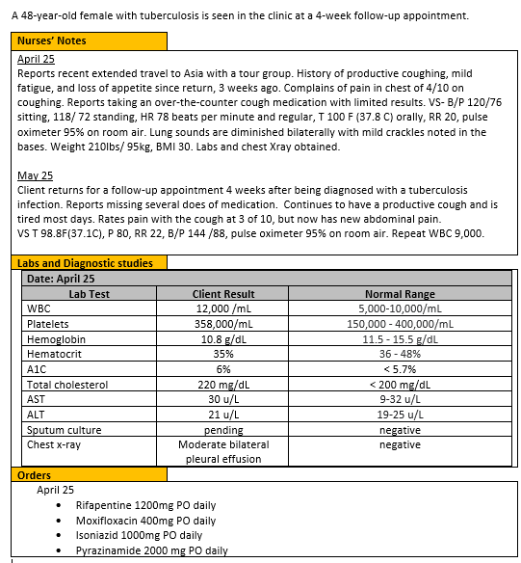
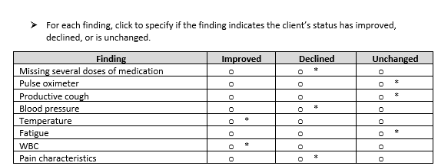
0/1. This item is worth 8 points. Give yourself 1 point for every row you got right.

Slide 40
Rationale
Elevated blood pressure and missed doses of medication are cause for further assessment and patient education. Abdominal pain could be a sign of a medication side effect off liver involvement Pulse oximeter has increased on room air, temperature is normal, and WBC count is within normal limits. Productive cough and fatigue are unchanged from initial visit.

Slide 41
Trend 1 Score
Question | Possible | My score
Points | 8
Total | 8

Slide 42
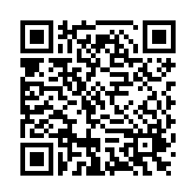
Case Study # 2
URL
QR Code
https://umaryland.az1.qualtrics.com/jfe/form/SV_6DPuGJHvhYznZqK
Take about 10 minutes

Slide 43
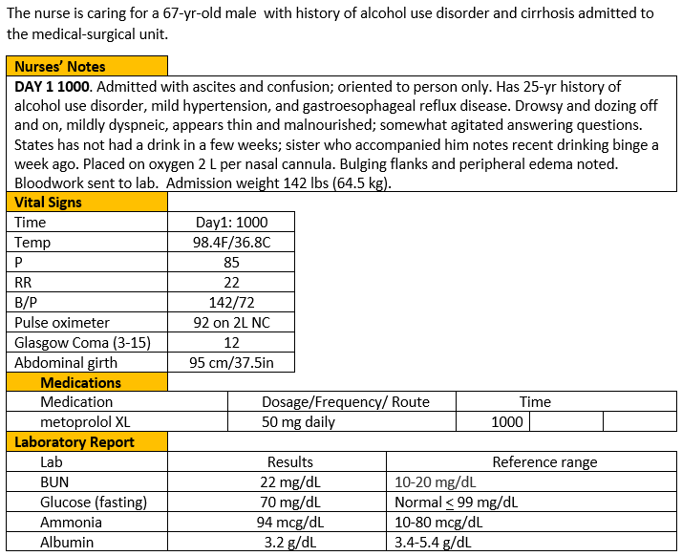
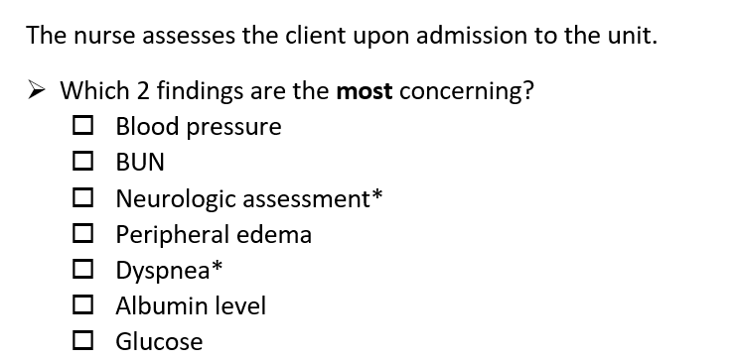
Screen 1 of 6
0/1. This question is worth 2 points.
Give yourself 1 point for each correct response.

Slide 44
Rationale
The most concerning signs are dyspnea which indicates hepatopulmonary syndrome from worsening ascites, as well as a decline in neurologic function (drowsy off and on, oriented to name only, slightly agitated, etc.). BUN slightly elevated but due to dehydration vs. acute kidney failure as creatinine is normal. A low serum albumin level is expected due to cirrhosis and malnourished condition from alcohol use disorder.

Slide 45
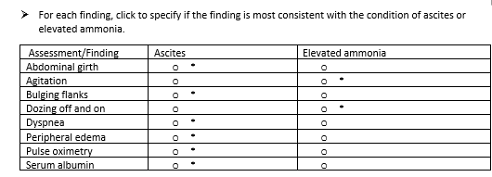
Screen 2 of 6
0/1. This question is worth 8 points.
Give yourself 1 point for each row you got correct.

Slide 46
Rationale
Ascites (a complication of portal hypertension and low albumin from cirrhosis/liver damage) can result in respiratory compromise while deterioration in neurologic status (confusion and agitation) results from increased ammonia levels causing hepatic encephalopathy.

Slide 47
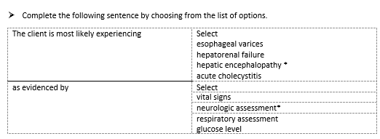
Screen 3 of 6
Rationale. This question is worth 1 point.
Give yourself 1 point only if you answered BOTH parts correctly

Slide 48
Rationale
Hepatic encephalopathy is a common complication of cirrhosis and is caused by inability of the liver to detoxify protein by-products. This results in increased ammonia levels which can be toxic to the CNS. Abnormal neurological findings which are common indicators of hepatic encephalopathy include confusion, lethargy, dozing on and off, restlessness and agitation.

Slide 49
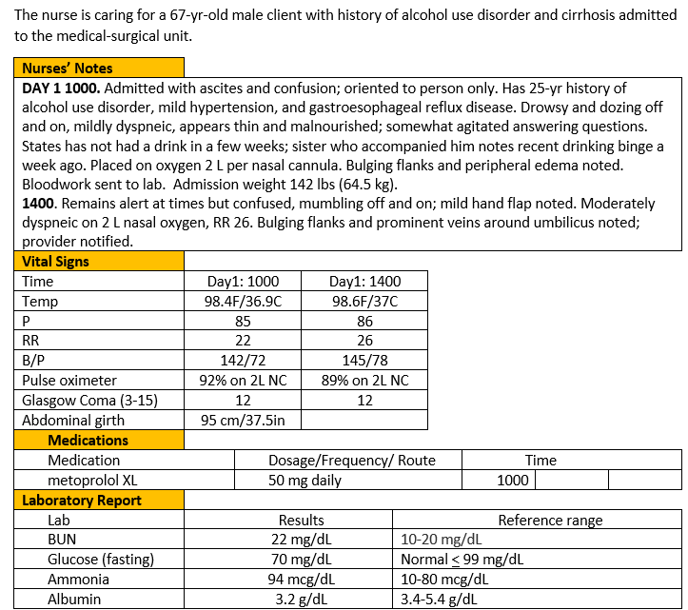
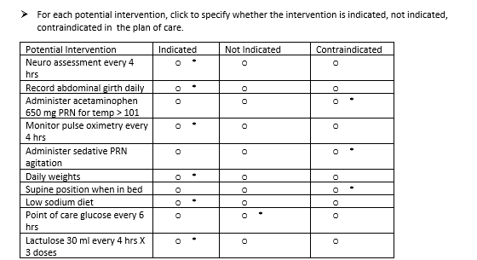
Screen 4 of 6
0/1. This question is worth 10 points. Give yourself 1 point for each row you got correct .

Slide 50
Rationale
Interventions are focused on treating both ascites and hepatic encephalopathy. Acetaminophen and sedatives are contraindicated as is placing the client flat in bed when dyspneic due to ascites. Glucose monitoring would not harm the client but is not necessary.

Slide 51
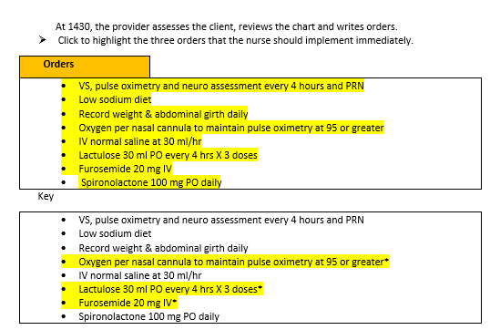
Screen 5 of 6
The
+/-. This item is worth 3 points. Give yourself 1 point for every correct option highlighted AND subtract 1 point for each incorrect answer highlighted. The worst you can score is 0.

Slide 52
Rationale
Priorities are to reduce the ammonia level with first dose of lactulose and promote prompt diuresis of excess fluid with IV furosemide. Oxygenation is another priority so increasing his oxygen in meantime to improve pulse oximetry/oxygenation.

Slide 53
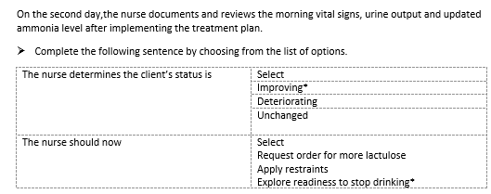
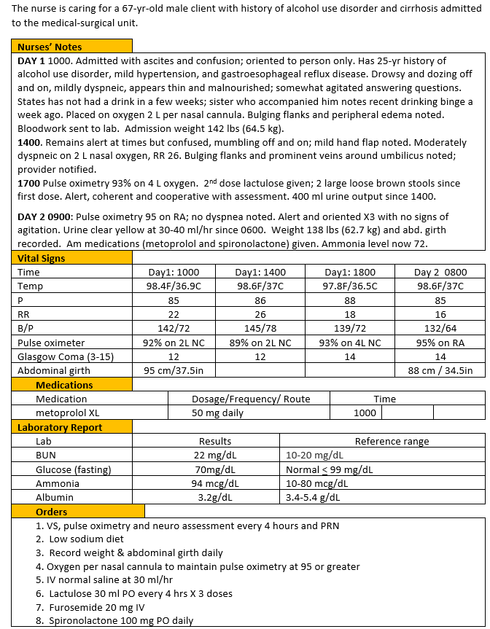
Screen 6 of 6
The
0/1. This item is worth 2 points. Give yourself 1 point for each correct response.

Slide 54
Rationale
Client’s overall condition has improved. Prescribed interventions of IV furosemide and sodium restriction were effective in reducing ascites; the ammonia level and neurologic status also improved after 3 doses of lactulose.

Slide 55
Case Study 2 Score
Question | Possible | My score
1 | 2
2 | 8
3 | 1
4 | 10
5 | 3
6 | 2
Total | 26

Slide 56
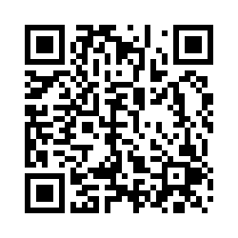
Bowtie # 1
URL
QR Code
https://umaryland.az1.qualtrics.com/jfe/form/SV_0wkHVeggkYdGlAq
Take 2-3 minutes

Slide 57
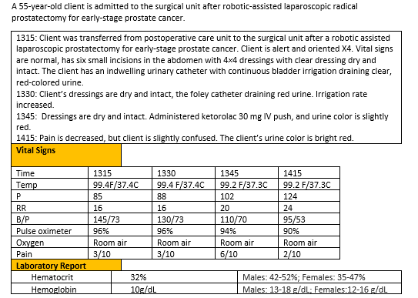
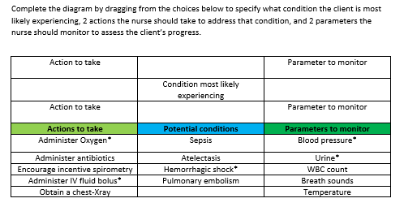
0/1. This item is worth 5 points. Give yourself 1 point for every correct selection.

Slide 58
Rationale
The trends in the heart rate, blood pressure, and pulse oximeter reading are consistent with shock and the confusion may be a symptom of of poor cerebral perfusions. The urine was only slightly red but is now once again bright red suggesting the bleeding is getting worse. The client needs oxygen and a fluid bolus to improve perfusion. Urine and the blood pressure should be monitored for resolution of the hypotension and bleeding.

Slide 59
Bowtie 1 Score
Question | Possible | My score
Conditions | 1
Actions | 2
Parameters | 2
Total | 5

Slide 60
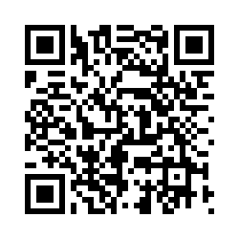
Case Study # 3
URL
QR Code
https://umaryland.az1.qualtrics.com/jfe/form/SV_0BrMPXvR3wzARsW
Take about 10 minutes

Slide 61
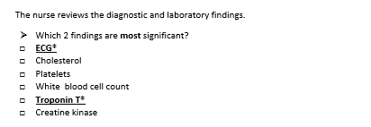
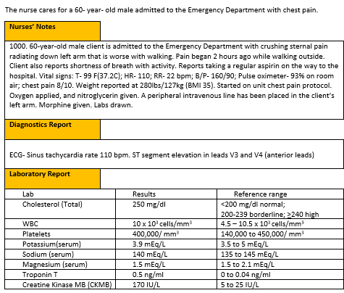
Screen 1 of 6
0/1. This question is worth 2 points.
Give yourself 1 point for each correct response.

Slide 62
Rationale
An ECG of sinus tachycardia with ST segment elevation indicates there is damage to the cardiac muscle and should be addressed immediately. Elevated troponin T is specific for myocardial injury. Creatine kinase-MB can be used as a test for myocardial cell death but is also commonly found in other sites, so it is not specific to the myocardium. The cholesterol is elevated but not diagnostic for a myocardial infarction. Platelets and white blood cell counts are normal.

Slide 63
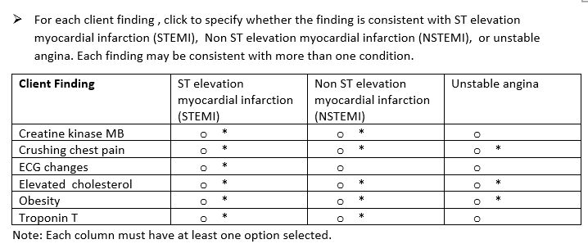
Screen 2 of 6
+/-. This question is worth 14 points. Score each column separately first, then add scores together. Earn 1 point for each correct item selected AND subtract 1 point for each incorrect option you select. The worst you can score is 0 per column.
Column 1- 6 points
Column 2 -5 points
Column 3 -3 points

Slide 64
Rationale
Obesity, elevated cholesterol, and crushing chest pain are associated with all three acute coronary syndromes. Cardiac biomarkers are not elevated with unstable angina. The EKG findings show ST elevation which indicates significant cardiac damage associated with an ST elevation myocardial infarction (STEMI).

Slide 65
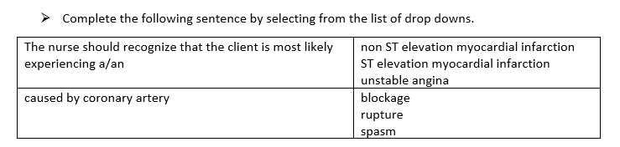
Screen 3 of 6
Rationale. This question is worth 1 point.
Give yourself 1 point only if you answered BOTH parts correctly.

Slide 66
Rationale
The client’s labs and symptoms are congruent with STEMI. STEMI occurs when there is sudden rupture of an unstable part of the wall in a heart artery followed by the build- up of a clot in an attempt to heal it. This clot formation results in total blockage of the artery and loss of blood supply to the heart.

Slide 67
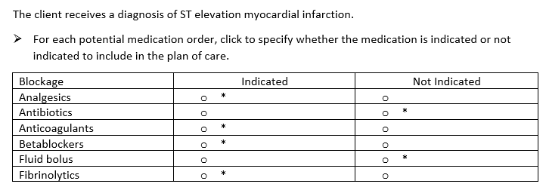
Screen 4 of 6
0/1. This question is worth 6 points. Give yourself 1 point for each row you got correct.

Slide 68
Rationale
Acute care for STEMI includes pain management, establishing perfusion, and limiting ischemic damage. Analgesics, typically morphine, are given for pain. Ischemia is limited by decreasing perfusion needs. Beta blockers can be given to control lower heart rate and blood pressure. Reperfusion therapy can be medical or manual. Medical therapy includes giving a fibrinolytic to dissolve any blood clots that may be present blocking blood vessels. Anti- coagulants prevent worsening obstruction. Fluid boluses would increase cardiac load. There is no evidence of infection to need antibiotics.

Slide 69
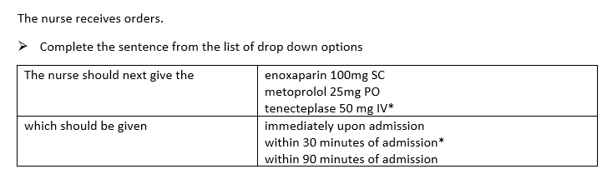
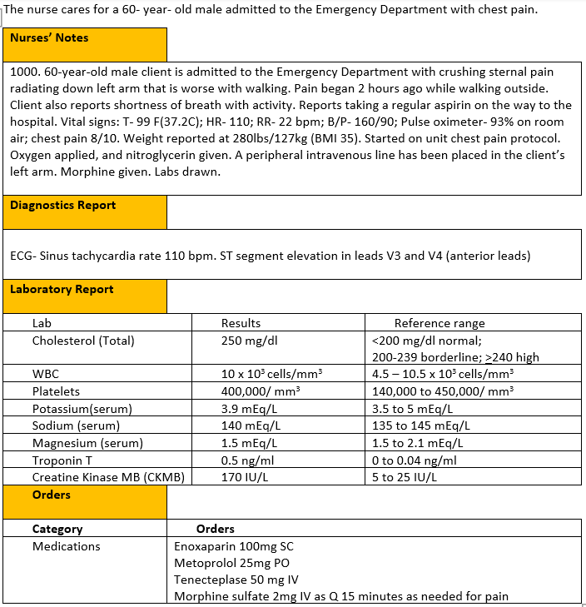
Screen 5 of 6
The
Rationale. This item is worth 1 point. Give yourself 1 point only if you answered BOTH parts correctly.

Slide 70
Rationale
Tenecteplase is a tissue plasma activator that works to dissolve any blood clots that block blood vessels. The standard of care is to give the medication within 30 minutes of arrival if a STEMI is diagnosed.

Slide 71
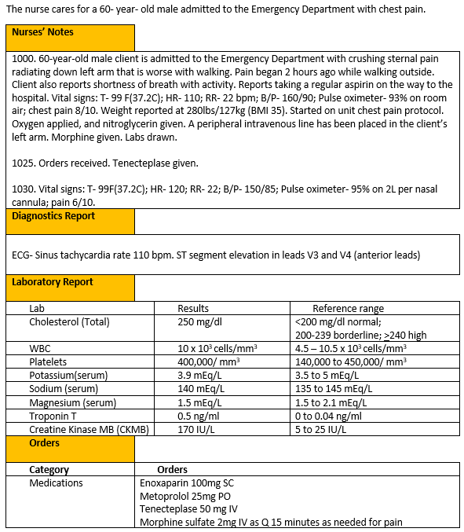
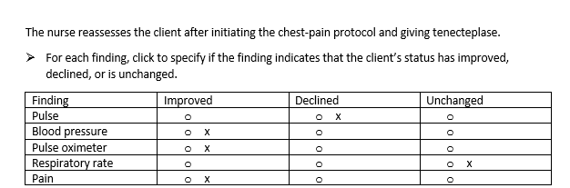
Screen 6 of 6
The
0/1. This item is worth 5 points. Give yourself 1 point for each row you got correct.

Slide 72
Rationale
The blood pressure, pulse oximeter, and pain level have all improved after the client received oxygen per nasal cannula, nitroglycerin, morphine, and tenecteplase. The client’s heart rate has increased, this could be an indicator of the heart muscle attempting to pump more oxygenated blood to the tissues. The client’s respiratory rate is unchanged.

Slide 73
Case Study 3 Score
Question | Possible | My score
1 | 2
2 | 14
3 | 1
4 | 6
5 | 1
6 | 5
Total | 29

Slide 74
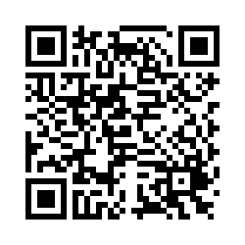
Bowtie # 2
URL
QR Code
https://umaryland.az1.qualtrics.com/jfe/form/SV_3UTFzmsmqzPdKey
Take 2-3 minutes

Slide 75


0/1. This item is worth 5 points. Give yourself 1 point for every correct selection.

Slide 76
Rationale
The vital signs, absent breath sounds, and tracheal deviations indicate the client is developing a tension pneumothorax. The nurse should call the rapid response team to administer emergency treatment to the client, such as inserting a chest tube. A stat chest Xray can help confirm the diagnosis. Improved respiratory status and improved hemodynamic status(blood pressure/pulse) are the best indicators the tension pneumothorax is resolved. Pain may stay elevated because of rib fractures. Blood gases are obtained as needed. If the respiratory improves another blood gas may not be needed after treatment.

Slide 77
Bowtie 2 Score
Question | Possible | My score
Conditions | 1
Actions | 2
Parameters | 2
Total | 5

Slide 78

Case Study # 4
URL
QR Code
https://umaryland.az1.qualtrics.com/jfe/form/SV_b28egVeIF5tG5F4
Take about 10 minutes

Slide 79


Screen 1 of 6
0/1. This question is worth 4 points.
Give yourself 1 point for each correct response.

Slide 80
Rationale
Because the client has a history of type II diabetes, the nurse should follow up with signs that the client’s diabetes may be out of control such as the deep and rapid respirations, the odor on the breath, and mental changes. The low B/P and tachycardia can indicate severe hypovolemia.

Slide 81


Screen 2 of 6
+/-. This question is worth 5 points. Score each column separately first then add scores together. Earn 1 point for each correct item selected AND subtract 1 point for each incorrect option you select. The worst you can score is 0 per column.
Column 1- 4 points
Column 2 -1 points

Slide 82
Rationale
Serum blood glucose levels in diabetic ketoacidosis can fluctuate between 300 and 800mg/dl. It is typically above 600 mg/dL with HHS. Low pH and urine ketones are seen with DKA. Those values are typically normal with HHS. Both conditions can cause dehydration and elevated creatine.

Slide 83

Screen 3 of 6
0/1. This question is worth 1 point.
Give yourself 1 point if you answered correctly.

Slide 84
Rationale
The priority for care is to restore volume so the client has adequate perfusion. Once the volume is improved, insulin therapy can begin to slowly bring the glucose down. The client will be monitored to determine if the acidosis is getting worse, giving sodium bicarbonate is not done unless the pH is <6.9

Slide 85

Screen 4 of 6
0/1. This question is worth 6 points. Give yourself 1 point for each row you got correct.

Slide 86
Rationale
The nurse monitors fingerstick glucoses. The glycosylated hemoglobin A1C is not a good indicator to determine the effectiveness of treatment. Pursed-lipped breathing will help slow the pace of breathing. Treatment for DKA is with regular insulin, not glargine, because it can be given IV and titrated to slowly achieve goals. The client's urine output should be measured with a urinal. Clients with diabetes have a high risk of developing infections and a high risk of delayed healing time, thereby an indwelling catheter poses a greater risk for infection. Cardiovascular changes can be observed with mild acidosis. Prolonged and untreated acidosis can lead to the onset of hyperkalemia. The heart rate will decrease, T waves become tall and peaked, and the QRS complex widens. Conversely, hypokalemia can result with insulin therapy; potassium replacement is initiated when serum levels fall below the normal range.

Slide 87


Screen 5 of 6
The
+/-. This item is worth 4 points. Give yourself 1 point for every correct option selected AND subtract 1 point for each incorrect option selected. The worst you can score is 0.

Slide 88
Rationale
Hypokalemia can result with insulin therapy. Insulin is typically held if levels fall below 3.3mEq/L. Dextrose is added to IV fluids when glucose levels stabilize to prevent hypoglycemia. Clients can eat when their respiratory status is stable, and they feel like eating. During the initial phase of treating the client for DKA, the nurse should monitor the client’s status to prevent the onset of fluid overload. The client weighs 93 kg so based on orders the starting rate would be 9.3 Units/hr.

Slide 89


Screen 6 of 6
+/-. This item is worth 3 points. Give yourself 1 point for every correct option selected AND subtract 1 point for each incorrect option selected. The worst you can score is 0.

Slide 90
Rationale
Treatment of diabetic ketoacidosis focuses on managing and correcting the serum glucose along with correcting dehydration, electrolyte imbalances and acidosis. With the administration of the intravenous fluids and the insulin infusion, the accumulated ketone bodies are reversed, thereby correcting the acidotic state, and ending the production of ketones from the fat breakdown. Reversal of the ketone production and correction of the fluid and electrolyte imbalance, the compensatory mechanisms are stimulated. The blood pressure will increase, and the heart rate will decrease. With the cells being rehydrated and glucose moving into the cells, the client's neurological status should improve. Pain was not a primary issue and breath sounds were clear to start. The blood glucose has not yet begun to decrease.

Slide 91
Case Study 4 Score
Question | Possible | My score
1 | 4
2 | 5
3 | 1
4 | 6
5 | 4
6 | 3
Total | 23

Slide 92

Trend # 2
URL
QR Code
https://umaryland.az1.qualtrics.com/jfe/form/SV_cC45X6a615zWvnE
Take 2-3 minutes

Slide 93


0/1. This item is worth 6 points. Give yourself 1 point for every row you got right.

Slide 94
Rationale
The client’s hemodynamic status is stabilizing with fairly consistent heart and blood pressure measurements. The temperature also as remained fairly stable. Urine output of 50 mL an hour is a sign of improved renal perfusion. Stridor and decreased pulse oximeter readings suggest the development of upper airway edema.

Slide 95
Trend 2 Score
Question | Possible | My score
Points | 6
Total | 6

Slide 96

Case Study # 5
URL
QR Code
https://umaryland.az1.qualtrics.com/jfe/form/SV_cAMTval8GPKlwOO
Take about 10 minutes

Slide 97


Screen 1 of 6
+/-. This question is worth 4 points.
Give yourself 1 point for each correct response AND subtract 1 point for every incorrect answer you picked. The worst you can score is 0.

Slide 98
Rationale
An impairment in gas exchange, as evidenced by the client exhibiting tachypnea, accessory muscle use, coarse crackles and green-tinged sputum are all priority findings. The client is afebrile with a temp of 99.0 F (37.2C). Digital clubbing is a common finding in clients with a history of COPD, and the client’s smoking history along with medication non-compliance are less acute and non-urgent findings that do not require priority nursing intervention.

Slide 99

Screen 2 of 6
+/-. This question is worth 12 points. Score each column separately first and then add scores. Earn 1 point for each correct item selected AND subtract 1 point for each incorrect option you select. The worst you can score is 0 per column.
Column 1- 3 points
Column 2 -5 points
Column 3- 3 points
Column 4- 1 point

Slide 100
Rationale
Clinical manifestations of COPD include dyspnea, cough, increased A/P diameter (barrel chest), digital clubbing, and expiratory wheezing. Both an increased A/P diameter and digital clubbing are not clinical manifestations of pneumonia, or asthma, or pulmonary embolism. Wheezing is rare with pulmonary embolism and the cough is dry or blood tinged.

Slide 101

Screen 3 of 6
0/1. This question is worth 1 point.
Give yourself 1 point if you answered correctly.

Slide 102
Rationale
The client has a known history of COPD –emphysema; they are hypoxic and using accessory muscles to breathe. The client also verbalizes worsening shortness of breath. Based on the client’s presenting signs, symptoms, and clinical manifestations, this client is most likely experiencing a COPD exacerbation.

Slide 103

Screen 4 of 6
+/-. This question is worth 4 points; Score each group separately first and then add scores together. Earn 1 point for each correct item selected AND subtract 1 point for each incorrect option you select. The worst you can score is 0 per column.
Nursing- 2 points
Medications -2 points

Slide 104
Rationale
The client is experiencing a COPD exacerbation. Placing the client in a high fowler’s position and encouraging the use of the incentive spirometer will assist in maximizing the client’s lung expansion and improving ventilatory efforts. Administering ipratropium bromide and albuterol and methylprednisolone can assist in alleviating airway narrowing and inflammation caused by the client’s exacerbated symptoms. Placing a client with a known history of COPD on high-flow oxygen can induce carbon dioxide narcosis. Administering ondansetron is not indicated unless in this case since the client does not have nausea and/or vomiting.

Slide 105


Screen 5 of 6
The
0/1. This item is worth 1 point. Give yourself 1 point if you answered correctly.

Slide 106
Rationale
IV methylprednisolone is ordered now and will help reduce inflammation to improve ease of breathing. The antibiotic should be given after the neb treatment. Albuterol was just given. The client would need to be reassessed to determine if another dose is needed PRN. The client is verbalizing 0 out of 10 pain, so acetaminophen is not necessary at this time

Slide 107


Screen 6 of 6
0/1. This item is worth 7 points. Give yourself 1 point for each row you answered correctly.

Slide 108
Rationale
The client’s respiratory rate, breath sounds, heart rate, oxygen saturation, and blood pressure have all declined despite the nurse administering ordered medications. The client is no longer exhibiting expiratory wheezing upon auscultation. The client’s temperature remains unchanged. The nurse should promptly alert the provider as the client’s respiratory symptoms are rapidly deteriorating.

Slide 109
Case Study 5 Score
Question | Possible | My score
1 | 4
2 | 12
3 | 1
4 | 4
5 | 1
6 | 7
Total | 29

Slide 110

Bowtie # 3
URL
QR Code
https://umaryland.az1.qualtrics.com/jfe/form/SV_eFI4BYLpuV3n3bo
Take 2-3 minutes

Slide 111


0/1. This item is worth 5 points. Give yourself 1 point for every correct selection.

Slide 112
Rationale
The client is experiencing an acute thyroid storm that requires administration of anti-hyperthyroid drugs such as methimazole. In order to help decrease the client’s metabolic demands, the nurse should promote a calm and restful care environment. Cooling methods and Intravenous fluids are also needed. Monitoring the client’s body temperature, and serum thyroid levels are all important parameters to monitor in a client experiencing a thyroid storm. Daily weights and monitoring the client’s sleeping habits and WBC’s level are not effective in assessing the individual client’s progress.

Slide 113
Bowtie 3 Score
Question | Possible | My score
Conditions | 1
Actions | 2
Parameters | 2
Total | 5

Slide 114

Case Study # 6
URL
QR Code
https://umaryland.az1.qualtrics.com/jfe/form/SV_d76sxmjHW6XOqTc
Take about 10 minutes

Slide 115


Screen 1 of 6
0/1. This question is worth 5 points.
Give yourself 1 point for each correct response.

Slide 116
Rationale
Fever, abdominal pain, elevated WBC in the serum and dialysate effluent are indications of peritonitis, a potentially life-threatening complication of peritoneal dialysis. Although the BUN and creatinine are high for an individual without renal failure, these values are typical of a client with end stage renal disease on peritoneal dialysis. The blood pressure and heart rate are only slightly elevated, so are not a priority at this time. The respiratory rate is within normal range for an adult. Erythema and creamy, yellow exudate around the peritoneal dialysis catheter exit site indicate the possible presence of an exit site infection, which may be the source of the peritonitis.

Slide 117

Screen 2 of 6
+/-. This question is worth 8 points. Score each column separately first and then add scores together. Earn 1 point for each correct item selected AND subtract 1 point for each incorrect option you select. The worst you can score is 0 per column.
Column 1- 3 points
Column 2 -5 points

Slide 118
Rationale
C-reactive protein is an inflammatory marker and is elevated in the presence of infection and inflammation. BUN, creatinine, and potassium imbalances are common in clients with ESRD associated with the inability of the client’s kidneys to excrete waste products. Anemia is indicated by the low hemoglobin and hematocrit. This is a result of the kidney’s inability to produce erythropoietin in client’s with ESRD. Elevated WBC and neutrophil levels are diagnostic of infection.

Slide 119

Screen 3 of 6
0/1. This question is worth 1 point.
Give yourself 1 point if you answered correctly.

Slide 120
Rationale
Approximately 11% of ESRD patients with peritonitis develop sepsis. Sepsis is a general term used to characterize an immune system response to an infection. In sepsis the chemicals from the body's own defenses trigger inflammatory responses, which can impair blood flow to organs, like the brain or heart. This in turn can lead to organ failure and tissue damage. At its most severe, the body's response to infection can cause dangerously low blood pressure, a sign of septic shock. The mortality from septic shock is about 33%.

Slide 121


Screen 4 of 6
0/1. This question is worth 9 points. Give yourself 1 point for each row you got correct.

Slide 122
Rationale
Rationale for “Not Appropriate”: IVF: D5 ½ NS with 20mEq/l KCl at 120 ml/hr is not appropriate as client’s with ESRD are oliguric or anuric and this would place the client at risk for developing hypervolemia and hyperkalemia. Vancomycin is not effective against gram-negative pathogens. Unless the patient is septic, antibiotics should be infused intraperitoneally for peritonitis in clients with ESRD on peritoneal dialysis. Enoxaparin is not appropriate in clients with ESRD. This medication is excreted renally, so clients with ESRD cannot clear the medication, leading to a high risk of bleeding.
Rationale for “Appropriate”: A daily weight is needed to assess for hypervolemia associated with ESRD. Inflammation of the peritoneum associated with peritonitis may interfere with the efficacy of peritoneal dialysis. Blood cultures are needed to assess for potential bacteremia. Clients with bacteremia may need IV antibiotics in addition to intra-peritoneal antibiotics. PD catheter care is needed to treat the infection. The catheter may need to be removed and reinserted if the infection does not clear. Gentamicin is a good broad-spectrum antibiotic that treats gram-negative bacteria. Once culture results are received, the antibiotic should be adjusted based on sensitivity results. Intra-peritoneal delivery is more effective than IV for peritonitis. Epoetin alfa is used to treat anemia associated with ESRD. In clients with ESRD, the kidneys do not produce enough erythropoietin to stimulate red blood cell production. Calcium carbonate, a phosphate binders must be taken with each meal to prevent the absorption of phosphorus from the gut. Keeping serum phosphate levels within the normal range will prevent serum phosphorus from binding with serum calcium, which lowers the calcium level.

Slide 123

Screen 5 of 6
The
0/1 This item is worth 6 points. Give yourself 1 point for every row you got correct.

Slide 124
Rationale
The UAP provides basic care skills such as hygiene, and collects limited assessment data, such as vital signs and weights. The LPN can perform nursing care in “routine” nursing situations. They can provide non-complicated wound care. They cannot implement “non-routine” care such as administering antibiotics intraperitoneally, providing catheter care teaching or performing a dialysate exchange for a client on peritoneal dialysis. Those tasks must be done by the RN.

Slide 125


Screen 6 of 6
0/1. This item is worth 7 points. Give yourself 1 point for each row you answered correctly.

Slide 126
Rationale
Clients should not pick or remove crusts or scabs at the exit site before washing the site. This could tear the skin and increase the risk for site infection. Clients should clean the catheter exit site with a liquid antibacterial soap and a clean cloth. Antiseptics can dry and crack the skin, increasing the risk of infection. The exit site should not be left open to air. It should be covered with sterile gauze, which should be changed every time the site is cleaned.

Slide 127
Case Study 6 Score
Question | Possible | My score
1 | 5
2 | 8
3 | 1
4 | 9
5 | 6
6 | 7
Total | 36

Slide 128

Trend # 3
URL
QR Code
https://umaryland.az1.qualtrics.com/jfe/form/SV_b2YBl9uUvQ1F5kO
Take 2-3 minutes

Slide 129


0/7. This item is worth 6 points. Give yourself 1 point for every row you got right.

Slide 130
Rationale
The client’s temperature, pulse, respirations were elevated and abnormal on admission. The pulse oximeter was low. On day two, the client’s temperature, pulse, respirations and pulse oximeter % are within normal limits. Coughing has decreased and the client is not short of breath. The client’s blood pressure is consistently within normal limits.
.

Slide 131
Trend 3 Score
Question | Possible | My score
Points | 7
Total | 7

Slide 132

Case Study # 7
URL
QR Code
https://umaryland.az1.qualtrics.com/jfe/form/SV_20rzGeirj3MjONU
Take about 10 minutes

Slide 133


Screen 1 of 6
+/-. This question is worth 4 points.
Give yourself 1 point for each correct response highlighted AND subtract 1 point for every incorrect answer you highlighted. The worst you can score is 0.

Slide 134
Rationale
A disruption of the blood supply to brain areas leads to a sudden loss of motor function. Like a myocardial infarction or heart attack, a disruption of blood flow to the brain is a medical emergency that requires immediate and intentional interventions. Lightheadedness, weakness of the left lower and upper extremity, sudden headache, elevated heart rate, elevated blood pressure, denotes poor cerebral perfusion and requires immediate follow up.

Slide 135


Screen 2 of 6
0/1. This question is worth 5 points.
Give yourself 1 point for each row you answered correctly.

Slide 136
Rationale
Efforts to reduce the onset of stroke remain a focal point for healthcare providers. A healthy lifestyle that addresses modifiable risk factors such as physical activity (40 minutes per day, 3 – 4 days/week), alcohol consumption in moderation, and healthy eating practices can reduce the onset of a stroke. Age, race, and gender are nonmodifiable risk factors for a stroke. African Americans and some Hispanic/Latino Americans have a higher stroke and mortality when compared to Caucasian Americans. Combined hormonal contraceptive is a birth control that contains estrogen to prevent ovulation by altering the cervical mucus and uterine lining. Exogenous estrogens impact the skeletal, metabolic, and coagulation systems, thereby increasing the risk of blood clots, stroke, or heart attack. Vape contains nicotine as an active ingredient and increases the risk of developing a blood clot, stroke, or heart attack while using estrogen.

Slide 137


Screen 3 of 6
0/1. This question is worth 1 point.
Give yourself 1 point if you answered correctly.

Slide 138
Rationale
An interruption of blood flow to the brain because of a thrombotic or embolic event can lead to the onset of an ischemic stroke. The main nursing priority with a client experiencing an ischemic stroke is to restore cerebral perfusion to prevent further neurological deficits, altered level of consciousness, or death of the cells.

Slide 139


Screen 4 of 6
+/-.This question is worth 6 points. Give yourself 1 point for each correct option you selected AND subtract 1 point for each incorrect option you selected. The worst you can score is 0.

Slide 140
Rationale
Thrombolytic therapy, alteplase or recombinant t-Pa, dissolves the clot and is used once an ischemic stroke is determined. Dose is weight dependent. A thorough assessment to diagnose stroke and initiating thrombolytic therapy within 3 hours lessens the stroke's magnitude and improves the brain's overall function and outcomes three months after the stroke. Contraindications to thrombolytic treatment include but are not limited to if symptoms started longer ago than 3-hours, having a major surgical procedure within the last 14 days, current pregnancy, blood glucose less than 50 mg/dL, and receiving heparin in the past 48 hours.

Slide 141


Screen 5 of 6
The
0/1. This item is worth 7 points. Give yourself 1 point for every row you answered correctly.

Slide 142
Rationale
Clients who receive thrombolytic therapy are admitted to an intensive care unit for continuous cardiac monitoring and close observation for bleeding; therefore, oral anticoagulants are withheld for the next 24 hours. Insertion of nasogastric tubes, urinary catheters, and intra-arterial pressure catheters is delayed for 24 hours. Vital signs are recorded and documented every 15 minutes for the first two hours, then every 30 minutes for the next six hours, and then every hour until 24 hours after treatment to monitor for intracerebral hemorrhage and other signs of bleeding. Serum glucose blood levels should be assessed and maintained within 140 to 180 mg/dL. Efforts to reduce hypoglycemia are also significant. Poor neurological outcomes in acute stroke have been associated with hyperglycemia.

Slide 143


Screen 6 of 6
0/1. This item is worth 6 points. Give yourself 1 point for each row you answered correctly.

Slide 144
Rationale
Thrombolytic agents are designed to dissolve the thrombi to help reestablish blood flow to reduce injury and death of the neural cells. Like other anticoagulant agents, the risk of bleeding is a significant adverse effect. To prevent a fall, the nurse should instruct the client to call someone to help her get out of bed. An ischemic stroke can cause dysphagia (difficulty swallowing) due to impairment of the mouth, tongue, palate, larynx, pharynx, and upper esophagus, therefore, a swallow evaluation should be completed within 4 to 24 hours. The speech and swallow evaluation will determine if the client should have thin or thicken liquids or pureed foods to prevent aspiration. The client should take the necessary precaution to reduce bleeding by switching to an electric razor or brushing their teeth with a soft bristle toothbrush to reduce bleeding at the gumline. Combined hormonal contraception contains the estrogen hormone that influences fibrinogen in the plasma, specifically factor VII and X, thereby increasing the risk of stroke, bleeding, and heart attack. The client should inquire about other alternatives to prevent pregnancy. A baseline assessment of the client’s functional ability is important to determine the motor, social, and cognitive function. This assessment is completed by the nurse. The client should plan to take apixaban, an oral anticoagulant used to treat and prevent blood clots to prevent a stroke. Clients with type II diabetes should plan to monitor their blood glucose and if indicated self-administer insulin as prescribed.

Slide 145
Case Study 7 Score
Question | Possible | My score
1 | 4
2 | 5
3 | 1
4 | 6
5 | 7
6 | 6
Total | 29

Slide 146

Trend # 4
URL
QR Code
https://umaryland.az1.qualtrics.com/jfe/form/SV_6ruyAZEcS7fU7pI
Take 2-3 minutes

Slide 147


0/1. This item is worth 6 points. Give yourself 1 point for every row you answered correctly.

Slide 148
Rationale
The heart rate decreased from 110 to 100 and blood pressure dropped from 180/90 to 150/70; both indicate improvement. The client is drowsy showing the agitation has decreased. The client’s temperature and respiratory rate remain unchanged. The client’s pulse oximeter has declined slightly. The nurse should assess the lungs sounds to determine if suctioning or ventilator increases are needed.

Slide 149
Trend 4 Score
Question | Possible | My score
Points | 6
Total | 6

Slide 150

Bowtie # 4
URL
QR Code
https://umaryland.az1.qualtrics.com/jfe/form/SV_4Sc935OzwzAJujI
Take 2-3 minutes

Slide 151


0/1. This item is worth 5 points. Give yourself 1 point for every correct selection.

Slide 152
Rationale
The client is experiencing infection of the surgical site which can be identified through yellow drainage on the surgical bandage, increased pain, and increased WBC count.
The nurse would want to administer acetaminophen to reduce the fever and remove the bandage to assess the surgical site to view for other signs of infection. Reinforcing the surgical dressing is not appropriate, as the nurse would want to remove the bandage to assess the incision. Administering ibuprofen for fever is contraindicated in a client with spinal surgery due to increased risk of bleeding. It is not necessary to empty the JP drain as there is only 10 mL of output.
The nurse would want to monitor the client’s temperature to assess the response to Tylenol and monitor the client’s WBC as it will indicate improvement of worsening of the infection. The client’s neurologic status, respiratory rate, and blood pressure are currently stable and are not the top priority.

Slide 153
Bowtie 4 Score
Question | Possible | My score
Conditions | 1
Actions | 2
Parameters | 2
Total | 5

Slide 154
My Total
Case study | Possible Points | My score | Standalone | Possible Points | My score
Case study 1 | 30 |  | Trend 1 | 8
Case study 2 | 26 |  | Bowtie 1 | 5
Case study 3 | 29 |  | Bowtie 2 | 5
Case study 4 | 23 |  | Trend 2 | 6
Case study 5 | 29 |  | Bowtie 3 | 5
Case study 6 | 36 |  | Trend 3 | 7
Case Study7 | 29 |  | Trend 4 | 6
 |  |  | Bowtie | 5
Total Possible | 202 |  | Possible | 47
TOTAL | 249 |  | My Score

Slide 155

Please Complete the Mini Review Evaluation
https://umaryland.az1.qualtrics.com/jfe/form/SV_1ZYu3gxvlMDziMS
This evaluation will take approximately less than 2 minutes to complete.

