Slide 1
Sending Email Invites and Reminders
If you are taking an exam at home and have exam issues, you may contact ExamSoft Support at:
Toll Free: 866.429.8889
(ExamSoft support is 24/7)
support@examsoft.com

Slide 2
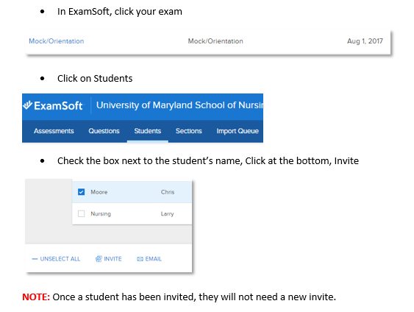
Sending Invites

Slide 3
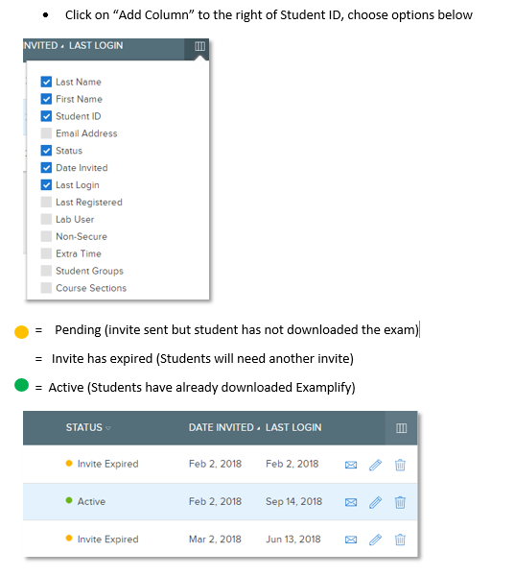
How to See if a Student has been Invited in the Past

Slide 4
If Student has not
Downloaded the Exam:
Through ExamSoft:
  You should send them an email
  alert them they have not downloaded the exam
If they have already been invited in the past:
  they will automatically get an email reminder for downloading through the “Post Exam Options”

Slide 5
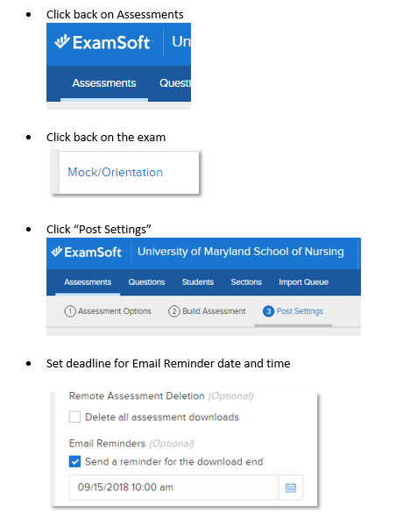
Where to Find Post Exam Options to Set Download Reminder:

Slide 6
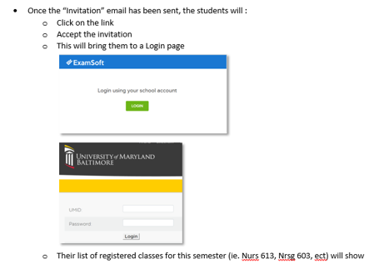
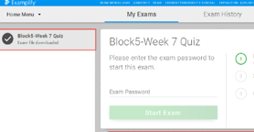
What Students Do After Invite is Sent:

