Slide 1
ExamSoft
Presented by The Department of Learning Technologies

Slide 2
What is ExamSoft
ExamSoft is a cloud-based solution to create, deliver, and analyze integrated assessments using a single format.
Create questions or import questions into a question bank.
Tag items to a course and program objectives.
Secure testing environment.
Encrypted exam files that are downloadable to students.
Immediate grading, analyzed results and feedback are available

Slide 3
What is Examplify
An assessment program developed and licensed by ExamSoft that enables exam takers to securely take examinations downloaded to their own laptop computers by blocking access to files, programs, and the internet during an exam.
Instructions for students to download Examplify are located in the Bb Announcements and available to students when the course opens the week before the course begins.
Students have 20 days to register and download Examplify from the link provided.
Students download the exam prior to exam day and upload after the exam via the Internet.

Slide 4
What is Exambot
The Email invitation that is sent to students to download from Examplify
Please tell students Do Not Delete this email
They may need to check their spam folder if they do not see it

Slide 5
Preparing for an Exam
(If your Assessment is not currently in ExamSoft)
At least Two weeks prior to the scheduled date of the exam make arrangements with ILT to import questions into Examsoft from Blackboard or create questions in Word using the correct format
Seven days prior to the scheduled date of the exam complete the ExamSoft Assessment Options Form and attach exam questions
ILT creates assessment and notifies faculty it is ready for review
Faculty reviews the assessment in Examsoft and responds to ILT
ILT finalizes assessment and notifies faculty of final settings and provides passwords for access
Faculty posts announcements in Blackboard

Slide 6
Preparing for an Exam
(If your Assessment is currently in ExamSoft)
Seven days prior to the scheduled date of the exam complete the ExamSoft Assessment Options Form and attaches document with new questions
ILT creates assessment and notifies faculty it is ready for review
Faculty reviews the assessment in Examsoft and responds to ILT
ILT finalizes assessment and notifies faculty of final settings and provides passwords for access
Faculty posts announcements in Blackboard

Slide 7
Preparing for an Exam
We suggest that faculty post and have students download their assessment on their personal devices at least 48 to 72 hours prior to the date of the exam.
Lab Users- will download their assessment on the day of the exam
Please give the Academic Program Specialist in the Learning Technologies Office at least seven business days prior to the exam download date to create the exam.
  Example: Download date Friday, 09/23/19 Assessment Form should be sent to Academic Program Specialist on Wednesday 09/18/19.

Slide 8
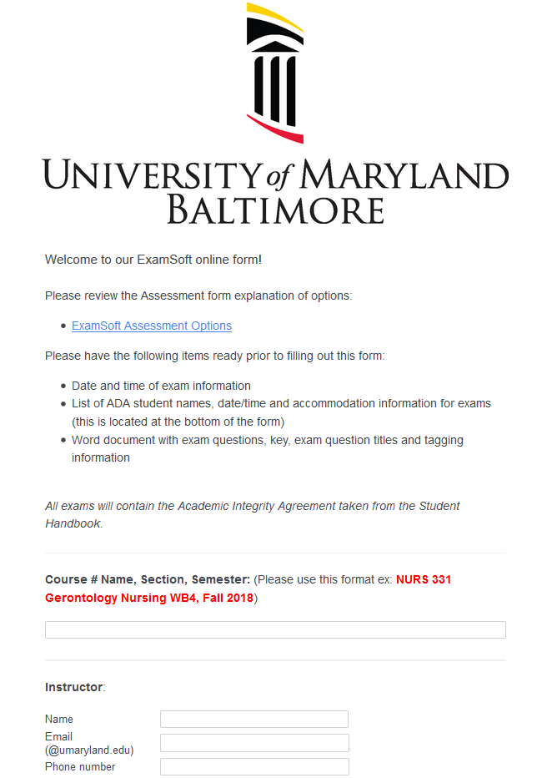
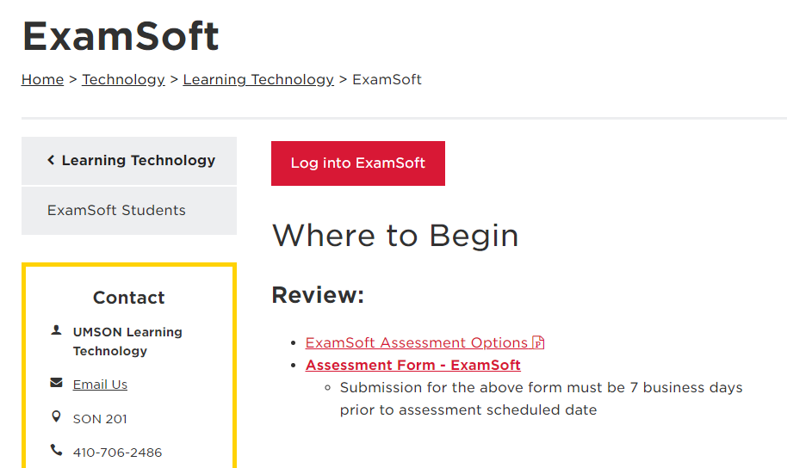
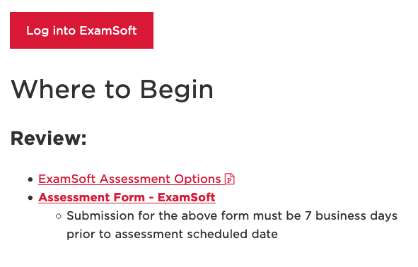
ExamSoft Assessment Form
https://www.nursing.umaryland.edu/technology/learning-technology/examsoft/#d.en.352084

Slide 9
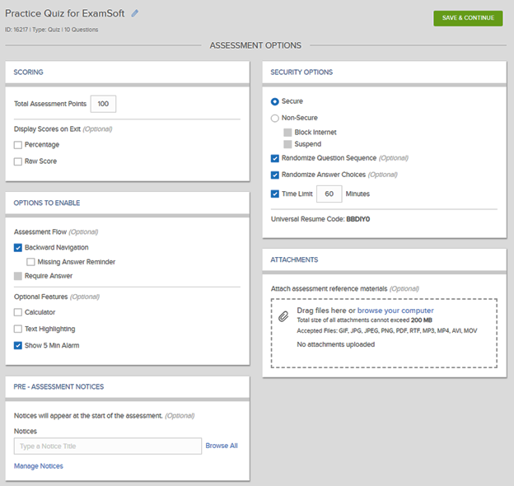
ExamSoft Assessment Options

Slide 10
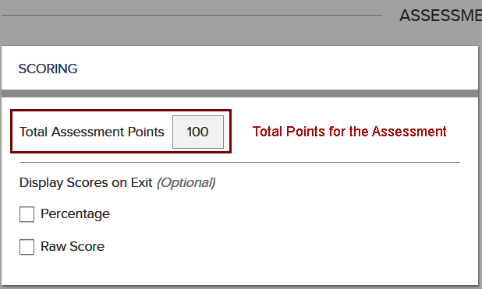
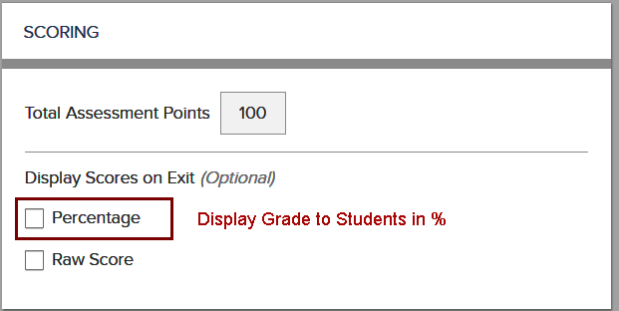
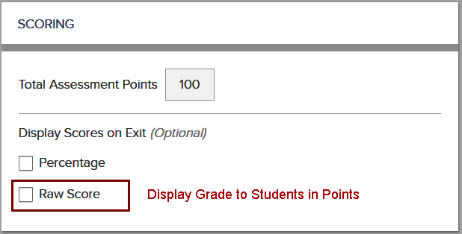
Scoring
NOTE: Display Scores on Exit is an option.
If neither Percentage and or Raw Score is chosen,
the students will not see any results.

Slide 11
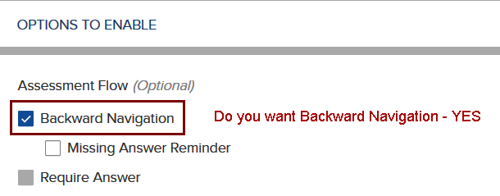
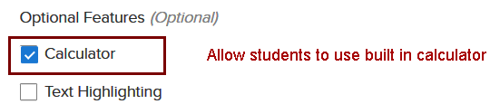
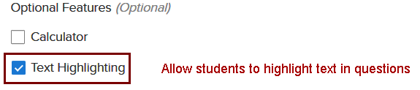
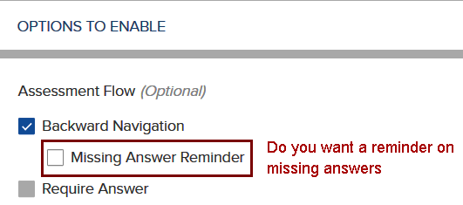

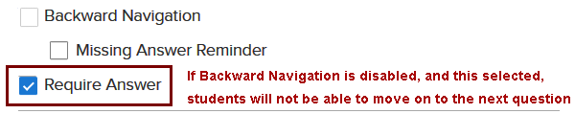
Options to Enable

Slide 12
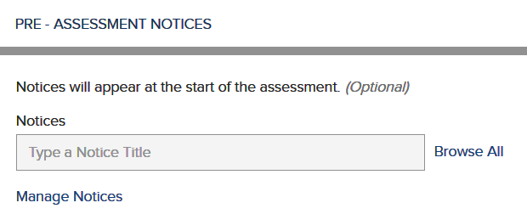
Pre-Assessment Notices
This area will contain the Academic Integrity Notification and will be seen by students and agreed to before the exam will be visible to them.
Here you can also add exam instructions or other information about the exam you want your students to know.

Slide 13
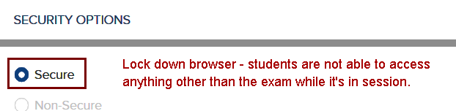
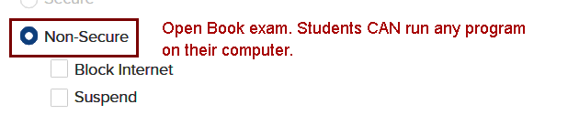

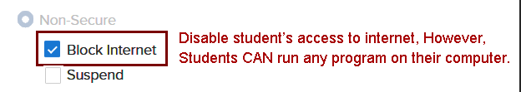
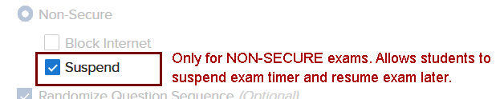
Security Options

Slide 14




Security Options
Note: Universal Resume Code is NOT to be released unless an event occurs, such as a fire drill.

Slide 15
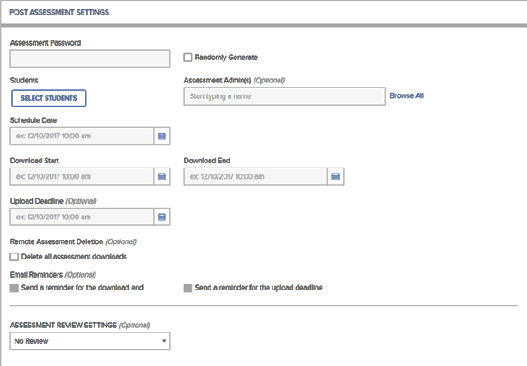
Post Assessment Settings

Slide 16
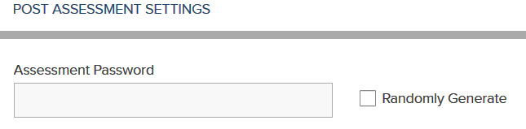
Assessment Password
You may randomly generate a password for your course or you may create a password yourself.
To create a password you must:
  6 to 60 alphanumeric characters
  At least 1 – letter
  At least – number
NOTE: Password is case sensitive

Slide 17
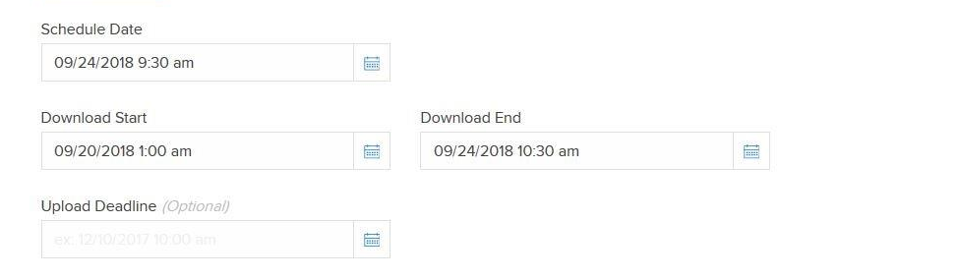
Download/Upload Exam
A
B
C
D
A - Schedule Date – When you plan to open your exam to students (date of exam)
B - Download Start – When you want the students to start downloading the exam
NOTE: Recommendation 48 -72 hours prior to exam opening, if the student will be using
their own computer..
C - Download End – When you want to stop the ability to download exam
D – Upload Deadline - When the student must upload the exam
NOTE: If deadline passes the student will not be able to upload exam without
changing the date and time

Slide 18

Remote Deletion
Time and date of which a downloaded assessment will be removed from student’s computer
NOTE: Remote Deletion must occur after the Scheduled Date, Download End, and Upload Deadline

Slide 19
Email Reminders
A
B
A – Email alert to students that the ability to Download the exam is ending
B – Email alert to students that the ability to Upload the exam is ending

Slide 20
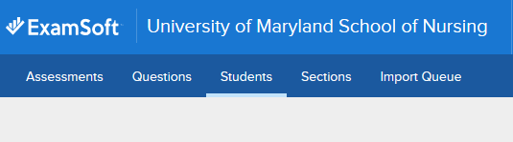
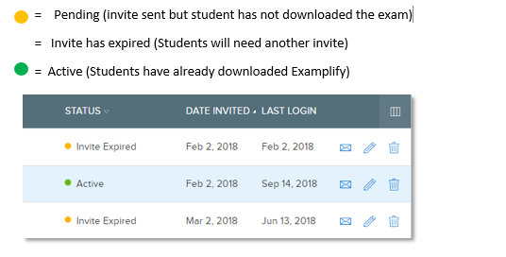
Email Reminders
Status of a Student Invite in ExamSoft

Slide 21
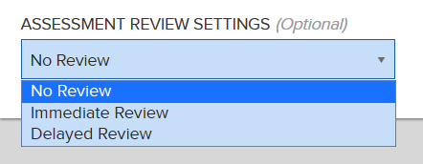
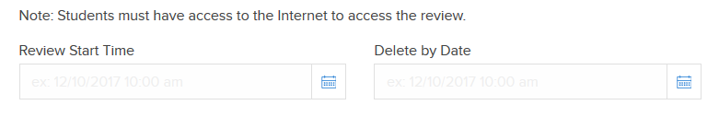
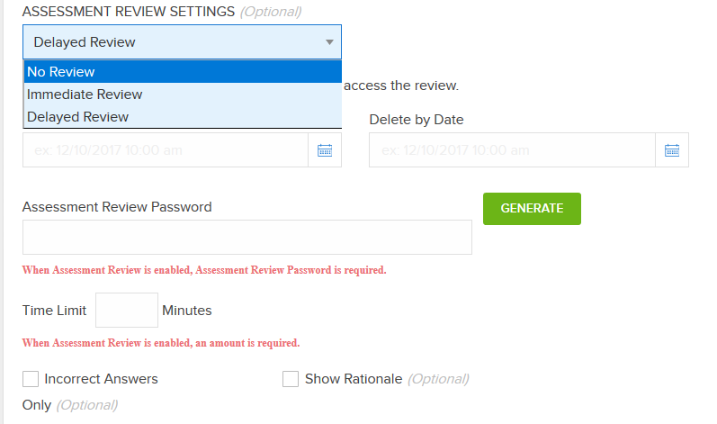
Assessment Review Settings
Immediate Review (Assessment Review Password is Required):
Generate a review password – 4 word password
Time Limit – dictates how long students can spend on a review
Incorrect Answers and Rational are options as well
Delayed Review (Assessment Review Password is Required):
Review Start Time and End Date
(Must be after Download End Date and Upload End Time)
Time Limit – dictates how long students can spend on a review
Incorrect Answers and Rational are options as well
Note: Students must have internet connection to review

Slide 22
Other Information
Unexpected Outages
Resume Codes
Make-Up/Missed Assessments
  Linked vs Unlinked
Testing Accommodations for Proctor

Slide 23
Unexpected Outages
Internet Outages
  Download exams prior to arrival to class
  You will be able to enter and complete exam
  Answers will be safe and secure until able to reconnect to the internet
Power Outages
  Students need to fully charge devises prior to exam
  If there is enough battery life, upload once connected to the internet
  If your instructor chooses to postpone the exam, COMPLETELY SHUT DOWN devices to stop the timer until power is restored
Mid-Exam Evacuation (ie Fire Drill)
  COMPLETELY SHUT DOWN devices to stop timer
  DO NOT SUBMIT the exam
  DO NOT close the laptop
    Closing will put the computer to sleep but WILL NOT stop the timer

Slide 24
Resume Codes
A number that needs to be entered into Examplify in the event when a computer is turned off mid-exam.
Two types of Resume Codes
  Individual Continuation Code only to be used by one individual student
  Universal Resume Code which can be used by all students for that assessment

Slide 25
Make-Up/Missed Assessments
“Method I: Linked”
Step 1: Remove Missing Students
Step 2: Create a Linked Assessment
    Set up new assessment password
    Select the students
    Strict download start and end times for make-up exam
      Post assessment
      Notify the students that need to make-up exam
      New posting and assessment password
NOTE: this method will allow you to run a Combined report with the original posting and the Linked assessment.

Slide 26
Make-Up/Missed Assessments
“Method II: Unlinked”
Step 1: Remove Missing Students
Step 2: Create an Unlinked Assessment
    Create new assessment password
    Select the students
    Strict download start and end times for make-up exam
      Post assessment
      Notify the students that need to make-up exam
    You will be able to edit all of the assessment options, content, and post settings
    NOTE: this method will NOT allow you to run a Combined report.

Slide 27
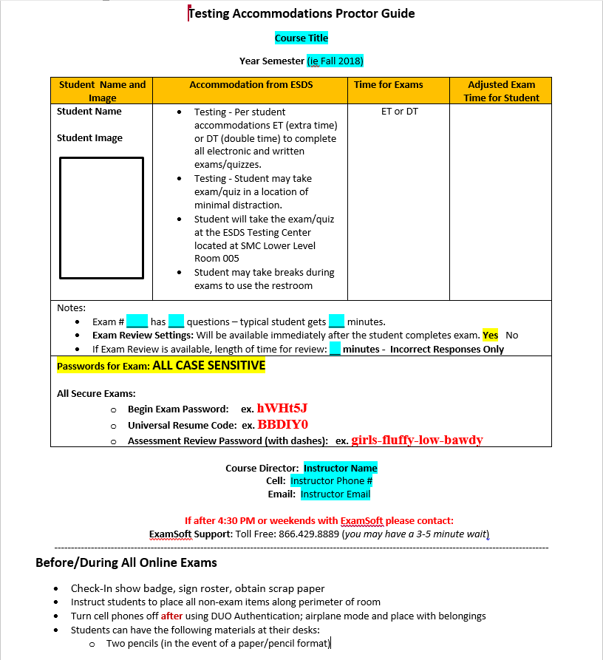
Testing Accommodations
Proctor Guide

Slide 28
Log into ExamSoft
https://prod-ui.examsoft.io/login?institutioncode=maryland
Log in from our Webpage:
http://www.nursing.umaryland.edu/technology/

Slide 29
Downloading Examplify Onto your device

Slide 30
Minimum Requirements
Windows
  Operating System: 32-bit and 64-bit Versions of Windows 7 and Windows 10.
  ​Support for Windows 7 devices will be discontinued on December 31st, 2018.
  Alternate versions of Windows 10, such as Windows RT, and Windows 10 S are NOT supported at this time.
  Only genuine, U.S.-English versions of Windows Operating Systems are supported
  CPU Processor: 1.86Ghz Intel Core 2 Duo or greater
  RAM: 2GB or highest recommended for the operating system
  Hard drive: 1GB of available space or highest recommended for the operating system
  Internet connection for Examplify download, registration, exam download and upload
  Screen Resolution must be 1024 x 768 or higher
Operating system:
  Mac OS X 10.11 El Capitan
  Mac OS X 10.12 Sierra
  Mac OS X 10.13 High Sierra
  Mac OS X 10.14 Mojave

Slide 31
Examplify
The following slides are ExamSoft’s recommended best practices.
Use Google Chrome or Mozilla Firefox to download Examplify.
When downloading Examplify or accessing your exam, please close all running applications.
(NOTE: Once this is downloaded it will not need to be downloaded again.)

Slide 32
Downloading Examplify
Examplify will download in one of 3 places
  Desktop
  Browser's Download tab
  App tray
You must be connected to the Internet to Register Examplify and/or download exams
  Run the installer file (.exe)
  Agree to the terms

Slide 33
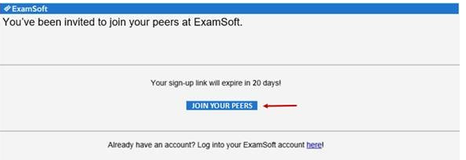
Examplify Invitation
Students will receive an invitation to download Examplify. This is currently located in the Announcements

Slide 34
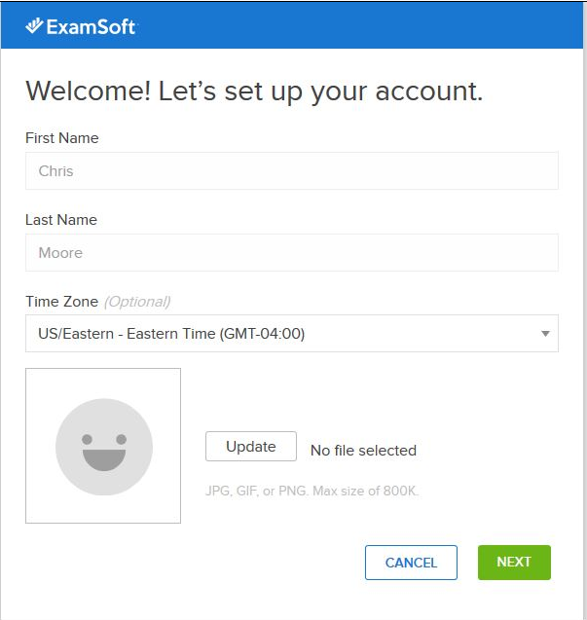
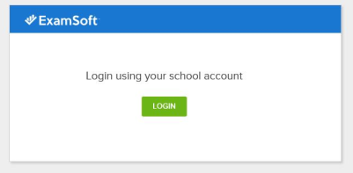
Downloading Examplify

Slide 35
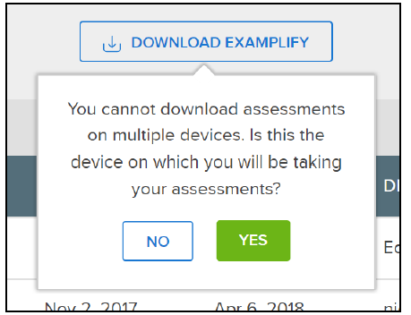
Downloading Examplify
  A message will appear prompting you to confirm
  that this device will be the one you will be using to download exams.
  Click Yes to confirm

Slide 36
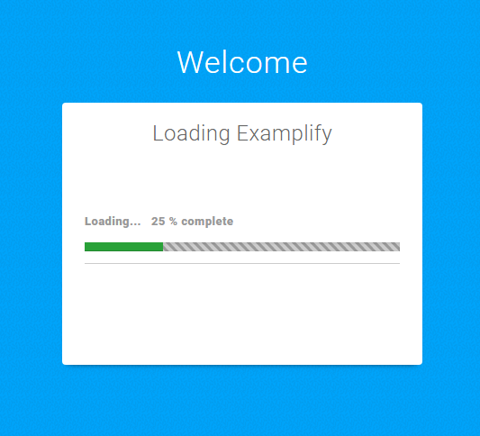
Opening Examplify
Once the installation is finished, you will then be able to launch the application from the Desktop or App tray.
Click on the icon on your desktop to open Examplify

Slide 37
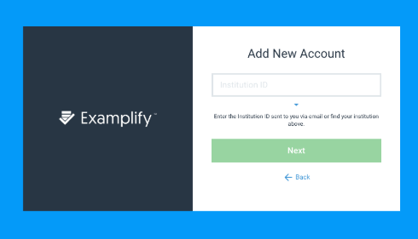
Opening Examplify
Locate your Institution ID within the list
Start typing:
University of Maryland School of Nursing
The box will start to populate as you type
Click on the Institution ID and then click Next

Slide 38
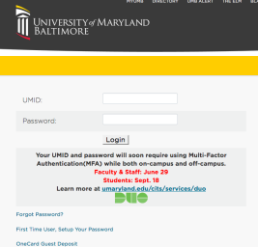
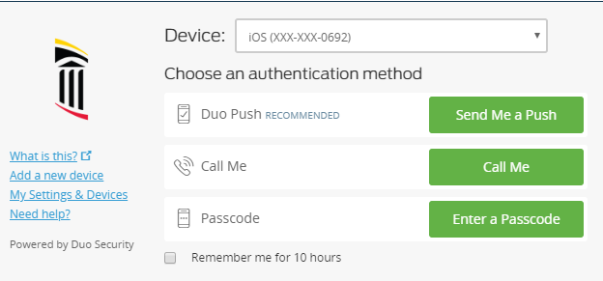
You will be directed to the UM login page for DUO
Enter your UMID and Password
Choose your authentication method for DUO
Click Sign In to complete registration

Slide 39
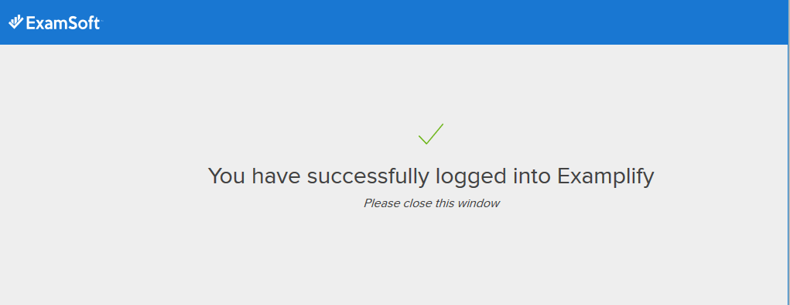
Opening Examplify
You will see this screen when you have a successful login
Close this window to display Examplify home page
Please wait for the Home Page to load

Slide 40
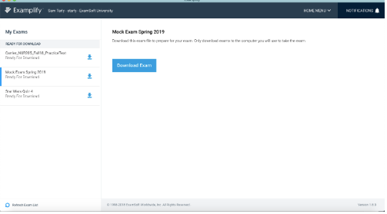
Examplify Home Page
You are now at the Home Page
Download your exam file 48-72 hours prior to exam day
*(Note: If you are taking the exam on a SON laptop or in a computer lab you will not download the exam prior to the exam day. You will download in the classroom the day of the exam)

Slide 41
Downloading Exams

Slide 42
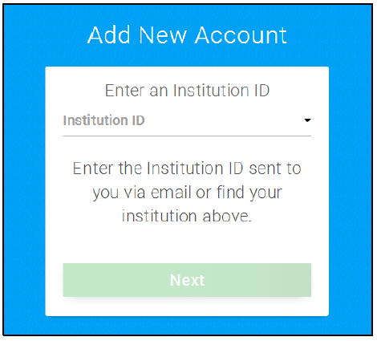

Downloading an Exam
If you have logged out of Examplify follow the below directions:
Locate your Institution ID within the list
Start typing University of Maryland School of Nursing the box will start to populate as you type
Click on the ID and then click Next

Slide 43
You will be directed to the UM login page for DUO
Enter your UMID and Password
Choose your authentication method for DUO
Click Sign In to complete registration

Slide 44
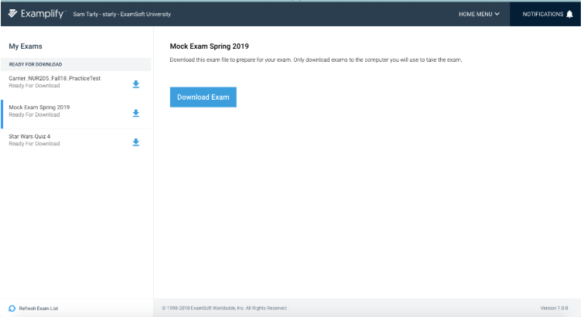
Downloading an Exam
If you do not see the exam you are scheduled to take, click the “Refresh Exam List” button at the bottom of the screen
Select the exam you will be taking from the Exam list on the left-hand side that are Ready For Download
Click on Download Exam

Slide 45
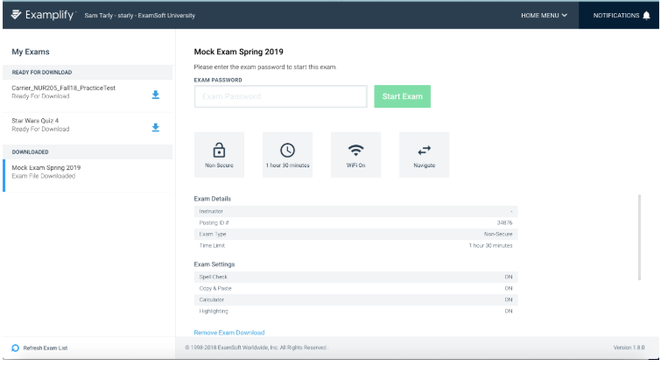
Downloading an Exam
A successful download you will the exam listed under the “DOWNLOADED” section.

Slide 46
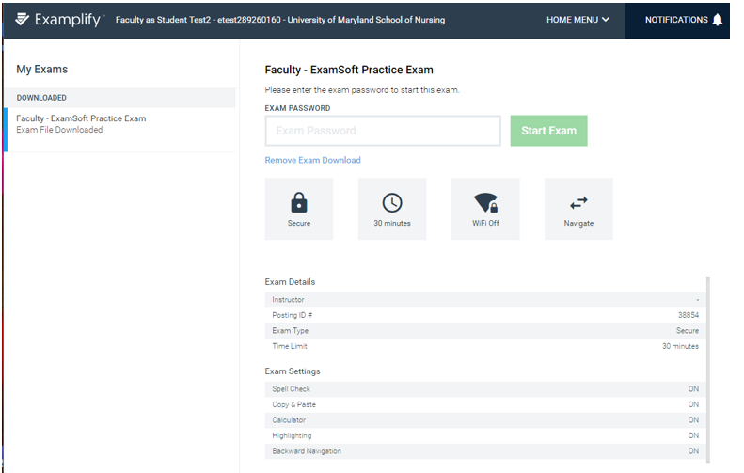
Downloading an Exam
Review the details and settings enabled by your Instructor
Enter the exam password and click Start Exam. This password will be given to you by your instructor.

Slide 47
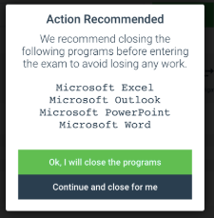
Starting an Exam
If there are applications running on your computer you will need to close before taking the exam
Please follow the instructions:
Otherwise, continue to the next slide

Slide 48
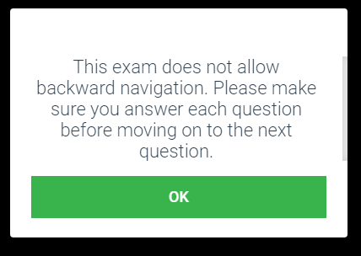
Starting an Exam
If the exam does not allow Backward Navigation the following slide will appear.

Slide 49
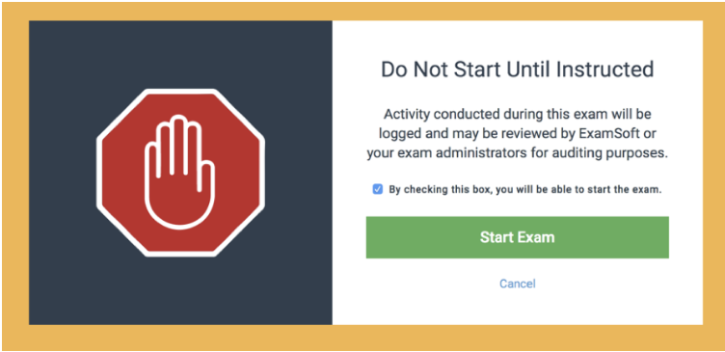
Starting an Exam
Enter the exam password
This password will be given out at the start of the exam
NOTE: this password is case-sensitive, and will need to be entered exactly as shown
Stop here until instructed to proceed.

Slide 50
Exam Options

Slide 51
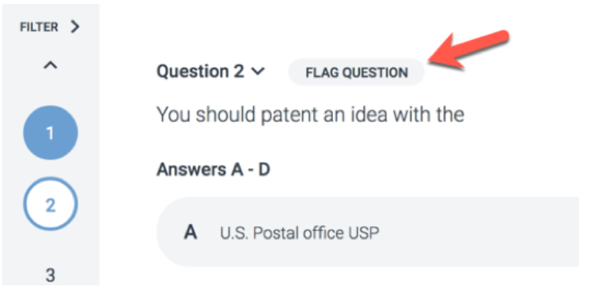
Exam Controls and Options
On the left-hand side of the screen, you see numbers that correspond to each questions. An answered question will be filled in and the current question that you are on will be outlined in blue.
To flag a question, click on “FLAG QUESTION”. Note, if backward navigation is disabled you will not be able to return to any flagged questions.

Slide 52
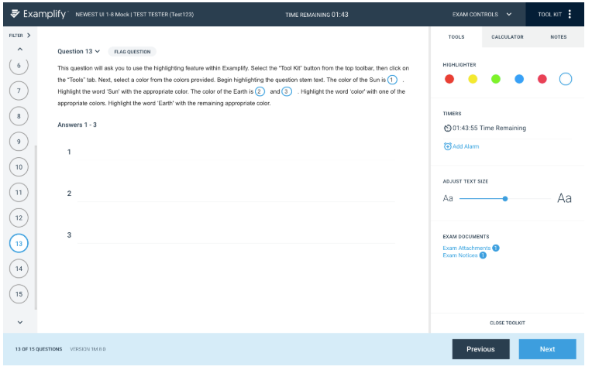
Exam Controls: Top
Along the top row, you will have the ability to:
Display exam level attachments & notices, Set an alarm, See exam time remaining, Highlighting tool, Adjust question text size, Calculator, Notes and Feedback

Slide 53
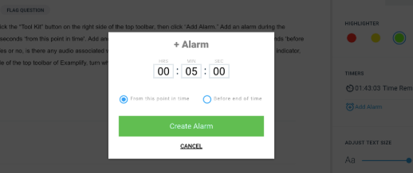
Exam Alarm
Most exams will have a Time Remaining alarm with a time countdown OR a 5 Minute Warning alarm with a time countdown.
Otherwise, to set an alarm, click the Alarm icon, and select “Add Alarm”.
Within the popup window, you will be able to set an alarm “From this point in time”, or “Before end of time”.
You may add up to two alarms.

Slide 54
Exam Controls: Bottom
Along the bottom row, you will see:
Examplify version number
Current question number displayed out of the total number of questions on the exam
The Previous and Next buttons to navigate through questions.

Slide 55
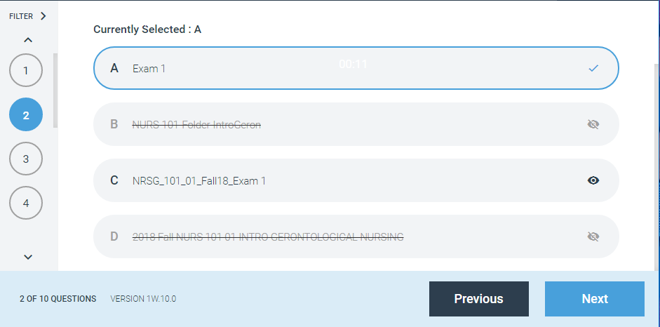
Multiple Choice Choosing Answers
If the entire question or answers are not displayed, a scroll bar will appear.
The strikethrough feature allows you to cross out an unwanted answer choice by clicking on the eye icon to the right of the answer
When you select an answer a blue border appears around the answer choice. When moving to the next question the question number on the left will be filled in with blue.

Slide 56
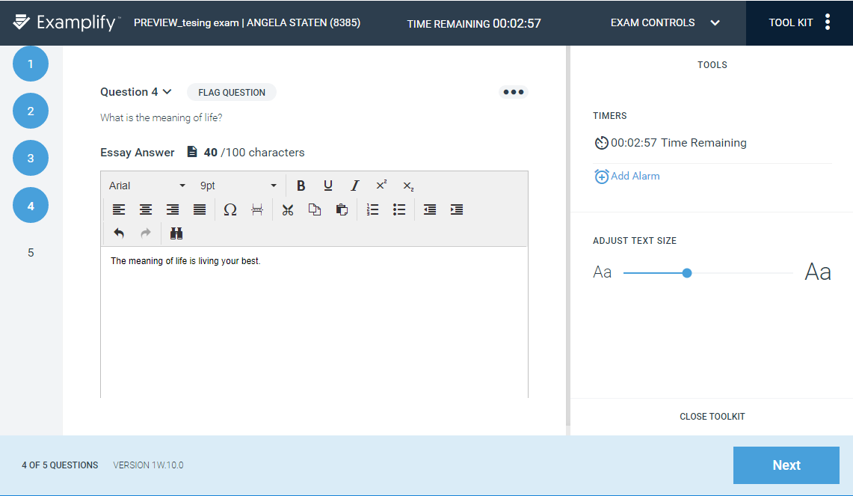
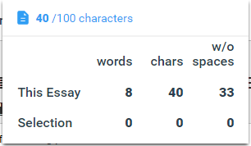
Essay Question
A text box will appear for essay questions
You can adjust the size of the text maximize the question text

Slide 57
Submitting Exams

Slide 58
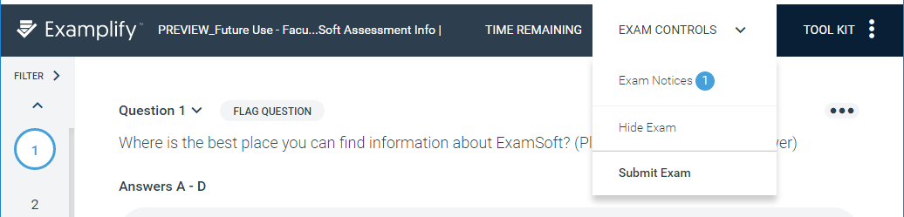
Exiting and Submitting your Exam
When you have completed all questions on your exam click on the Next button or go to Exam Controls in the top right corner and click Submit Exam.
Most exams are timed, so if you run out of time the program will exit you from the exam.

Slide 59

Submitting your Exam
If the Instructor has selected Backward Navigation you will have an option to Return to Exam.
If have completed the exam click on Submit Exam.

Slide 60

Submitting an Exam
If the student has not answered all of the questions this screen will appear if they chose to submit the exam.

Slide 61


Preliminary Results “with a Review ”
You can see your Preliminary Results score for “Objective Questions Only” Raw & Percentage score shown if the Instructor has chosen this option.
You can see an Immediate Review if the Instructor has chosen this option, which requires a password.
You have the option to Continue to Upload your exam

Slide 62

No Results and “No Review”
If the Instructor did not choose Preliminary Results or a Review you will then follow the steps to submit your exam.

Slide 63

After submitting your Exam
If the upload was successful, you will see this confirmation screen
Once you reached this screen, your exam has finished uploading and you will not be able to enter back into this exam.
Do not close this window the Instructor or Proctor will need to verify this confirmation

Slide 64
Post Exam
Exit Examplify
You will receive a confirmation email confirming your exam’s data has been uploaded.

Slide 65
Exam Day Help
If you are taking an exam at home and have exam issues, you may contact ExamSoft Support at:
Toll Free: 866.429.8889
(ExamSoft support is 24/7)
support@examsoft.com

Slide 66
ExamSoft FAQ's
Backward navigation - when checked, what does that mean?
  This means: Do you want the students to be able to go back and answer missed or not answered questions.
What about functions that we currently use in Blackboard like:
  Force Submit
    No Force Submit
    The Time Limit will be the determining factor
  Display one question at a time
    All questions are displayed 1 at a time
  Multiple attempts
    Multiple attempts per student is possible
How can students taking the exam at alternate times - how does that happen?
  Make-up Assessments or Missing Students (2 options)
    Remove the missing students from the student list
  Option 1: Create Linked Assessment [(Same Exact Exam) cannot edit or change any content]
    Create new Password
  Option 2: Create Unlinked Exam (Exam question changes, setting changes, etc)
    Create new Password
    NOTE: In this option you will not be able to combine the data because the questions have been altered. This will be a new exam.
Do Pre-Assessment Notices instructions remain visible throughout the exam?
  In the Exam, at the top of the page, students have the option to display:
    Exam attachments
    Pre-assessment notices
    Alarm
    As well as a timer
Time limit - is there a force submit?
  NO - but the exam will end when the exam time is up for the student

Slide 67
ExamSoft FAQ's
Do Pre-Assessment Notices instructions remain visible throughout the exam?
  In the Exam, at the top of the page, students have the option to display:
    Exam attachments
    Pre-assessment notices
    Alarm
    As well as a timer
Time limit - is there a force submit?
  NO - but the exam will end when the exam time is up for the student

Slide 68
ExamSoft FAQ's
Post Assessment Settings - does this mean posting the test, not after the test is taken?
  In Post assessment setting you will see:
    Assessment schedule of start date
    Download Start time
    Download End Time
    Upload End Time
    Remote Assessment Deletion
    Download and Upload Email reminders
What if you want to review a specific exam with a student after students have completed them, can you reivew their specific exam?
  Yes
Pre-Assessmnet Notice deployed to an entire cohort/class or do we menu select who gets the e-mail link?
  Faculty can send the student invite to an individual student and/or whole cohort
If a student is sent an invite link, but it doesn't arrive, they obviously can't download. How can we know if this happens, or if they just don't upload, or this nevers happens?
  You should give all exams 24-48 hours prior to exam day to download exam
  Non-Downloaded Exam:
    In ExamSoft next to a student's name you can see who has not downloaded the exam
  Through ExamSoft you can send them a direct email asking why they have not done so yet
  In ExamSoft you can set dated for email reminders as well.
  Proctored After/During Exam:
    If a student has not uploaded the exam they should not be able to leave the room
    NOTE: Best Practice - The proctor should check if the exam was uploaded
Can we as faculty open an exam at any time after completion if we meet F2F with a student for review/discussion?
  Yes

