Slide 1

Examplify
The following slides are ExamSoft’s recommended best practices to help you take your exam.
We want you to be prepared for your exam
on exam day!
Use Google Chrome or Mozilla Firefox to access the Examplify.
When downloading Examplify or accessing your exam, please close all running applications.
(NOTE: Once this is downloaded it will not need to be downloaded again.)

Slide 2

Minimum Requirements
The below link assist you with the following information:
SON Computer Requirements - updated April 2023
Instructions on how to check your computer’s specifications
Instructions on how to update your device
Instructions on how to check your version of Examplify
NOTE:
Use Chrome as your default browser
SON does not support iPads for exams.

Slide 3
Downloading Examplify
Disable your antivirus
Close all applications running in the background before starting any exam

Slide 4
Downloading Examplify
Click on the below link on the School of Nursing website:
https://www.nursing.umaryland.edu/technology/learning-technology/examsoft/examsoft-students/
Scroll down to Step #3
Click on the "Examplify Download" button (Windows/MAC)

Slide 5
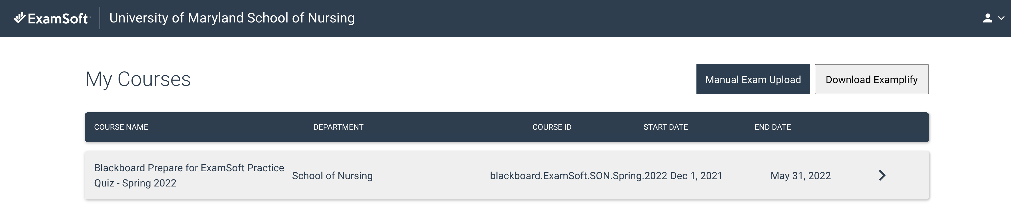

Downloading Examplify

Slide 6
Downloading Examplify
You must be connected to the Internet to download
  Run the installer file (.exe)
  Agree to the terms
Examplify will download in one of 3 places
  Desktop
  Browser's Download tab
  App tray

Slide 7
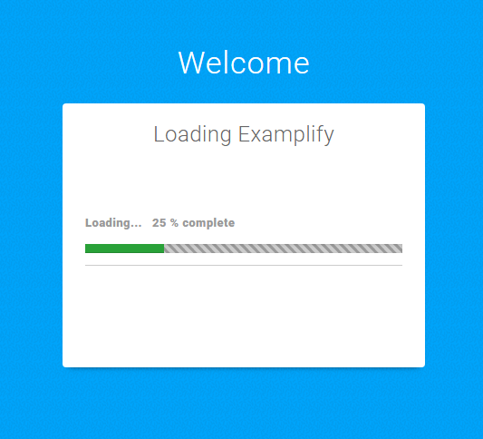
Opening Examplify
Once the installation is finished, you will then be able to launch the application from the Desktop or App tray.
Click on the icon to open Examplify.

Slide 8
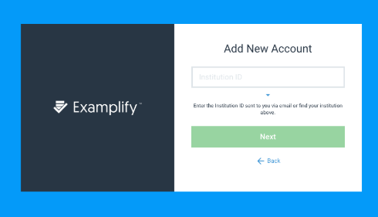
Opening Examplify
Locate your Institution ID within the list
Start typing:
University of Maryland School of Nursing
The box will start to populate as you type
Add the Institution ID and then click Next

Slide 9
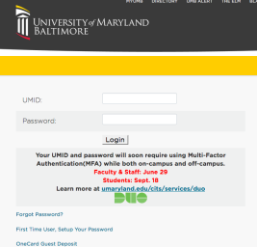
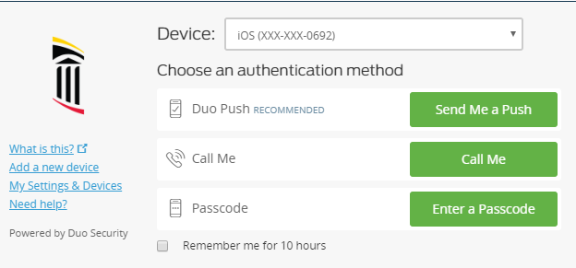
Opening Examplify
You will be directed to the UM login page for DUO
Enter your UMID and Password
Choose your authentication method for DUO
Click Sign In to complete registration

Slide 10
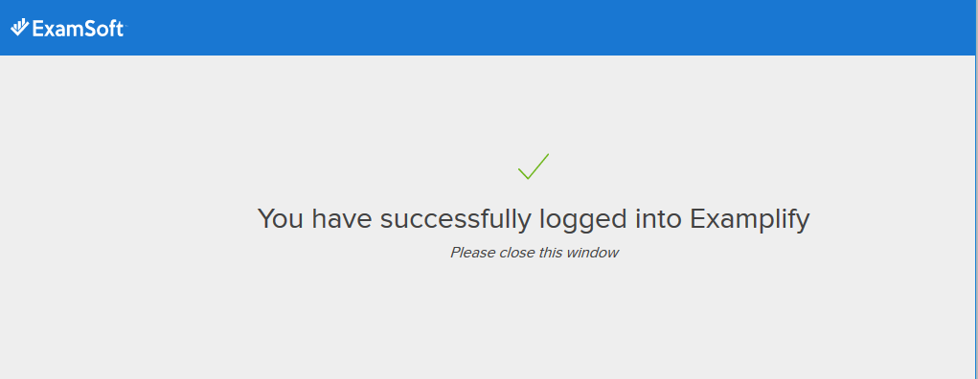
Opening Examplify
You will see this screen when you have a successful login.
Close this window to display the Examplify home page. (May be running in the background)
X

Slide 11
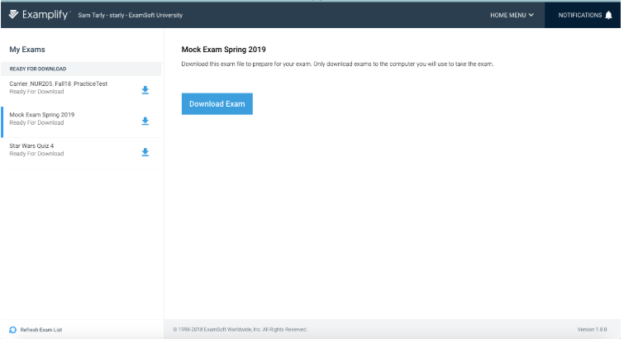
Examplify Home Page
Download your exam file 48 hours prior to exam day
*(Note: If you are taking the exam on a SON laptop or in a computer lab you will not download the exam prior to the exam day. You will download the day of the exam.)

Slide 12
Downloading an Exam
If you do not see the exam you are scheduled to take, click the “Refresh Exam List” button at the bottom of the screen
Select the exam you will be taking from the Exam list on the left-hand side that are Ready For Download
Click on Download Exam

Slide 13
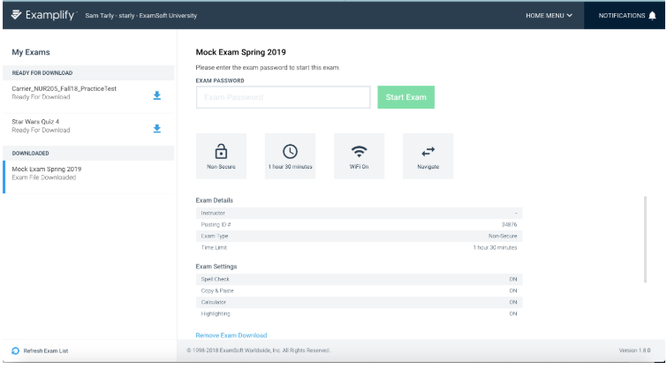
Downloading an Exam
A successful download you will the exam listed under the “DOWNLOADED” section.

Slide 14
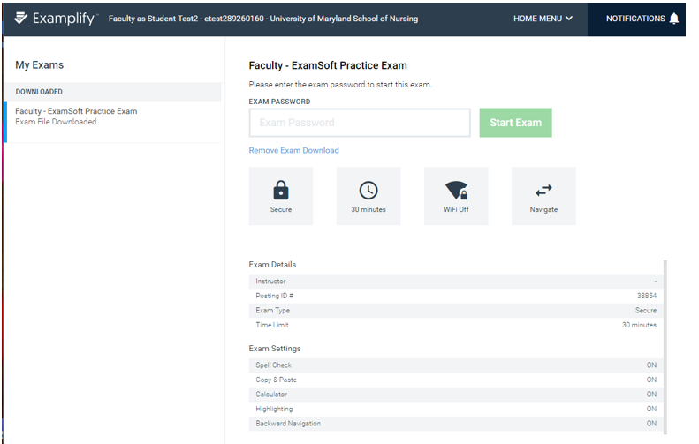
Downloading an Exam
Review the details and settings enabled by your Instructor.
Enter the exam password given to you by your instructor.
This password will be given the day of the exam.
*NOTE: Password is case-sensitive, and will need to be entered exactly as shown

Slide 15
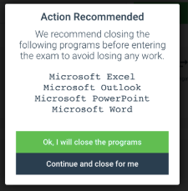
Starting an Exam
If there are applications running on your computer you will need to close before taking the exam
Please follow the instructions.
Otherwise, continue to the next slide

Slide 16
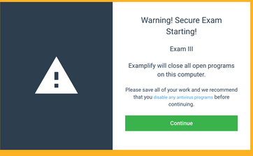
Secure Exam
If there are applications running on your computer you will need to close before taking the exam
Please follow the instructions.
Otherwise, continue to the next slide

Slide 17
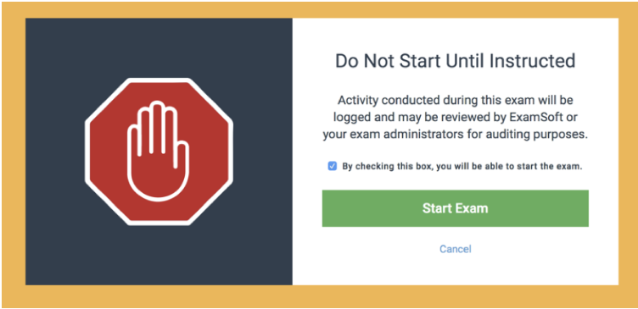
Starting an Exam
In-class exam - Stop here until instructed to proceed.
Remote exam - You do not need to stop here.

