Slide 1
[Student org
Name Goes
Here]
Not just for men — we welcome all!
RECRUITMENT
MEETING
Monday, Sept. 15 | 2 p.m.
Room 150
We’ll take some time to go over events that we will be hosting; e.g. community events, fund raisers, and collaborative events.
There will be pizza, wings, salad, & refreshers

Slide 2
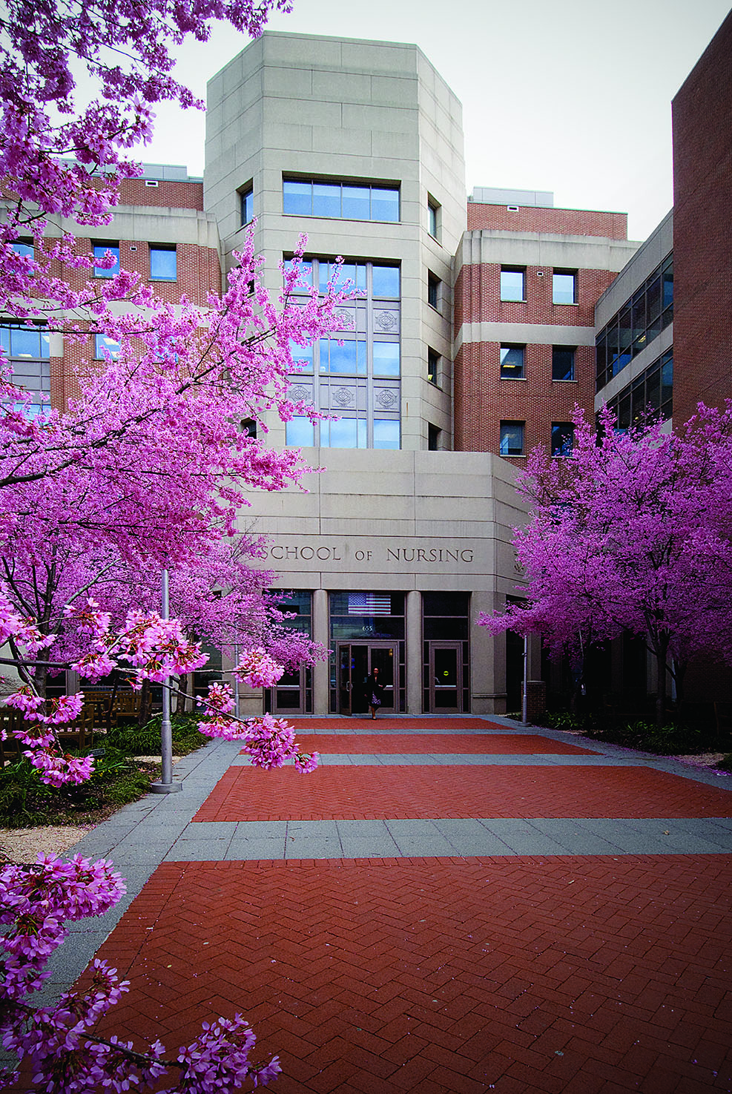
[Student org
Name Goes
Here]
Not just for men — we welcome all!
ARECRUITMENT
MEETING
Monday, Sept. 15 | 2 p.m.
Room 150
We’ll take some time to go over events that we will be hosting; e.g. community events, fund raisers, and collaborative events.
There will be pizza, wings, salad, & refreshers

