Slide 1
[Insert Student Org Name Here]
RECRUITMENT MEETING
Monday, Sept. 15 | 2 p.m.
Room 150
We’ll take some time to go over events that we will be hosting; e.g. community events, fund raisers, and collaborative events.
There will be pizza, wings, salad, & refreshers

Slide 2
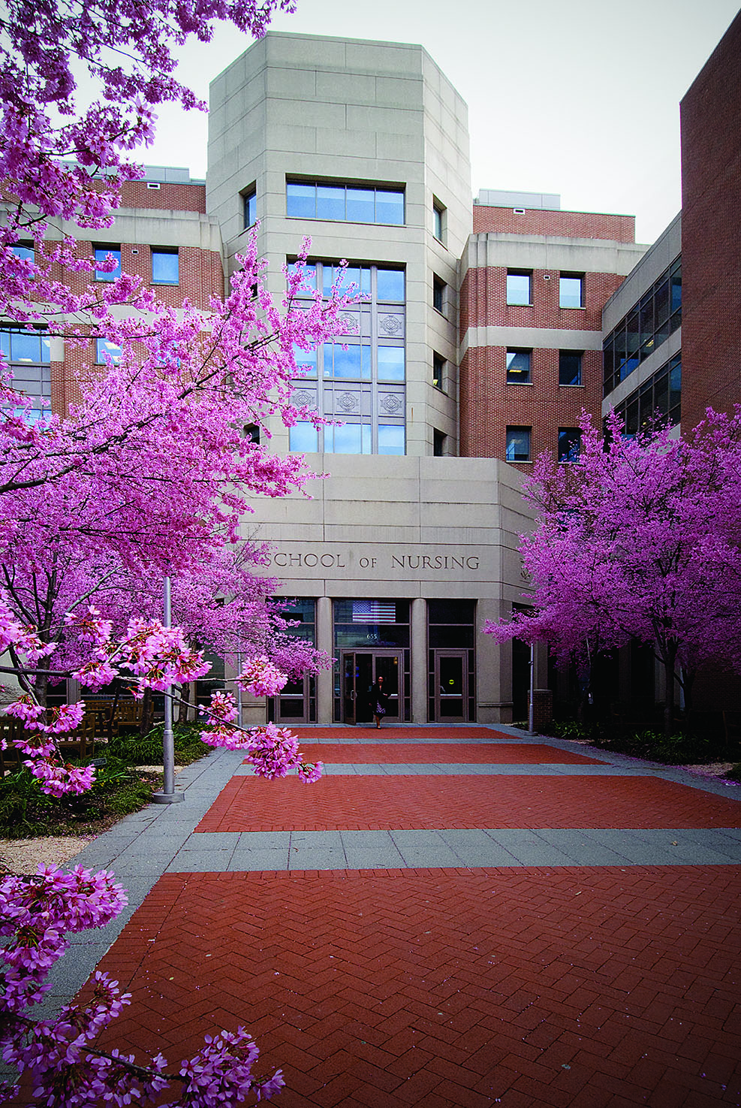
[Insert Student Org Name Here]
RECRUITMENT MEETING
Monday, Sept. 15 | 2 p.m.
Room 150
We’ll take some time to go over events that we will be hosting; e.g. community events, fund raisers, and collaborative events.
There will be pizza, wings, salad, & refreshers

