Slide 1
Informed Consent and Ethical Considerations in Clinical Trials
Jon Mark Hirshon, MD, MPH, PhD
Professor, Department of Emergency Medicine
Senior Vice-Chairman, IRB
University of Maryland Baltimore

Slide 2
Disclosures
Commercial
  Pfizer
    Sickle Cell Disease Council for Change & Advisory Board
  Global Blood Therapeutics
    Sickle Cell Disease Access-to-Care Summit, travel reimbursement
Other
  American College of Emergency Physicians
    Member, Board of Directors and Vice-President

Slide 3
What We Will Cover
Historical perspective on research ethics
  Focus on consent
Brief Discussion on Federal regulations
  Food and Drug Administration (FDA) versus Health and Human Services (HHS) regulations
  New regulations
    The Revised “Common Rule”
Notes:
3

Slide 4


Human Subject Research: Balancing Two Goals
Protection of
Subject Welfare/Rights
Advancement of Science
Notes:
Embedded within Dr. Jekyll and Mr. Hyde are several stories. One involves the duality of human nature.
It is also story of when science is considered to be a discipline without any boundaries and without any or little regard to its consequences. It is this story that serves as an anchor for my presentation.
Embedded in every research experiment is a balancing of two values: on one hand you have the advancement of science. But instead of being without any boundaries, such a goal needs to be balanced against that of protecting subject welfare and their rights. Abuses have occurred when the goals of science were considered with little concern for the protection of subject welfare and rights. Let’s take a careful look at the history of research ethics and the missteps that have occurred.

Slide 5
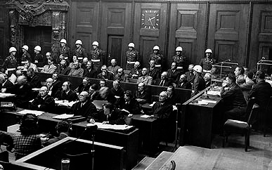

Slide 6
Nuremberg Code (1947)
First Codification of Research Guidelines
“The voluntary consent of the human subject is absolutely essential.”
Prior animal data
Scientific value; Anticipated results justify the risks
Favorable risk/benefit ratio
Suffering by subjects should be avoided
No expectation of death/disability
No coercion in informed consent
Subjects must be free to stop at any time.
Notes:
Ethics and Clinical Trials: What are the Concerns?
1/18/01
Presenter: Henry Silverman, MD, MA
The Nuremberg Code represents the first codification of research guidelines and the core of the Nuremberg Code, has rightly been viewed as the proctection of subjects’ human rights. Because the judges were concerned that investigators’ primary interest was advancing science and not necessarily the protection of subjects, the judges thought that subjects needed to actively protect themselves by giving their consent and having the ability to withdraw.
Overall, 10 points (copied from Wikipedia: http://en.wikipedia.org/wiki/Nuremberg_Code, but source is US NIH)
The voluntary consent of the human subject is absolutely essential.
The experiment should be such as to yield fruitful results for the good of society, unprocurable by other methods or means of study, and not random and unnecessary in nature.
The experiment should be so designed and based on the results of animal experimentation and a knowledge of the natural history of the disease or other problem under study that the anticipated results will justify the performance of the experiment.
The experiment should be so conducted as to avoid all unnecessary physical and mental suffering and injury.
No experiment should be conducted where there is a prior reason to believe that death or disabling injury will occur; except, perhaps, in those experiments where the experimental physicians also serve as subjects.
The degree of risk to be taken should never exceed that determined by the humanitarian importance of the problem to be solved by the experiment.
Proper preparations should be made and adequate facilities provided to protect the experimental subject against even remote possibilities of injury, disability, or death.
The experiment should be conducted only by scientifically qualified persons. The highest degree of skill and care should be required through all stages of the experiment of those who conduct or engage in the experiment.
During the course of the experiment the human subject should be at liberty to bring the experiment to an end if he has reached the physical or mental state where continuation of the experiment seems to him to be impossible.
During the course of the experiment the scientist in charge must be prepared to terminate the experiment at any stage, if he has probable cause to believe, in the exercise of the good faith, superior skill and careful judgment required of him that a continuation of the experiment is likely to result in injury, disability, or death to the experimental subject.

Slide 7
Lessons Learned from Nuremberg Trials
Medical Practice
  Clinical Ethics: guided by Hippocratic Oath
    Patient is silent; dutifully obedient to the beneficent physician
    Doctor’s primary obligation is the patient and acts in the patients’ best interest
Research
  Lies outside of the context of the physician-patient relationship
    Primary goal is to test a hypothesis, secondary obligation is to subject
Conflict of Roles?
Notes:
Ethics and Clinical Trials: What are the Concerns?
1/18/01
Presenter: Henry Silverman, MD, MA
Although the Nuremberg judges realized the importance of Hippocratic ehtics and the maxim “do no harm”, they were concerned that more was necessary to protect human subjects.
In the traditional Hippocratic doctor-patient relationship, the patient is silent; dutifully obedient to the beneficent physician
physicians will act in patients’ best interest based on what physicians think is best, and the moral foundations of of doctor patient relationship was patient trust and medical beneficence.
However, Research lies
Outside of the context of the physician-patient relationship and in contrast to the doctor-patient relationship, the
primary goal of investigators is to test a hypothesis by following a protocol
Only through a conflation of treatment and research could one expand on Hippocratic ethics to protect the rights of subjects in human experimentation.

Slide 8

Declaration of Helsinki
World Medical Association
Adopted by the 18th WMA General Assembly, Helsinki, Finland, June 1964
  Subsequent multiple amendments
Updated informed consent
  Consent individuals
    Capable of giving informed consent
    Recognizes that consent may not always be possible

Slide 9
Tuskegee Syphilis Study (1932 - 1972)
In 1932, medical authorities firmly believed in the efficacy of arsenic therapy for treating syphilis
Tuskegee, Alabama
  High prevalence of syphilis
  Although treatment existed, African-Americans in the rural South were not receiving treatment
  Lack of funds/Lack of doctors
  Study natural course of syphilis
  Enrolled 400 African-Americans males infected with syphilis to study the natural course of syphilis
  Not an experiment but rather a“study in nature”

Slide 10

Tuskegee Syphilis Study (1932 - 1972)
Ethical Issues
  Inadequate disclosure of information
  Subjects believed they were getting free treatment
  Told that spinal taps were therapy
  US Government actively prevented men from receiving penicillin
  1972 press reports caused the study to stop
Notes:
Ethics and Clinical Trials: What are the Concerns?
1/18/01
Presenter: Henry Silverman, MD, MA
The most famous example of research abuse is the Tuskegee research. This study started out to understand the natural history of syphillis, at that time therapy for syphyllis involved the use of heavy metals, which were very toxic and it was not know whether the therapy was worse than the natural history of the disease. The study enrolled 400 African Americans with syphyllis and 200 uninfected controls.
The controversial ethical aspect of this study included failure to adequately explain to the enrolled subjects the nature of the experiment and the procedures, e.g., the subjects were told that lumbar puncture was for therapy. More significantly was the fact that that the USPHS actively tried to prevent men from receiving penicillen, even when it was known that pcn was useful for therapy and it was widely available. In 1972, newspaper press reports caused the U.S government to stop the study

Slide 11
Tuskegee: Ethical Lapses
Lacking in Social Value
Scientifically Invalid Study: Existing Therapy for Syphilis
Unfair Subject Selection
Unfavorable Risk-Benefit Ratio
Failure of Independent Review
Informed Consent Process Invalid; No provisions for ongoing Consent
Lack of Respect for Enrolled Subjects: Failure to provide new information, Coercive Activities

Slide 12
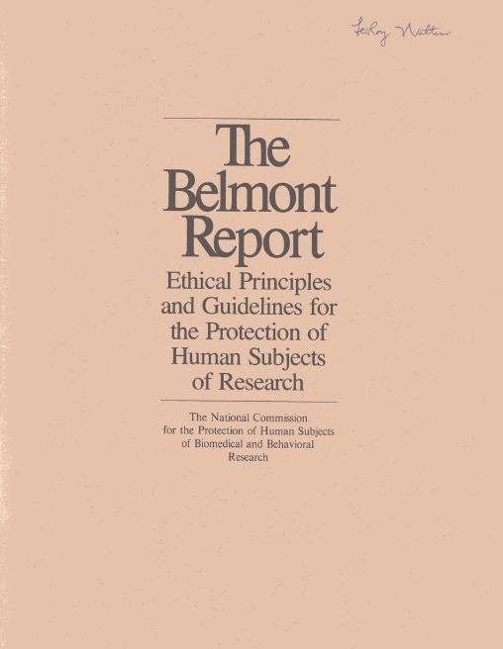
The Belmont Report
April 18, 1979
Basic ethical principles
  Respect for Persons
    Autonomy
  Beneficence
    Maximizing benefits while minimizing risks
  Justice
    Fair distribution of costs and benefits
The Common Rule (1981)
  No exceptions for emergencies

Slide 13
“The Common Rule”
The HHS regulations, 45 CFR part 46 include
  Four subparts:
    subpart A, also known as the Federal Policy or the “Common Rule”;
    subpart B, additional protections for pregnant women, human fetuses, and neonates;
    subpart C, additional protections for prisoners; and
    subpart D, additional protections for children.
  Published in 1991
The Common Rule regulations are separate from FDA regulations

Slide 14


https://cioms.ch/shop/product/international-ethical-guidelines-for-biomedical-research-involving-human-subjects-2/

Slide 15
Clinical Research: 7 Ethical Requirements
Social or Scientific Value
Scientific Validity
Fair Subject Selection
Favorable Risk-Benefit Ratio
Independent Review
Informed Consent
Respect for Potential/ Enrolled Subjects
Emanuel EJ, Wendler D, Grady C. in JAMA 2000;283:2701

Slide 16
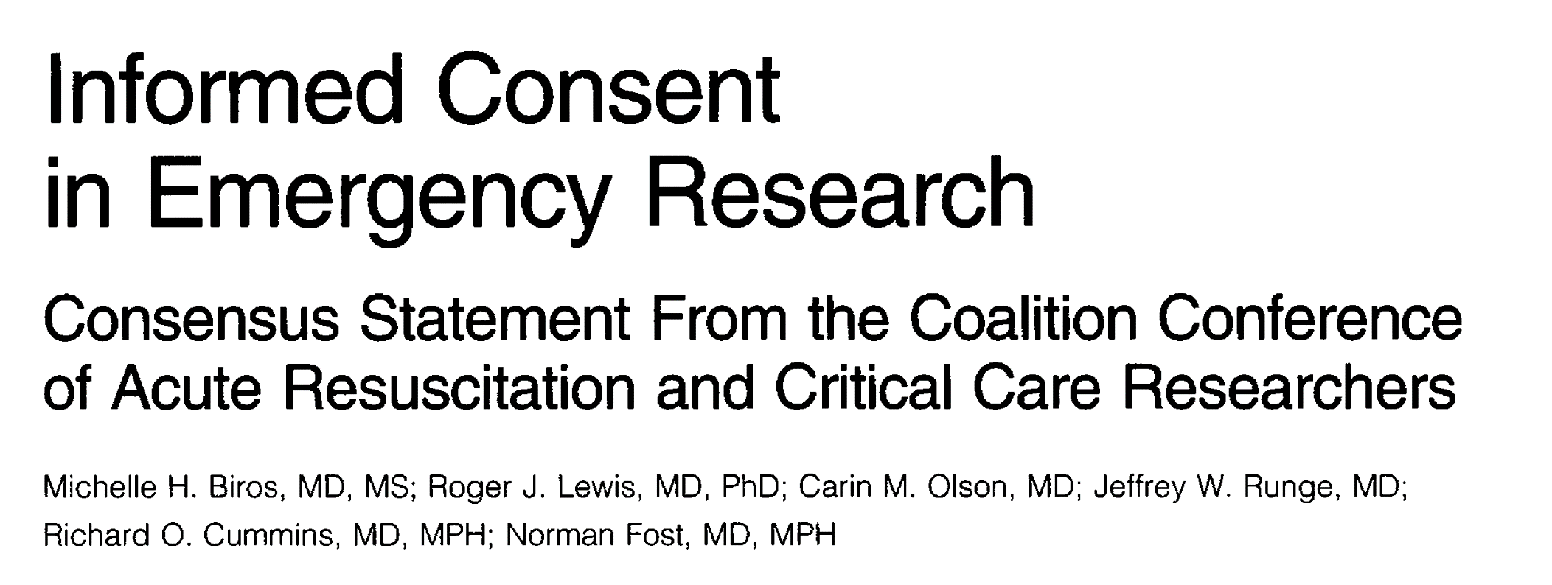
JAMA April 1995

Slide 17
What is Informed Consent?
It is a process- not just a document!
  (1) disclosing to potential research subjects information needed to make an informed decision;
  (2) facilitating the understanding of what has been disclosed; and
  (3) promoting the voluntariness of the decision about whether or not to participate in the research
See: http://answers.hhs.gov/ohrp/categories/1566

Slide 18
Informed Consent
Informed consent ensures that individuals themselves decide:
  whether to enroll in research and
  whether research fits with their own values, interests, and goals.
Research on individuals who cannot decide:
  Children and individuals with cognitive impairment
  Requires surrogate consent
Notes:
IC consists of 3 elements:
Disclosure of adequate information to the potential subject.
Adequate understanding by the subject
Voluntariness of the decision

Slide 19
Informed Consent
Guidelines require several items to be disclosed to potential subjects:
  Purpose and duration of participation
  Procedures and identification of which are experimental
  Risks/Benefits
  Alternatives
  Confidentiality of records
  Compensation of injuries
  Person to contact for answers to questions
  Voluntariness and right to withdraw

Slide 20
Quality of informed consent
Informed consent in research is important, but imperfect.
  Consent forms are complete, but complex (often incomprehensible)
  Importance of personal explanation, time to digest
  Ongoing consent process
  Subject may leave study at his/her discretion

Slide 21
Respect for Enrolled Subjects
The ethical requirements of research do not end with a signed consent document.
Respecting enrolled subjects includes:
  Protecting confidentiality
  Permitting withdrawal
  Providing new information
  Monitoring welfare throughout the study

Slide 22
Informed Consent
It’s the process, not the paper!

Slide 23
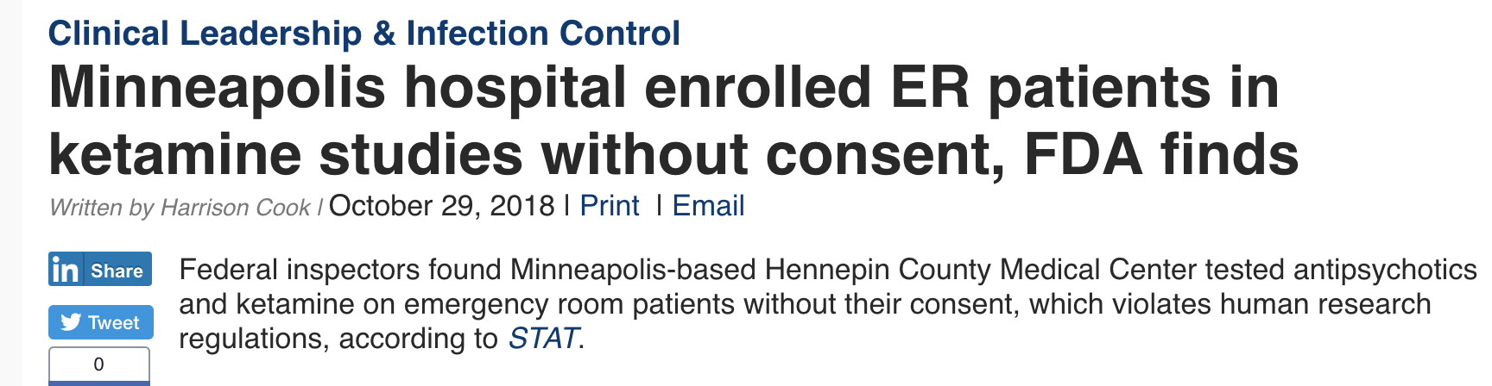
https://www.beckershospitalreview.com/quality/minneapolis-hospital-enrolled-er-patients-in-ketamine-studies-without-consent-fda-finds.html

Slide 24

Federal Regulations

Slide 25
Definitions
“Medical Practice” (IRB is not involved)
  Interventions designed solely to enhance the well-being of the patient.
  Provides diagnosis, prevention or therapy with the expectation of a successful outcome.
"Experimental"
  Defined as new, untested or different.
  An experimental procedure is not automatically categorized as research.
  A new "experimental" procedure should be formally researched (investigated) to determine if is safe and effective.

Slide 26
Research Definition (HHS)
“Research” (IRB is involved)
  Activities designed to contribute to generalizable knowledge.
  Tests a hypothesis and draws conclusions.
  Research is described in a formal protocol and a set of procedures designed to reach an objective.
  The line between practice and research is often blurred.
  Research and practice can occur simultaneously

Slide 27
Definition of a Human Subject (HHS)
A “human subject” (participant, volunteer) is a living individual about whom an investigator conducting research obtains:
  Data through intervention or interaction with the individual
    or
  Identifiable private information
From: 45 Code of Federal Regulations (CFR) 46.102

Slide 28
Responsibilities of the IRB and Human Research Protections Program
Protect the rights and welfare of human research subjects
Determine if Benefit of the research (to the individual or society) exceeds the Risk to the participant (subject, volunteer, patient)

Slide 29
Research Regulations FDA and HHS
Regulatory Scope
  Regulated products (FDA)
  All human subjects research (HHS)
Definitions (synonymous)
  Clinical Investigation (FDA)
  Research (HHS)
https://www.fda.gov/scienceresearch/specialtopics/runningclinicaltrials/educationalmaterials/ucm112910.htm

Slide 30
Research Regulations FDA and HHS
Human Subject (FDA):
  an individual who is or becomes a participant in research, either as a recipient of the test article or as a control.
“Virtually Identical” regulations
  IRB Composition,
  Criteria for approval
  Record requirements
  Informed consent requirements

Slide 31
Research Regulations FDA
Need for drug and device review and approval
  investigational new drug application (IND)
  investigational device exemption (IDE)

Slide 32
Changes to the Federal Regulations Governing Human Subjects Research
Revised Common Rule

Slide 33
Significant Changes
IRB Operations
  Single IRBs for multi-site cooperative research
  External IRBs
  For specific research activities, continuing review will no longer be required

Slide 34
Significant Changes
Scope
  Definitions
    human subjects,
    clinical trial research
    identifiable biospecimen
    identifiable private information/vulnerable population
  Tribal law
Exemption categories expanded

Slide 35
sIRB Objectives
NIH and revised Common Rule compatible
Enhance and streamline the IRB review process for multi-site research
High standards and protections for human subjects maintained
Efficient and effective
Eliminate redundancy

Slide 36
sIRB- When Do They Apply?
Applies to
  U.S. institutions engaged in cooperative research for the portion of the research conducted in the U.S.
Does not apply to:
  When more than single IRB review is required by law (including tribal law)
  When determined by a Federal department or agency
  Foreign sites
  Training awards (e.g.: K, T and F awards)

Slide 37
sIRB- Local Responsibilities
Conflict of Interest (COI) management plans
HIPAA may be handled locally
Ensuring that investigators/study staff are qualified and meet standards to conduct research
Responsible for the safe and appropriate performance of the research
  Includes monitoring study compliance.

Slide 38
sIRB Challenges
Implementation ongoing nationally
  Only a small number of institutions are currently functional as a sIRB
CICERO currently not configured to operate as a single IRB for large multi-site studies
  UMB is committed to ensuring the successful implementation of a sIRB for these trials requiring reliance agreements

Slide 39
Human Subject Definition
Human subject ‐ a living individual about whom an investigator conducting research:
  Obtains information or biospecimens through intervention or interaction with the individual, and uses, studies, or analyzes the information or biospecimens; or
  Obtains, uses, studies, analyzes, or generates identifiable private information or identifiable biospecimens
Notes:
Intervention: Now references biospecimens
Interaction: Includes communication or interpersonal contact between investigator or subject

Slide 40
Exempt Studies- Expansion
Significant expansion
  Scholarly and journalistic activities
    Oral history, Journalism, Biography, Literary Criticism, Legal Research, Historical Scholarship
  Public health surveillance activities
    “conducted, supported, requested, ordered, required or authorized by a public health authority (PHA)”
      Intent for governmental public health agencies
Multiple other categories added or revised

Slide 41
Informed Consent
New language/clarity
  Basic and additional elements of informed consent
Broad consent
Recruitment/screening waivers
Clinical trials consent forms
Electronic consent
Legally authorized representatives

Slide 42
Continuing Review
No longer required (examples)
  Research approved by expedited review
  Exempt research requiring limited IRB review
  Research in which interventions have been completed:
    Data analysis including analysis of identifiable private information or identifiable biospecimens
    Data from clinical care accessed as part of follow-up
The IRB can still require continuing review but this must be documented.
Guidance forthcoming from oversight agencies and UMB

Slide 43
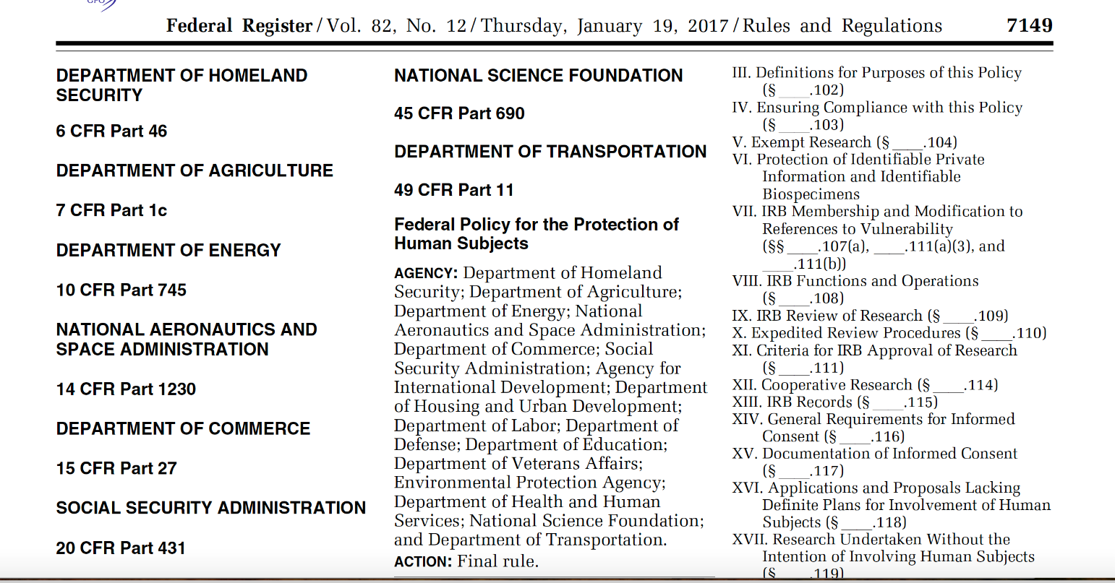
Many more Common Rule changes…
Federal Register
  https://www.gpo.gov/fdsys/pkg/FR-2017-01-19/pdf/2017-01058.pdf

Slide 44
Questions?
Email: jhirshon@umaryland.edu

