Slide 1

Conducting VA Research
Frederick M. Ivey, PhD
Human and Animal Research Protections Officer
Veterans Affairs Maryland Health Care System (VAMHCS)
October 18, 2018

Slide 2

Overview
VAMHCS Research Oversight- Key Personnel
Seeking Approval- IRB & VA Submission Processes
After VA Approval- Regulatory Compliance
VA Funding Opportunities - Growing the VAMHCS research portfolio

Slide 3
VA Maryland Health Care System (VAMHCS) Human Research Protection Program (HRPP)

Slide 4


VAMHCS HRPP
Adam M. Robinson, MD
Director, VAMHCS
Caroline Zink, PhD
BREF Director
Terrylisa Johnson
Res. Compliance Officer
Sandra Marshall, MD
Chief of Staff
Julia Kindred
Assistant RCO
VAMHCS Investigators & Staff
Les Katzel MD, PhD
R&D Committee Chair
Thomas Hornyak, MD
ACOS R&D Service
Hai-Yan Jiang, R.Ph.
Pharmacy IDS
Dr. Ortmeyer
Research safety
Dr. Rosenthal
UMB IRB
Carol Fowler, PhD
Deputy ACOS R&D
Carol Roberts
Administrative Officer
Janice Crosby
Privacy Officer
VA Central IRB
Will Camacho
Information Security
Fred Ivey, PhD
HARPO
Tina McGinley
RDC Coordinator
Nic Letexier
Biosafety Officer
Federal-Wide Assurance (FWA)

Slide 5
VAMHCS HRPP
Adam M. Robinson, MD
Director, VAMHCS
Caroline Zink, PhD
BREF Director
Terrylisa Johnson
Res. Compliance Officer
Sandra Marshall, MD
Chief of Staff
Julia Kindred
Assistant RCO
VAMHCS Investigators & Staff
Les Katzel MD, PhD
R&D Committee Chair
Thomas Hornyak, MD
ACOS R&D Service
Hai-Yan Jiang, R.Ph.
Pharmacy IDS
Dr. Ortmeyer
Research safety
Dr. Rosenthal
UMB IRB
Carol Fowler, PhD
Deputy ACOS R&D
Carol Roberts
Administrative Officer
Janice Crosby
Privacy Officer
VA Central IRB
Will Camacho
Information Security
Fred Ivey, PhD
HARPO
Tina McGinley
RDC Coordinator
Nic Letexier
Biosafety Officer
Federal-Wide Assurance (FWA)

Slide 6
Where to Start?
6
Human and Animal Research Protections Officer
Primary goal of the VA “HARPO” is to promote understanding of and compliance with established VA Research Policy by:
  -Creating practical local policies, procedures, guidances, tools & templates
  -Educating the research community to increase awareness of requirements
  -Advising investigators and study teams in cases of serious and/or continuing non-compliance (i.e. those warranting VA Office of Research Oversight- ORO- tracking)
Contact Fred Ivey at VA Research Service 410-605-7000 x(5)6582 or Frederick.Ivey@va.gov

Slide 7
Getting a VAMHCS protocol approved
  Before you Upload and Submit to CICERO
  After submission in CICERO
  After IRB approval
  Before Submitting to VA Research & Development Committee
  After VA R&D Approval
  ** Do not, under any circumstances conduct research work within the VAMHCS without first securing VA R&D committee approval.

Slide 8
Before you Upload and Submit to CICERO
First consider whether work fits the VAMHCS Mission
  The VAMHCS research program strives to conduct research that is relevant to Veterans and their families
Next, Reach Out to VA Research Service POC (HARPO- Fred Ivey). Again, preferably before you submit.
  Develop timeline to optimize efficiency in meeting VA requirements
  **Complete and secure signatures on ACOS approval form
Pay particular attention to VA-Specific Queries and clear delineating of all research activity locations when drafting in CICERO
  VA “Collaborative Studies”

Slide 9
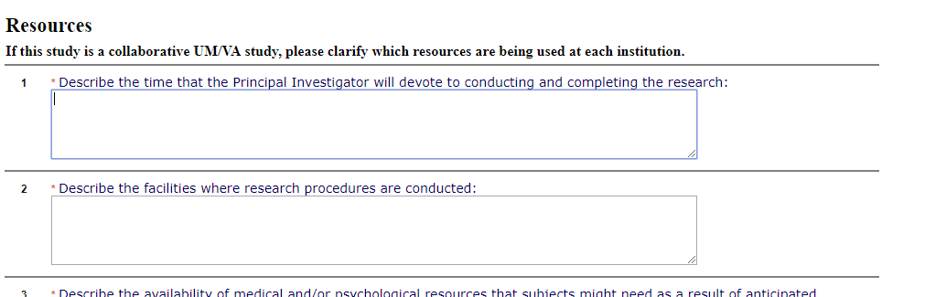
Resources Section- CICERO

Slide 10
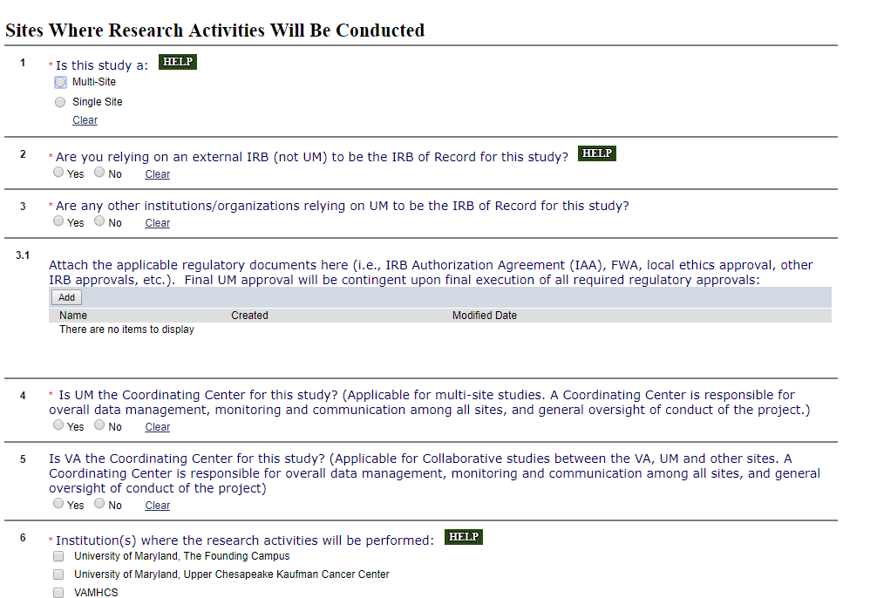
Sites Section

Slide 11
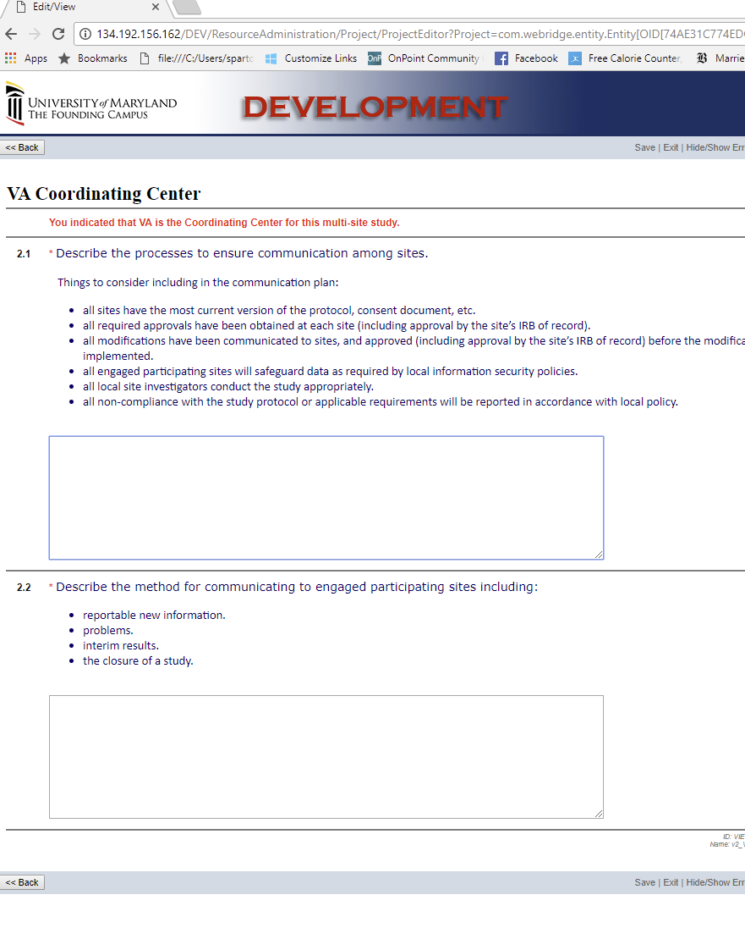
New “VA Coordinating Center” Page

Slide 12
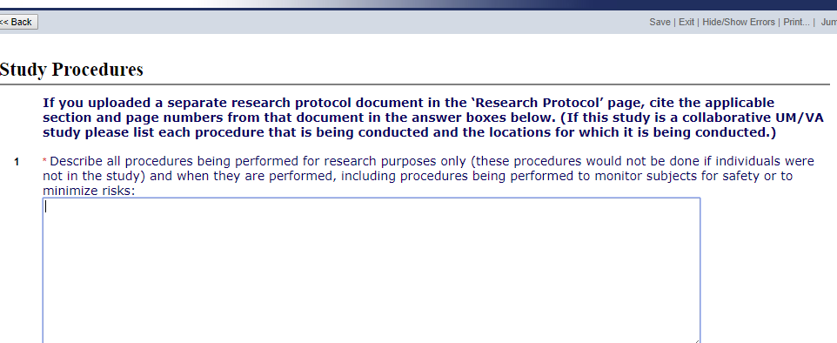
Study Procedures Section
**Very important section for specifying where everything (including data analysis) is taking place

Slide 13
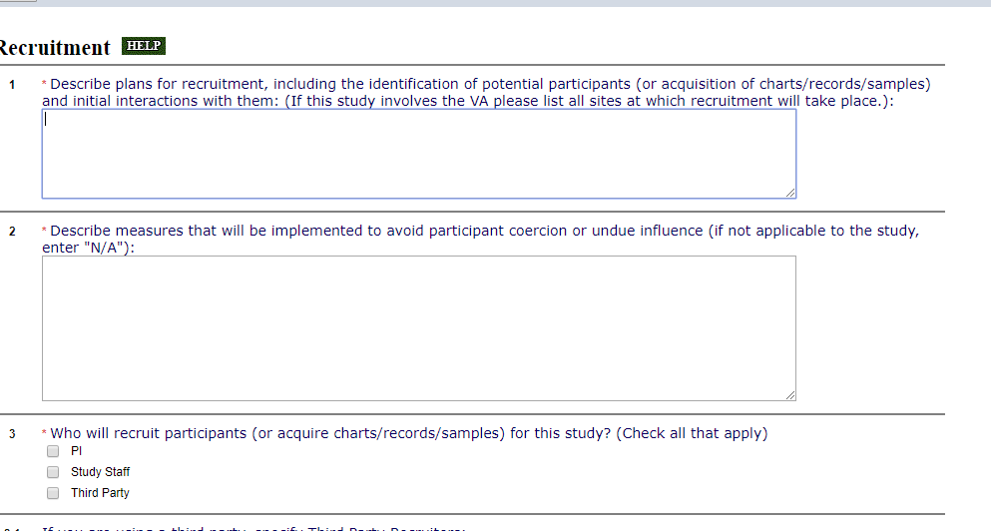
Recruitment Section

Slide 14
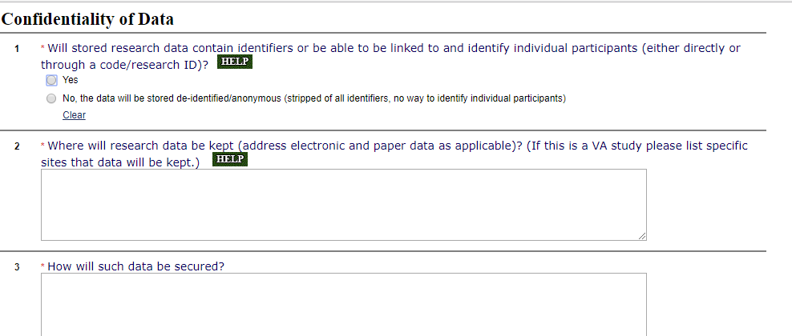
Confidentiality of Data Section
**In box 2 please carefully inventory the precise locations of all paper (room #) and electronic (drive name) data.

Slide 15
After submission in CICERO
Fill out and send the all-important “ISO-PO checklist”
  HRPO will not forward your protocol to full-board review prior to the VA Information Security and Privacy Officers having signed off
Look for my VA Pre-Review Form to appear in History Log
  Will be uploaded as a public comment sometime during HRPO admin. review (usually within 7 business days of submission)
  After getting protocol back from IRB with their requested changes, also address suggested changes on my summary sheet to get yourself in line with VA regs. ahead of IRB approval.

Slide 16
ISO-PO Checklist

Slide 17
ISO-PO Checklist
(cont.)

Slide 18
VA Pre-Review Form

Slide 19
VA Pre-Review Checklist (cont.)

Slide 20
After IRB approval
Immediately contact Tina McGinley in VA Research Service upon receiving IRB approval
  410-605-7000, ext. (5)6568, Tina.McGinley@va.gov

Slide 21
VAMHCS HRPP
Adam M. Robinson, MD
Director, VAMHCS
Caroline Zink, PhD
BREF Director
Terrylisa Johnson
Res. Compliance Officer
Sandra Marshall, MD
Chief of Staff
Julia Kindred
Assistant RCO
VAMHCS Investigators & Staff
Les Katzel MD, PhD
R&D Committee Chair
Thomas Hornyak, MD
ACOS R&D Service
Hai-Yan Jiang, R.Ph.
Pharmacy IDS
Dr. Ortmeyer
Research safety
Dr. Rosenthal
UMB IRB
Carol Fowler, PhD
Deputy ACOS R&D
Carol Roberts
Administrative Officer
Janice Crosby
Privacy Officer
VA Central IRB
Will Camacho
Information Security
Fred Ivey, PhD
HARPO
Tina McGinley
RDC Coordinator
Nic Letexier
Biosafety Officer
Federal-Wide Assurance (FWA)

Slide 22
R&D Committee Approval
  Brief Introductory Points:
  -Project must have approval from all applicable subcommittees before being approved by R&D
  -University of Maryland IRB and IACUC are subcommittees of the VA R&D Committee
  -Must have R&D approval letter prior to any of the following being conducted at the VA
  **New investigators would be best advised to discuss process with Acting VA RDC coordinator
  Contact: Tina.McGinley@va.gov

Slide 23

Subcommittee on Research Safety (SRS)
This VA regulatory entity is lead by Dr. Ortmeyer and assisted by the Research Service Biosafety Officer (Nic Letexier)
The SRS reviews all research projects that (1) are VA funded, (2) take place in VA facilities or VA leased space, and/or (3) involve VAMHCS Veterans and/or samples obtained from Veterans.
Research Protocol Safety Survey (RPSS): facilitates review of risk, level of containment, laboratory procedures, practices, training, and expertise of personnel involved.

Slide 24
SRS contacts
http://www.maryland.va.gov/research/committees/researchsafety.asp
Contact: Heidi.Ortmeyer@va.gov
Nicolas.Letexier@va.gov

Slide 25
Animal Research Protections
UM SOM Institutional Animal Care and Use Committee (IACUC) is the IACUC of record for the BVAMC.
Office of Animal Welfare Assurance (OAWA)
  - All IACUC matters should be directed to this office.
  - Website: http://medschool.umaryland.edu/iacuc/
  - Email: iacuc@som.umaryland.edu
Animal Care and Use Program is PHS assured, USDA registered and AAALAC accredited.
VA Training and protocol requirements
  - CITI Training is now required once every 3 years.
  - VA CVMO will accept UMSOM Animal Use Protocol forms.
  Caveat: All ACORP requirements must be in the IACUC Protocol

Slide 26
Animal Research Protections (cont.)
Draft Animal Use Protocol (AUP)
  - Submit for VA Veterinary Review (nkriel@vetmed.umaryland.edu)
  - Submit for OAWA Administrative Pre-Review
Submit revised AUP for IACUC Review
    Complete CITI Training & Occupational Health Assessment
    Obtain BVAMC SRS Approval
    Obtain any other necessary approvals, e.g., IBC, IRB
Complete IACUC Review and Approval Process
Obtain R&D Approval to initiate work.
Adhere to the IACUC approved protocol at all times.
  - Submit amendments and adverse event notifications.
  - Submit progress reports when prompted.

Slide 27
Before Submitting to VA R&D Committee
R&D Committee
Submission Worksheet

Slide 28
R&D Committee
Submission Worksheet

Slide 29
R&D Committee
Submission Worksheet
(Final Page)

Slide 30
VA appointment is required….
30
To participate in VA Research as:
    a PI, Co-I, Team Member or Other Contributor
Types of Appointments:
  - Without Compensation (WOC)
  - IPA (requires WOC)
  - VA paid (full –Time or Part-time)

Slide 31
Without Compensation (WOC) Appts.
31
WOCs: To initiate, contact: balresearchwoc@va.gov
  - Instructions and packets can be sent to you
  - WOC terms for US citizens may be for up to 3 years
  - Non-citizen WOCs – normally for 1 year, but may be requested for duration of the VISA status (up to 3 years)
WOC Timelines
  - Submit WOC requests ~6 weeks before start of WOC
  - Once submitted, HR schedules fingerprinting
        (**fingerprints may take up to weeks for clearance)
  - WOC letter issued ~2-3 weeks after clearance
  - WOC Renewals should be submitted 3-4 weeks before expiration

Slide 32
WOC Processing
32
PI or POC sends completed and signed WOC paperwork to balresearchwoc@va.gov
These forms are:
1- WOC Appointment Request
2- Intellectual Property Agreement
3- WOC occupational Checklist
4- OF306 – sign in boxes 17a and 17b
5- VHA-10-2850C
6- Research scope of practice form
7- Assignment of Functional Category information
**Include a copy of your CV and a copy of your VISA if not a US Citizen

Slide 33
HR POC will contact WOC Team Member
to schedule Fingerprinting
33
-Once the fingerprinting results are returned to the VA (normally 1-2 weeks), the WOC POC will ask that copies of passport or proof of citizenship be submitted.
-Once the WOC letter is received, the WOC letter is sent to WOC applicant for Signature.
-The WOC may then contact Tom.Bowen@va.gov if a VA ID badge and computer access is needed.
Hard copies of the Signed WOC letter and the WOC paperwork are filed in the R&D Service office

Slide 34
IPAs
34
IPAs are temporary assignments (1-2 years)
  - Reimburses employer (UMB) for VA work
  - Contact: balresearchipa@va.gov
Newest guidance from HR
  - Current WOC letter required for all IPAs
  - WOC must be active for entire length of the proposed IPA.
    - WOC extension requests must be submitted to extend the WOC for the length of the IPA, if needed.

Slide 35
Online Training Requirements
TMS & CITI training
  - Direct Hospital Hires: Enrolled by education office
    Research specific training along with mandated training
  - All others (WOC, etc): contact Coordinator for link to self enrollment
Most trainings are completed yearly and are based on the individual’s role in the system
Once completed, send your certificates to VA Research Service so the database and paper file can be updated
Notes:
CITI every 2 years, other trainings are assigned per the joint commission, etc.

Slide 36
After VA R&D Approval
Proceed with an eye towards VA Regulatory Compliance
  VAMHCS Office of Research Compliance:
    RCO: Terrylisa Johnson, Terrylisa.Johnson@va.gov
    Assistant RCO: Julia Kindred, Julia.Kindred@va.gov
  VHA ORO mandated audit program:
    Triennial Full Audit for all protocols listing VAMHCS as a site
    Annual Consent Audits for all VAMHCS protocols

Slide 37
Annual Informed Consent Audits
ORO Audit Elements
    ICD located
    Correct version of the ICD was used
    Presence of subject signature and date
    Presence of signature of person obtaining consent and date
    Research specific training along with mandated training
    Presence of IRB approval date on ICD
    Presence of research related injury language
    Presence of progress note in CPRS or hard copy note
    Presence of a signed and dated HIPAA authorization form
    Use of VA HIPAA form 10-0493

Slide 38
HRPP Triennial Regulatory Audit
ORO Audit Elements
    Complete record of IRB & RDC submissions, approvals & notifications (initial, modifications, continuing reviews)
    Complete record (history) of protocol approvals
    Complete record (history) of informed consent approvals
    Complete record (history) of HIPAA authorizations
    Complete record of Reports of New Information (RNIs)
    Any local unanticipated SAEs; unanticipated problems involving risk to subjects or others; significant safety reports/ data monitoring committee reports. (compliance with reporting procedures; timeliness of IRB review/ determination)

Slide 39
HRPP Triennial Regulatory Audit (cont.)
ORO Audit Elements (cont.)
    Subject Record Review (Minimum 10 or 10% of total enrollment) ORO requirement
    Check to see if consent obtained prior to initiation of study procedures
    Study Staff Qualifications and Training
      Current CITI Human Subject Protections Training
      Presence of Research Scope of Practice
      Current VA appointment (staff, WOC, IPA)
    Other VA Requirements
      Conflict of Interest Statement
      Compliance with Information Security and Privacy requirements

Slide 40
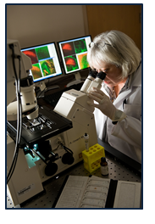
Size & Scope of VAMHCS Research
Annual VA Funding- $24.1 M
(RR&D, HSR&D, CSR&D, BLR&D)
Number of Active VA Projects- 291
Number of VA-associated Principal
Investigators- 126
Currently funded VA Centers:
Geriatric Research, Education & Clinical
Center (GRECC)
Mental Illness Research, Education & Clinical
Center (MIRECC)
Multiple Sclerosis Center of Excellence
Epilepsy Center of Excellence

Slide 41
Growing The VAMHCS Research Program
Funding VA-based projects through:
- VA Merit Program- RR&D, HSR&D, CSR&D, BLR&D
- VA SPiRE Program (Pilots)- RR&D
- VA Career Development Award (CDA) Programs
- NIH
- DoD
- Commercial/ Industry Grants (administered through BREF)
VA Research Center Funding Opportunities
Notes:
Explain OSRI

Slide 42
VA MERIT AWARD Submissions
42
Investigator-Initiated Merit Awards (main funding mechanism)
Career Development Awards (Mentored training)
Submission Cycles:
Spring and Fall – Biomedical Laboratory R&D (Basic Science); Clinical Science R&D; SPiRE (Pilots/RR&D)
Summer and Winter – Health Services R&D; Rehabilitation R&D
Four Workshops/ year specific to the RFAs and services
Requirements for submission constantly change
Contacts: Carol.Fowler@va.gov and Natalie.Dugger@va.gov

Slide 43
Baltimore Research and Education
Foundation (BREF)
43
BREF staff will assist you in initiating and managing your non-VA funded grant:
  - Work with sponsor to complete study agreement (CRADA)
  - Assist in development of study budget
  - Hire employees, as needed
  - Manage budget, order equipment and supplies
  Contact: Caroline Zink, Director Caroline.Zink@va.gov

Slide 44
VAMHCS Research Locations
44
Research Service Locations:
-Baltimore VA Medical Center (VAMC)
-Baltimore VA Annex
-VA Loch Raven CBOC
VAMHCS research also often simultaneously takes place at VAMHCS collaborating institutions (UMB, UM College Park, JHU, etc.), constituting what’s now known as our currently evolving “Collaborative Studies Program”.

Slide 45
Thank You!
Link for VA forms:
http://www.maryland.va.gov/research/human/human_subject_forms.asp

