Slide 1
Postdoctoral Fellow Orientation
Updated 7.7.2023
***To open hyperlinks, hover over, right click and select “Open Link.”***

Slide 2
Table of Contents
About the Dean
Welcome from the Dean
About the Co-Directors of Postdoctoral Training Program
UMB Mission and Vision
UMB Core Values
University System of Maryland Vaccine Mandate
Onboarding and Set-Up
Important UMSON Postdoc Documents
Training Certifications
CICERO User Accounts
REDCap
Conflict of Interest Training (COI) and Significant Financial Disclosure (SFI)
Responsible Conduct in Research (RCR) Training
Animal Research Training
UMSON Organized Research Centers (ORC)
Monthly Research Seminar Series
Research Compliance and Education Resources
Pre-Clinical Research Support
ORS Researcher Toolkit
Pre-Award Process
Post-Award Resources
Writing Support
Statistical Support
UMSON Research Information on the UMSON Intranet
Important UMSON Research Policies and Procedures
Diversity and Inclusion
Helpful Information for Parents
SMC Campus Center
Tools
Campus Resources
Social Media
UMB Campus Map

Slide 3
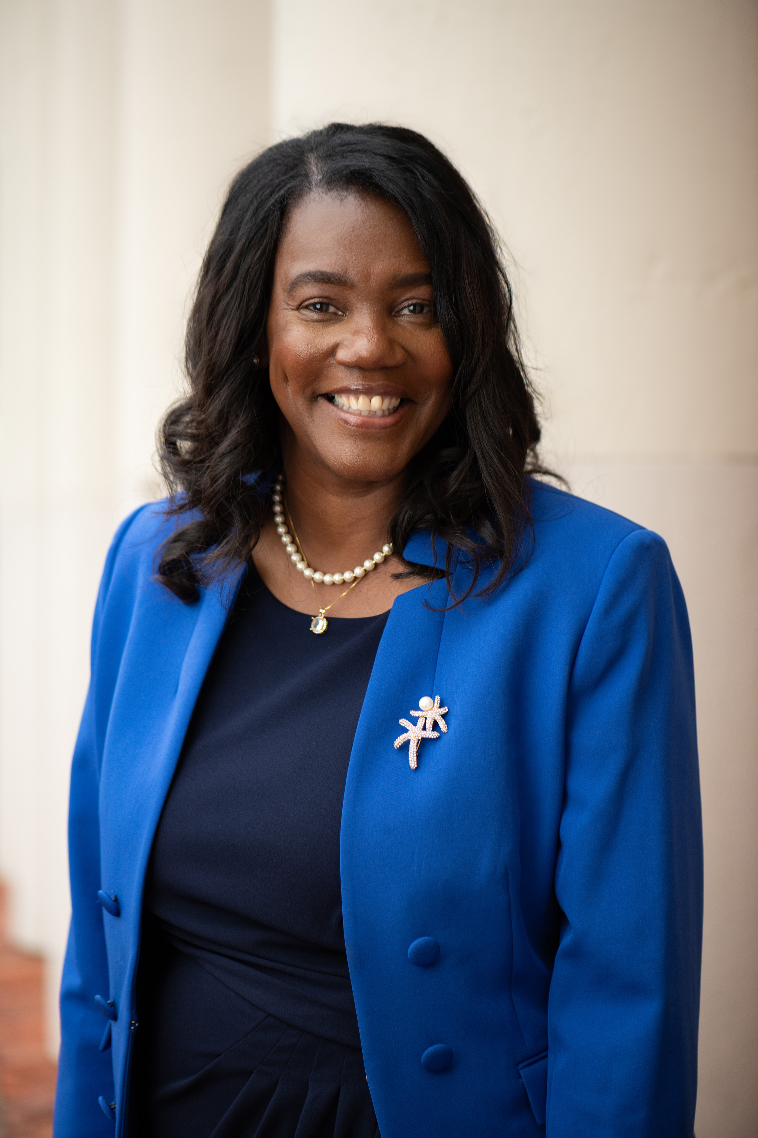
About the Dean
University of Maryland, Baltimore (UMB) President Bruce R. Jarrell, MD, FACS, has announced the appointment of Yolanda Ogbolu, PhD ’11, MS ’05, BSN ’04, CRNP-Neonatal, FNAP, FAAN, as the next Bill and Joanne Conway Dean of the University of Maryland School of Nursing (UMSON).
An experienced researcher at international and national levels, educator, clinician, and public servant, Ogbolu is an associate professor (tenured) and has served as chair of UMSON’s Department of Partnerships, Professional Education, and Practice and co-director of its Center for Health Equity and Outcomes Research.
Ogbolu’s work in community health embodies the University’s mission of improving the human condition, Jarrell said.
“Through her research and scholarship focus on health equity, improving the social determinants of health, dissemination and implementation of health equity research and policy into clinical practice, and improving the lives of vulnerable newborns and their families. Dr. Ogbolu is the perfect choice to lead the School of Nursing into its next chapter,” Jarrell said.
Ogbolu was chosen for the Bill and Joanne Conway Dean position from a talented pool of candidates after a national search. The committee was chaired by Mark A. Reynolds, DDS ’86, PhD ’99, MA, dean of the University of Maryland School of Dentistry, and Lisa Rowen, DNSc, RN, CENP, FAAN, chief nurse executive for the University of Maryland Medical System and professor and alumna of UMSON.

Slide 4
Welcome from the Dean

Slide 5
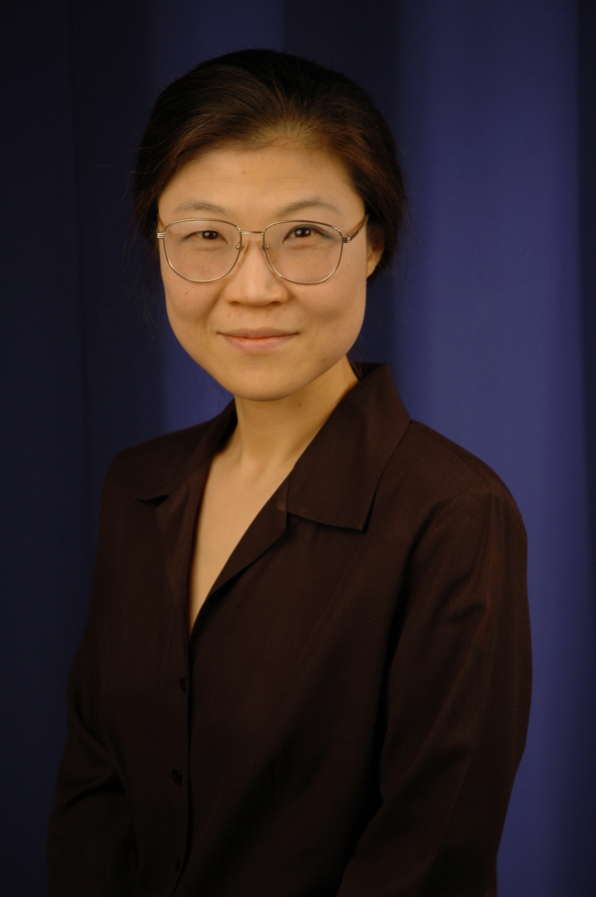
About the Co-Directors of Postdoctoral Training Program (Page 1)
Eun-Shim Nahm, PhD, RN, FAAN, FGSA, is the Co-Director of the Postdoctoral Fellowship Training Program as well as Professor, Department of Organizational Systems and Adult Health, Associate Dean for the PhD Program and Director of the Master of Science in Nursing, Nursing Informatics Program at the University of Maryland School of Nursing. She joined the faculty of the School of Nursing in 2003 and served as the Director of the Nursing Informatics Program since 2010, which ranked number one in the nation throughout the period that US News & World Report provided rankings for the specialty. She received her PhD from UMSON focusing on gero-informatics, in 2003, having previously earned a Master of Science, Clinical Nurse Specialist Certificate in Adult Health Nursing from the University of Hawaii. She received her Bachelor of Nursing Science summa cum laude, from the EWHA Woman’s University in Seoul, Korea in 1989. She was elected a Fellow of the American Academy of Nursing in 2009 and a Fellow of the Gerontological Association of America in 2016.

Slide 6
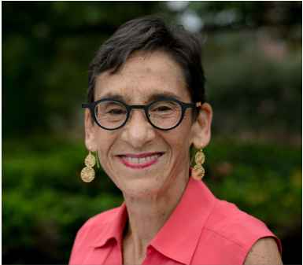
About the Co-Directors of Postdoctoral Training Program (Page 2)
Barbara Resnick, PhD, RN, CRNP, FAAN, FAANP is the Co-Director of the Postdoctoral Fellowship Training Program as well as distinguished University Professor and the Sonya Ziporkin Gershowitz Endowed Chair in Gerontology. Dr. Resnick has had a long and distinguished career. She joined the faculty in 1993 and developed and directed UMSON’s masters-level Geriatric Nurse Practitioner Program and its successor doctoral-level Adult/Gerontological Nurse Practitioner Program up until 2019. She continues to teach and mentor students and has maintained a practice as a certified gerontological nurse practitioner. Dr. Resnick is nationally and internationally recognized for her research and scholarship. Her research has focused on the care of older adults with regard to optimizing health, function, and physical activity; exploring the impact of resilience and genetics on function and physical activity; and testing dissemination and implementation of interventions in real world settings, including nursing homes and assisted living facilities.

Slide 7
UMB Mission and Vision
Mission: To improve the human condition and serve the public good of Maryland and society at-large through education, research, clinical care, and service.
Vision: The University will excel as a pre-eminent institution in its missions to educate professionals, conduct research that addresses real-world issues affecting the human condition, provide excellent clinical care and practice, and serve the public with dedication to improve health, justice, and the public good. The University will become a dominant economic leader of the region through innovation, entrepreneurship, philanthropy, and interdisciplinary and interprofessional teamwork. The University will extend its reach with hallmark local and global initiatives that positively transform lives and our economy. The University will be a beacon to the world as an environment for learning and discovery that is rich in diversity and inclusion. The University’s pillars of professionalism are civility, accountability, transparency, and efficiency. The University will be a vibrant community where students, faculty, staff, visitors, and neighbors are engaged intellectually, culturally, and socially.
The UMB’s Mission, Vision, and Fast Facts can be found here.
Notes:
UMB Mission, Vision, and Fast Facts
https://www.umaryland.edu/about-umb/umb-fast-facts/

Slide 8
UMB Core Values
The University of Maryland, Baltimore’s (UMB) core values are at the heart of our mission to improve the human condition and serve the public good of Maryland and society at-large through education, research, clinical care, and service. These core values guide our academic programs, operating philosophy, and commitment to our constituents, while supporting our dedication to global enhancement and social progress.
Respect and Integrity We value each other and hold ourselves accountable for acting ethically and transparently using compassion and empathy.
Well-Being and Sustainability We care about the welfare of our people, planet, communities, and University.
Equity and Justice We embrace and are committed to diversity, and we value inclusive and just communities. We oppose racism and oppression in all its forms.
Innovation and Discovery We imagine and explore new and improved ways to accomplish our mission of education, research, clinical care, and service.
Notes:
UMB Core Values
https://www.umaryland.edu/president/core-values/

Slide 9
University System of Maryland Vaccine Mandate
All eligible faculty, students, postdoctoral fellows, and staff are required to be vaccinated against COVID-19.
Use the UMB COVID-19 Management Portal to upload your information directly or to approve the Chesapeake Regional Information System for Our Patients (CRISP) COVID-19 health information sharing. For COVID-19 vaccine exemption for medical and religious reasons can be requested by filling out an exemption form available on the UMB COVID-19 Management Portal. For detailed information, see link provided on notes below.
The UMB COVID-19 Guide and latest vaccination protocols can be found here.
Notes:
UMSON Employee COVID-19 Vaccination Requirements:
https://www.nursing.umaryland.edu/covid19/employee-reqs/
UMB COVID-19 Management Portal:
https://webauth.umaryland.edu/idp/profile/SAML2/Redirect/SSO?execution=e2s1
UMB COVID-19 Vaccination Protocols:
https://www.umaryland.edu/coronavirus/content/testing-hygiene-and-health/umb-vaccination-mandate.php

Slide 10
Onboarding and Set-Up (Page 1)
The following list will be provided for and/or requested by your dept.:
Computer Set-up
Keys
Lab Purchases
Office Supplies
Phone Set-up
Room Requests
Timesheet
Travel Requests

Slide 11
Onboarding and Set-Up (Page 2)
The following list can be accessed/requested for using the UMB webpages:
Benefits
Center for Information Technology Services (CITS)
Holiday Schedule (Check with your dept. as it varies per dept.)
Learning Hub
One Card ID (UMB ID)
Parking and Transportation
Payroll
Police and Public Safety
UMB Alerts
UMID Account
Notes:
Benefits
https://www.umaryland.edu/hrs/benefits/
Center for Information Technology Services
https://www.umaryland.edu/cits/
Learning Hub
https://umb.sumtotal.host
One Card
https://www.umaryland.edu/onecard/one-card-uses/
Parking and Transportation
https://www.umaryland.edu/parking/about-us/
Payroll
https://www.umaryland.edu/financialservices/payroll/about-the-office/
Police and Public Safety
https://www.umaryland.edu/publicsafety/
UMB Alerts
https://www.umaryland.edu/alerts/access-umb-alerts/
UMID Account
https://www.umaryland.edu/helpdesk/umb-account/creating-a-umid-and-password/

Slide 12
Important UMSON Postdoc Documents
All Postdocs:
Postdoctoral Fellow Policy
UMSON Trainee Individual Development Plan (IDP) (This will be emailed and is to be submitted every year to the Research Grants and Contracts Coordinator)
T32 Postdocs:
NIH PHS6031 Payback Agreement Form (if applicable and to be submitted to the Research Grants and Contracts Coordinator, no later than 1 week after receiving this document)
*Note: All the above documents listed will be sent through email as applicable.

Slide 13
Training Certifications
Prior to being added to any study, postdoctoral fellow must complete the following trainings:
1. HIPAA 125 & 201 (only required once)
CITI (required every 3 years)
GCP (required every 3 years)
EHS (required on an annual basis)
Title IX Training
For Organizational Systems and Adult Health - PA staff, Title IX training through Penn State
See link to required trainings - HIPAA 125 & 201, CITI, and GCP.
*Email the HIPAA 125 & 201, CITI, and GCP PDF certificates to both your dept. and the Office of Research and Scholarship at nrsresearch@umaryland.edu.
Notes:
Training Certifications List for HIPAA, CITI, GCP
http://www.umaryland.edu/hrp/for-researchers/required-training/
EHS Training
https://www.umaryland.edu/ehs/training/what-training-is-required/
Title IX Training
https://webauth.umaryland.edu/idp/profile/SAML2/POST/SSO?execution=e1s1

Slide 14
CICERO User Accounts
Below is a general flow of instructions but be sure to check with your dept. as the process may vary per each dept. In addition, check with your dept. to see when you’ll need the CICERO account.
Apply for CICERO account.
Applicant will receive an email confirming account set up.
3. Email your project manager/administrator or your supervisor to alert CICERO account has been set-up.
4. Your project manager/administrator or your supervisor will upload team member documents and add team member to the IRB. Final approval and submission is completed by the PI.
Your project manager/administrator or your supervisor will send a confirmation email after receiving team member approval from the IRB.
CICERO instructional videos can be found here.
For any questions, please contact your supervisor or your administrator. The Human Research Protections Office may also be contacted at hrpo@umaryland.edu.
Notes:
CICERO Instructional Videos
https://www.umaryland.edu/hrp/for-researchers/instructional-videos/cicero-instructional-videos/

Slide 15
REDCap
REDCap is the web-based data capture system used to house source documentation for the EIT-4 data study. All study team members will have active accounts. A UMID is required prior to requesting a REDCap account. Once a UMID account is established, and you have been added to the protocol, document with instructions on the REDCap information page to request a user account will be provided.
The UMB’s REDCap website provides instructions on how to create a REDCap account list of video tutorials, and instructions on how sign up for on-campus training. In addition, check with your dept. to see if/when access is needed.
Notes:
REDCap
http://www.umaryland.edu/ictr/investigator-resources/data-and-data-handling/data-management-/redcap/

Slide 16
Conflict of Interest Training (COI) and Significant Financial Disclosure (SFI)
All UMB employees participating in the design, conduct or reporting of research funded by Public Health Service (PHS) agencies (includes NIH, CDC, SAMHSA, FDA, AHRQ, HRSA, ATSDR, IHS) will complete their online PHS Conflict of Interest Training through the CITI program website. Access to the CITI COI module is outlined below for UMB employees with and without current CITI accounts. Non-UMB employees, which includes sub-award recipients, consultants, or other collaborators without a UMB account, will continue to take the training through the NIH website. Staff are required to take this training every 4 years.
The disclosure of SFI is required at or before the time of submission of an application for PHS-funded research. This must be done at least annually during the period of the PHS-funded research award, no later than 60 days prior to the beginning of each fiscal year of such award. In addition, SFI must be disclosed within 30 days of discovering or acquiring a new SFI (i.e., by purchase, inheritance, etc.)
For any questions or to submit the annual SFI and PHS disclosures, please send them to disclosure@umaryland.edu or to the Research Integrity Specialist, Erin Burch, MS, at erin.burch@umaryland.edu.

Slide 17
Responsible Conduct in Research (RCR) Training
The RCR Training is hosted by the Office of Accountability and Compliance and the Office of Postdoctoral Scholars. Sessions are held once a month and cover a variety of topics in research ethics. Emails are distributed for registration. Below are a few examples of the sessions previously held:
Tales from the Crypt of Research Misconduct- Stephan Vigues, Research Integrity Officer
Use of Human Subjects, Erin Hager, Department of Pediatrics
Publication and Authorship, Patrik Bavoil, Department of Microbial Pathogenesis
Data Acquisition and Maintenance, C.S. Raman, Department of Pharmaceutical Sciences
Use of Animal Subjects, Institutional Animal Care and Use Committee
Panel on How to Make Peer Review Better- Adam Puche, Susan Dorsey, Brad Alger
Conflict of Interest, Erin Burch, Office of Accountability & Compliance
And more!
Ongoing RCR training also occurs through face-to-face meetings with postdocs mentor/s. In addition, each trainee participates in individually tailored training and courses as outlined in each grant submission. CITI RCR training also is encouraged. Further information related to RCR requirements can be found in the Accountability and Compliance website. Information on research misconduct can be found here.
The above RCR training held fulfills requirements, however, for a more in-depth course, the School of Nursing also offers CIPP 909-Responsible Conduct of Research course through the School of Medicine.
Notes:
Accountability and Compliance:
https://www.umaryland.edu/oac/areas-of-responsibility/research-integrity-office/research-integrity---rcr/rcr-training/
CIPP 909 Responsible Conduct of Research:
https://www.medschool.umaryland.edu/career/Resources-for-Research-Faculty/Research-Ethics-Courses/
Research Misconduct:
https://www.umaryland.edu/oac/oac-programs/research-integrity-office/research-misconduct/

Slide 18
Animal Research Training
ALL UMB personnel working with animals in research, teaching or other activities must be trained. Training courses include the Institutional Animal Care & Use Committee (IACUC) Training – CITI Laboratory Animal Welfare, Laboratory Animal Exposure Risk Assessment Program (LAERAP), among others. To learn more about the requirement needed, to view the Collaborative Institutional Training Initiative (CITI) curriculum, as well as to view the policies and procedures surrounding animal welfare, visit the Office of Animal Welfare Assurance (OAWA) website.
Notes:
Office of Animal Welfare Assurance (OAWA) Education & Training:
https://www.medschool.umaryland.edu/iacuc/Education--Training/

Slide 19
UMSON Organized Research Centers (ORC)
Biology and Behavior Across the Lifespan (BBAL) Organized Research Center
BBAL, directed by Eun-Shim Nahm, PhD, RN, FAAN, and Kelly Doran, PhD, RN, promotes interdisciplinary research related to the influence of biology and behavior on health and health outcomes across the lifespan, providing a core for pooling resources and sharing data across a wide variety of projects.
To be included in the BBAL listserv, contact Kelly Doran, PhD, RN at kdoran@umaryland.edu and Jennifer Klinedinst, PhD, MPH, RN, FAHA at klinedinst@umaryland.edu.
Mission: The Center for Biology and Behavior Across the Lifespan (BBAL) promotes the conduct of interdisciplinary research related to the influence of biology and behavior on health and health outcomes across the lifespan.
Vision: Our vision is to serve as a center for shared thinking — within the School of Nursing and across the University of Maryland, Baltimore — aimed at the development of pioneering research ideas and interventions to promote and sustain health in all people, from infancy to old age.
Notes:
Biology and Behavior Across the Lifespan (BBAL) Organized Research Center
https://www.nursing.umaryland.edu/research/research-centers/bbal/

Slide 20
UMSON Organized Research Centers (ORC) (Cont.’d)
Center for Health Equity and Outcomes Research (CHEOR)
CHEOR, lead by Michael Lepore, PhD provides various activities to support its UMSON researchers through collaboration and service to support the mission to improve health outcomes and eliminate health inequities.
Mission: Our mission is to improve health outcomes and eliminate health inequities. We aim to generate knowledge about the complex causal influences that affect health and inequities in outcomes, Identify, intervene, and dismantle social and institutional systems and structures that impede health equity and outcomes, including addressing racism and social determinants of health, and create social impact through changes in policy, clinical, and community practice.
Vision: Our vision is to be a thriving research center for interprofessional scientists to collaborate and act to address complex health outcomes and health inequities through contextually rich
To be included in the CHEOR listserv, contact Michael Lepore, PhD, at mlepore@umaryland.edu.
Notes:
Center for Health Equity and Outcomes Research (CHEOR)
https://www.nursing.umaryland.edu/research/research-centers/cheor/

Slide 21
UMSON Organized Research Centers (ORC) (Cont.’d)

Slide 22
UMSON Organized Research Centers (ORC) (Cont.’d)

Slide 23
UMSON Organized Research Centers (ORC) (Cont.’d)
University of Maryland Center to Advance Chronic Pain Research (CACPR)
CACPR, led by Susan G. Dorsey, PhD, RN, FAAN, and Man-Kyo Chung, DMD, PhD is a multidisciplinary center comprising nationally and internationally renowned clinical and preclinical translational scientists whose principal research focus is on the physiological, genetic, and psychosocial underpinnings of the development and persistence of debilitating chronic pain conditions.
Application form to request membership can be found on the CACPR Membership website.
Mission: The mission of the CACPR is to cultivate and expand the cutting-edge multidisciplinary pain research portfolio at the University of Maryland, Baltimore with the overarching goal of improved patient care and quality of life.
Notes:
Center to Advance Chronic Pain Research (CACPR) website:
https://www.umaryland.edu/cacpr/about-cacpr/
CACPR Membership application:
https://www.umaryland.edu/cacpr/membership/apply/

Slide 24
Monthly Research Seminar Series
The Office of Research and Scholarship holds a monthly research seminar with topics related to research quality and compliance. Certificate of Attendance (COA) is also available for those who attended the entire seminar. List of previous and upcoming research seminars as well as a link to request a COA can be found on the Monthly Research Seminars website.
For any questions, please contact the Research Quality Improvement Manager, Casey Jackson, MS, CCRP at casey.jackson@umaryland.edu.
Notes:
Monthly Research Seminars
https://www.nursing.umaryland.edu/research/seminar-series/

Slide 25
Research Compliance and Education Resources
Individual Consultations
The Research Quality Improvement Manager, Casey Jackson, MS, CCRP, offers one-on-one sessions to assist with human subject research regulatory and compliance issues and can be reached at casey.jackson@umaryland.edu.
Quality Assurance Reviews
The Office of Research and Scholarship’s Research Quality Manager conducts the required QA reviews for students, staff, and faculty engaged in all human subject research.
See the Human Subjects Research Compliance and Education webpage or contact Casey Jackson, MS, CCRP at casey.jackson@umaryland.edu.
Notes:
CICERO
https://www.umaryland.edu/hrp/past-announcements/cicero-login.php
Human Subjects Research Compliance and Education
https://www.nursing.umaryland.edu/research/resources/regulatory-affairs/
Monthly Research Seminars
https://www.nursing.umaryland.edu/research/seminar-series/

Slide 26
Pre-Clinical Research Support
Research Involving Animal Subjects
The Office of Research and Scholarship is committed to supporting research initiatives from postdoctoral trainees through their faculty mentor, as well as aiding with pre-award training and protocols, quality improvement, and general oversight. Information on research involving animal subjects, training requirements, and associated standard operating procedures (SOP) can be found in the Pre-Clinical Research Compliance and Education webpage.
Notes:
Pre-Clinical Research Compliance and Education
https://www.nursing.umaryland.edu/research/resources/pre-clinical-research-compliance-and-education/

Slide 27
ORS Researcher Toolkit
To assist researchers with best practices for their human subjects-related research and facilitate their regulatory compliance efforts, the Office of Research and Scholarship (ORS) developed a Researcher Toolkit. The toolkit contains sections on:
Guidance and Training: links to School of Nursing (SON), University of Maryland Baltimore (UMB), and federal human subjects-related research regulations, guidance's, policies, presentations, and instructions
Regulatory Binders and Subject Binders: checklists and optional template documents reference matched to applicable regulations and guidance documents
Quality Assurance: checklists to assist researchers when self-monitoring their studies
Miscellaneous Information
Notes:
Researcher Toolkit
https://www.nursing.umaryland.edu/research/resources/regulatory-affairs/researcher-toolkit/

Slide 28
Pre-Award Process
Everyone applying for funding opportunities are required to complete the pre-award form to obtain approval from their department chair and the Associate Dean of Research. The Office of Administrative Services (OAS) requests that the Pre-Award form be submitted 6 weeks before due date. The following services are also available to postdoctoral trainees through their faculty mentors:
Mock reviews
The Office of Research and Scholarship coordinates mock grant reviews to provide investigators with written feedback. For more information, contact Ayamba Ayuk-Brown, business operations manager, at ayamba.ayuk@umaryland.edu.
Budget and Submission Support
The Office of Administrative Services (OAS) and Office of Research and Scholarship (ORS) offer assistance with preparing budgets as well as developing subcontracts. Administrative assistance is available for maintaining and updating personal biosketches. Support is also offered during the final stage of submission by preparing and organizing final grant documents. For more information, visit the Pre-Award webpage or contact Steven Pease, assistant dean of research and finance administration, at spease@umaryland.edu.
Notes:
Pre-Award Information
https://www.nursing.umaryland.edu/research/resources/preaward/funding-proposal/

Slide 29
Post-Award Resources
Get access to important forms, policies, procedures, among other helpful information for managing post-award grants such as forms, policies, procedures, among others. It includes the following:
Forms, Policies, Procedures, and Others:
Campus & Contractor Purchasing Guide:
Meal/Food Approval Form (for UMSON Use Only)
Please allow up to two business days for a response
Policy on Allowable Food Purchases
Procurement Services Purchasing Guide
Purchasing guide/process for computers, food, other materials (includes: Allowable/not allowable purchases)
Travel Guidelines
Form, information, pocket guide, among others can be found under “Travel” in the UMSON intranet link here. However, please meet with your dept. manager directly as process may vary per each dept.
Notes:
Post-Award Resources
https://www.nursing.umaryland.edu/research/resources/postaward/

Slide 30
Post-Award Resources (Cont’d)
Hiring and Recruitment:
Request to Fill Position Form for Hiring processes for Contractual Employees
Policy on Hiring C1/C2 Positions
Contingent Category 1 (C1):
contracts are renewed in 6 month increments
employee does not get a leave package
employee is only able to work a maximum of 19 hours weekly if the position is needed for 1 year or more
employee can be appointed to a position (without a recruitment).
employee is considered temporary & can be terminated without notice
Contingent Category 2 (C2):
contracts can be renewed in 1 year increments
employees gets 3 days of personal leave yearly & pro-rated annual/sick leave based upon the amount hours he or she works.
employee can work between 20-40 hours weekly
C2s can be exempt or non exempt depending on the position
supervisor must go through the recruitment/interview/selection process.
a 14 day notice is required to terminate
Both C1 & C2 employees are health benefit eligible through the state subsidy program if the individual works 30 or more hours weekly.
Notes:
Post-Award Resources
https://www.nursing.umaryland.edu/research/resources/postaward/

Slide 31
Post-Award Resources (Cont’d)
Hiring and Recruitment:
Policy on Graduate Research Assistantships
Policy on the Recruitment and Selection
Note that all positions except C1 positions, must go through active recruitment and be posted for a minimum of 5 days. There must be at least 3 candidates for each position (provided 3 people have applied). For any position regardless of the categorization, a request to fill form must be completed, and returned to Human Resources, Kristie Nichols, for appropriate approvals , at kristie.nichols@umaryland.edu
For any further questions and for the most up-to-date policy on hiring and recruitment, please contact Kristie Nichols, at kristie.nichols@umaryland.edu.
Notes:
Post-Award Resources
https://www.nursing.umaryland.edu/research/resources/postaward/

Slide 32
Post-Award Resources (Cont’d)
Investigator’s Guide to Grant Management:
Overview of Application Process (umaryland.edu)
Post-Award Tips:
BBAL Post-Award Tips
Research/Faculty Incentive Plan:
Research/Faculty Incentive Plan
Study Participant Payments:
Policy and Procedures on Research Study Participant Payments
Study Participant Payments Gift Card Request Form Instructions
Study Participant Payments Gift Card Request Form
Study Participant Payments Working Fund Request Form Instructions - Request Working Fund checks issued from UMB Financial Services
Notes:
Post-Award Resources
https://www.nursing.umaryland.edu/research/resources/postaward/

Slide 33
Writing Support
Editing Services
The Office of Research and Scholarship (ORS) is available to help you through your mentor with editing support for publications and grants. For more information, please reach out to DL-nrsresearch@umaryland.edu.
Health Sciences and Human Services Library (HS/HSL)
The Writing Center and HS/HSL have teamed up and writing consultants are available to for walk-ins, every Wednesday, from 6:00pm-8:00pm in room 128. More info can be found on the HS/HSL Writing Center website.
Scientific Writing Seminar Series
The purpose of the scientific writing seminar series is to help faculty, fellows, and postdocs write clear, well-organized scientific papers. The series consists of ten (10), 1-hour stand-alone sessions, each of which focuses on an important aspect of scientific writing. For the most up-to-date schedule, please see link here. For any questions, contact Marey Shriver, PhD, director, at mshriver@som.umaryland.edu.
Writing Center
The Writing Center offers face-to-face and online consultations, workshops, and writing resources. To see the most up-to-date business hours as well as to schedule an appointment for consultation, please see link here.
Notes:
HS/HSL Writing Center
https://www2.hshsl.umaryland.edu/hslupdates/?p=3610
Scientific Writing Seminar Series
https://www.medschool.umaryland.edu/CARTI/Writing--Communication-Instruction/
Writing Center
https://www.umaryland.edu/writing/

Slide 34
Statistical Support
Staff/Faculty Biostatisticians
UMSON Statisticians will support UMSON postdoctoral trainees through their faculty mentor in the pre-award by working alongside them to produce proposals and post-award by assisting with data analyses and interpretation. If possible, statistical support should be requested through the ICTR. For more information, visit the Biostatistical Services webpage or for any questions, please contact Shijun Zhu, associate professor/biostatistician, at shijun.zhu@umaryland.edu.
Notes:
Biostatistical Services
https://www.nursing.umaryland.edu/research/resources/other-biostats/
ICTR Biostatistics Core Services
https://www.umaryland.edu/ictr/investigator-resources/ictr-biostatistics-core-services/

Slide 35
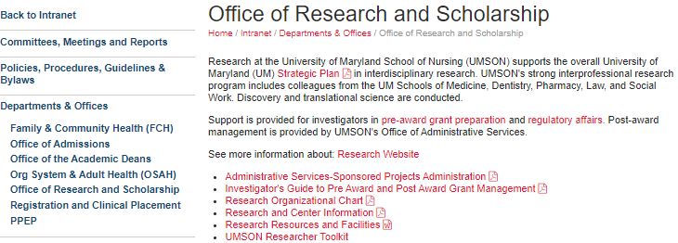
UMSON Research Information on the UMSON Intranet
See UMSON Research intranet. Please note that you will need your username, password, and a 2-step verification to log-in. Then, you will be able to view the latest information on the following topics:
Pre-Award Grant Preparation
Regulatory Affairs
Administrative Services-Sponsored Projects Administration
Investigator’s Guide to Pre and Post Award Grant Management
Research Resources and Facilities
UMSON Researcher Toolkit
And More!
Notes:
UMSON Intranet
https://www.nursing.umaryland.edu/intranet/departments-offices/office-of-research-and-scholarship/

Slide 36
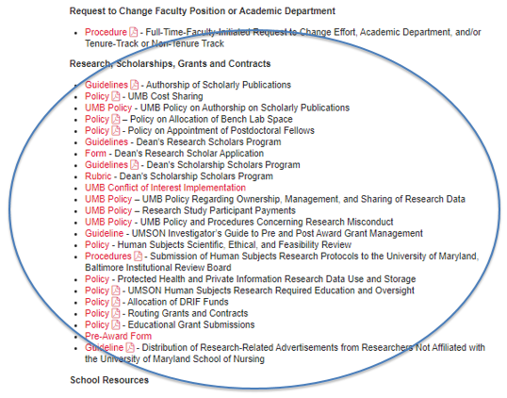
Important UMSON Research Policies and Procedures
The UMSON Research Policies and Procedures in the intranet can be found under “Research, Scholarships, Grants and Contracts” (see screenshot below):
Notes:
UMSON Research Policies and Procedures Intranet
https://www.nursing.umaryland.edu/intranet/policies-procedures-guidelines--bylaws/

Slide 37
Diversity and Inclusion (Page 1)
Welcome. We are so glad you are here. You are welcome and belong. You are integral to the School’s success. We value the unique parts of who you are and commit to providing you with the support and encouragement you need to thrive.
Who We Are
We are a vibrant community of diverse students, faculty, and staff dedicated to learning and growing together professionally and personally.
What We Believe
Diversity is a source of strength and innovation.
Every student is valuable and important.
We must prepare you to provide culturally competent care and help end health inequity.
Our nursing workforce must reflect the rich diversity of the United States.
We oppose racism and all forms of oppression.
We are truly better together.
Notes:
Diversity and Inclusion webpage
https://www.nursing.umaryland.edu/about/diversity/

Slide 38
Diversity and Inclusion (Page 2)
What We Do
Work to build a positive, equitable, and inclusive School culture
Ensure equitable student access, engagement, retention, and progression
Provide individual and departmental support and assistance with relationship and community building
Support our diverse student organizations
Utilize Restorative Justice to build community
Offer professional development programs and initiatives
Design spaces for integrative and innovative thinking
Be a resource for diversity, equity, and inclusion topics
Advocate for fairness in policies and practices at all levels
Be an ally in minimizing micro-injustices and pursuing organizational trust
What You Can Do
Be a champion of inclusion.
Read our Anti-Oppression Statement.
Join the Diversity, Equity, and Inclusion Council.
Check out our Diversity and Inclusion webpage.
We want to hear from you. Please send ideas to nrstogether@umaryland.edu.
Notes:
Anti-Oppression Statement
https://www.nursing.umaryland.edu/about/diversity/unison/
Diversity, Equity, and Inclusion Council
https://www.nursing.umaryland.edu/about/diversity/programs-initiatives/
Diversity and Inclusion Contact Information
Jeffrey R. Ash, EdD Associate Dean for Diversity and Inclusion and Assistant Professor jash@umaryland.edu
Nicole Palmore Director, Diversity and Inclusion, Multicultural Leadership and Learning
nicole.palmore@umaryland.edu

Slide 39
Diversity and Inclusion (Page 3)
For more information, please see below for links to Diversity and Inclusion:
Anti-Oppression Statement
Programs and Initiatives
Diversity and Inclusion Contact Information
Yvette Conyers, DNP, RN, FNP-C, CTN-B, CFCN, CFCS Associate Dean for Diversity and Inclusion yconyers@umaryland.edu
Laurelyn Irving, PhD‌ Program Director, Diversity and Inclusion and Multicultural Affairs lirving@umaryland.edu
Notes:
Anti-Oppression Statement
https://www.nursing.umaryland.edu/about/diversity/unison/
Programs and Initiatives
https://www.nursing.umaryland.edu/about/diversity/programs-initiatives/

Slide 40
Helpful Information for Parents
Childcare - Locate childcare online or receive a free personalized assistance to help identify child care options based on specific needs.
Lactation Center – The LC is located in the SMC Campus Center in rm. 335 and is available on a first-come, first-served basis. It is equipped with hospital-grade Medela pump.
Lactation Center Resources – The Lactation Center Resources offers a wide range of information and data.
List of Lactation Rooms – See website for a list of lactation rooms throughout the UMB campus and for room availability.
UMB Guidelines for Breastfeeding Individuals – See UMB Guidelines for requesting access, cleaning and sanitization, and privacy.
UMB Pilot Child Care Grant – This grant is available on an annual basis to assist working parents at UMB to relieve some burden of childcare cost. This is offered on a first-come, first-served basis. For questions, contact childcaregrant@umaryland.edu.
UMSON Lactation Room Request – The UMSON lactation room is located in W202A. Requests can be made through filling out the online registration form and confirmation is sent between 24-48 business hours. For any questions, please contact Megan Meadow, Senior Specialist, Facilities Maintenance & Operations, at megan.meadow@umaryland.edu.
Notes:
Childcare
https://umb-eap.org/childcare/
Lactation Center
https://www.umaryland.edu/campuscenter/building-resources/lactation-center/
Lactation Center Resources
https://www.umaryland.edu/wellness/lactation-center/lactation-center-resources/
List of Lactation Rooms
https://www.umaryland.edu/wellness/lactation-center/location-and-hours/
UMB Guidelines for Breastfeeding Individuals
https://www.umaryland.edu/wellness/lactation-center/umb-guidelines-for-breastfeeding-individuals/
UMB Pilot Child Care Grant
https://www.umaryland.edu/hrs/benefits/umb-child-care-grant/
UMSON Lactation Room Request
https://www.umaryland.edu/wellness/lactation-center/lactation-center-registration/

Slide 41
SMC Campus Center
The SMC Campus Center is an interprofessional hub providing the following services:
Amazon Lockers
CulinArt Market – This café has a coffee machine, made-to-order deli and salads, and a self-checkout for after normal business hours.
Event Services
Lost & Found
Microwaves
OneCard Office
Seven Scholars Bookstore – Offers school supplies, textbooks, and spirit apparel.
URecFit
And more!
Notes:
OneCard Office
https://www.umaryland.edu/onecard/
SMC Campus Center
https://www.umaryland.edu/campuscenter/
Seven Scholars Bookstore
https://umb.bncollege.com/shop/um-baltimore/home

Slide 42
Tools
Mobile UMB App – Provides info on UM shuttle, safe ride, campus map, calendar for events, fitness info, access to blackboard, dining, UMB news, emergency alerts, campus directory, and many more!
One Card – UMB campus ID is used for entering campus, parking garage, URecFit, receiving library services, etc. An appointment can be made to pick-up ID at the One Card office.
Parking and Transportation Services – Get info on garage locations around campus, faculty/staff parking, visitor parking. Parking policies have been updated since June 2023.
The Elm Nursing – UMSON publication of events, important announcements, accolades, etc.
UMB Alerts – Sign up to be alerted by the Emergency Management Team of any emergencies and weather-related closings.
Notes:
Mobile UMB App
https://www.umaryland.edu/cpa/toolbox/mobile-umb/
One Card
https://www.umaryland.edu/onecard/
Parking and Transportation Services
https://www.umaryland.edu/parking/parking-at-umb/
The Elm Nursing
https://elm.umaryland.edu/nursing/
UMB Alerts
https://www.umaryland.edu/emergency/alerts/

Slide 43
Campus Resources (Page 1)
Career Development – Offers variety of training and counseling activities.
Center for Advanced Research Training & Innovation Eventbrite – Lists various events/seminars/zoom sessions ranging from effective grant writing to conflict resolution. Brief list of previous sessions included the following:
Career Counseling & Careers in Science Seminar Series
Conflict Resolution for Scientists
Research Career Development & Planning
Rigor and Reproducibility Series
Writing an Effective Grant Writing
Diversity Advisory Council – Serves to provide recommendations to the UMB president to promote diversity, equity, and inclusion as well as hosts campus-wide events.
Educational Support and Disability Services (ESDS) – For any accomodations and/or questions, please contact ESDS at disabilityservices@umaryland.edu.
Employee Assistance Program (EAP) – Offers free, confidential services and helps individuals with mental health counseling.
Notes:
Career Development
https://www.medschool.umaryland.edu/postdoc/Career-Development/
Center for Advanced Research Training & Innovation Eventbrite:
https://www.eventbrite.com/o/office-for-research-career-development-444376009
Diversity Advisory Council
https://www.umaryland.edu/diversity/
Educational Support and Disability Services (ESDS)
https://www.umaryland.edu/disabilityservices/
Employee Assistance Program (EAP)
https://umb-eap.org/

Slide 44
Campus Resources (Page 2)
Event Services – Event coordinators assists with scheduling and helping with A/V needs such as Zoom and Webex for all SMC Campus Center meetings, conferences, and events.
Health Sciences and Human Services Library – The HSHSL also provides various workshops & tutorials, poster printing, study rooms, among others.
Intercultural Leadership and Engagement Center – Provides social support for underrepresented population.
International Scholars – Some international scholar organizations include the Chinese Student and Scholar Organization, Muslim Student and Scholars Association, International Students Organization, among others.
National Postdoctoral Association (NPA) - All UMB postdoctoral fellows can join for free.
Notes:
Event Services
https://www.umaryland.edu/eventservices/
Health Sciences and Human Services Library
https://www.hshsl.umaryland.edu/
Intercultural Leadership and Engagement Center
https://www.umaryland.edu/ile/
International Scholars
https://www.medschool.umaryland.edu/postdoc/Postdoc-Life/International-Scholars/
National Postdoctoral Association:
https://www.nationalpostdoc.org/

Slide 45
Campus Resources (Page 3)
Office of Accountability and Compliance – UMB is committed to helping and providing guidance with accountability and compliance concerns, and is committed to fostering a transparent community culture.
Office of International Services – Advises on federal immigration regulations, peer mentorship, among others.
Technology – Information and Learning Technology is available to support use of information technology to enhance research and learning.
Title IX – “No person in the United States shall, on the basis of sex, be excluded from participation in, be denied the benefits of, or be subjected to discrimination under any educational program or activity receiving Federal financial assistance.” See website for training, resources, policies and procedures, FAQ’s, and reporting analytics.
UMB Crisis Care Resource Guide - This guide provides local/national crisis hotlines and resources. For counseling for postdoctoral trainees, see Employee Assistance Program (EAP).
Notes:
Office of Accountability and Compliance
https://www.umaryland.edu/oac/
Office of International Services
https://www.umaryland.edu/ois/
Technology
https://www.nursing.umaryland.edu/technology/
Title IX
https://www.umaryland.edu/titleix/
UMB Crisis Care Resource Guide https://www.umaryland.edu/media/umb/oaa/campus-life/student-counseling-center/documents/Campus-Resources-Handout.pdf

Slide 46
Campus Resources (Page 4)
UMB Housing – Fayette Square and Pascault Row offer apartment living close to the UMB campus and has study spaces, washer/dryers, gym, among others.
UMB Police Dept. – Provides Safe Walk/Safe Ride services that is available 24/7 all year round as well as well as safety tips.
URecFit – Offers wellness resources, virtual group exercise, personal training, intramural sports, among others.
Notes:
UMB Housing
https://www.umaryland.edu/housing/
UMB Police Dept.
https://www.umaryland.edu/police/services/safe-walk-safe-ride/
URecFit
https://www.umaryland.edu/urecfit/

Slide 47
Social media (Page 1)
We encourage you to follow and engage with UMSON’s social media accounts and we also encourage you to tag #UMSON or the relevant UMSON account when posting to your own social media accounts. However, we urge you to be mindful of how and what you post on social media, whether related to UMSON or not.
Remember that you are responsible for the content you post or promote on social media. Content contributed on social media platforms is immediately searchable and shareable, regardless of whether that is your intent. Once posted online, the content leaves your control forever, may be traced back to you in perpetuity, is discoverable, and can place you and others at risk.
Notes:
Social Media Webpage
https://www.nursing.umaryland.edu/news-events/social-media/

Slide 48
Social media (Page 2)
Read the Policy on Social Media use and note the following important information:
You are prohibited from disclosing through social media the following:
protected health information, as defined by HIPAA
any information about your clinical or precepted experiences
copyrighted information, trade secrets, or other types of intellectual property belonging to the School or its clinical partners.
Anyone who violate this policy are in violation of the UMB Code of Conduct and may be subject to disciplinary action.
Notes:
Policy on Social Media
https://www.nursing.umaryland.edu/intranet/media/son/intranet/policies-procedures/Policy-Use-Social-Media.pdf
UMB Code of Ethics and Conduct
https://www.umaryland.edu/policies-and-procedures/library/financial-affairs/policies/viii-711a.php

Slide 49
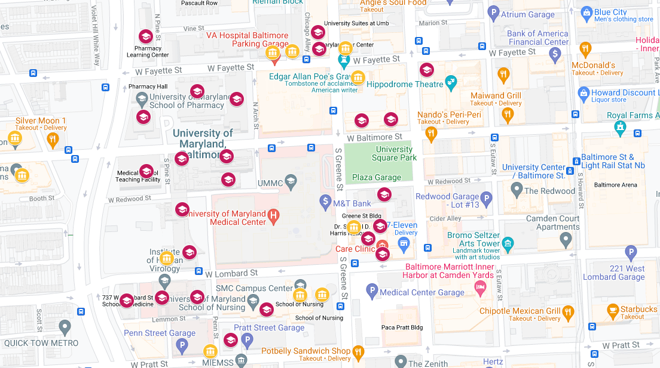
UMB Campus Map
See link for UMB campus map.
Notes:
UMB Campus Map
https://www.umaryland.edu/maps/

Slide 50
Congratulations again and we wish you a successful time at the University of Maryland School of Nursing!!!

Slide 51
For any other information that you feel would be helpful to include on this PowerPoint, please contact the Research Grants and Development Specialist.

