Slide 1
Applying the 10th Principle of Good Clinical Practice (GCP) Good Data and Record Management Practices
Casey Jackson, MS, CCRP
Research Quality Manager
University of Maryland, Baltimore
School of Nursing

Slide 2
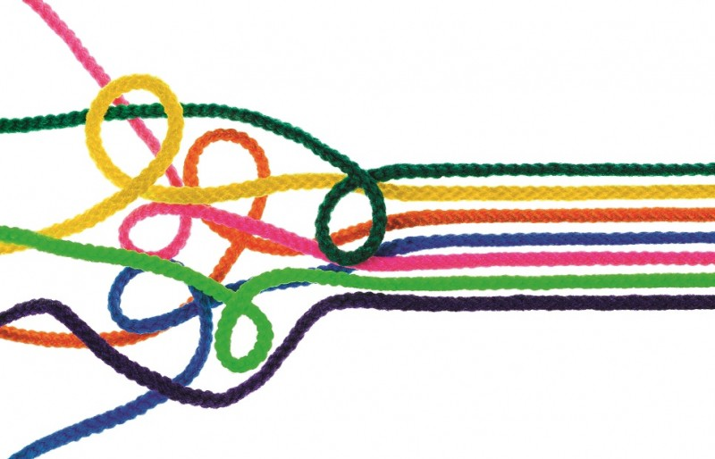
A Little History Lesson…
<1980’s
Today
International Council for Harmonization of Technical Requirements for Pharmaceuticals for Human Use (or ICH for short)
http://beyondthemarquee.com/wp-content/uploads/2013/07/Lone_7.jpg
https://www.taxadvisermagazine.com/article/chaos-order
https://www.ich.org/
Notes:
First, a little history lesson for context. Prior to the 1980’s the international pharmaceutical industry was a bit like the wild west in that countries had their own regulations and thoughts on what research standards were acceptable. This was a problem because products could be developed in one country under regulations that were not acceptable for others, which hindered the advancement of international public health. The European Union was the first to remedy that by harmonizing their regulatory requirements in the 1980’s, which prompted an initiative to expand regulatory harmonization to the greater international community. In 1990, the non-profit organization called the International Council for Harmonization of Technical Requirements for Pharmaceuticals for Human Use (which we happily call “ICH” for short) was born and it included Europe, the US, and Japan. Since 1990 the ICH has expanded greatly and now includes 16 Members and 32 Observers, including Australia, Canada, Switzerland, Brazil, China, and the WHO- to name a few.
There is an excellent mission statement listed on the ICH website which provides the entirety of their intended purpose. But the crude summary of their mission is that they wish to advance public health by creating and proposing unified standards to be followed by pharma and regulatory bodies. Note the words creating and proposing. Its important to make clear that the ICH is a non-profit organization, not a regulatory authority. They do not have any legal oversight over any one industry or regulatory body. They CREATED and PROPOSED standards in hopes that countries would adopt these standards. Thankfully many international industries and regulatory authorities have adopted these standards, and have extended them beyond pharmaceutical research.

Slide 3
Where does Good Clinical Practice (GCP) come from?
ICH’s 4 guidelines: “QSEM”
Quality
Safety
Efficacy
Multidisciplinary
20 Standards (#6= Good Clinical Practice)
Notes:
Which brings us to where Good Clinical Practice (GCP) comes from. Many of you have probably taken GCP training of some sort through your educational or professional role so this may be a refresher for you. But we are going to take a moment to look at how the ICH standards are organized so we can understand where GCP, and subsequently Good Documentation Practices (or GDP) comes from.
The ICH standards are broken up into four topic areas called “Guidelines”. The four areas are quality, safety, efficacy and multidisciplinary. [CLICK] Each area is comprised of a list of standards.
[CLICK] The concept of Good Clinical Practice comes from the language found in the 6th standard of the Efficacy guideline.

Slide 4
Where does Good Documentation Practice (GDP) come from?
Efficacy
← E6[R2]= GCP
= 13 Principles
TTTTTTTTTTTTTTTTTTTT
TTTTTTTTTTTTT
← GDP
Notes:
Because Good Clinical Practice is the 6th standard listed within the Efficacy guideline, [CLICK] you may see GCP referred to as the E-6 guideline.
Now within the E6 guideline there are 13 principles. [CLICK] The 10th principle, {CLICK] and the focus of todays seminar, is the impetus behind Good Documentation Practices (GDP).
Note here we have R2 in brackets. This denotes the second revision of the 6th Efficacy guideline. As a side note- In June 2019 the European working group met to discuss a third revision, which I suspect is forthcoming. So we may see some changes and/or additions soon….

Slide 5
Good Documentation Practices (GDP)
Supports the 10th Principle of ICH E6[R2]:
“All clinical trial information should be recorded, handled, and stored in a way that allows its accurate reporting, interpretation and verification.”
Applies to all drug, device, and social & behavioral research
Used by ALL research staff
Described in detail through SOPs, policies, best practices, etc.
ICH GCP (R2)
Notes:
The 10th principle of GCP is what supports Good Documentation Practices and it states :
“All clinical trial information should be recorded, handled, and stored in a way that allows its accurate reporting, interpretation and verification.”
[CLICK] This principle applies to all records, irrespective of the type of media used and it applies to all study team members. And most institutions require this principle to be applied to all research, regardless of whether it fits the definition of a clinical trial.
[CLICK] How this principle is specifically applied depends on an institutions SOPs and policies. If your institution does not have SOPs or policies on Good Documentation Practices, then industry best practices are typically utilized.

Slide 6
Regulatory Bodies
FDA (21CFR: drug, device, biologic studies- products intended for marketing)
HHS/HRPO (45CFR46: social/behavioral, drug, device, biologic- all engaged human subjects research, as decided by the IRB, required for federally funded institutions)
OAC/HRPO (Institutional, local, policy/SOP based)
Quality Assurance Departments (Divisional, local, policy/SOP based)
ICH GCP (R2)
Notes:
So earlier when I was describing the purpose of the ICH and their intended audience, I used the term “Regulatory Bodies”.
There are many, depending on where the research is being done, who it is funded by, what the intent is, and what level of risk it poses.
The FDA has oversight over studies that are intended to support a marketing application for drugs, devices, and biologics.
The Department of Health and Human Services Human Research Protections Office has oversight over studies conducting human subjects research at institutions that have signed onto the “common rule”. The Common Rule describes a set of ethical practices that federally funded research must comply with. However the majority of academic institutions comply with the common rule regardless of whether or not their researchers are conducting federally funded research. In regulatory terms, the common rule [CLICK] is referred to as the 45th chapter of the Code of Federal Regulations, Part 46, Subpart A.
Institutional Offices of Accountability and Compliance and Human Research Protections Offices also have regulatory oversight over human subjects research and conduct both routine and for-cause audits based on their local policies and SOPs.
Quality Assurance Departments within a specific division of an institution conduct routine and for-cause audits and quality assurance assessments based on their specific policies and SOPs

Slide 7
GDP: FDA Federal Consequences
FDA (*80% findings due to data integrity issues)
audits, marketing application denied, expensive, warning letters/reputation
ICH GCP (R2)
*https://www.fdli.org/2018/04/update-fda-data-integrity-enforcement-trends-practical-mitigation-measures/
Notes:
We have gone over where Good Documentation Practices come from, and who they apply to. Now lets dive into some of the consequences of not applying GDP in research, starting at a federal level with the FDA. Consequences range from ugly audit reports to written warning letters to more extreme measures such as FDA market application withdraws. All of which are administratively costly and some of which can be economically damaging. Not to mention the adverse effects on reputation. FDA warning letters are publicly available on the FDA website and include the name of the principal investigator.
A couple of years ago an analysis was done on FDA findings and they found that up to 80% of the findings were due to issues that could have been avoided if good documentation practices were followed. If you take a look at the highlighted sections of this excerpt, you’ll see examples of these issues. “Lacking a signature and date”… “inability to provide evidence that a test was done”… “failure to put quality measures in place- which if they did have in place, then the documentation issues could have been found early, education and training GDP could have been provided, and the issue would have been remediated…. And a biggie we see on this slide is the last highlight where the lack of GDP essentially questions that the product failed to meet quality and purity specifications. A finding like this could take down an entire marketing application, delaying progress and costing millions or more to the sponsor of the product as they would potentially have to re-run the experiments and re-submit the application.

Slide 8
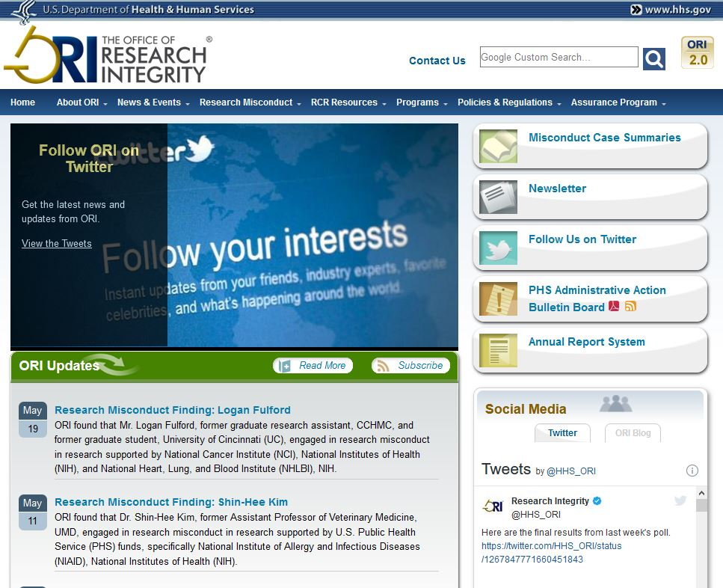
GDP: HHS Federal Consequences
HHS
funding, reputation, publication withdraw
ICH GCP (R2)
Notes:
Now lets dive into some of the consequences of not applying GDP in research from the HHS federal level. Not all research aims to market a product- most HHS supported research looks to advance pubic health, services, biomedical research and overall scientific understanding. Knowing that you can imagine the expanse of research activities involved under the HHS.
Consequences here can range from ugly audit reports to more extreme measures such a research misconduct findings by the HHS Office of Research Integrity. Consequences of this caliper can harm an investigators’ reputation, harm their funding and their institutions’ funding opportunities.
*CLICK* Similar to the FDA warning letters, the HSS Office of Research Integrity makes their findings publically available and the researchers are explicitly named- a bad look for someone’s career.
Included in these findings is a list of the publications that had to be withdrawn, which harms the public’s trust in sound science and can severely impact the advancement of science and public health.

Slide 9
GDP: Local Consequences
Office of Accountability and Compliance (OAC) and Human Research Protections Office (HRPO)
audits, research termination, reputation, RNIs
Quality Assurance (QA) Departments
multiple QA reviews and audits, energy expensive, reputation
ICH GCP (R2)
Notes:
Local Offices of Accountability and Compliance and Human Research Protections Offices have institutional regulatory authority. Some of the more dramatic consequences of not applying GDP in research from this level include [CLICK] for-cause audits, termination of research studies, and of course, marks on one’s institutional reputation.
Every institution that receives federal funding or aims to publish their research in a respectable journal must have their research project reviewed and approved by an Institutional Review Board (or IRB for short) through their HRPO. Note each HRPO has a certain set of reporting criteria with specific reporting deadlines. So in addition to having a study approved prior to commencement, there are additional review requirements throughout the life of the study. The UMB HRPO has a set of reporting criteria called “RNI” criteria which stands for Reportable New Information which we will get into in the next slide.
Quality Assurance departments, if present, also play an important role in GDP compliance. [CLICK] Some of the consequences of not applying GDP in research from this level include the potential for frequent QA reviews and audits, which can be time and energy expensive.

Slide 10
GDP – RNI Relationship
Reportable New Information (RNI)- Specific to IRB of record
Most relevant UMB IRB RNI criteria potentially affected by GDP (or lack of):
3) Non‐compliance with the federal regulations governing human research or with the requirements or determinations of the IRB, or an allegation of such non‐compliance.
4) Failure to follow the protocol due to the action or inaction of the investigator or research staff.
5) Breach of confidentiality.
12) Written reports of study monitors.
ICH GCP (R2)
Notes:
In the last slide I mentioned RNI criteria that local IRBs require investigators to disclose as applicable throughout the life of the study. Lets take a quick moment to dig a little deeper into the relationship between Good Documentation Practices and how they relate to RNIs.
Highlighted on this slide is the UMB HRPO’s RNI criteria which I felt to be most relevant to GDP. #3 is a biggie and a major flag. An example of this would be failure to provide documentation that participants signed informed consent to research. This is non-compliance with federal regulations.
Failure to provide appropriate documentation could also result in #4, a failure to follow the protocol because if you don’t have documentation, you don’t have proof that the protocol was followed as approved by the IRB.
Failure to maintain good documentation practices in data safe-keeping could result in a data breach and as such, a breach in confidentiality. And lastly, study monitor reports may include a description of missing source data and/or data issues, which if the findings are dramatic enough, need attention so that increased education around the issue and the root cause can be addressed.
These are just some quick examples to help you get the gist of it and is in no way meant to be exhaustive. And although RNI submissions appear punitive, they are really aimed at transparency and awareness so that the study team can further educate themselves and improve their research practices.

Slide 11
GDP Applications
The 10th Principle of GCP states “All clinical trial information should be recorded, handled, and stored in a way that allows its accurate reporting, interpretation and verification.”
specific school, department, lab, or office SOPs
-OR-
best practices
Notes:
To recap- we have now discussed the history of Good Documentation Practices, Regulatory Authorities, and implications of failing to practice GDP. Now lets get into what Good Documentation Best Practices look like.
The 10th Principle of GCP states “All clinical trial information should be recorded, handled, and stored in a way that allows its accurate reporting, interpretation and verification.”
Which is a great backbone but it leaves a lot to interpretation and doesn’t provide prescriptive expectations, which can lead to a lot of misunderstandings.
Earlier when we talked about this 10th principle I mentioned that it is applied through local SOPs or best practices. As an institution, UMB does not have prescriptive SOPs that are specific to Good Documentation in research - so unless your specific school, department, lab, or office has SOPs describing precise GDP expectations, you will need to reply on best practices. A lot of you may be saying well then what are GDP best practices? How can I ensure that I am doing the right thing when it comes to documentation in research?
The easiest way to describe this to you would be to introduce you to an acronym called ALCOA.

Slide 12
Birth of ALCOA!
ICH E6 [R2] FDA Guidance Document Section 4.9.0:
“The investigator/institution should maintain adequate and accurate source documents and trial records that include all pertinent observations on each of the site's trial subjects. Source data should be Attributable, Legible, Contemporaneous, Original, Accurate, and complete. Changes to source data should be traceable, should not obscure the original entry, and should be explained if necessary (e.g., via an audit trail).”
WHO Technical Report Series #996 (2016):
“Personnel should follow GDocP for both paper records and electronic records in order to assure data integrity. These principles require that documentation has the characteristics of being Attributable, Legible, Contemporaneously recorded, Original and Accurate.”
ICH GCP (R2)
Notes:
ALCOA is a handy acronym used by the WHO and the FDA to help clarify the GDP best practices. ALCOA stands for Attributable, Legible, Contemporaneous, Original, and Accurate.
Over time the adoption of a few more clarifications gave it the term ALCOA+ so you may hear it described that way as well.
Displayed is an excerpt from the FDA’s ICH E6 [R2] guidance document and the World Health Organizations Technical Report Series so you can see where the acronym came from.
In the next slides we will discuss each letter of the acronym, a couple examples of how it may be used, its importance, and what it means from a regulatory perspective.

Slide 13
ALCOA- Attributable
Use:
User ID/Password (electronic)
Sign/Date Consent Form
Signature and Delegation Log
GDP perspective:
Who entered the data and when?
Who changed data, when was the change made and why?
Proper certifications and training to carry out duties?
Importance:
Ownership
Timing
Trace to certification/
delegation/training
Data integrity
ICH GCP (R2)
Notes:
The first A in ALCOA stands for “Attributable”
Think “who did what and when and were they qualified to do so?”
*CLICK* - You see the Attributable best practice in use when user IDs and passwords in electronic applications are utilized, signatures and dates are on consent forms, and signatures and dates are present on delegation of authority logs.
*CLICK* - these are important to GDP because they provide proof of ownership, timing, tracing, and data integrity.
*CLICK* - With Good Documentation Practices such as these, you can clearly answer questions such as “who entered the data?, who changed it?, when was the data documented?, and does the person carrying out the procedure have the qualifications and delegation to do so?”

Slide 14
ALCOA- Attributable
Study team member Bill signs off that participant 015’s blood pressure was taken at 3:00pm on 1/14/2018. Delegation log shows that Bill is delegated as a regulatory coordinator.
Consent form signed and dated by participant. Person providing consent signature and date is missing.
Chart review raw data was printed out and placed in the regulatory binder. Print out contained no time/date stamp from the printer.
A team member collects the PI’s signature on the screening intake form. When he gets back to the office he notices that the PI did not date the form. The PI’s office is all the way across campus and the team member is short on time.
ICH GCP (R2)
Notes:
Now lets look at some examples of potential problems arising from lack of Attribution:
What problem does this pose? Well, a non-delegated team member conducted a study procedure. This is a solid audit finding. But what if Bill is a certified nurse he just isn’t delegated to take BP on the log? Still- he wasn’t delegated to do so. If the investigator wishes to delegate Bill he can do so but only moving forward, there is nothing he can do about delegating retrospectively.
*CLICK* Who consented the participant? We don’t know at this point…….. What should we do? Submit RNI and find cause of problem so that you can re-educate and avoid problem in the future.
*CLICK* Are there potential issues here? Does the institution have SOPs on how they certify copies of electronic data? Best practice would be to have IT help you implement time/date stamping on your computer or to keep the raw data electronically and password protected with a note to file in the regulatory binder describing the location of the data.
*CLICK* I know all of us have encountered a scenario similar to this before. What should he do? We know what he wants to do, but the correct approach is to take it back to the PI to properly date the form.

Slide 15
ALCOA - Legible
Use:
Permanent Ink
Clear handwriting and/or clear font choice
Proper error correction techniques
(no overwrites or
scratch-outs!)
GDP perspective:
Is the handwriting readable?
Are there any overwrites or was white-out used?
Are data changes clear?
Importance:
Data Integrity
Trace to delegation
Avoid protocol deviations/properly address protocol deviations
ICH GCP (R2)
Notes:
The L in ALCOA stands for “Legible”
*CLICK* - We see this part of GDP utilized when research staff use permanent ink pens, clear notations, and proper error corrections
*CLICK* - these are important to GDP for many reasons, one being data integrity- error corrections like scratch outs and whiteout give the impression that you are hiding something. Furthermore an auditor can’t track what happened. Unclear initialing and signing can make it hard to trace a study teams members’ procedure delegation. Messy writing and error corrections can lead to protocol deviations if you can’t ascertain whether a data entry point is within the protocol specified range.
*CLICK* - When thinking about the legibility part of GDP, ask yourself is my handwriting clear to other people? Did I correct my errors in a way that allows others to see what originally happened and understand why I had to change it? Did I throw away all of the white-out in my office? ;)

Slide 16
ALCOA - Legible
As an Investigator is signing off on the eligibility criteria, she realizes that she was off by one day in the date field. She writes over the date to correct it.
Staff member CG conducts a physical exam and writes their initials on the source document to note completion of the procedure. However, the initials appear to read “LG”. The delegation log does not delegate physical exam duties for LG, a data manager.
After enrolling the first participant in a study, the PI notices that the IRB approved participant questionnaire form does not leave much space for the participant to print their name.
Notes:
Is this the correct way to fix the error? Well.. Human error is ok, but write overs are not acceptable because it doesn’t tell the story of what happened. The correct way would be to write a single line through the error, clearly write the correct value, and then initial and date next to it so if an auditor has a question, they can consult the person who made the correction. In my travels I have also seen people write an acronym such as “EC” for “error correction” near the entry.
2) *CLICK* So, this is a clear example of illegibility/un-clear handwriting. How can this be addressed? Is it realistic to ask someone to change the way they write their initials? This is tricky and needs to be addressed on a case by case basis. It could be that CG was rushed that day and didn’t write clearly in that instance. It could be that CG’s handwriting style makes their C look like an L. The best way to investigate this is to look at the delegation and signature log to see if the latter is the case. Otherwise a minor error correction may need to be requested.
3) *CLICK* Can the participant write under the line where there is more room? Can the study team update the form to create more space to record names ? Yes and yes – From a regulatory perspective -as long as the language and look of the form is unchanged, the PI can make minor edits to allow for writing space and to improve legibility efforts. Although it would be more appropriate to vet the forms prior to implementation in order to avoid sloppiness. And note that some sponsors and monitors may not approve of this approach, so it is best to consult with the QA department or monitor/sponsor as appropriate.

Slide 17
ALCOA - Contemporaneous
Use:
Accurate time/date stamp
Data Entry- recorded as it is observed (real time)
GDP perspective:
Was the data recorded in real time?
Was the error correction appropriately dated?
Importance:
Trust in data
Chronological accuracy
Audit ready
Backdating does not reflect real time
ICH GCP (R2)
Notes:
The C in ALCOA stands for “Contemporaneous”. Think “real time”
*CLICK*- We see this part of GDP utilized when research staff record observations or data as it is occurring, and when electronic documents and print-outs are time/date stamped.
*CLICK* - contemporaneous data practices are important to GDP because it allows for chronological accuracy, audit readiness, and overall trust in what is recorded.
*CLICK* - When thinking about the practice of contemporaneous data recording, you should ask yourself whether or not the data was recorded as it happened and if any errors were appropriately addressed, such as the example we went over in the legibility slide.

Slide 18
ALCOA - Contemporaneous
A Research Assistant conducted a routine QA review of their study documents and found that the subject ID number was not filled out on the last few pages of a participants’ data collection forms. RA had her daughter fill them all in for completeness. It’s a menial task and the RA didn’t have time for it.
A PI finished the screening consent process with a participant and gave them a copy of their signed informed consent document. It was noticed afterwards that the time of the PI’s signature was not recorded on the time field of the consent document.
At a routine audit on 10/8/2019, it was discovered that a study staff member’s CV was not signed and dated. The staff member came in at that moment to sign and date their CV. The auditor noticed he signed his CV with the date of 5/5/2019, the start date of the study.
ICH GCP (R2)
Notes:
So what are some issues here? Well there are a few. For one, the correction was not made by a delegated team member. And filling in data late is not a contemporaneous practice. An acceptable thing to do would be to have an appropriately delegated team member go through and record the subject ID’s along with a late entry notation.
*CLICK* What should the PI do? Late entry error correction technique should be used and the participant should be provided with a new copy. A notation in the progress notes explaining the issue and how/when it was resolved may help with audit preparedness.
*CLICK* Is there anything wrong with this? Well yes, the staff member back-dated without explanation. The study team member should have dated his CV with the current date. It would be prudent to provide an appropriately dated CV for filing.

Slide 19
ALCOA - Original
Use:
Official source documents
Electronic data capture with audit trail
Electronic data print-outs with date/time stamp
GDP perspective:
Who entered the data and when?
Certified copy?
Missing data?
Uncontrolled documents?
Importance:
Trust in data
Observe transcription errors/need for education
Backbone of research
ICH GCP (R2)
Notes:
The O in ALCOA stands for “Original”.
*CLICK* - Some examples of when we see this practiced is when the appropriate paper source document versions are used, electronic data capture is complete with audit trail capabilities, and print-outs are time-stamped.
*CLICK* - adherence to use of original data is important to GDP not only as a backbone to research, but to instill trust in research. Issues with original data allows us to see if there are any problems that need to be addressed and if re-education of study staff is required
*CLICK* - Supporting the use and preservation of original data allows us to understand when the data was recorded and observed, and who observed and recorded it. It also allows us to see whether efforts to improve document control need to be improved, and if a standard data recording and preservation practice needs to be adjusted in order to maintain compliance.

Slide 20
ALCOA - Original
After the initial consent process, a delegated team member provides the participants with a copy of the signed and dated consent. Afterwards she files the original signature page of the consent in a study binder and shreds the remainder of the consent document to save space in the study binder.
PI just finished his research project and is leaving the institution. He scans in copies of the project data and regulatory binder so that he has it electronically. Afterwards he shreds all of the source documents.
A study team member forgot to grab the subject binder on her way to address a participant’s study visit. She writes down the participants blood pressure recording on a piece of paper. Later she records the data in the subject binder and staples the original paper onto the back of the proper form.
ICH GCP (R2)
Notes:
Are there any issues with this approach? Yes- this type of practice does not provide assurance that the participant was consented with the full consent form. It would be the investigators word which is not an appropriate form of documentation. The full original consent form should be filed securely.
*CLICK* Is this ok? Well, it depends. First the PI would need to ensure there are no local, federal, or funder policies against data destruction. Most policies have a time frame requirement for maintenance of original documents. UMB HRPO requires storage of original documents for least 3 years. If the data contains HIPAA information, the storage requirement is 6 years. Best practice is to consult data storage and retention policies before destruction.
*CLICK* Is this ok? Well, This is not a good practice since GDP frowns upon the use of uncontrolled documents. I could see this scenario where the BP needs to be taken within a certain time window and if the study team member went back for the binder they may end up taking the BP outside of the window- resulting in a protocol deviation. In that case I could understand the rationale behind the late entry and provision of original source, albeit the incorrect paper form. However it is not something that should be repeated or considered an acceptable practice.

Slide 21
ALCOA - Accurate
Use:
Machine calibration
Validated surveys
True reporting
No “testing into compliance”
GDP perspective:
Is the data “too clean”?
Does data meet protocol requirements for statistical significance?
Protocol deviations?
Recording errors? Patterns of error?
Importance:
Trust in data
Source of scientific conclusions/decision making
ICH GCP (R2)
Notes:
The last “A” in ALCOA stands for Accurate.
*CLICK* - We see this in practice when data collection machines are calibrated, data collection surveys are validated, and true reporting is maintained- meaning there is no practice of “testing into compliance”. For those of you who are not familiar with the term “testing into compliance”, it refers to the highly denounced practice of repeating a procedure in search of a more favorable value. There are numerous instances of these types of findings which ultimately resulted in publication withdraws and loss of funding.
*CLICK* - As you can imagine, accuracy is important to GDP because accurate data forms the foundation for conclusions and decision making. And as with other parts of ALCOA- accuracy supports trust in science
*CLICK* - When thinking about accuracy from a GDP perspective, think “statistical significance”. Are there too many protocol deviations? Recording errors? Patterns of error? Does the data appear too clean?

Slide 22
ALCOA - Accurate
During screening, study team member signs off that a blood draw was taken at 1:05pm on 11/14/2018. The date recorded by the participant next to their signature on the informed consent form reads 11/15/2018.
The inclusion criteria in the IRB approved study protocol states that participants must have a fasting blood sugar lab result of <100mg/dL. Participant X’s lab results show they have a blood sugar count of 101mg/dL.
The protocol states to take the participants blood pressure on day 1 in triplicate. After taking 2 readings, you notice that the machine was due for calibration a couple months ago. You take the participant to a recently calibrated machine and record 3 readings.
ICH GCP (R2)
Notes:
What problem does this pose and what should the study team member do about it? Well it appears as though research was conducted without prior consent (a huge ding and likely non-compliance RNI!). It would be prudent to double check the date to see if the study team member is recording the appropriate blood draw date and implement proper error correction technique if in fact wrong- alternatively, if the participant recorded the incorrect date, the participant should correct the consent form using proper error correction technique. It would be appropriate to include this change as part of the study progress note.
*CLICK* The figure is so close, is it okay to enroll them? Nope! In this instance the protocol specifies LESS THAN 100mg/dL. Would it be okay to ask the potential participant to fast again and have their blood re-drawn and tested on another day to see if they met the criteria? Careful- although this sounds like a potential option this is considered “testing into compliance” and is not an acceptable practice.
*CLICK* Is this ok? Yes. However a record of what was done and why the two readings won’t be used must be made. No original data should be destroyed! As a side note to this scenario, it would be good to check the protocol for data collection windows to see whether the accurate recording on the calibrated machine was outside the specified window for blood pressure reading. If that is the case, you may have a minor protocol deviation but at least you have an accurate BP reading.

Slide 23
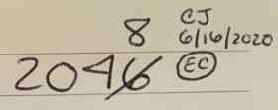
Examples of Error Correction Tools/Techniques
Notes-to- File
(NTF)
Progress Note
Notes:
Before we wrap up I’d like to show you some examples of error correction tools and techniques I mentioned throughout the presentation.
Two tools that I mentioned were [CLICK] Notes-to –file and [CLICK] progress notes. A Note-to-file (also called “memo to file”) may be filed in a regulatory binder and/or a participant binder and is commonly used when an error is best resolved with an explanation. It is not a best practice to have a regulatory binder full of notes-to-file. These should be used only when necessary to describe an issue and its resolution.
Progress notes are typically a part of a participant file. They are used throughout the participants’ study duration to supplement the documentation within the binder. Progress notes are typically found at the beginning of the participants binder, containing comments and notes on the progression of a study, along with the recording study team members’ initials and date.
Some error correction techniques in GDP best practices include refraining from over-writes [CLICK], and scratch-outs [CLICK]. Instead, the best practice [CLICK] should be to draw a single line through the error (to provide transparency), legibly record the correct value next to it, and then initial and date beside the correction. You can see here that the letters “EC” are circled next to the initials and date of the study team member. In this hypothetical scenario the investigator trained their study team using SOPs for GDP- those SOPs required specific error codes to be used to provide rationale for the revision. I note this here because many labs use error codes such as “EC” for “Error Correction”, “LE” for Late Entry”, and many others. There are designated codes developed by the PI, Office, institution or company to be followed by all study team members. If you do not have SOPs requiring use of error codes, using them may be confusing to a reviewer without an SOP or “legend” that defines them. So in that case, you would either not use an error code or work with your office/department to implement an SOP or best practice instruction to designate error codes.
And of course there are many other techniques and tools not mentioned here (like deviation logs and CAPA plans) but for sake of time but I wanted to highlight just a few for reference

Slide 24
SON Resources
*NEW* Researchers Toolkit
https://www.nursing.umaryland.edu/research/resources/regulatory-affairs/researcher-toolkit/
ICH GCP (R2)
Notes:
To wrap up the presentation today I would like to shamelessly plug our new researchers’ toolkit available on the SON research website. There are many toolkits available through various DHHS sub-organizations, and local offices as well. Our toolkit was developed from the perspective of the regulatory binder, with each section linked to its respective regulation and/or guidance. The reason for this was to help users understand the reasoning behind the section, the importance of its place, and to support Good Documentation Practices. It is not meant to replace sponsor provided regulatory binders or any other issued binders. And the template documents within the website are not meant to be a fits-all model- they should be tailored prior to use. So please take a moment to visit the website and use the materials. And as always I welcome any feedback or comments you may have.

Slide 25
Questions? Email: Casey.Jackson@umaryland.edu Phone: 6-1611
ICH GCP (R2)

Slide 26
References
SON Research and Compliance: https://www.nursing.umaryland.edu/research/resources/regulatory-affairs/
ICH E6 [R2]: https://database.ich.org/sites/default/files/E6_R2_Addendum.pdf
DHHS 45CFR46: https://www.ecfr.gov/cgi-bin/retrieveECFR?gp=&SID=83cd09e1c0f5c6937cd9d7513160fc3f&pitd=20180719&n=pt45.1.46&r=PART&ty=HTML#se45.1.46_1101
FDA’s ICH E6 [R2] Guidance: https://www.fda.gov/regulatory-information/search-fda-guidance-documents/e6r2-good-clinical-practice-integrated-addendum-ich-e6r1
WHO’s Annex 5: https://www.who.int/medicines/publications/pharmprep/WHO_TRS_996_annex05.pdf
ASQ Supporting slide material: http://asq.org/audit/2017/10/auditing/data-integrity-and-good-documentation-practices-not-just-for-the-pharmaceutical-industry.pdf
UMB IRB RNI Criteria: https://www.umaryland.edu/media/umb/oaa/hrp/documents/study-tools-docs/Reportable-New-Information-Bulletin.pdf
FDA Data Integrity Enforcement Trends and Practical Mitigation Measures by Barbara Unger: https://www.fdli.org/2018/04/update-fda-data-integrity-enforcement-trends-practical-mitigation-measures/
ICH GCP (R2)

