Slide 1
Human Research Protections Program sIRB Processes & Workflow: Relying on an External IRB
Dr. Julie Doherty, DM, MSN,RN, CIP, CCEP
University of Maryland Baltimore
School of Nursing Seminar Series
August 15, 2019

Slide 2
sIRB
Workflow and business processes
Increase efficiency
Removal of multiple IRB reviews ( in most instances)
Increase effectiveness
Decrease regulatory burden

Slide 3
sIRB Mandate
Set of complementary federal policies that require certain types of federally-funded studies that involve multiple institutions to use a single IRB to accomplish IRB review and approval for all participating sites.

Slide 4
NIH Requirement for Single IRB
Effective January 25, 2018
The single IRB (sIRB) mandate is an NIH policy that requires certain types of NIH-supported studies involving multiple sites where each site will conduct the same protocol involving non-exempt human subjects research to use a single IRB to accomplish IRB review and approval for all domestic participating sites.
Whether supported through grants, cooperative agreements, contracts, or the NIH Intramural Research Program.

Slide 5
Exceptions:
VA sites
International sites
Site involving tribal nations
Other

Slide 6
Requirement for Single IRB
The Final Rule: Federal Policy for the Protection of Human Subjects
Issued January 2017
Includes a mandate for single IRB review for cooperative research (federally-funded research taking place at two or more institutions)
Effective - January 2020

Slide 7
Exceptions:
VA sites
International sites
Site involving tribal nations
Other

Slide 8
Requirement for Single IRB (cont).
Master agreements
National Cancer Institute Central IRB
Department of Veterans Affairs Central IRB
SMART IRB –reliance communication platform
Otherwise agreed to on a case-by-case basis
Relationships established between UMB leadership, UMB faculty and external IRB/EC
Notes:
Discuss appropriate of study design to reduce risk later

Slide 9
Reliance Agreements
Currently @ 270 formally executed agreements
Academic, hospital, commercial IRBs
UMB Signatory Official
Dr. Bruce Jarrell, Executive Vice President & Provost

Slide 10
UMB Global Research Presence
Research conducted in @ 70 countries
Minimal risk and greater than minimal risk research

Slide 11
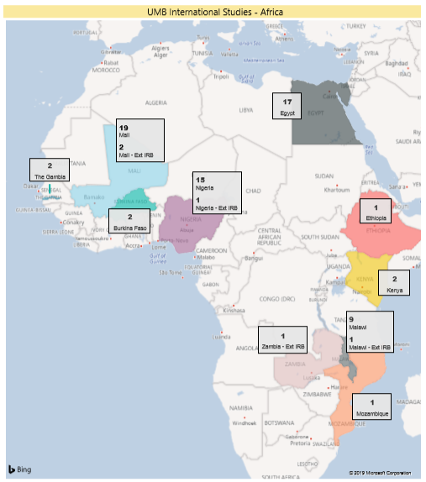
UMB Research in Africa 72 protocols UMB IRB 4 protocols external IRBs

Slide 12
UMB Resources for Investigators
Consultation pre-grant submission
sIRB
Grant letter of support from UMB
SMART-IRB documentation & communication
Review of reliance agreements

Slide 13
UMB Resources for Investigators
Liaison with external partners (both domestic and international) to facilitate execution of agreements
Reliance Manager is single point-of-contact in UMB HRPO for questions related to sIRB and external IRB processes
Step-by-step workflow and processes through UMB electronic system - CICERO

Slide 14
Completion of local context questionnaires
Depending on length and complexity can take 5-10 business days for completion
Local context generally refers to local circumstances, preferences and variability

Slide 15
Local Context
All involved individuals are credentialed and/or appropriately qualified and meet standards for eligibility to conduct the research
Completion of required training—CITI, HIPAA, GCP

Slide 16
Local context
Review of protocol and IC template for identification of any institutional requirements (policy or procedural requirements such as recruitment, data security, renumeration) that apply to this study
Describe steps that must be taken to adhere to these requirements

Slide 17
Local Context
Variation in language
Economic issues
State and local laws
Age of majority
Informed consent/assent procedures; use of LARs,
HIPAA
Conflict of interest

Slide 18
Processes
So I want to use a single IRB for my study? Now what?
Steps to consider

Slide 19
Processes
Site Registration of UMB in external IRB
Depending on steps, can take 1-2 business days
External IRB requires local site administrator to be identified to grant access of UMB research personnel to external IRB system
Dependent on number requested
Julie Doherty or Scott Evans

Slide 20
Processes
CICERO –Collaborative Institutional Comprehensive Evaluation of Research Online
Department or Entity Scientific and Feasibility Review of Research
Institutional Biosafety Review
Radiation Safety Review
UMB maintains institutional oversight when IRB review is external

Slide 21
Processes
Conflict of interest
UMB management plan would be reviewed as applicable by external IRB
External IRB can make additional requirements r/t COI management
Use CICERO for local documentation for lifecycle of study
Minimize email communication as much as possible to facilitate processing of documentation
HRPO Inbox

Slide 22
Processes
Documentation in SMART IRB or other system of agreement to rely
Documentation in external IRB system of agreement to rely
Separate reliance agreement needed in some instances
Requires signatories at both institutions
Indemnification language

Slide 23
Processes
Request to rely
Protocol
Investigator brochure
Informed consent documents
Other supporting documents
Advertisements
Recruitment materials
Reliance agreement

Slide 24
Processes
Vulnerable populations
Pediatrics
External IRB determination of pediatric category required for local consideration
Pregnant women
Even though no longer considered vulnerable, what were IRB determinations?
Cognitively impaired
Considerations
IRB determination
Student, employees
Considerations
IRB determination
Who can consent? Determine eligibility

Slide 25
Processes & Considerations
Recruitment from socially or economically disenfranchised populations.
Local cultural mores or unique clinical circumstances , in which local knowledge might impact the review and approval related to recruitment methods.
Relying institution considers if ceding IRB could create or mitigate unique institutional risks such as conflicts of interest.

Slide 26
Processes & Considerations
Significant additional administrative time and costs associated with establishing authorization agreements.
Authorization agreements are flexible and can be highly customized. They may cover one protocol, multiple protocols, or all research within a certain set of parameters.
The relying institution considers that from a practical standpoint, investigators, research staff and others will need to learn the electronic systems, policies and processes of the reviewing IRB.

Slide 27
Processes
Initial IRB approval obtained ?
UMB experience with external IRB?
AAHRPP accredited
SMART IRB

Slide 28
Processes
Local PI must be familiar with external IRB SOPs
PI must have communication plan for relaying information between sites (if lead PI)
Reporting requirements – UMB RNI Policy (SOP 024)

Slide 29
Key Take-Aways
‘It is NOT less work, it is DIFFERENT work’
Currently no standardization on processes and procedures
Different reliance agreement formats
Different local context documentation formats and questions
Currently no guidance from oversight agencies

Slide 30
Key Take-Aways
Communication
Collaboration

Slide 31
Questions??
University of Maryland Baltimore
Human Research Protections Office 410-706-5037
Julie Doherty jdoherty@umaryland.edu 410-706-3867
Scott Evans sevans@umaryland.edu 410-706-3893

Slide 32

Thank you !! University of Maryland Baltimore

