Slide 1

EVOLVING ETHICAL ISSUES AND IMPLICATIONS FOR CLINICAL PRACTICE
Connie M. Ulrich, PhD, RN
Lillian S. Brunner Chair
Professor of Nursing and Bioethics
University of Pennsylvania School of Nursing and Perelman School of Medicine

Slide 2

Thank You!
Dean Kirschling and Dr. Mary Etta Mills
Cynthia Sikorski
UMD and Interdisciplinary Mentorship at NIH

Slide 3
“It is no surprise that nurses face some of the most complex and challenging ethical issues in clinical care by virtue of their bedside presence and the time they spend directly with patients and their families.
The everyday stress and strain of caring for ill patients within complex medical institutions raises significant concerns for the health and well-being of nurses and their retention within these institutions. The ethical issues they encounter are many, and although they are not often seen as prominent, they are significant nonetheless."
    Ulrich, C. (2015). Testimony to the Presidential Bioethics Commission under President Barack Obama.

Slide 4
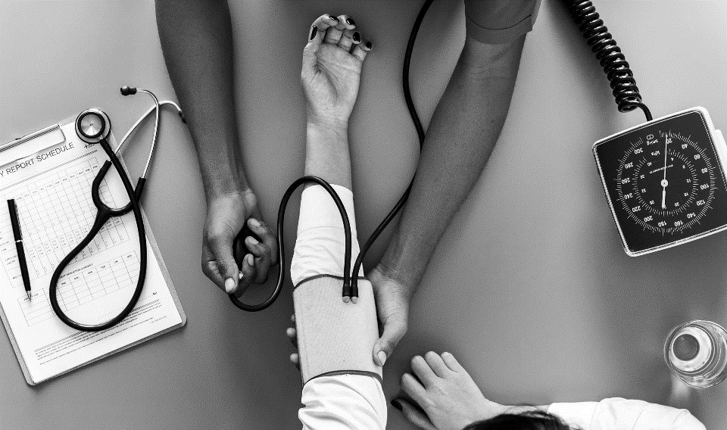
On Any Given Day
Informed Consent
Medical Mistakes
Advance Directives; End-of-Life; Palliative Care
Angry Patients and Families
Disparities in Care
Resource Allocation Issues (Access)
Religious/Cultural Concerns
Aggressive Measures
Truth-telling
Competency of Co-workers
Genetics, Precision Science
Privacy and Confidentiality
Research Recruitment and Retention
Cognitively Impaired
Opioid Overdoses
Gun Violence and Other Types of Violence
Infectious Diseases

Slide 5
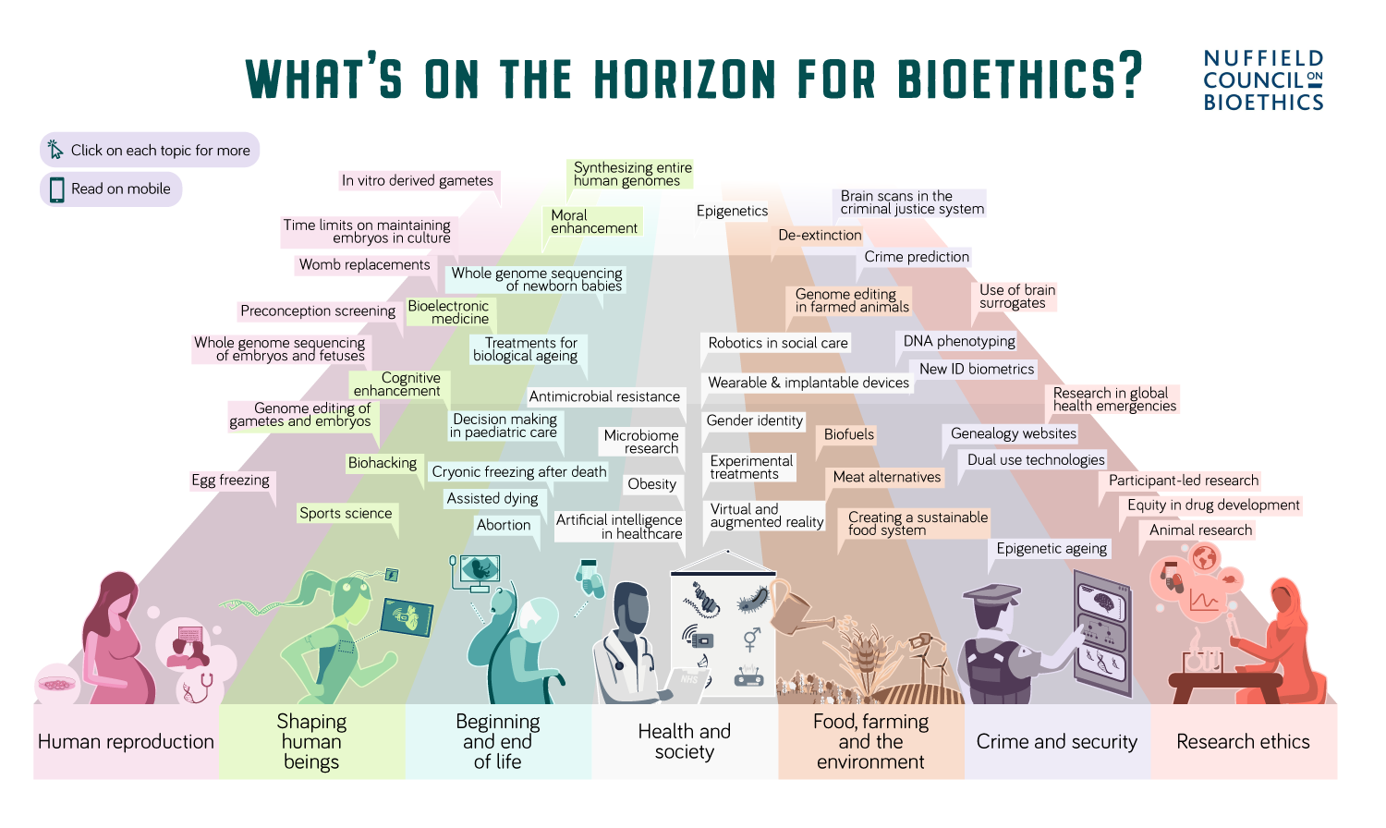
Ethical Issues

Slide 6
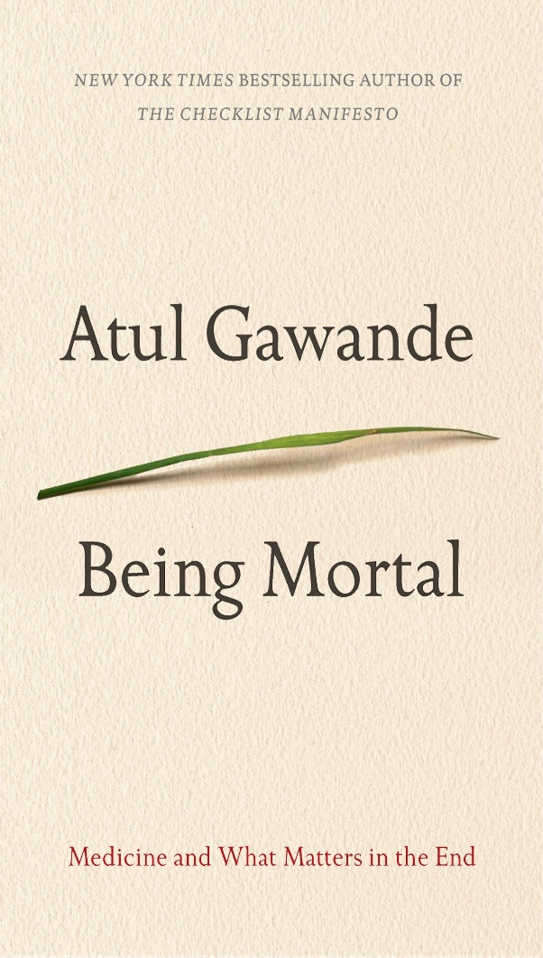
Troubling Scenario
“Modern scientific capability has profoundly altered the course of human life. People live longer and better than at any time in history. But scientific advances have turned the processes of aging and dying into medical experiences, matters to be managed by health care professionals. And we in the medical world have proved alarmingly unprepared for it.”

Slide 7

Want big impact?
Use big image.
“And I think that her suffering, for me, is worse than her passing. That is the hardest thing to think about that could occur in the future. [When asked if anyone has helped to talk about this…]
I don’t think we’ve… we’ve gone near that topic yet.”

Slide 8
Who Will Help And Can We Afford It?
98,000,000
AGING AND COSTLY SOCIETY
$3.3-3.5 Trillion
45,000,000

Slide 9
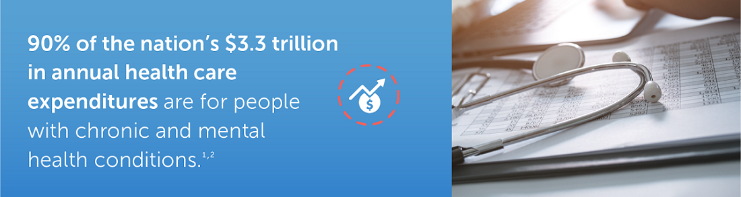
Costs Of Chronic Illness
Notes:
As we write in a new Milken Institute report, U.S. health care costs for chronic diseases such as heart disease, cancer, diabetes, and Alzheimer’s disease totaled $1.1 trillion in 2016. When lost economic productivity is included, the total economic impact was $3.7 trillion. This is equivalent to nearly 20 percent of the U.S. gross domestic product.

Slide 10
End-Of-Life Issues
33% of health expenditures are for hospital care.
https://www.cms.gov/Research-Statistics-Data-and-Systems/Statistics-Trends-and-Reports/NationalHealthExpendData/downloads/highlights.pdf
More than 40% of U.S. patients who die with cancer are admitted to the ICU in the last six months of life.
Bekelman JE, Halpern SD, Blankart CR, Bynum JP, Cohen J, Fowler R, Kaasa S, Kwietniewski L, Melberg HO, Onwuteaka-Philipsen B, Oosterveld-Vlug M, Pring A, Schreyögg J, Ulrich CM, Verne J, Wunsch H, Emanuel EJ; International Consortium for End-of-Life Research (ICELR). Comparison of Site of Death, Health Care Utilization, and Hospital Expenitures for Patients Dying With Cancer in 7 Developed Countries. JAMA. 2016 Jan 19;315(3):272-83.

Slide 11
Advance Directives in CCTs
38% and 33% of those who are Stage IV and Stage III do not have an AD.
55% and 62% of those diagnosed as Stage I and Stage II do not have an AD.
Of those who indicate they have no other options, 48% have no AD.
33% of participants indicate no discussions with healthcare providers on other options. [53% of those who have no discussion do not have ADs].
Ulrich CM, Grady, C, Gordon T, Hanlon A, Knafl K, Mao J, Naylor M, Ratcliffe S, Schapira M, Richmond T, Wallen G, Zhou P. Retention in Cancer Clinical Trials: Modeling Patients' Risk Benefit Assessments. National Cancer Institute, Grant #R01CA196131; 2014-2019.
Notes:
Given the serious illness of our population, we were surprised to find that almost 40% have no AD.
We are not doing well and it reflects work by Halpern et al’s study of ADs in the general public.

Slide 12

“A doctor in California used a video-link robot to tell a patient he was going to die. The man's family is upset.”—CNN, March 10, 2019

Slide 13
Missed Care

Slide 14
Ethics and the Use of Artificial Intelligence
Do nurses need help?
If so, what tasks would be amenable to this type of technology?
  What would be the risks and benefits?
  How would we ensure ethical behavior?
  How would we secure the public’s trust?
  How would we ensure that information is communicated effectively and in a clear manner?
    Majeed, ABA. (2017). Roboethics- Making sense of ethical conundrums. Procedia Computer Science 105 (2017) 310 – 315

Slide 15
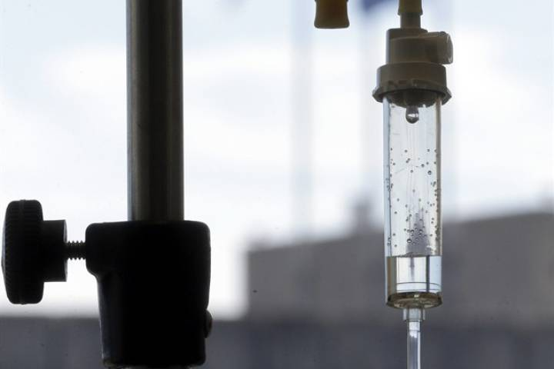
Aid-In-Dying

Slide 16
What Is Our Role?
“Maryland House approves aid-in-dying bill after emotional debate” (March 7th, 2019)
Does an individual with an incurable disease and intolerable pain and suffering have a right to request death and assistance in doing so?
  If so, do we have an obligation to assist them?

Slide 17
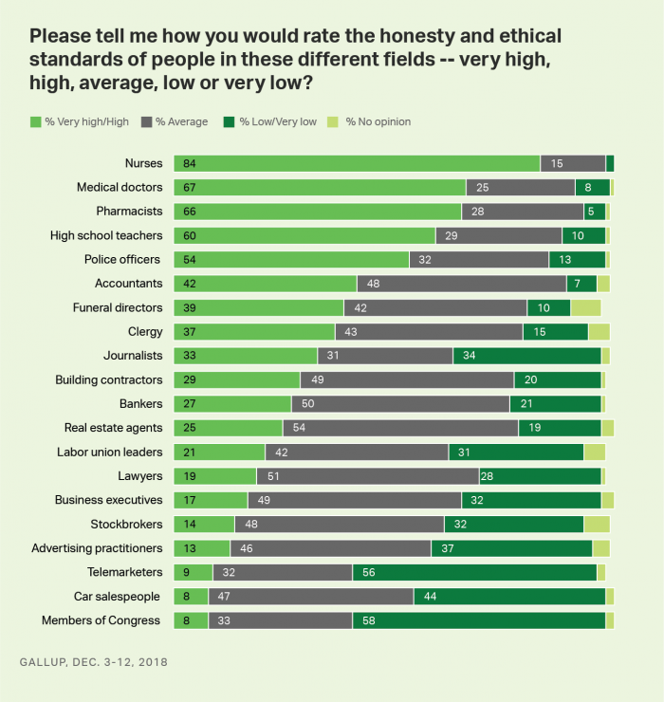
Honesty/Ethics in Professions

Slide 18
Code Of Ethics
Nurses “should provide interventions to relieve pain and other symptoms in the dying patient consistent with palliative care practice standards and may not act with the sole intent to end life (ANA, 2015, p. 3).”

Slide 19
NPs and Aid-in-Dying
New York Bill No A10059, the Medical Aid in Dying Act, proposes to allow NPs to participate in PAD if he or she qualifies as a mental health professional by training, clinical expertise, or certification.
If deemed as a qualified mental health professional, the NP could be eligible to provide a determination of capacity in cases in which the capacity of the PAD patient is questioned by the attending physician, provided that the NP does not have a collaborative agreement with the attending or consulting physician.

Slide 20
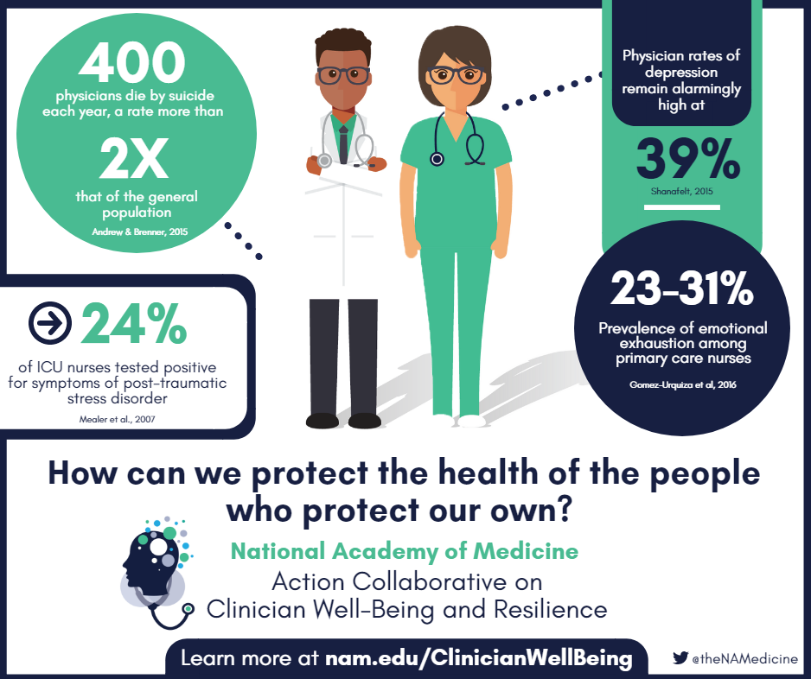
Health And Well-Being Of Clinicians

Slide 21

Headlines
Why America’s nurses are getting 'hangovers' from their work
Nurses face burnout, a high turnover and patient safety errors as ‘unsafe staffing’ has become the standard, advocates say
Notes:
Top News

Slide 22
Moral Distress

Slide 23
Kutney-Lee, A., Sloane, DM, Bowles, KH, Burns, LR, Aiken, A. (2019). Electronic Health Record Adoption and Nurse Reports of Usability and Quality of Care: The Role of Work Environment . Appl Clin Inform 2019;10:129–139

Slide 24
  “By nature of our vocation we are held to a higher standard than non-medical professions, and patients insist we remain unblemished to gain and maintain their trust. We are expected to be both human (akin to our patients) and simultaneously superhuman heroes (capable of saving lives).”
      Alysa Burgart, MD, MA & Katherine E. Kruse, MD
Notes:
‘Many physicians find themselves well trained in medicine, but woefully underprepared emotionally for its stressors. At the core of our calling to be doctors, sometimes lies both our greatest strength and the seed of our undoing. Our drive to be the very best clinicians leads us to spend long hours caring for patients, voluntarily cutting into time with our families and personal interests.”

Slide 25
“Many physicians find themselves well trained in medicine, but woefully underprepared emotionally for its stressors. At the core of our calling to be doctors, sometimes lies both our greatest strength and the seed of our undoing. Our drive to be the very best clinicians leads us to spend long hours caring for patients, voluntarily cutting into time with our families and personal interests.”
  Alysa Burgart, MD, MA & Katherine E. Kruse, MD

Slide 26
“We have to remember that not all physicians or health providers are burnt out. Many of those who are burned out do recover. But nonetheless, there’s a serious issue that’s facing health professionals.”
Liselotte Dyrbye, MD, MHPE
Professor of Medicine and Medical Education, Mayo Clinic; Associate Director, Mayo Clinic Program on Physician Well-Being; Consultant, Division of Primary Care Internal Medicine, College of Medicine, Mayo Clinic

Slide 27
Other Evolving and Broad Areas of Ethical Concern
Research (Informed Consent)
Global Emergencies (Ebola)
Social Media (Facebook, Google, Twitter; Privacy and Confidentiality of Data)
Nurse’s Role In Countering Misinformation to the Public (Vaccinations, Social-Societal Issues)
Genetics
Notes:
iNOCUluM [Nurses biOethics CoUntering Misinformation]

Slide 28
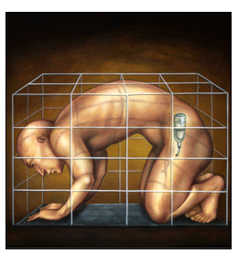
TIME, 2002

Slide 29
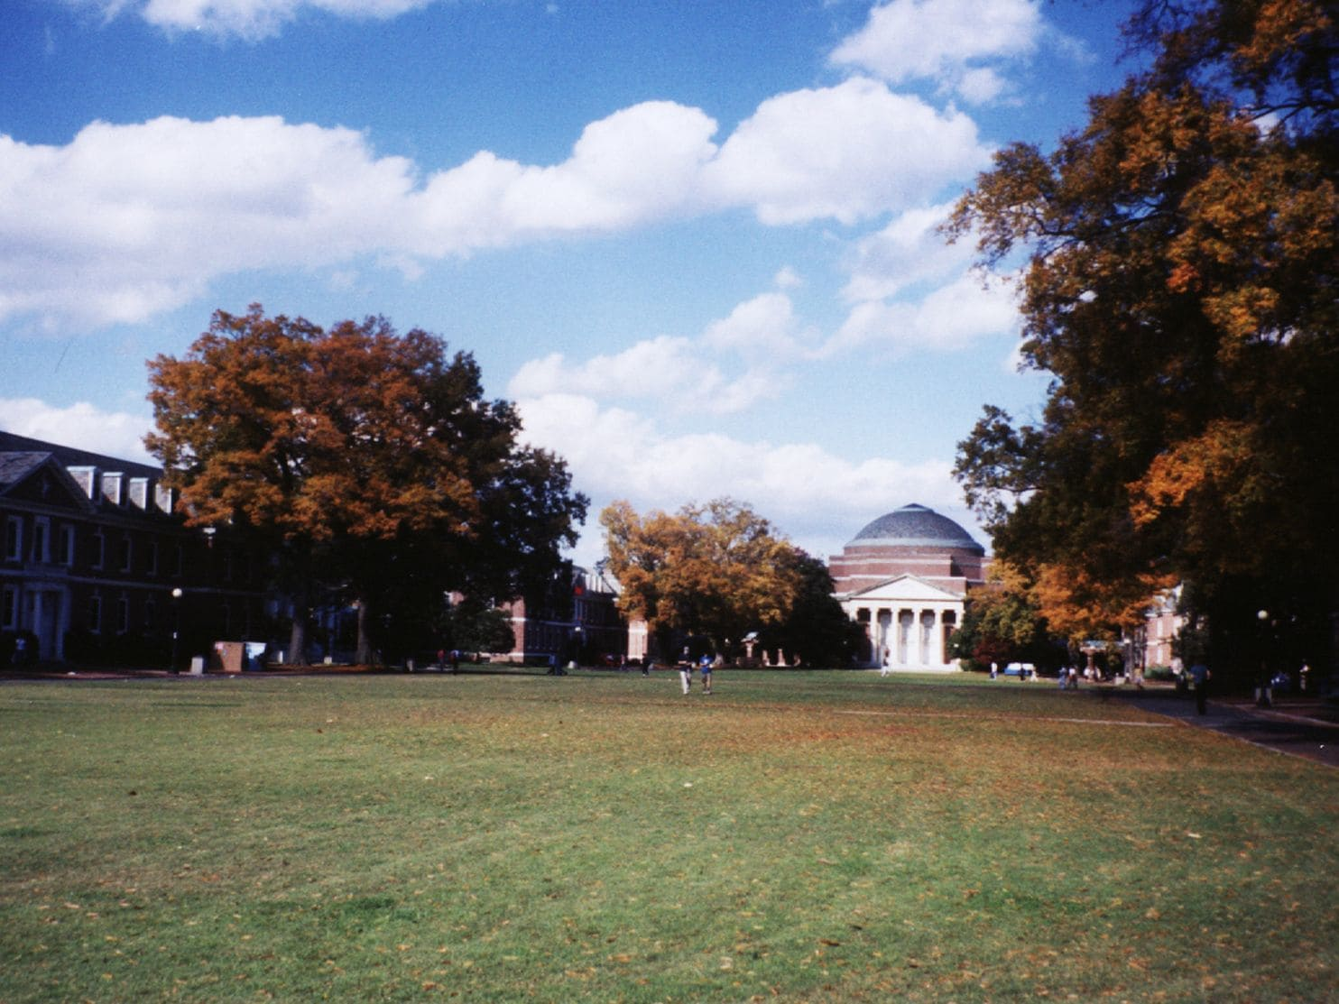
“Duke settles research misconduct case, agrees to pay U.S. government $112.5 million”

Slide 30
Therapeutic Misunderstanding
We worry about Therapeutic Misunderstanding in Clinical Research
Misunderstanding: Conflating research with treatment
Misestimation: Over or underestimate the benefits and over or underestimate the risks
Optimism: Unduly hopeful or excessively optimistic about one’s outcomes

Slide 31
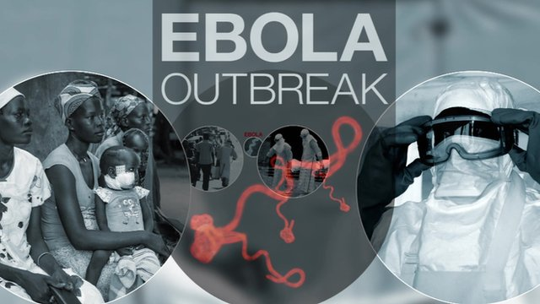
What Are Our Responsibilities?

Slide 32



“Facebook staff had access to hundreds of millions of people's passwords”—March 21, 2019

Slide 33
Some Common Genetics Topics
  Pre-symptomatic genetic testing
  Genetic discrimination
  Testing of minors
  Disclosure of incidental findings
  Conflicting and/or inter-dependency of goals/actions within family units
  Privacy vs. duty to warn
  Prenatal & Preconception testing
  Genetic Determinism vs. Uncertainty
  Newborn Screening
  Legal status of DNA ownership
    Perlmutters vs. Peerenboom
    Labs & Hospital profit from selling DNA
    Henrietta Lacks
  Disclosure of consanguinity & non-paternity
  Direct to consumer marketing
  Gene patenting
  Resource allocation and usage
  Health equity, race, & genetics
  Confounding of research and clinical testing
  Reproductive duty & identity
  Conflicted interest of providers & labs
  Duty to return research results
  Duty to re-contact
  Gene editing – preconception, prenatal, and post-natal
Courtesy of Shana Merrill, Genetic Counselor, UPenn

Slide 34

“The research and experience of others is the best place to start when looking for your answers.”
---Gary Keller, 2012
Thank You!

Slide 35
Acknowledgements
Patients and Families
Funding Mechanisms
R21 [Grant # 1R21NR010259] National Institutes of Health
R01 [Grant # R01CA196131] National Cancer Institute
New Courtland Center for Transitions in Health [Caregiver supplement]
Research Team of Colleagues and Consultants [Penn, UNC, NIH, UMass, GWU, Duke, UVA, Sloan Kettering]; special thank you to Sarah Ratcliffe and Tianhao Wang for their statistical support; and my project manager, Debbie Tiller.

