Slide 1
Navigating Cancer Survivorship
Jennifer Wenzel, PhD, RN, CCM, FAAN
MiKaela Olsen MS, APRN-CNS, AOCNS, FAAN

Slide 2
Objectives
Describe the changing landscape of cancer treatment and survivorship care
Recognize cancer survivorship needs and how navigation can be applied to help address them

Slide 3
Cancer Survivors in the U.S.
Cancer survivor- any person with a history of cancer from diagnosis through the remainder of their life
  15.5 million cancer survivors- 2016
  50% are >70 years
  20.3 million cancer survivors expected by 2026
2 out of 3 people diagnosed with cancer are expected to live at least 5 years after diagnosis
Cancer as a chronic disease
  Control
  Modify the evolution of the disease
ACS, 2017, CDC, 2017

Slide 4
Cancer Survivorship
As cancer treatment improves and patients live longer their survivorship care will become more complicated.
  Comorbidities, such as diabetes, heart, and lung disease and other long term cancer treatment toxicities will need to be carefully managed.
New immune therapies can have lasting inflammatory toxicities
Chronic oral therapies require constant management

Slide 5
The Changing Landscape of Cancer Care
Major shift from inpatient to ambulatory care
Integrated health systems (inpatient and outpatient continuum)
>80% of cancer care is delivered in the ambulatory setting
  Outpatient clinics
    Expanded hours
    Interprofessional collaboration
    Administration and management of complex therapies
    Urgent care access with a focus on prevention of hospital admissions
  Home care
  Telemedicine
  Caregiver support
Notes:
Reduce cost
Increase quality
Decrease harm
Patient centered

Slide 6
The Changing Landscape of Cancer Care Cont.
Precision medicine- customized care based on people’s genes and history
Harnessing the power of the immune system to fight cancer
New epigenetic drugs could turn cancer cells back to normal instead of destroying them outright.
Scientists are learning more about the genes and pathways that drive metastasis, the process by which cancer spreads.

Slide 7
The Changing Landscape of Cancer Care Cont.
Genomics to guide treatment decisions
Survivorship care plans should start at diagnosis
Patient centered, shared decision-making process before treatment begins
Better outcomes- measure other things not just mortality (e.g. access to pain management, palliative care, psychosocial care)
Modified early warning systems (MEWS)
Patient reported outcomes (PROs)
Distress screening
Cultural assessment

Slide 8
Novel Strategies for the Treatment of Cancer
Targeted therapies- mostly oral
Immunotherapy
  Monoclonal antibodies
  Immune checkpoint inhibitors
  CAR T-cells
  Cancer vaccines
Combinations with traditional chemotherapy

Slide 9
Novel Strategies for the Treatment of Cancer
Monoclonal antibodies
  Antigen specific
  Naked or conjugated
  Used in combination with
  chemotherapy
  Mechanism of action
  Toxicities

Slide 10
Novel Strategies for the Treatment of Cancer
Immune checkpoint inhibitors
Immune checkpoints
  stimulatory or inhibitory.
  Tumors can use these checkpoints to protect themselves from immune system attacks.
  checkpoint therapies block inhibitory checkpoint receptors. Blockade of negative feedback signaling to immune cells thus results in an enhanced immune response against tumors

Slide 11
Novel Strategies for the Treatment of Cancer
Molecularly targeted therapies
  Small molecule inhibitors
  Mostly oral
  Convenient
  Costly
  Adherence concerns
  Drug drug/food interactions

Slide 12
Novel Strategies for the Treatment of Cancer
Cancer vaccines
  Stimulate the immune system to
  recognize cancer cells and destroy
  them
  One FDA-approved vaccine for
the treatment of prostate cancer
  Many vaccines in clinical trials
Notes:
First demonstration of a cancer vaccine by coley in the late 1800s
Types: tumor cell, antigen, dendritic cell, vector-based

Slide 13
Novel Strategies for the Treatment of Cancer
Chimeric antigen receptor (CAR) T-cell therapy
  Referred to as adoptive cell transfer therapy
  The patient’s own T-cells or a matched donor’s are changed in the lab by adding a man-made receptor (chimeric antigen receptor or CAR) so that they can identify specific cancer cell antigens.
  Toxicities

Slide 14
Ambulatory Care Delivery Model
Challenged to drive value through optimization, coordination, and management of care during transitions.
Lead with preparedness as a core value
Create a “high reliability” infrastructure
Invest in interprofessional relationships
Promote a culture of accountability
Leverage evidence based practice/standardization
Center on the patient

Slide 15
Ambulatory Care Delivery Models
Novel strategies for the delivery of cancer care
  Oral cancer pharmacy and nursing specialists
  Ambulatory clinical evaluation program
  Injection clinic
  Telephone triage/telemedicine
  Moving chemo traditional cancer regimens to the ambulatory clinics
  High dose chemotherapy and hematopoietic stem cell transplant ambulatory- IPOP/HIPOP©
  High tech radiation diagnostics and therapies
  Mobile VAD team
  Transition to cancer treatment and care in the patient’s home
  Transition standard regimens to community practices/research and other specialty care in academic medical centers

Slide 16
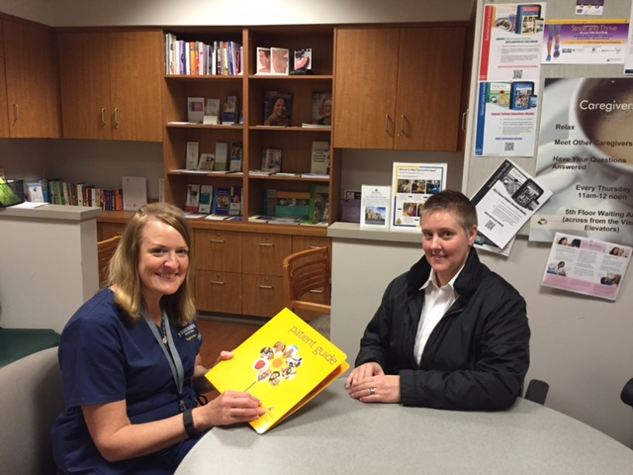
Patient and Caregiver Education
Our goal: to ensure patients are prepared for their journey
Focus:
  Patient and caregiver education
  Teach back focus
  New patient resources
  Navigating the system
  General Education:
    Effects of cancer treatment
    Self care management – nutrition, sleep, exercise, infection prevention
  Managing side effects related to immunotherapy, chemotherapy, and or radiation therapy
Notes:
Finally… we are re-branding our “chemo class” to a cancer center orientation class that includes introductory information on chemo and immunotherapies. The predominant themes are navigating the cancer center environment, self care, important resources, basic treatment routines and much more. The class last about an hour.. It is informative, visibly reduces anxiety about the unknown, and is FUN. There is lots of smiles and goo dialogue. It is a requirement for all new patients to our cancer center.

Slide 17
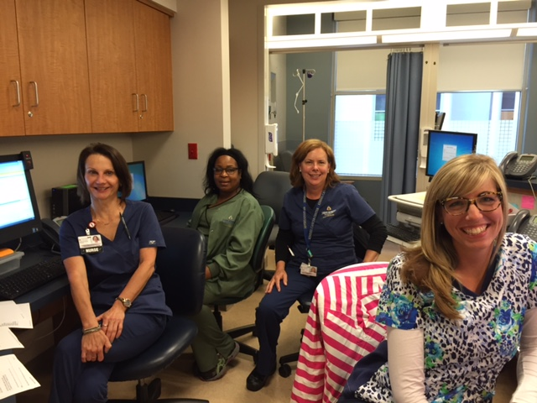
Primary Oncology Nurse/Care Team Coordination
All patients are assigned a primary nurse & primary team who are experts in their disease and the treatments
Primary nurse works closely with research RN and PI to conduct clinical research
All pts have a ACE nurse who works exclusively with the primary nursing team
ALL primary RN’s maintain patient database
Primary RNs attend disease based weekly meeting with care team
1 clinical nurse specialist
1 clinical specialty pharmacists
4 social workers
2 dieticians
1 psychiatric nurse liaison
Palliative care RN

Slide 18
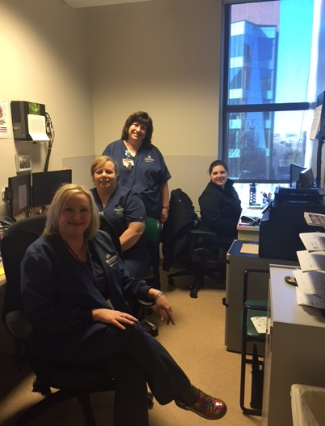
Ambulatory Clinical Evaluation Team -ACE
Inter-professional team made of experienced oncology nurses and pharmacists.
Each person has a specific role in a timed workflow to clear patients and have their drugs prepared in advance of their appointment.
Purpose of this initiative: To prepare to see our patients in advance of their appointment, to prevent same day inefficiencies, to reduce patient wait times, and to ensure safe delivery of cancer therapy for all patients.
All patients receive an RN phone call the night prior to their appointments.

Slide 19
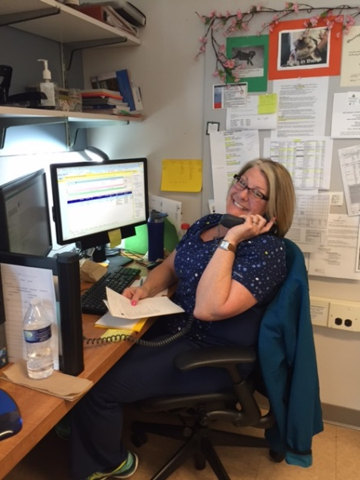
Oncology Nursing Telephone Triage
Goal: support patients and prevent ED and
Hospital admissions
~80% oncology patient EHR utilization
2 Triage RNs- 60 yrs of Oncology experience
After hours oncology MD
Service- 24/7
  Symptom calls
  Patient advice
  Support
  Prescription refills
Referrals

Slide 20
Injection Clinic
Provides rapid assessment and treatment
Standardization
Decreased patient wait times
Increased patient satisfaction
Increased staff satisfaction

Slide 21
Port and Central Line Access Clinic
Port and central line vascular access expert RN
Standardization
Rapid access and phlebotomy
On site troubleshooting

Slide 22
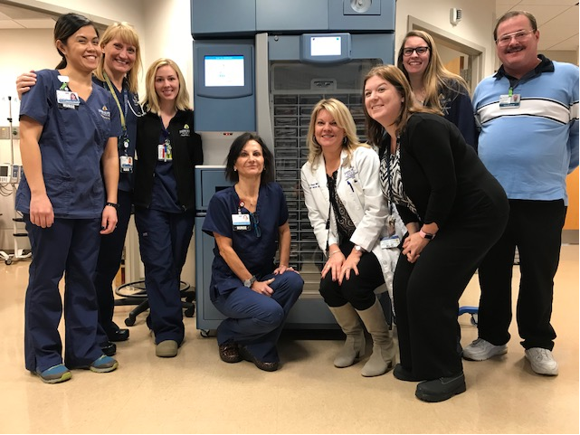
Blood and Hydration Station
Standardization
Staffed by hematologic malignancy nurses
Transfuse on average- 334 PRBCs/Month
Transfuse on average- 268 PLTs/Month
Blood wastage= 1.62 products per month

Slide 23
Oncology Urgent Care Center
Mission:
To provide immediate oncology expertise & intervention in safe environment that promotes effective continuity of care
Vision:
Accessible, advanced oncology urgent care services that
  reduce emergency room visits
  prevent unnecessary admissions
  stabilize patients symptoms
  prevent further patient decline
  support patients ambulatory status
Values:
Right patient in the right environment with the highest quality care at the lowest cost

Slide 24
Background
More than 50% of Medicare patients receiving chemotherapy have at least 1 ED visit/year
80% of ED visits lead to admissions
Average ED cost: $800
Average admission cost: $22,000
Source: 2013 Advisory Board

Slide 25
Significance
Oncology patients experience acute symptoms & toxicities
ED often the only option
Oncology Urgent Care Center
  decreases ED visits
  reduces avoidable admissions
  provides continuity of care
  promotes patient/family centered care
  improves patient safety & satisfaction

Slide 26
Oncology Urgent Care Center Resources
Staffed by NP, RN, Clinical Technician
Consultants
  Oncology pharmacist
  Procedures team
  Palliative care team
    Symptom management and end of life planning
  Oncology wound care nurse
  Oncology Clinical Nurse Specialist
  Oncology Social Work and Dieticians
Two preapproved slots available each morning for center call
Patients too sick for Urgent Care get transferred out within 1 hour (6 bed inpatient Oncology Critical Care Unit)

Slide 27
Summary
The cost of cancer care continues to rise
The number of survivors is increasing
Novel strategies for the delivery of care are necessary
  Quality and safety
  Patient-centered care
  Cost Effectiveness
  Evidence-based practice
  Standardization

Slide 28
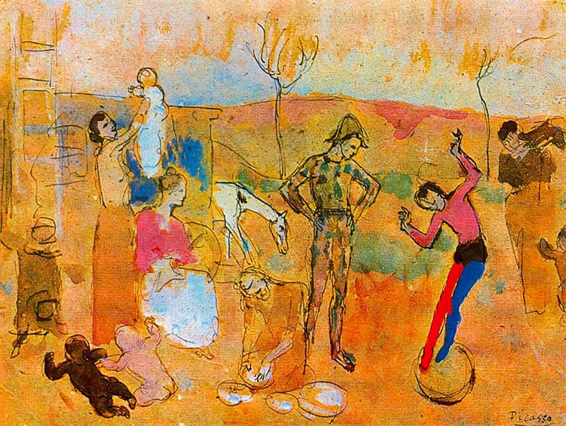
PATIENT NAVIGATION
Navigating Cancer Survivorship
  Jennifer Wenzel, PhD, RN, CCM, FAAN
Associate Professor: Schools of Nursing, Medicine
  Johns Hopkins University; Baltimore, MD
Picasso: Family of Jugglers, 1905
Notes:
Discussion of the family and how this conceptualization has shifted
Recognition that families are very different; thus, their individual and collective needs may differ

Slide 29

Patient & Family Challenges/Needs
PATIENT NAVIGATION
Information
Daily life integration
Self-care
Balancing
Emotional support;
  positivity
Rockwell: Glen Canyon Dam, 1969
Notes:
Information that they need to take care of their loved one. Then being taught how to integrate that into their life. It's fine to be taught how to do a procedure or a technique, but unless we know how to integrate that into the family environment, the home environment, it's really not effective teaching. I also think caregivers have to learn how to take care of themselves and fulfill their other responsibilities at that same time, for instance, having other children and other people that they're expected to take care of in the family, as well as having full-time jobs. - See more at: http://www.curetoday.com/cure-forum/brain-cancer/464/#sthash.LF0JfS4o.dpuf
Interventions:
Help with research (disease, treatment)
Listen & Learn (understand family beliefs—use open-ended questions to aid understanding)
Understanding what to expect
Observing and referral, as needed (i.e., legal issues)
Validate feelings/emotions
Allow time for decision-making
Anticipate transitions and assist with survivorship planning

Slide 30

Factors Influencing Patient and Family Response
Importance of others (+ or -)
Influence of care providers & systems
Financial resources
Adequate health care coverage
Depression/anxiety
Knafl, Deatrick, & Havill, 2012; Turner, 2004
Benson: Summer of 1909

Slide 31

Health Care Providers
Goal: Recognize patients and families as partners in care.
Help them to live as a family—integrating treatment into daily life
Establishing normalcy as much as possible within the context of family life →better outcomes for patients and families
Connection to available resources
Lawrence: The Builders, 1974
Notes:
It’s important for nurses to recognize the family as their partners in care. Many times the nurse knows family best and the issues that are concerning them. Families look to nurses to help them learn to live each day as any family would. They want to be able to say, 'OK, my family member is having cancer treatment, but how can I integrate that so I can have a life that I see as more normal than not?' In fact, we find that families who are able to do that do much better, their loved one gets better care, and everybody has better outcomes when they are what we call 'family focused' in their management. While we want to teach people how to take care of a condition, we need to reframe that as nurses and talk about how can we take care of this person in the context of ongoing family life.

Slide 32
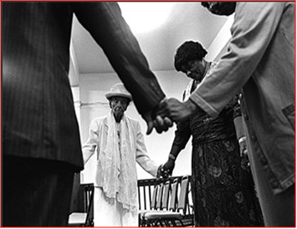
Care Transitions
Patients & families may draw closer early in care; this may change
Social support needs are dynamic
Financial planning, coping techniques (disease, symptom management), counseling, and education needs continue post-treatment
Adjustment to a ‘new normal’
M. Brown
Sherwood et al., 2011; Klimmek et al., 2015
Notes:
Stages: Diagnosis, Treatment, Follow-up
Atul Gawande tells us that each person has a story. Each family also has a story—part of our role, as providers, is to help patients and their families as they shape these stories, specifically, how they take cancer diagnosis and treatment—what we can think of as the central conflict—and construct their own ‘resolution’.

Slide 33

Navigation to Support
Patients & Families throughout the Cancer Experience
Alston: Family in Cityscape, 1966
Notes:
if we can help families function effectively, we can help maximize the neurocognitive functioning that the survivor has. For example, sometimes brain tumor survivors may have trouble with what we call executive functioning, or just that ability to organize, prioritize, and move forward. In other words, that's what really stops them from getting through the day. But if you have a functioning family that has some degree of organization — things are just not chaotic — that can enable the best neurocognitive functioning that's possible.
Late effects of treatment and the tumor.
http://www.curetoday.com/cure-forum/brain-cancer/464/#sthash.LF0JfS4o.dpuf

Slide 34
Patient Navigation
“The use of lay community health workers to help patients overcome barriers in their communities and in the health care system”
Commonly applied in the context of cancer prevention and treatment but also used in other health conditions
Fouad et al. J Onc Prac 2016, Paskett et al. CA Cancer J Clin 2011
Notes:
Strategy for overcoming barriers to participation….screening, treatment, clinical trial participation, survivorship
Bridge between patient and health care system
Has been used to increase trial enrollment among African Americans, Asians and Pacific Islanders, Latinos/Hispanics, and American Indians
Also aids in retention
Patient navigators may be clinicians, health educators, social workers, former patients, or community health workers/promotoras
Patient feedback: study participants like people who are not professional providers to engage with
Addressing scarcity of RNs and Social workers

Slide 35

Navigators
Patient Navigators are trained to:
Provide clinic-based information about trials to minority patients
Support minority patients enrolled in clinical trials
    Logistical barriers
      Utilizing resources available within cancer centers
      Referral to existing community resources
    Cultural considerations
    Emotional support
Notes:
Asking the right questions in a way that is not humbling; multiple questions different ways

Slide 36
STRATEGY 1
COLLABORATE WITH PROVIDERS
STRATEGY 2
PARTNER WITH COMMUNITY
STRATEGY 3
INVOLVE KEY DECISION PARTNERS
STRATEGY 4
PATIENT NAVIGATION
STRATEGY 5
INCREASE FEASIBILITY OF PARTICIPATION/ADHERENCE
STRATEGY 6
MAINTAIN CONNECTIONS
STRATEGY 7
ACKNOWLEDGE STRENGTHS/ONGOING NEEDS
Notes:
Not forgetting about these essential strategies when we think about how navigation fits into care delivery.

Slide 37

Family Navigators
Influence decision-making about treatment
Influence feasibility of treatment completion
  Familial obligations
  Logistical assistance
  Assistance with translation
WOMEN ARE MORE LIKELY TO DISCUSS DECISIONS
WITH FAMILY & FRIENDS
Wang et al. Clin Trials 2014; Wenzel et al. J Racial Ethn Health Disparities 2015,

Slide 38
Family-Centered Navigation Interventions
Goal: Increase patient, care partner engagement, activation & treatment adherence
Computer mediated communication programs targeting: a) cancer patients; b) care partners; and c) oncologists . A web-based communication skills glossary will include multiple video clips demonstrating communication skills uses the LEAPS framework (a pneumonic for Listen, Educate, Assess, Partner & Support).
Care partner training program targeting: specific stress points (appointment scheduling, compliance, decision making), and care transitions via facilitated enrollment and support using MyChart (EMR).
Notes:
Without resources in hand/place, providers/staff feel ill-equipped to even ask the right questions or identify resources.
Identify the ‘stress points’ for CTs for our patient population

Slide 39
Family-Centered Navigation Interventions (cont’d)
Goal: Increase patient, care partner engagement, activation & treatment adherence
Decision support for advanced prostate cancer decision-making for patients and care partners: nurse-community patient navigator-delivered decision intervention
Patient navigation/decision support for patients and decision partners eligible for therapeutic cancer clinical trials.
Notes:
Investing all of our time/resources in recruitment without attention to retention means the study outcomes won’t be moved.

Slide 40

Case Example: Survivorship
Alston: Family in Cityscape, 1966
Dali: Portrait of the Briggs Family, 1954

Slide 41

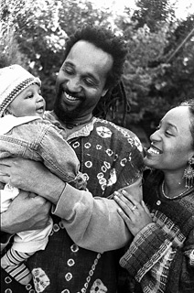
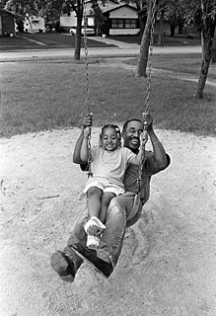
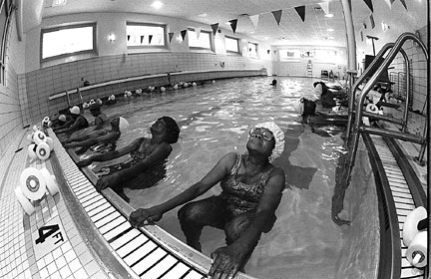
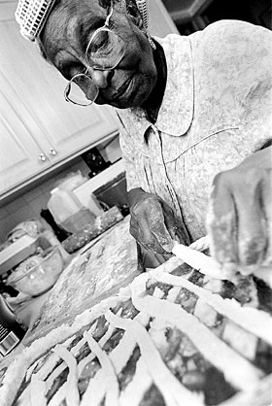
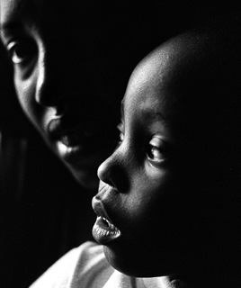
Kenneth Muhammed , 2001
Funsho Akerele-Ale, 2001
Leonard Evans, 2001
Milbert O. Brown, Jr 2001
Michael Bracy ,2001
All photographs by artists associated with the Chicago Alliance of African-American Photographers (CAAAP).
Notes:
“Call it a clan, call it a network, call it a tribe, call it a family: Whatever you call it, whoever you are, you need one.”
Elizabeth Jane Howard: novelist

