Slide 1
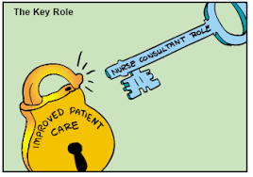
Turning Passion and Purpose into a Successful Consulting Practice – One Nurse’s Journey
Marla Oros, RN, MS
April 13, 2019

Slide 2

Learning Objectives
Describe the ways that nursing expertise can become a foundation for consultation
Identify the initial steps to exploring or developing a consulting practice
Define the critical success factors for implementing and growing a successful consulting practice

Slide 3

Defining Management Consultancy
Management consultancy is the creation of value for organizations, through the application of knowledge, techniques and assets, to improve performance. This is achieved through the rendering of objective advise and/or the implementation of business solutions

Slide 4

About Mosaic Group
The Mosaic Group is a nationally recognized management-consulting firm with expertise in community and public health, and human-services strategies, program design, and evaluation across a breadth of content areas.

Slide 5
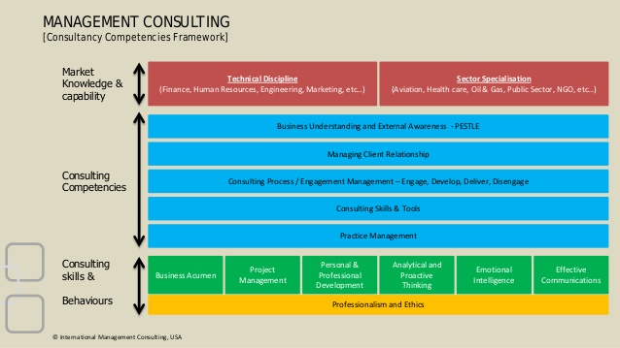

Slide 6
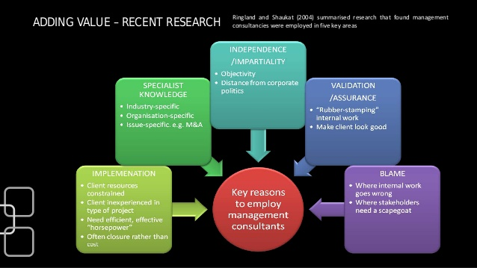
Adding Value – Recent Research

Slide 7

Nursing and Consulting
Subject Matter Experts
  Clinical content expertise – Service line management
  Policy expertise
  Research and Education expertise
  Staffing, recruitment and retention
  Management practices
Implementation Specialist
  Clinical program design
  Curriculum development
  Policy and procedure design
  Nurse recruitment and retention
“Hot Areas”
  Population health
  Informatics
  Quality improvement/cost management
  Magnet status – blue ribbon quality

Slide 8
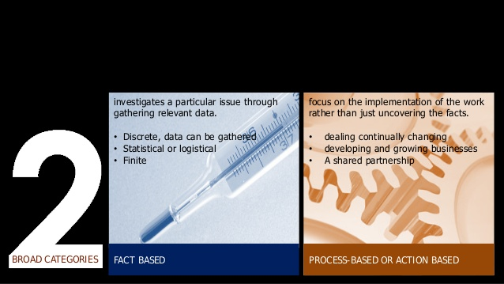
Consulting Project Types

Slide 9
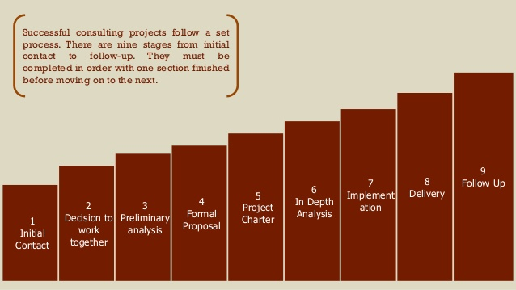
Consulting Processes

Slide 10
Steps to Get Your Business Started
Establish
Establish your business – Decide on the legal model for your company
Develop
Develop basic marketing materials – Name of business, address, website
Build up
Build up your Rolodex
Find
Find your niche
Practice
Practice a set of talking points
Get
Get ready to formulate proposals and letters of engagement
Lay out
Lay out your pricing structure
Be
Be prepared to execute when a client says “YES”

Slide 11
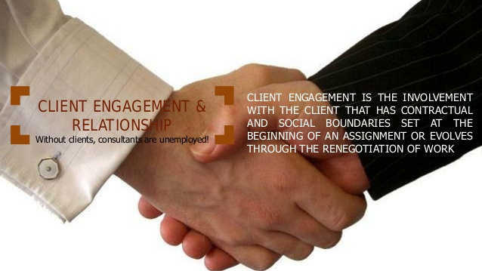

Slide 12
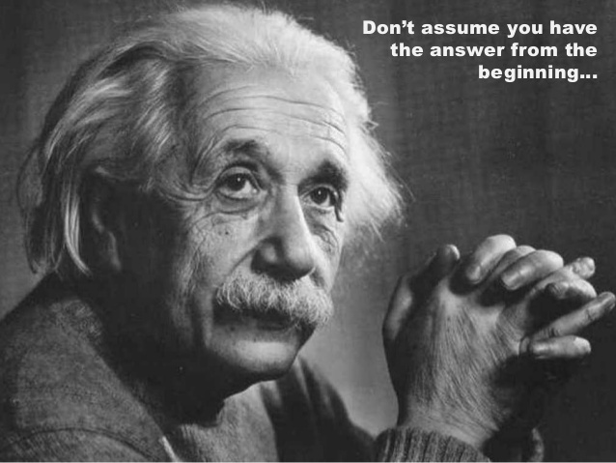

Slide 13
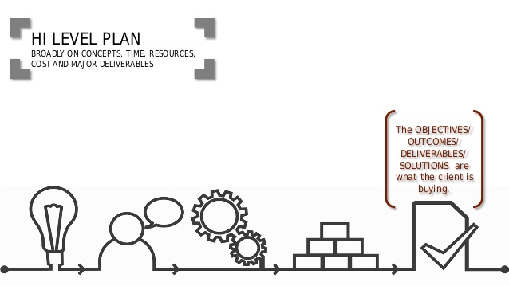

Slide 14
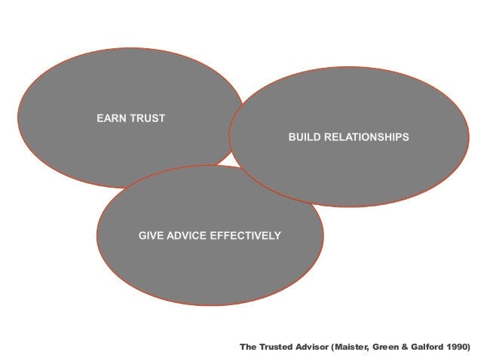
Critical Success Factors

Slide 15
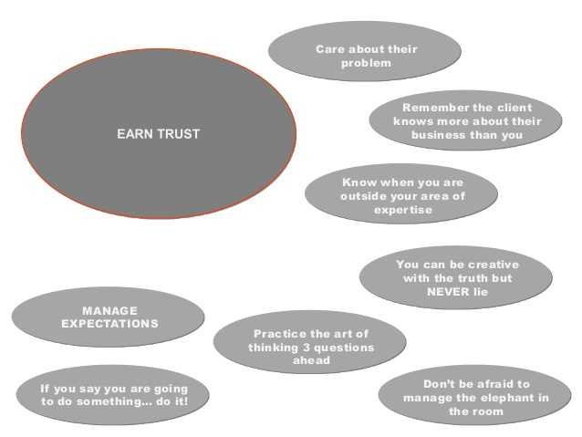

Slide 16
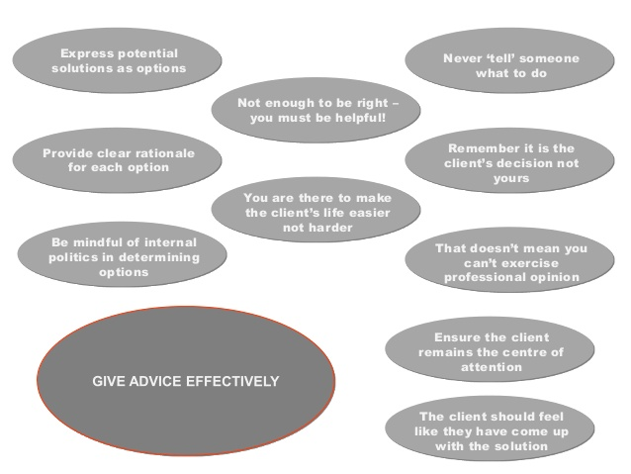

Slide 17
Questions?
Marla Oros, Rn, MS, President
(410) 852-4263
moros@groupmosaic.com

