Slide 1
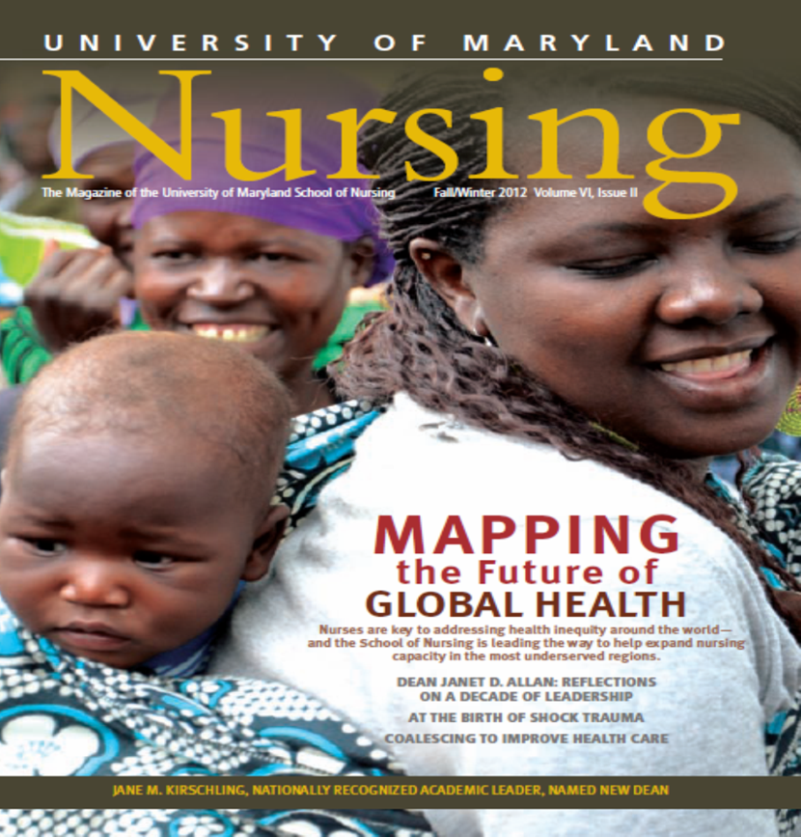
Global Health Nursing
Leadership and Practice in Action
Dr. Yolanda Ogbolu, FNAP, FAAN
University of Maryland School of Nursing!
Building the next generation of nurse leaders in education, research, practice and Global Health!

Slide 2
Objectives
Learning outcomes:
Stimulate inquiry related to the role of nurses in global health practice, education, research and leadership.
Describe nursing and interprofessional global health activities within UMB.
Explore opportunities for nursing engagement in global health in local and international communities.
Panel of Speakers:
Yolanda Ogbolu, PhD, CRNP-Neonatal, FAAN- Global Health Nursing Leadership and Practice
Trish Martin, DNP,CRNP- Global Health Nursing: Leadership in Action
Adanna Agbo, DRPh candidate, MSN, RN- Global Health Scholarship in Action

Slide 3
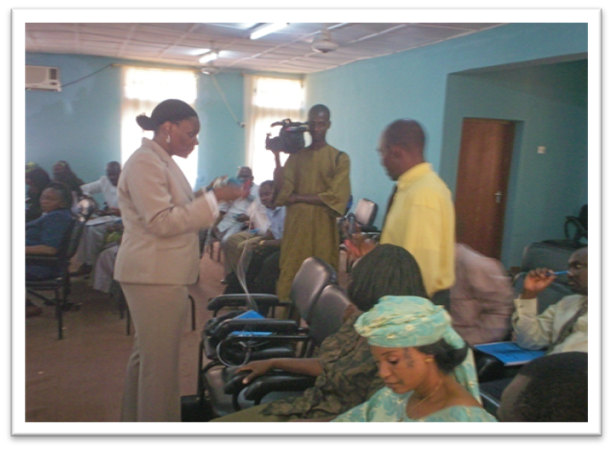
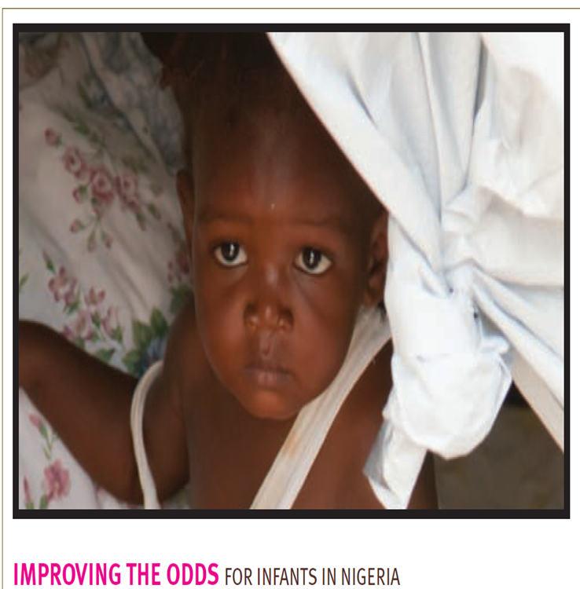
My 20 Year Journey Towards a Leadership Role in Global Health Nursing
1998- 2006

Slide 4
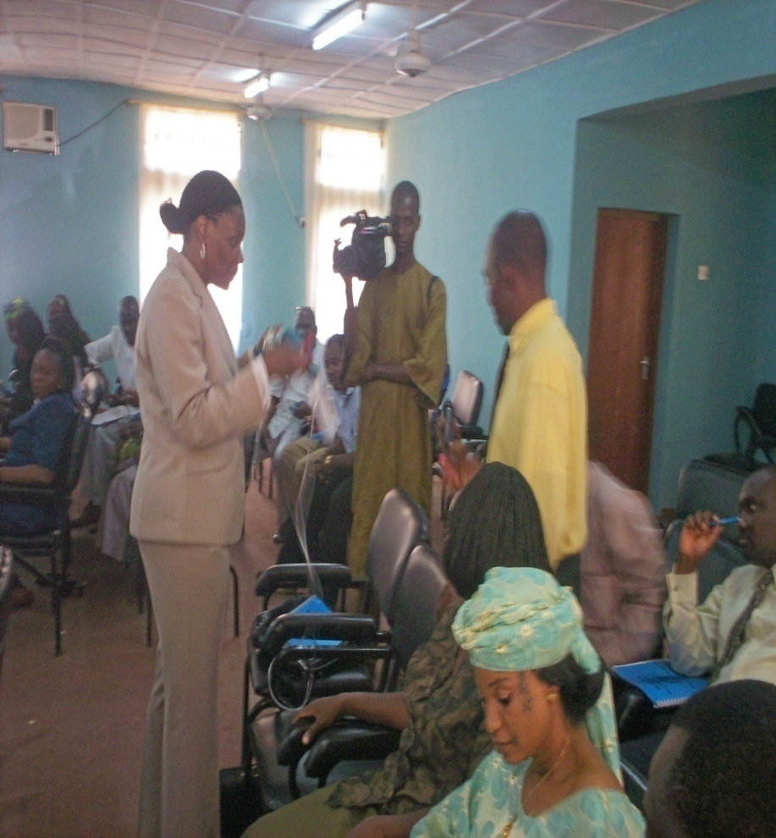
Knowledge Translation Neonatal Resuscitation Class in Kebbi State, Nigeria
Lecture Presentation
Clinical Simulation

Slide 5
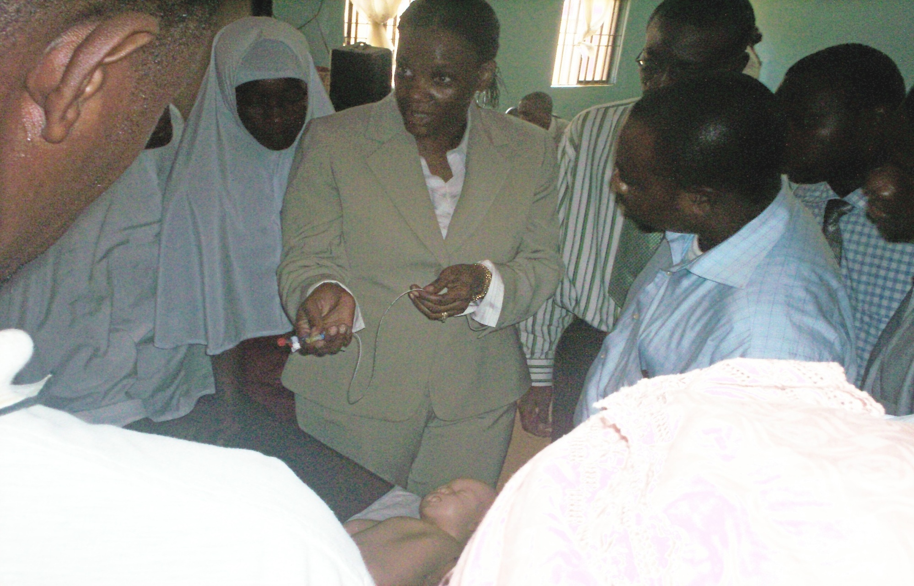
Diverse Group of 114 MCH Professionals have attended Bi-annual NRP Seminars to date

Slide 6
early Journey Towards Leadership in Nursing
Qualitative Study (2008)- Maternal Child Health Physicians in Nigeria-Perspectives on improving neonatal survival
Mixed Method Study (Survey and Interviews) (2010)examining the impact of nurses staffing and practice environment on neonatal outcomes
Curriculum development for Advanced Practice Providers (2011)
Collaborations with key Nigeria Stakeholders including a local NGO, 3 nursing schools, nursing and midwifery councils, and inter-professional regulatory bodies

Slide 7
Why focus on nurses?
Nurses are the most essential component of health care systems, yet are the most neglected and overlooked¹
Nurse constitute the largest number of healthcare providers in sub-Saharan Africa and are the backbone of the health care setting.²
1. Joint Learning Initiative (2004); 2. WHO ,(2006 ) USAID (2003); International Council of Nurses (2004);3. (Aiken, Clarke & Sloane, 2002, Aiken, Sloane & Lake, 1997, Aiken, Smith & Lake, 1994, Aiken, Clarke, Sloane, Lake, & Cheny, 2008, Farley & Ozminkowski, 1992, Flynn, 2007, Flynn, Thomas-Hawkins, & Clarke, 2009 2005,, Gardner, Thomas-Hawkins, Fogg, & Latham, 2007, Hartz, et al., 1989, Kane et. al, 2007, Manheim et al., 1992, and Needleman et al, 2002, , Rantz et. al, 2004)
Notes:
According to the Joint Learning Initiative (JLI), a consortium of more than 100 global health leaders convened in 2004, the health care worker is the most critical factor to health system performance, yet often the most neglected and overlooked (2004).
There is growing consensus among international agencies that nurses form the backbone of health systems and constitute the largest number of professional healthcare workers in sub-Saharan Africa (Ogilvie, Mill, Astle, Fannings & Opare, 2007, the Regional Network for Equity and Health for Southern Africa (EQUINET), Health Care Systems Trust (South Africa) MEDACT (UK), the United States Agency for International Development (USAID), 2003; the International Council of Nurses (Buchanan & Calman, 2004); World Health Organization(Buchan, Parkin and Sochalski, 2003, WHO,
Despite the fact that nurses are the primary care providers in Sub-Saharan Africa, very little attention has been given to the Modifiable nurse organizational factors, such as nurse qualifications(education and experience), staffing, the practice environment of these nurse, and its impact both the care practices that nurses are able to perform and on patient outcomes has received very little attention in Africa.

Slide 8
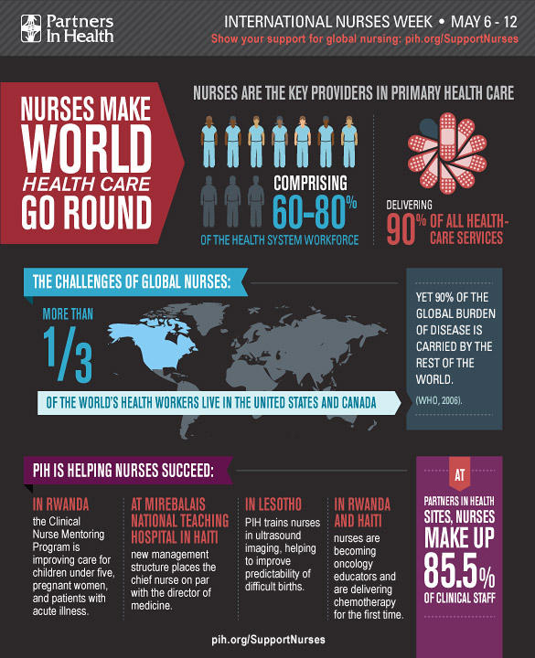
Global Health Nursing offers:
Opportunities to shine a light on the work of nurses around the world
Improve patient outcomes in our local and global communities.
Notes:
Nurses shoulder more than their share of care for the sick in poverty-stricken communities around the world, but they're underpaid, under-supported and undervalued. We believe all nurses deserve the education, compensation, and empowerment that will enable them to provide the best care to their patients.

Slide 9
Nursing image across the globe
The professional image of nurses is challenged in many places in the world
Poor professional image, professional development and regulation systems
Nursing image is better in most high resourced countries
“Nurses working in global health have a duty to shine a light on the work of nurses in countries where the challenges are the greatest!”
-Gini Williams, RN

Slide 11
Neonatal Survival in Nigeria
United States
Nigeria
150 million people
214,000 nurses
Newborns primarily born at home without a professional birth attendant
Deliveries in PHC
Patient to Nurse ratios- not mandated
Limited or absent Emergency transport
311 Million people
2.6 million nurses
Newborns born primarily in the hospital
No deliveries in primary health care (PHC)
Patient to nurse ratios indirectly mandated- QA plus NANN & AAP
Emergency transport system in place

Slide 12
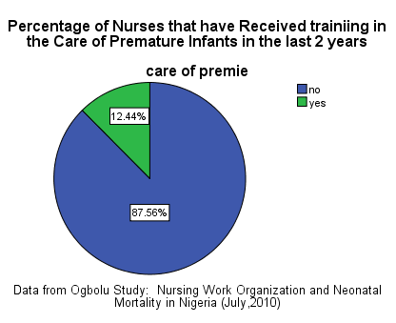
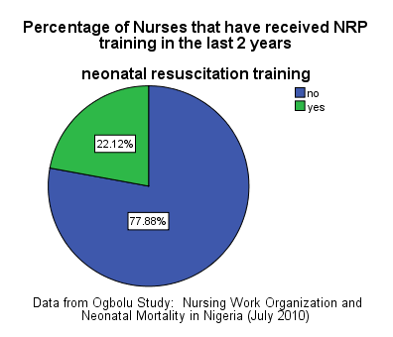
Neonatal Education & Training

Slide 13
Lessons Learned from Nurses in Nigeria
Nigerian Nurses are creative and resilient
Making an impact despite limited resources
Functioning in an advanced practice role due to limited number of physicians
Saving newborn lives despite challenging conditions
The role of neonatal nursing is emerging, not static

Slide 14
Key considerations for Building overall nurse Capacity
Defined Roles and Competencies
Education and training
Prerequisites
Regulatory Prohibitions
Related policies
Extending scope and standards of practice
Quality Improvement
Scope and standards of practice
Basic competencies for neonatal nurses
Interdisciplinary Stakeholders
Threat of role usurping
Education
Sustainability
Funding
Continuing and Preservice education-
NRP, HBB, Essential Newborn Care Package

Slide 15
Global Health at UMSON
We shape the profession of nursing and the health care environment by developing leaders in education, research, and practice
As a catalyst for creativity and collaboration, we engage diverse groups of professionals, organizations, and communities in addressing local, national, and global health priorities.
Consistent with the SON’s mission, The Office of Global Health strengthens nurse leadership and capacity by developing local, national, and global nurse leaders

Slide 16
OGH
PARTNERSHIP & PROFESSIONAL Education and Practice DEVELOPMENT
Professional Development
Simulation
Institute for Educators
Governors‘
Well mobile
Standardized Patient Center
University of Maryland- School of Nursing & Dean Kirschling
UMB- Campus Linkages
Global Health Interprofessional Council
Center for Global Education Initiatives
SOM’s WHO Collaborating Center on Occupational Health
Maryland Global Health Initiatives Corporation (MGIC)
The Institute of Human Virology (IHV)
The Global Health Institute in the School of Medicine
Notes:
Due to its school wide mission, meta-partnerships and ongoing relationships across the SON and campus are essential. The departments identified here have been directly or indirectly involved in OGH activities over the last 5 years. In addition, OGH has several key linkages across the campus, given the interprofessional nature of the work that we do.
MGIC is a non-profit affiliate of UMB with a mission to administratively support international operations of UMB Principal Investigators. Our purpose is to provide the administrative infrastructure for sizable and sustained operations outside of the U.S. Currently, MGIC operates in Kenya, Nigeria, Rwanda, Tanzania, and Zambia, with registration application in-process in Haiti. These operations support the research and clinical programs of the SOM, Institute of Human Virology.

Slide 17
Our Office of Global Health (OGH)
Global Health Education
Service
Scholarship &
Practice
Partnership
OGH
Notes:
In order to meet its key strategic goals, OGH functions and provides services to the entire school. Educational opportunities are provided for all students across all programs in SON. OGH has policies and practices in place to support faculty who are interested in collaborating and working with international post docs, scholars, or visiting scientists and faculty. OGH is the predominant organization responsible for ensuring visibility for SON in GH scholarly output and programmatic activities. OGH has also had a key leadership role in developing international and local partnerships. These activities are linked, For example, students and faculty have transformative service learning experiences in Liberia and Rwanda due to the ability to develop partnerships. Many of our publications and scholarship are linked to our work in global health education and service.

Slide 18
Global Health Nursing Education
Create innovative, global health learning experiences and educate nurses and other global health interprofessionals
Educate, develop, and mentor students to become the next generation global health nurse leaders
Undergraduate and graduate global health courses, some online
Global Health Certificate Program
12 credit program for working professionals or those interested in developing a career in global health
For individuals interested in becoming global health leaders
Notes:
Globalization, populations becoming increasingly diverse
Inability to meet international health goals due to shortage of qualified healthcare workers (nurses)
Knowledge based, technology driven society
Increased demand globally for advanced nursing education
Shared and continued (lifelong) competence

Slide 19
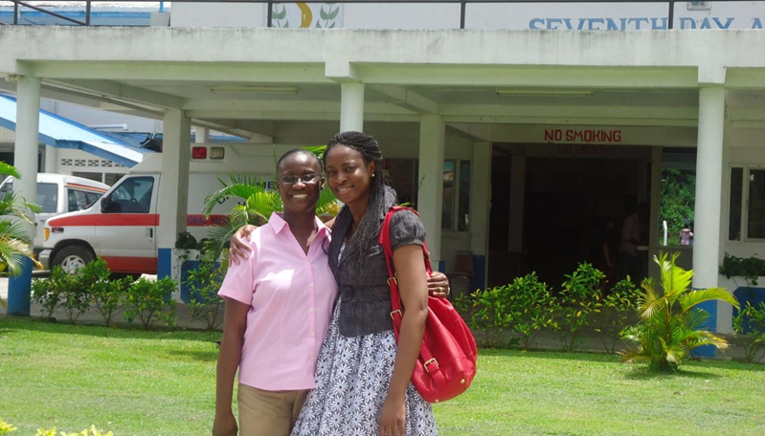
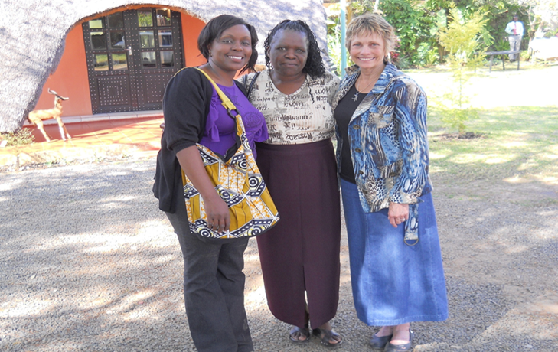
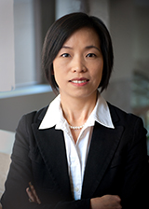
Transformational Experiences for Students & Faculty
Field placements-Service Learning Abroad
~60 students in 6 years
Support interprofessional GH experiences for faculty and students
Expanded Financial Support
Developed the Global Health Support Fund
Dr. Lee- Faculty Award to Hong Kong
Notes:
Transformational global health experiences are expected by students attending premier institutions like the University of Maryland. The ability to offer these exchanges is important to our competitive advantage.

Slide 20
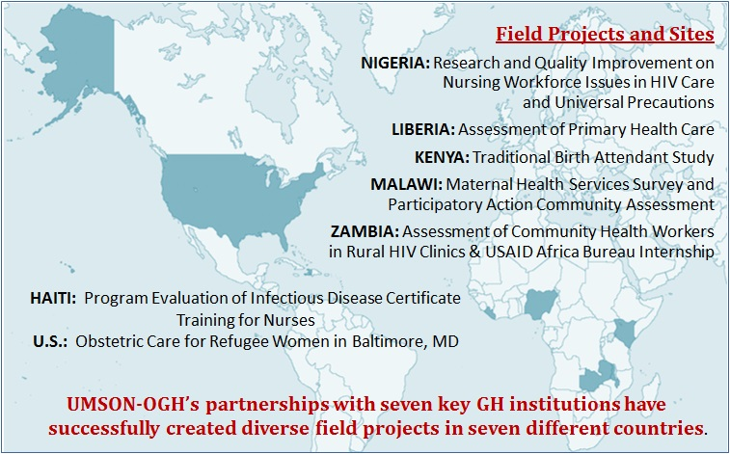
Signature Global Health Partnerships
Rwanda
Human Resources for Health Program
Clinton Health Initiatives
Nigeria*
University of Nigeria, Nssuka
OAU
Liberia*
Stella Maris Polytechnic Institute, Mother Patern College of Health Sciences
Oman
Ministry of Health, Oman Nursing Institute, and Sultan Qaboos University
*Countries impacted by Ebola outbreak
Notes:
Develop collaborative partnerships internally and externally with international organizations and nursing universities
Joint program of research, education or practice between two nurses schools that augments the capacity of both to solve a common problem
Requires continuous collective engagement

Slide 21
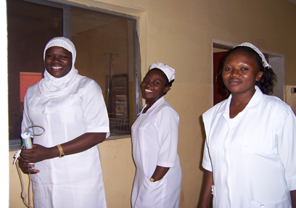
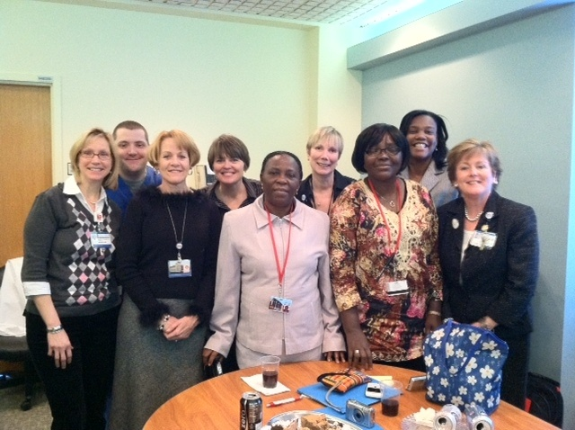
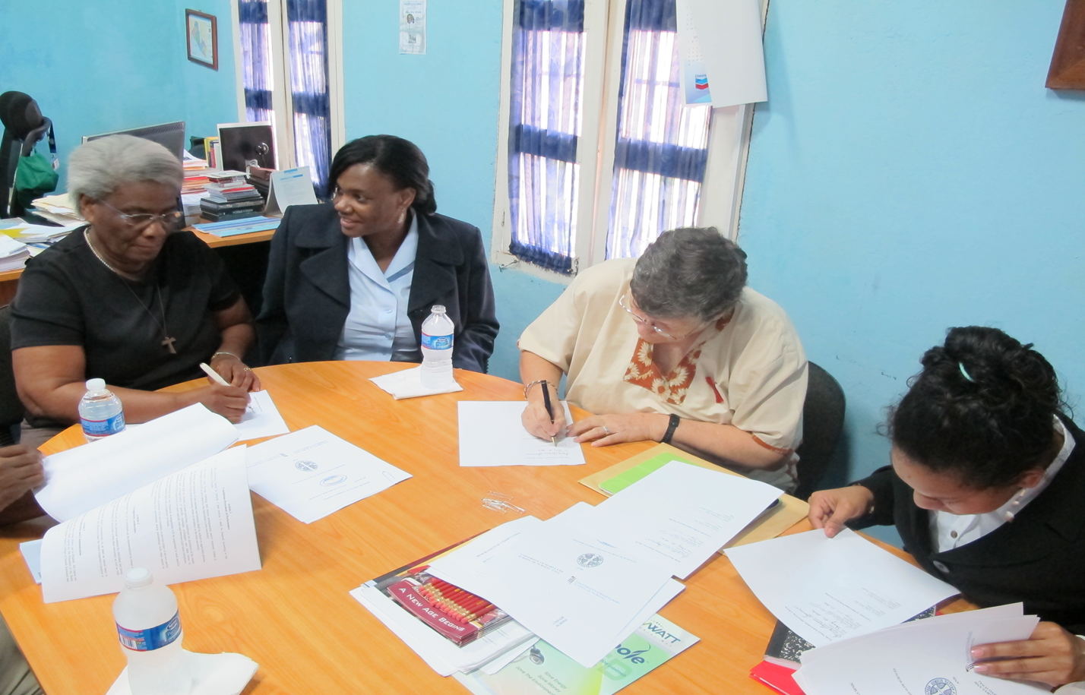
Building Meaningful Partnerships
Takes time and means Being Ready when it matters
Nigerian Nurses at UMB 2011
Liberia 2013
Notes:
We have proven to be quality, trustworthy partners – sustainable partnerships; Non-paid services that need to be recognized: Advising partners (SCGE), mentoring, publishing with partners;Health workforce strengthening
We’ve also created an institutional capacity w/in the SON and UMB campus and are well positioned to undertake significant educational, programmatic and partnership activities – we’ve built our capacity and now have the ability to respond to current conditions

Slide 22
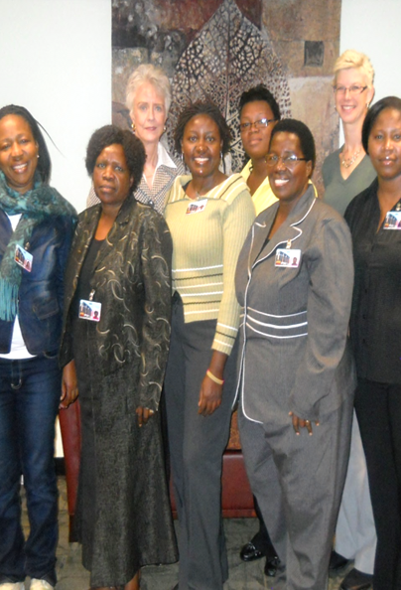
We Also Welcome International Visitors
Two programs
individuals or Groups
Visiting program welcomes international teams
Visiting Scholars Program- welcomes scholars who are matched to mentors
Notes:
Two programs are offered the International Scholars Program and the International Nurse Exchange program. Both offer opportunities for nurses from different countries have come to USA to learn from UMB Nursing Work with clinical preceptors (mostly in UMMS system) to develop their skills
Focus of scholars has varied from HIV/AIDS to simulation training. My vision is to expand these programs to match efforts of GH faculty including towards maternal and child health, occupational health, and nurse leadership programs. These programs have the potential to bring revenue to the school and should be expanded.

Slide 23
The Future of Global health!
“Human progress is neither automatic nor inevitable. We are faced now with the fact that tomorrow is today. We are confronted with the fierce urgency of now.
-Dr. Martin Luther King Jr.

