Slide 1
castlebranch
Dr. Kelsey Bradford

Slide 2
Reimbursement
Senior Administration and University officials aware of Complio situation
Working on a plan for reimbursement
Final plans will be shared
Disbursement will take place at a later time
No further details at this time
Keep copy of receipt of payment to Complio

Slide 3
complio
No longer being used
Cannot access information
Information will not transfer to CastleBranch

Slide 4
Continuing students
No need to reorder either package, if both had been previously ordered
Update any outstanding requirements
Should say “complete” next to requirement on to do list
Deadline: August 15, 2023
ALL requirements
Continue to maintain compliance throughout semester

Slide 5
Incoming students
Order package 1 and 2
If you ordered package 1 previously, only need to order package 2
If you ordered package 1 and 2, make sure all requirements are complete
Deadline package 1: August 15, 2023
Deadline package 2: August 21, 2023

Slide 6
Package 1
Contents: MMR, Varicella, Hepatitis B, TB, Tetanus, MCV
Click here.
Choose Place Order
Under Please Select, choose Student Health
Select School of Nursing
Choose UP93im: Medical Document Manager
Complete the form.

Slide 9
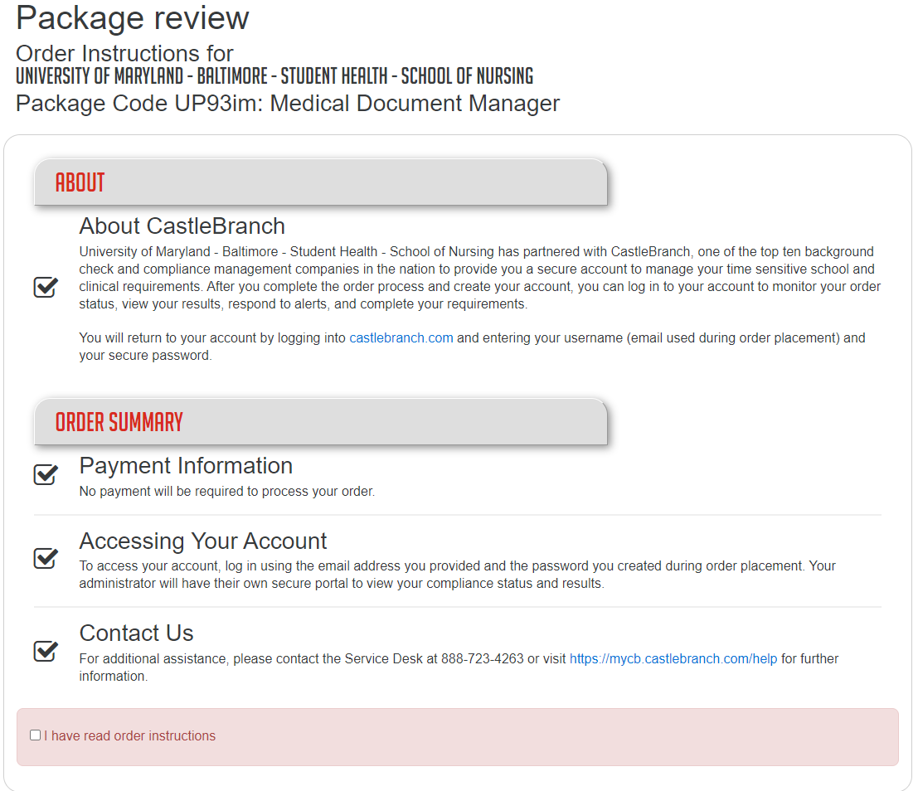

Slide 10
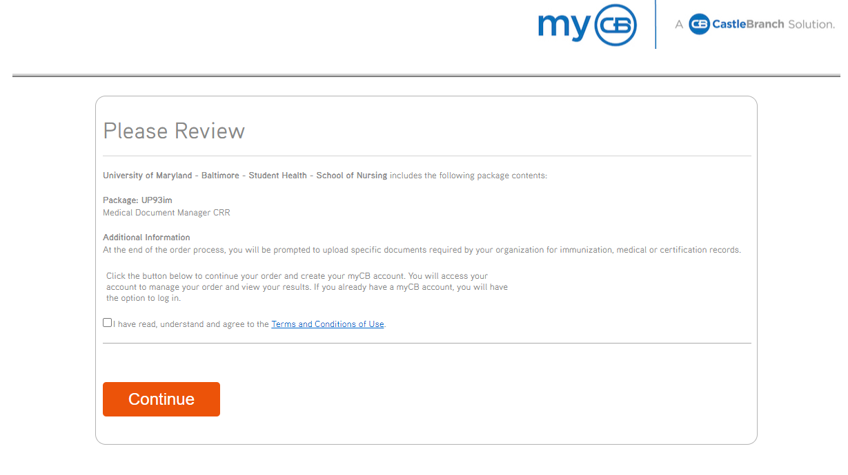

Slide 11
Package 2
Contents: Background check, drug screen, CPR, COVID-19, Flu, HIPAA, Code of Conduct, RN License/ACLS/PALS (for certain programs)
Click here.
Choose Place Order
Select I am a Student
Choose your program from the menu
Select I need to order my package from the drop-down menu
Review the contents of your package, check the box indicating you've read and understand the terms and conditions.
Choose Continue Order and you will be directed to set up your myCB account.
Provide evidence of completion of items outlined under "Compliance Requirements" below.

Slide 15
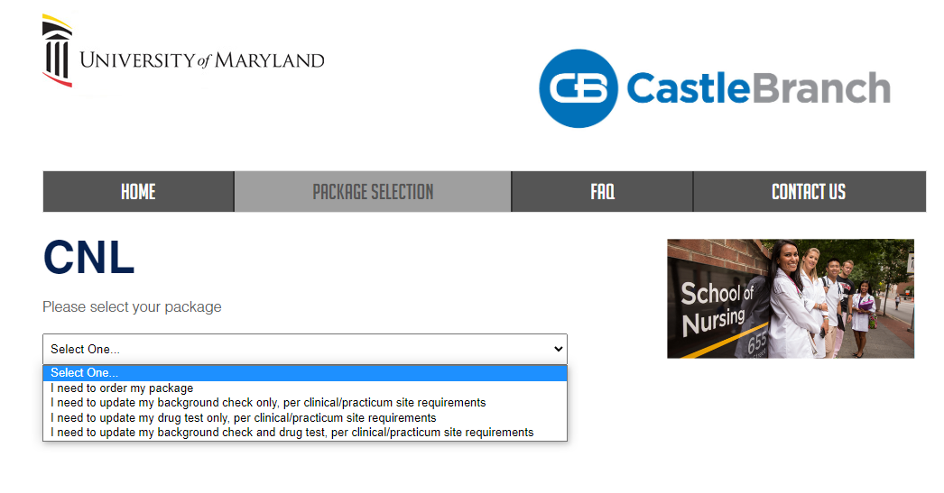

Slide 16
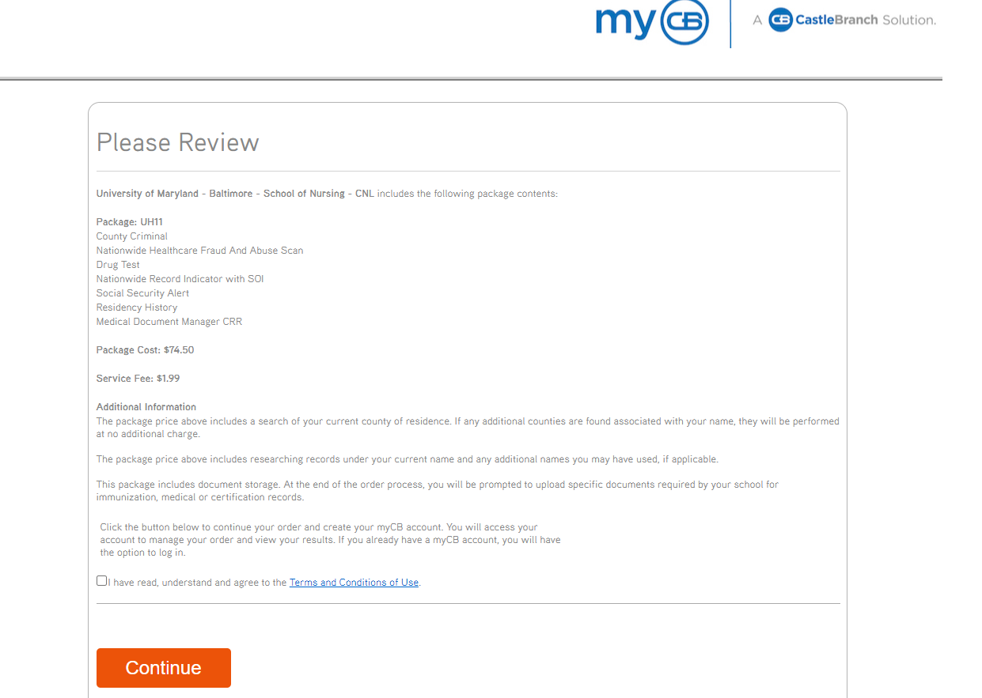

Slide 17
Common questions
Background check & Drug screen:
If already completed in CB, no need to get a new one unless site requires a more recent one
Will not transfer from Complio to CB
Use previous screenshots to help direct finding package code needed
If you used your personal email to create account, that is acceptable, but school email is preferred
If this is your first semester in a new program, please order new packages
Online students still need to be compliant
Flu deadline: October 1, 2023

Slide 18
Questions?
Please email nrscompliance@umaryland.edu
Compliance Team:
Dr. Kelsey Bradford-School Health Officer
Rachael Wright-Compliance Coordinator

