Slide 1
Reducing Re-hospitalizations in the Frist 30 Days and Beyond-
Are the Clinicians Ready?
Danielle Pierotti RN, PHD, CENP
Interim CEO
Vice President, Quality and Research
ElevatingHOME and Visiting Nurse Associations of America
Notes:
Code name: we are all in this together!
What exactly do we need to prepare for? Isn’t this just a hospital issue?

Slide 2
Readmissions: what
The unplanned hospital measures include:
  Rates of readmission measures
  Rates of hospital visits measures
  Hospital return days measures.
      https://www.medicare.gov/hospitalcompare/Data/30-day-measures.html
Notes:
Readmission
The readmission measures are estimates of the rate of unplanned readmission to an acute care hospital in the 30 days after discharge from a hospitalization. Patients may have had an unplanned readmission for any reason.
Visit measures
the rate that patients visit the hospital (in the emergency department, under observation, or in an inpatient unit) following an outpatient procedure. Patients may have a hospital visit for any reason.
Hospital return days
The hospital return days measures add up the number of days patients spent back in the hospital (in the emergency department, under observation, or in an inpatient unit) within 30 days after they were first treated and released. The measures compare each hospital’s return days to results from an average hospital with similar patients to determine if this hospital has more, similar, or fewer days than average.

Slide 3
Readmissions: who, how
ONLY those discharged
over 65 yrs of age enrolled in ORGINAL MEDICARE, excludes death during the admission and those leaving AMA
Data is from claims
Adjusted for Patient characteristics: age, medical hx, comorbities)
Notes:
What is impact of primary diagnosis?
Excludes medicare advantage, private insurance as primary, VA, Medicaid, medicare under 65 AND first 12 months on medicare!
Icd 9 to 10

Slide 4
Readmissions
Reported as better than, no different than or worse than the national rate on hospitalcompare.gov
Rates of all cause readmit have been decreasing
  Since 2013 (hospital penalty program)
  Program is complex:
    3 years of rolling data
    Targeted diagnosis- only 3 in 2013 now 6
    Escalating penalties
Reported for home health “preventing unplanned hospital care”

Slide 5
Readmissions
COPD
AMI
Heart failure
Pneumonia
CABG
Hip replacement
Knee Replacement
All cause unplanned
Notes:
Used for revenue and reimbursement
Building alternative payment
Stars program
Value based purchasing
Hospital compare… public data

Slide 6
Hospital Risk: Readmissions
National 30 day all cause readmission rate
  2007 = 19%
  2012 = 18.4%
  2015 = 15.6%
Hospital Compare
7/1/15 – 6/30/16
15.3%
Home Health Compare
7/1/16 – 6/30/17
12.9%
Notes:
Chf = 22%
Copd = 20%
Currently hospital compare
Nursing home compare
Short term residents21.1%
Are you confused yet?
I am so lets take this from the human side

Slide 7
Hospital Risk: Readmissions
  Readmissions is a core patient outcome.
  Impacts about 2 million people annually
    Reflects the National Quality Agenda
      Population based – encompasses more than the hospital
      Patient centered: rephrase- DAYS at HOME
      Lower cost- hospitals are the most expensive
      Workforce
Notes:
Not just about the hospital finances
Ever readmission is a
Patient- experiencing illness,
Family- under stress
Every ED visit is a system failure.

Slide 8
Quality Agenda
Aging Population
  10,000 new Medicare enrollees a DAY
  80 million enrolled in Medicare by 2035
  In 2017, 1.3 million Medicare hospital discharge to home health
  800,000 people ORDERED for home health but didn’t get it
Population based
Patient Centered
Lower cost
Workforce
Notes:
So lets talk about the 2 million humans and the role of home health care to this issue
Health care is evolving beyond the borders of the hospital walls both with in integrated systems and for independent organizations. Achieving patient, population and business success requires new partnerships across the community. Nursing leadership can seize critical opportunities to break down the walls.
WHY?
Joy- introduced
Now lets talk about the 1:1 level

Slide 9
Why Home-Based Care?
The TRIPLE AIM
Population health
  Improving health not just intervention
  In homes
  In communities and families
  Across the spectrum of health status
Notes:
Increasingly integrated approaches to medical, behavioral, public health and social services
Social determinants of health
Funding for social and community services

Slide 10
Population

Slide 11
Quality Agenda
Providing care that is:
  Respectful
  Responsive
  Individualized to preferences
  Needs
  Values
  and ensures patients guide all decisions. (IOM)
Population based
Patient Centered
Lower cost
Workforce
Notes:
So lets talk about the 2 million humans and the role of home health care to this issue
Health care is evolving beyond the borders of the hospital walls both with in integrated systems and for independent organizations. Achieving patient, population and business success requires new partnerships across the community. Nursing leadership can seize critical opportunities to break down the walls.
WHY?
Joy- introduced
Now lets talk about the 1:1 level

Slide 12

Patient centered

Slide 13
CAHPS National Averages (top box)
  Global rating
    Hospitals = 73%
    Home Health = 84%
    Hospice = 80%
  Recommendation
    Hospitals = 72%
    Home Health = 78%
    Hospice = 84%

Slide 14
Quality Agenda
Hospital vs. Home
  Inpatient care avg: $1,974-$2,346/night (Ellison, 2016)
  New Jersey state/gov hospital - $4,656
  Montana state/gov hospital $645
  Home care avg cost: $2,443 per 60 DAY EPISODE
Population based
Population based
Patient Centered
Patient Centered
Lower cost
Workforce
https://www.beckershospitalreview.com/finance/average-cost-per-inpatient-day-across-50-states-2016.html
Notes:
So lets talk about the 2 million humans and the role of home health care to this issue
Health care is evolving beyond the borders of the hospital walls both with in integrated systems and for independent organizations. Achieving patient, population and business success requires new partnerships across the community. Nursing leadership can seize critical opportunities to break down the walls.
WHY?
Joy- introduced
Now lets talk about the 1:1 level

Slide 15
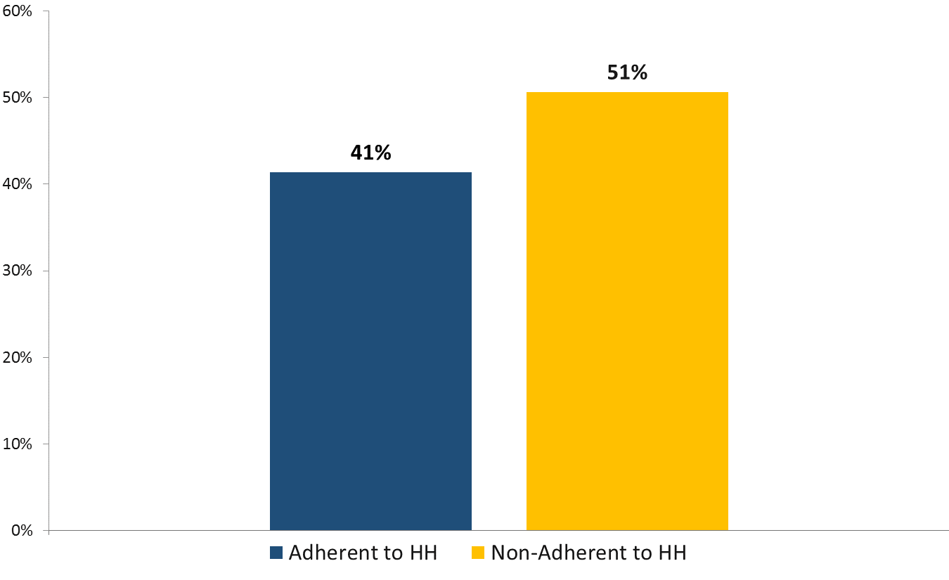
UNPUBLISHED
365-day Readmission Rate
800,000 adherent
500,000 non-adherent
2017 national, non-risk adjusted

Slide 16
Home Based Care: Integrated Systems/Networks
Western Connecticut Home Care (WCHC) is a fully-integrated division of Western Connecticut Health Network (WCHN) in Danbury, CT
Problem: bed flow related to high intensity, charity care patients
Solution: Upgraded home services
OUTCOME: savings $2,000/day/patient to network
All cause 30 day readmission rate down to 11.5%
Notes:
Transportation
Home infestation
Social work
Hirer acuity
More rehab

Slide 17
Home Based Care: Integrated Systems/Networks
Penn Home Care and Hospice Services part of the University of Pennsylvania System
Problem: Overall cost of high acuity, chronic care
Solution: Comprehensive Longitudinal Advanced Illness Management (CLAIM) program
OUTCOME: Projected 3 year savings $2,787,000
40% lower overall costs

Slide 18
Home Based Care: New partners
Summit Medical Group, physician owned multi-specialty practice and VNA of Somerset Hills New Jersey
Problem: Readmissions in CHF and COPD patients
Barrier: Coordination at transitions of care
Solution: Joint telehealth program with shared risk, planned communication between teams and standard patient tools
OUTCOME: ZERO 30 day readmissions in year 1

Slide 19
Home Based Care: New partners
VNA Care Network MA, a non-profit alliance of home care agencies
Problem: chronic illness readmissions in the local hospital
Barrier: Silo thinking
Solution: telehealth program addition to home care
OUTCOME: <1% 30 day readmission over 2 years
Notes:
CHF patient example from 2-3 hospitalizations/monthly for over a year to…8 months and counting at home
Technology impacts
Some new programs are reporting overall risk reduction for readmissions to be 6.5% automated call program

Slide 20
Home Based Care: New partners
Palliative Care and Care Choices
Hospice patients have the lowest rate of readmission
Referrals for goals of care discussions by palliative care specialists were associated with a significant decrease in 30-day readmission (15.0% vs. 10.3%).
Discharged patients seen by palliative care were much more likely to be discharged with a DNR order (39.8% vs. 4.1 %)
  Patients with a DNR order were much less likely to be readmitted (9.5 vs. 25.5%) (O’Conner, moyer, Behta, & Casarett; 2015)

Slide 21
External Industry Influences
Workforce
  RNs = 2% of US workforce
  RN shortage? Maybe
  U.S. will be short between 15,000 and 49,000 Primary care MDs by 2030
  Growing number of PTs
  Direct care workers- 2.4 million in homes
Population based
Patient Centered
Lower cost
Workforce
Notes:
Health care is evolving beyond the borders of the hospital walls both with in integrated systems and for independent organizations. Achieving patient, population and business success requires new partnerships across the community. Nursing leadership can seize critical opportunities to break down the walls.
WHY?
Joy- introduced
Now lets talk about the 1:1 level

Slide 22

RNs- which ‘facts”?
The U.S. Is Running Out of Nurses https://www.theatlantic.com/health/archive/2016/02/nursing-shortage/459741/
Nursing shortage is a sign that humanity's vital signs are weak http://www.latimes.com/opinion/op-ed/la-oe-watson-nurses-shortage-20180409-story.html
America’s Home Nurse Shortage is Stranding Kids in Hospitals https://www.bloomberg.com/news/features/2018-01-08/america-s-home-nurse-shortage-is-stranding-kids-in-hospitals
Baby Boomers

Slide 23
RNs- which ‘facts”?
HRSA (2014) Is there really a shortage?
  2.9 million active RNs in 2012
    We will have a 33% increase in workforce by 2025.
    Only a 21% increase in demand
    Resulting in excess of about ½ million RNS
Report continues with LPNs-
  Nationally an excess of 59,000 by 2025
Notes:
Rns represent 2% of the entire US workforce
ASSUMING
CURRENT DEMAND EQUALS SUPPLY
CURRENT MODELS OF CARE AND WORKFORCE NEEDS ARE UNCHANGED

Slide 24
RNs- which ‘facts”?
Bureau of Labor Statistics Occupational Employment Projections from 2012-2022
Reports 2,711,500 working RNS in 2012 (compared to 2,895,300 from HRSA)
Reports replacement needs to be 525,700 for 2022
Reports growth in new need to be 526,800
Total need by 2022: 1,052,600
Notes:
Hrsa reports 21% increase in demand
This shows 19.4% increase
This is rns only- there are other groups; lpns, crnas, ARNPs, nurse faculty!
EXCEPT in 16 states where there will still be shortages
3 states with the projected worst shortage in 2025:
Arizona
Colorado
NORTH CAROLINA

Slide 25

RNs- which ‘facts”?
Notes:
the authors concede that the national projections may be confounded by a number of factors, including the expanding roles for nurses, population growth, and an aging nursing workforce.
The report does not consider the projected supply and demand for RNs by education level,which makes it impossible to determine if we are graduating sufficient numbers of in-demand baccalaureate- and graduate-prepared nurses
The report also does not address one of the fastest growing segments of the nursingworkforce, Advanced Practice Registered Nurses, which include Nurse Practitioners,Clinical Nurse Specialists, Certified Registered Nurse Anesthetists, and Certified Nurse-Midwives. To review HRSA’s May 2014 report on Highlights from the 2012 NationalSample Survey of Nurse Practitioners, see http://bhw.hrsa.gov/health-workforce-analysis/nssnp.Throughout

Slide 26

Millennials?
Notes:
“The Montana Team” buerhaus, auerback and staiger
10 year increase in nursing school enrollment
In 2012, 1million of 2.5 million RNs were Baby Boomers.
By 2025, that number is expected to fall over 65%, to just over 340,000; while the percent of nurses under the age of 35 will increase almost 40%, exceeding one million, in a field of now over 3.5 million
The Millennial generation is known for civic commitment in a pragmatic way. They want to change the world on their terms. Terms which typically mean flexible work schedules, clear pathways to success, acknowledgement of their progress, and opportunities to share and apply what they know, ideally working in team

Slide 27
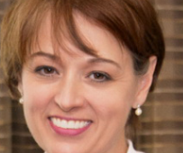

Baby Boomers
Millenials
Baby Boomers

Slide 28
RNs- which ‘facts”?
National aggregation is not the hiring pool.
Regional difference are stark.
By 2025 worst shortage- Arizona, Colorado,
  North Carolina
New England = oldest steady state entry and exit
  Aging fastest
West South Central = youngest, double entry to exit, 40% increase in RNs
Notes:
EXCEPT in 16 states where there will still be shortages
3 states with the projected worst shortage in 2025:
Arizona
Colorado
NORTH CAROLINA

Slide 29
RNs- which ‘facts”?
 | % of employment | Average NATIONAL wage
Hospitals | 30% | $72,980
Offices | 8% | $65,350
HOME HEALTH SERVICES | 13% | $68,510
Nursing Homes | 9% | $63,490
Outpt care | 15% | $73,620
HRSA May 2015
Notes:
Ancedotally- home care nurses leave for retirement
Now the leave for pay, working conditions – drive time , charting, hours, AND

Slide 30
RNs- which ‘facts”?
What is the turnover rate?
What motivates it?
Is nurse reported satisfaction linked to patient outcomes?
What makes a “good” home based care environment?
How can new grads enter home based care?
What about all the disciplines?

Slide 31
Avoiding Readmissions
Staying HOME
Staying home is a critical measure of health.
Reflects the national quality agenda
People have complex health needs.
Living conditions are even more complex.
How to balance PATIENT VALUES in decision making?
Cameras in homes?
Clinical pathways? Patient safety? Harm reduction?
Notes:
Lots of things we don’t know about care at home.

Slide 32
What can be done at home?
Care coordination
Family caregiving
Private duty
Skilled home care
Home based primary care
Hospital at home
Hospice
IDLs/ADLs
Rehab
Post op/wound care
Infusion therapy/chemo
Diaylsis, LVAD, Ventilators
Smart homes/more technology
Notes:
What can’t be?

Slide 33
STAYING HOME
(avoid readmissions)
Home is where we live.
Are we ready?
Notes:
Lifestyle view

Slide 34
Referenes
ABT Associates. Analysis in support of rebasing & updating Medicare home health payment rates. Retrieved on 2/3/17 from https://www.cms.gov/Medicare/Medicare-Fee-for-Service-Payment/HomeHealthPPS/Downloads/Analyses-in-Support-of-Rebasing-and-Updating-the-Medicare-Home-Health-Payment-Rates-Technical-Report.pdf.
American Hospital Association (AHA). (2014). Fact sheet: hospital readmission reduction program. Retrieved on 2/3/17 from http://www.aha.org/content/13/fs-readmissions.pdf.
Rice, S. (2015). Most hospitals face 30 day readmissions penalty in fiscal 2016. Modern Healthcare; Aug. 3. Retrieved on 2/3/17 from http://www.modernhealthcare.com/article/20150803/NEWS/150809981.
O’Connor NR, Moyer, ME, Behta, B, Casarett, DJ. The Impact of Palliative Care Consultations on 30 day readmissions. J Pall Med 2015;11:956-961.
Oh, J. (2013). Average cost per inpatient day across 50 states in 2010. Retrieved on 2/3/17 from http://www.beckershospitalreview.com/lists/average-cost-per-inpatient-day-across-50-states-in-2010.html. Anderson, B. 2018. Four things to know about your millennial workforce. Managed Healthcare Executive. Retrieved from http://managedhealthcareexecutive.modernmedicine.com/managed-healthcare-executive/news/four-things-know-about-your-millennial-workforce
Auerback, D., Buerhaus, P., & Staiger, D. (2017). Millennials almost twice as likely to be registered nurses as baby boomers were. Health Affairs; 36:10.
Auerbach, D., Chattopadhyay, A., Zangaro, G., Staiger, D., & Buerhaus, P. (2017). Improving nursing workforce forecasts: Comparative analysis of the cohort supply model and the health workforce simulation model. Nursing Economics; 35:6.
Korobka, T. (2018). The list of millennial characteristics. Lucky Attitude; Generation Change. Retrieved from http://luckyattitude.co.uk/millennial-characteristics/

