Slide 1
Reducing Re-hospitalizations in the Frist 30 Days and Beyond- Is the Nation Ready?
Joy M. Cameron
Vice-President, Policy and Innovation
ElevatingHOME and Visiting Nurse Associations of America

Slide 2
History of Care
The movement from institutional care to home and community based care
Drive to home
Drive to quality over quantity

Slide 3
Demographic focus
Silver Tsunami
Growing chronic conditions
Demographics of Medicare home health patients
Settings of care

Slide 4
High Quality with Cost-effectiveness
Successful care transitions
Focus on evidence-based practices
Team-Based Care
Specializations – joint replacement recovery, COPD, post-transplant recovery, etc.
Falls prevention
Medication management
Reduction in re-hospitalization

Slide 5
The Imperative for Home-Based Care
Demographic shifts
Patient preference
Alignment with HHS’ Triple Aim goals
Population Health
Patient Experience
Lower Cost of Care
Home health providers can serve homebound patients and many others; those facing an acute exacerbation, with chronic conditions, or that need care coordination services
Medicare beneficiaries want to stay home as long as possible, regardless of their homebound status; home health providers can increasingly facilitate this goal
Home health services can substitute for higher-cost institutional providers as well as provide the continuing care that prevents hospital and other high-cost utilization
Source: The Alliance for Home Health Quality and Innovation

Slide 6
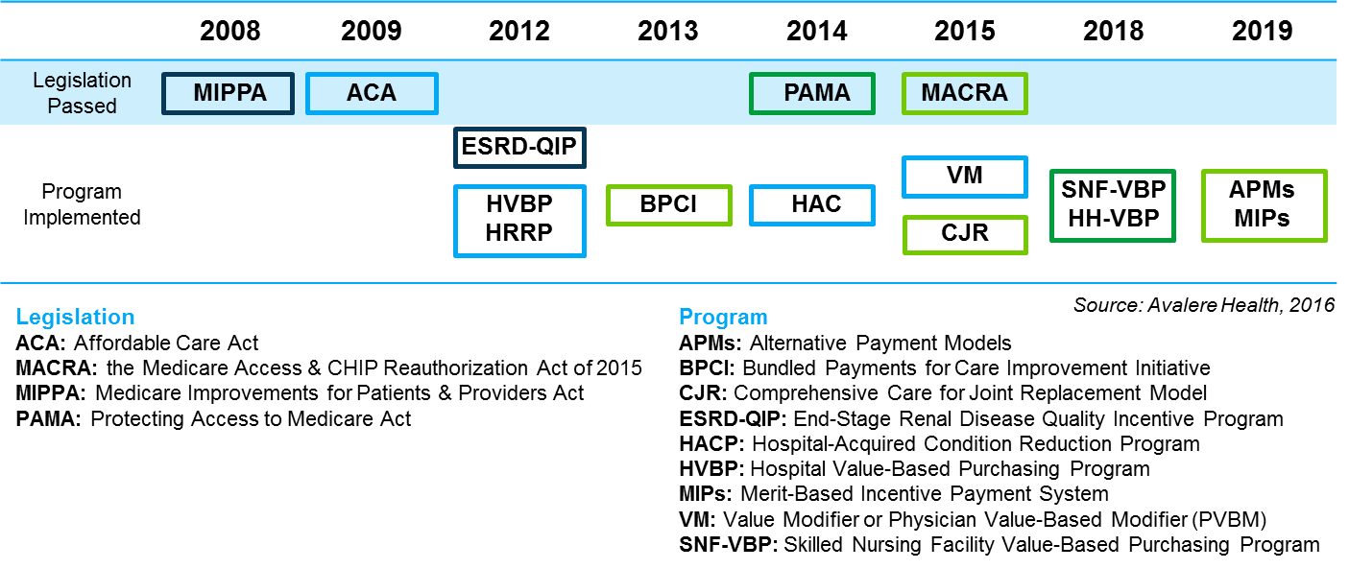
Drivers Emphasizing Home-Based Care
Policy and consumer preference influence the shift
Consumer preference for home-based care is consistently shown
CMS/CMMI initiatives incentivize the use of home healthcare in Medicare
Emphasis on value creates incentives to utilize less costly home healthcare services where appropriate
Payers and providers engaged in alternative payment models are developing emphasis on shifting the site of care towards the home.
Source: The Alliance for Home Health Quality and Innovation

Slide 7
External Industry Influences
Aging Population
Exponential Growth Anticipated
Individuals receiving long term care services and supports anticipated to increase from 15M in 2013 to 27M in 2050
Home health industry anticipated to grow from $30B to $137B in 2020
Prevalence of Chronic Disease
Rapid Advancement of New Care Delivery & APMs
Technology & Workforce Advances
Policy Emphasis on Improved Patient Experience

Slide 8
Medicaid Home Health Opportunities
New Populations
Non-homebound for all ages & functional status
Dev. disabled
High risk pregnant women / newborns
Behavioral health
Public health / prevention
Management of HCBS networks
New Services
PMPM for care coordination; management of HCBS networks; and services
Value-based Purchasing
Assume responsibility for care coordination across full continuum of care
New Payment Arrangements
Care Coordination

Slide 9
Readmissions: why?
Why the focus on this measure?
Cost driver
Acceptance of risk
Home Health Value Based Purchasing
Accountable Care organizations
Advanced Payment Models

Slide 10
VBP Growth in Medicare
Target % of Medicare FFS payments linked to quality and alternative payment models in 2016
By the end of 2014, CMS reported alternative payment models accounted for 20% of Medicare FFS payments to providers.
Medicare FFS
FFS linked to
Quality
Alternative Payment Models
85%
30%
90%
50%
2016
2018
*Alternative Payment Models: ACOs. medical homes, bundled payments, comprehensive primary care initiative, comprehensive ESRD, duals financial alignment FFS Model, Pioneer ACOS years 3-5

Slide 11
Increasing Experience with New Payment Models
Growing comfort with
Risk
Capitation
Bundling
Value-based Purchasing
Payment coordination amongst a variety of payers

Slide 12
Readmissions
The role of home based care in the continuum of care
The role of readmissions in payment models
Flexibility of methods of care

Slide 13
Home-Based Care Across the Continuum

Slide 14
Intersection of “Best” Practice & Costs
Paradigm Shift Required:
Move from “silo-approach” to practice to shared responsibility and accountability
“What you measure will get managed.”
Value = Outcomes
Risk Mgmt
⬇ Hospital

Slide 15
Risk vs. Reward
Risk models
Quality bonus payments
Role of contractor vs subcontractor

Slide 16
Interaction of Clinical Decision Making & Costs
Patient Satisfaction
Quality Outcomes
Reduced Costs
CMS’ Triple Aim
Paradigm Shift Required:
Move from optimizing “productivity” to measure of clinician success in risk management/(re-)hospitalization reduction
APTA Resource: Comprehensive Care Joint Replacement Model Contracting Checklist, March 2016. www.apta.org

Slide 17
Shifting Preferences Leading to Shifting Policies
How to meet public demand
Commonality of practice in other sectors of care

Slide 18
Barriers to Success
Homebound
Orders for home health
Conceptualization of capabilities
State and federal restrictions hindering practice and training

Slide 19
Don’t Know What They Don’t Know
Hospitals are aware of inpatient practices, but lack the knowledge of post-acute providers
In earliest conversations, most time was spent educating Conveners/Episode Initiators (EI) on Home Health Billing and practices
Erroneous assumptions by Conveners/EIs included believing:
# of days impacts total cost
HH agencies added nursing for additional revenue
Home health aide and social work increase cost
LUPAs were best practices

Slide 20
Legislative Options
Homebound
Orders for home health
State and federal restrictions hindering practice and training

Slide 21
Legislative update
Legislative Issue | Major Provisions | ElevatingHOME Actions
Home Health Care Planning and Improvement Act (H.R. 1825/S. 445) Status: House Cosponsors: 120 (71 D, 49 R) Senate Cosponsors: 38 (27 D, 10 R, 2 I) | Allows nurse practitioners, clinical nurse specialists and physician assistants to order home health services under Medicare | Actively engaging with E&C, W&M and Finance members to grow sponsorship and push for a hearing, markup, and passage. Positioning legislation to be included in potential end-of-year extenders package.
Palliative Care and Hospice Education and Training Act (H.R. 1676/S. 693) Status: House Cosponsors: 187 (115 D, 72 R) Senate Cosponsors: 15 (8 D, 6 R, 1 I) | Establishes Palliative Care and Hospice education centers and fellowship programs to provide training and workforce development in palliative care services. Provides funding for palliative care research. | Engaging with committees of jurisdiction (E&C and HELP Committee) to grow sponsorship in Senate and ask for markup in House. Participated as a Group Leader and supported follow-up efforts for the Patient Quality of Life Coalition Virtual Lobby Day & Hill Day in June.
Notes:
NM

Slide 22
Snapshot: Legislative Action
Legislative Issue | Major Provisions | ElevatingHOME Actions
Home Health Documentation and Program Improvement Act of 2017 (H.R. 2663) Status: House Cosponsors: 27 (9 D, 18 R) | Updates face to face documentation requirements to require that the home health agency’s patient record be used as supporting material as appropriate. Establishes a settlement process for appeals of denied claims. | Met with staff from previous Senate sponsors. There is interest in reintroducing. Meeting with W&M and E&C members to build sponsorship. Deploy VNAA & ElevatingHOME members to ask MoCs for support. Positioning to be included in end-of-year extenders package.
Patient Choice and Quality Care Act (H.R. 2797/S. 1334) Status: House Cosponsors: 16 (11 D, 5 R) Senate Cosponsors: 5 (2 D, 3 R) | Creates a Medicare benefit for those with serious or life-threatening illness that includes team-based discussion of goals of care and values, explanation of disease progression, exploration of a relevant range of treatment options, and documented care values and preferences. Directs the Center for Medicare and Medicaid Innovation (CMMI) to conduct an Advanced Illness Coordination Services demonstration | Collaborating with other Palliative Care and Hospice advocacy groups to strategize best approach to build support for the bills in Congress and to deliver a unified message.
Notes:
NM

Slide 23
Snapshot: Legislative Action
Legislative Issue | Major Provisions | ElevatingHOME Actions
Preserve Access to Medicare Rural Home Health Services Status: Legislation (S. 353) introduced in the Senate by Sen. Susan Collins (R-ME) & Sen. Maria Cantwell (D-WA). | Extends the 3 percent rural add-on for Medicare home health services through 2022. | Engaging House W&M members to sponsor a companion. Raising the legislation as a priority with W&M and Finance Committees to ensure this get extended.
S. 870 - Creating High Quality Results and Outcomes Necessary to Improve Chronic Care Act of 2017 | Allows for reimbursement of telehealth services for home health agencies participating in ACOs Commissions a GAO study and report on longitudinal comprehensive care planning services under Medicare part B. | VNAA is advocating for full Medicare reimbursement for telehealth services provided by HHAs, not just those participating in ACOs. Continues to reiterate this message in all meetings with the Senate before full Senate vote is scheduled.
Notes:
NM

Slide 24
Snapshot: Legislative Action
Legislative Issue | Major Provisions | ElevatingHOME Actions
Post-Acute Care Value-Based Purchasing Status: Legislation is currently being worked on for reintroduction in the House. Very little details are known. | Legislation introduced in the 114th Congress would have held post-acute care providers to untested IMPACT Act measures at a high percentage of risk. Legislation as introduced was focused solely on cost savings, with little attention paid to quality of care provided. | Engaging with other post-acute care provider stakeholders to influence legislation that places equal emphasis on quality that it does cost savings.
Notes:
NM

