Slide 1
PUTTING THE PIECES TOGETHER

Slide 2
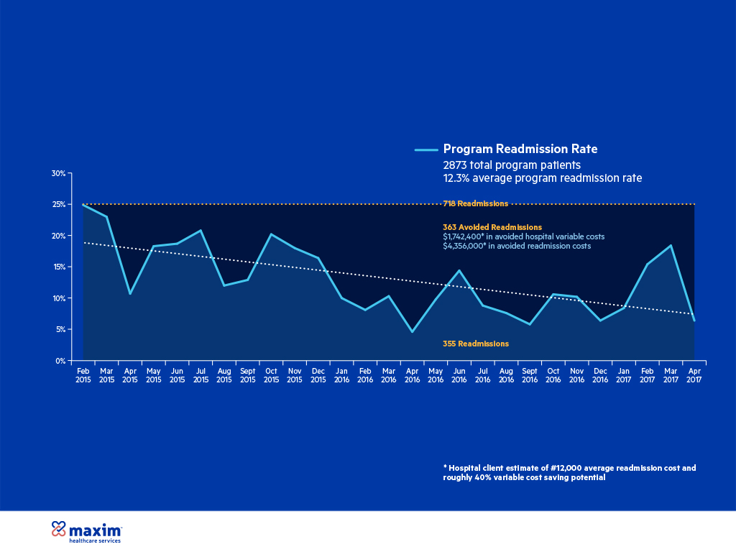
CBCM-UMSJMC Program Savings

Slide 3
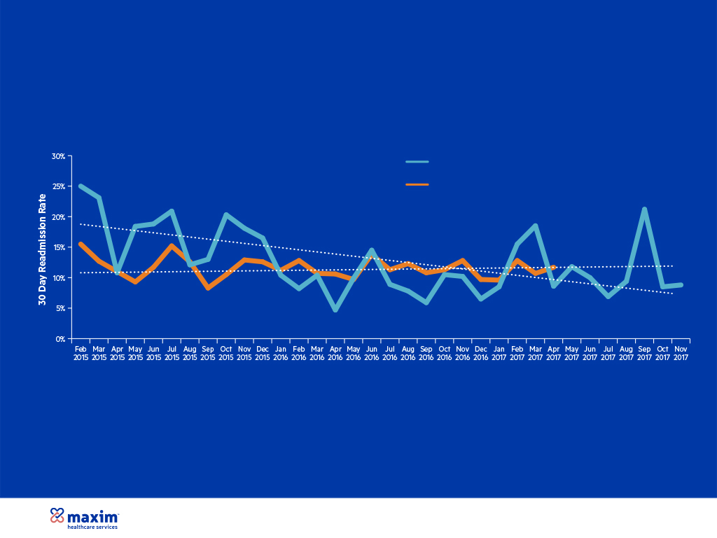
CBCM-UMSJMC Program Performance
Program Readmission Rate
Readmission Rate for High Risk Patients not Enrolled in the Program*
65% Reduction in Readmissions
Note the convergence of the trend lines for the program readmission rate and the readmission rate for high-risk patients not enrolled in the program
Notes:
This graph trends the readmission rates for three different populations: low-risk patients (red line); high-risk patients in the program (blue line); and the high-risk patients not enrolled in the program (orange line). The primary difference between the two high risk populations was that the program was comprised of high-risk patients going home while the non-program population was largely comprised of high-risk patients being discharged to a facility. There are several interesting takeaways from this graph:
1. The readmission rate for low-risk patients remained fairly stable throughout the two-year period.
2. At the start of the program, there was a significant difference in the readmission rates for the two different high-risk populations. This suggests that at that time there was a much higher readmission risk facing those patients who were being discharged back to their home.
3. The readmission rates for the two different high-risk populations converged over time and the program readmission rate was consistently below the non-program rate for the last several months of the chart. This suggests that the program interventions played a part in removing much of the risk that had been present for high-risk patients going home.
4. The trend lines for the program readmission rate and the readmission rate for low-risk patients essentially converge at the end of the chart. This is encouraging considering that the readmission rate for low-risk patients probably represents a natural floor in the share of readmissions stemming from avoidable utilization.

Slide 4
Everyone accepts the value of Homecare…
$1,433.11
Day of Hospital Care
$506.37
Day of Nursing Home Care
$293.40
Day of PDN Home Care
Source: Health Management Associates (FL Medicaid data)

Slide 5
THANK YOU
W. John Langley, M.D., FAAP
Senior Vice-President and Chief Medical Officer
Maxim Healthcare Services

