Slide 1
Health Information Exchange: Usefulness and Utility
April 17, 2018

Slide 2
Learning Objectives
Understand the technology and connectivity enabling CRISP
Learn about the specific services offered through CRISP
Determine how the CRISP core services assist population health and care coordination activities

Slide 3
About CRISP
Regional Health Information Exchange (HIE) serving Maryland and the District of Columbia, and collaborating with Delaware, Northern Virginia, Pennsylvania, and West Virginia
Vision: To advance health and wellness by deploying health information technology solutions adopted through cooperation and collaboration
Data source or attribute | #
Live hospitals | 91
Live clinical data feeds | 261 (lab, rad, ADT, CCD)
Live ENS practices | +1,000
Long-term and post-acute care facilities | 205
Standalone labs and radiology centers | 16
Unique patients in index | +16 million
Patient searches | +400,000/mo
Encounter alerts sent | +2,500,000/mo

Slide 4
Mission and Guiding Principles
Mission
We will enable and support the healthcare community of Maryland and our region to appropriately and securely share data in order to facilitate care, reduce costs, and improve health outcomes.
Guiding Principles
Begin with a manageable scope and remain incremental.
Create opportunities to cooperate even while participating healthcare organizations still compete in other ways.
Affirm that competition and market-mechanisms spur innovation and improvement.
Promote and enable consumers’ control over their own health information.
Use best practices and standards.
Serve our region’s entire healthcare community.

Slide 5
Maryland Waiver and Redesign Programs
Statewide plan to move the delivery system towards the goals of effective and efficient prevention, care management, and coordination
Implement care redesign and population health approaches in an effort to reduce potentially avoidable utilization and improve quality
Use innovative tools to facilitate care transformation
Steps for transformation:
All-Payer Model Global Budget
Care Redesign Amendment
Progression Plan/Phase 2 of the All-Payer Model

Slide 6
Services

Slide 7
CRISP Core Services
POINT OF CARE: Clinical Query Portal & In-context Information
Search for your patients’ prior hospital records (e.g., labs, radiology reports, etc.)
Monitor the prescribing and dispensing of PDMP drugs
Determine other members of your patient’s care team
Be alerted to important conditions or treatment information
CARE COORDINATION: Encounter Notification Service (ENS)
Be notified when your patient is hospitalized in any regional hospital
Receive special notification about ED visits that are potential readmissions
Know when your MCO member is in the ED
POPULATION HEALTH: CRISP Reporting Services (CRS)
Use Case Mix data and Medicare claims data to:
Identify patients who could benefit from services
Measure performance of initiatives for QI and program reporting
Coordinate with peers on behalf of patients who see multiple providers
PUBLIC HEALTH SUPPORT: Partnerships with Maryland MDH, District of Columbia DHCF, and West Virginia through the WVHIN
PROGRAM ADMINISTRATION: Technical and administrative support for Care Redesign Programs

Slide 8
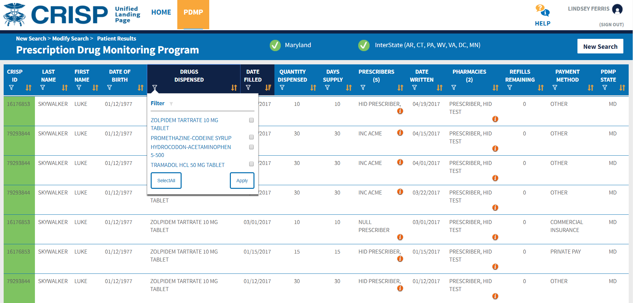
Prescription Drug Monitoring Program
PDMP data is available in the portal as well as the Unified Landing Page for Pharmacy users; additional features include sorting and multiple patient selection

Slide 9
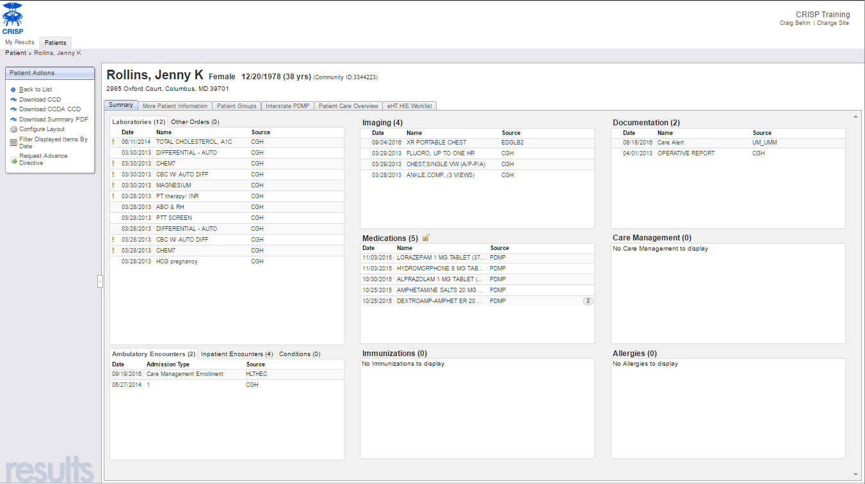
Clinical Query Portal
Manual patient search to view Prescription Drug Monitoring Program, labs, radiology results, recent encounters, and documents

Slide 10
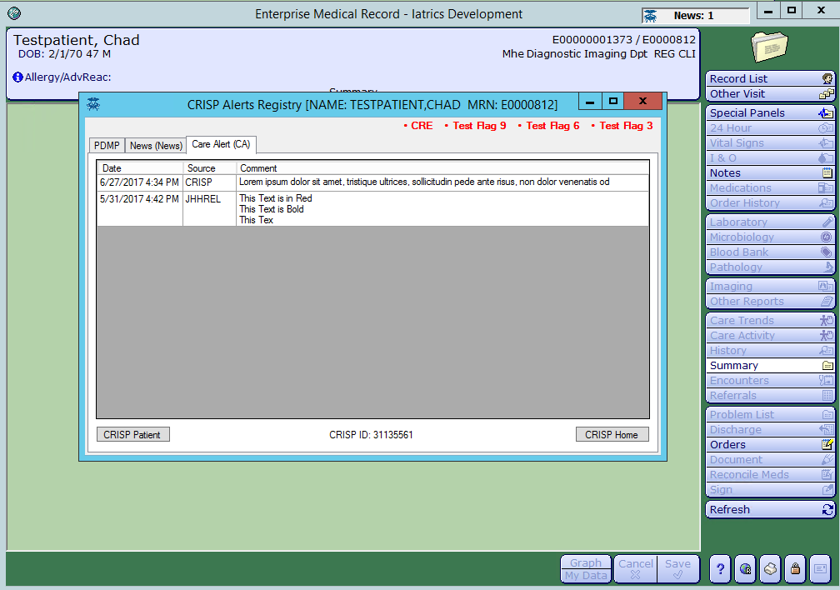
CRISP In-Context
Critical data available at the point of care through API, FHIR, or CCDA; single-sign-on to patient record

Slide 11
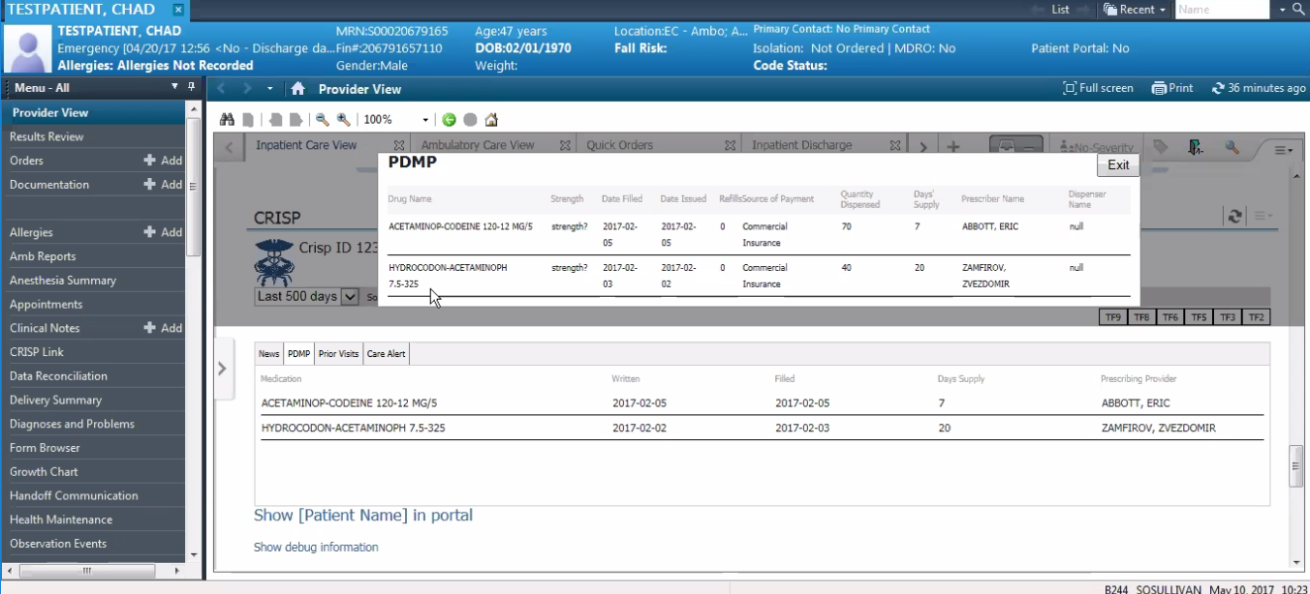
CRISP In-Context

Slide 12
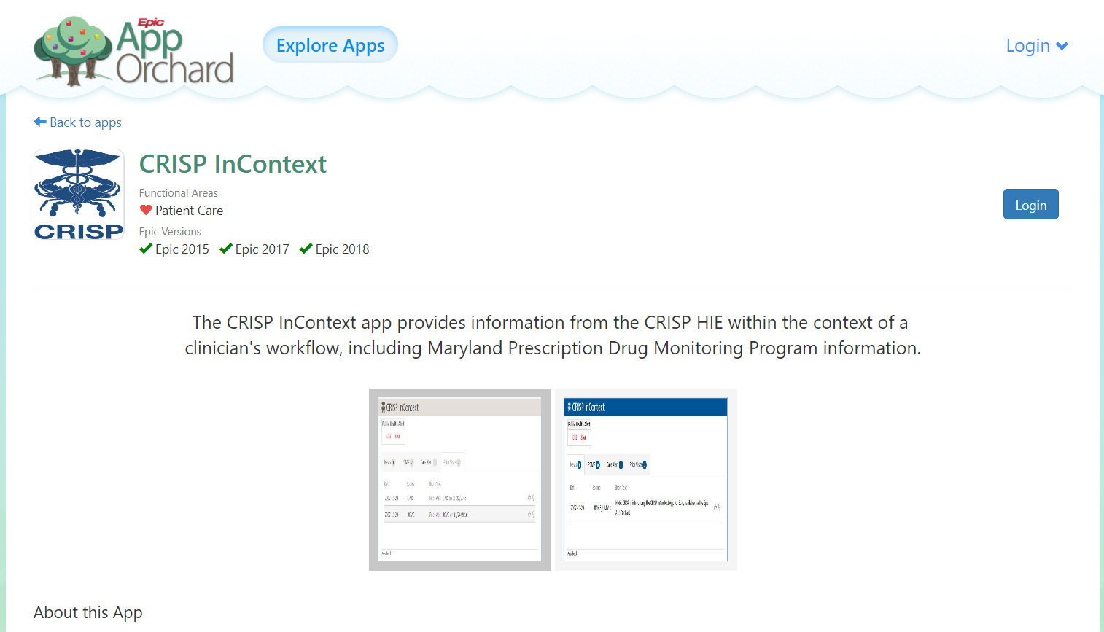
Epic App Orchard

Slide 13
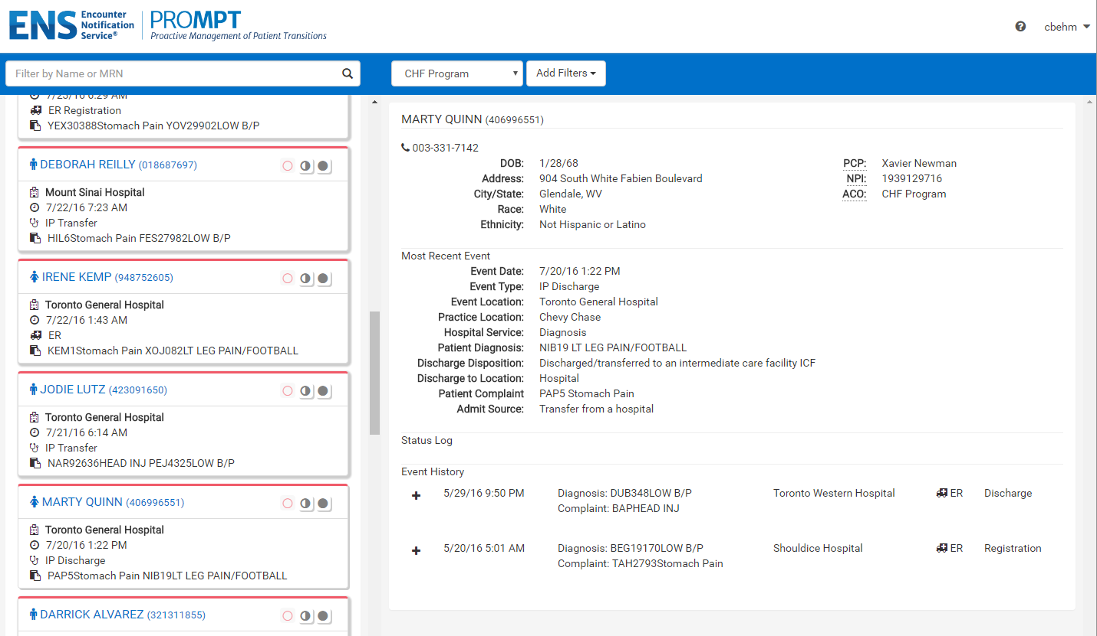
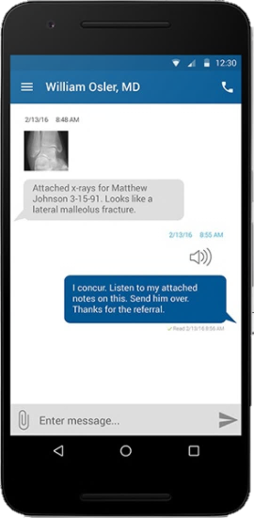
Encounter Notification Service
Real-time or batch alerts to appropriate providers based on treatment and care management relationships

Slide 14
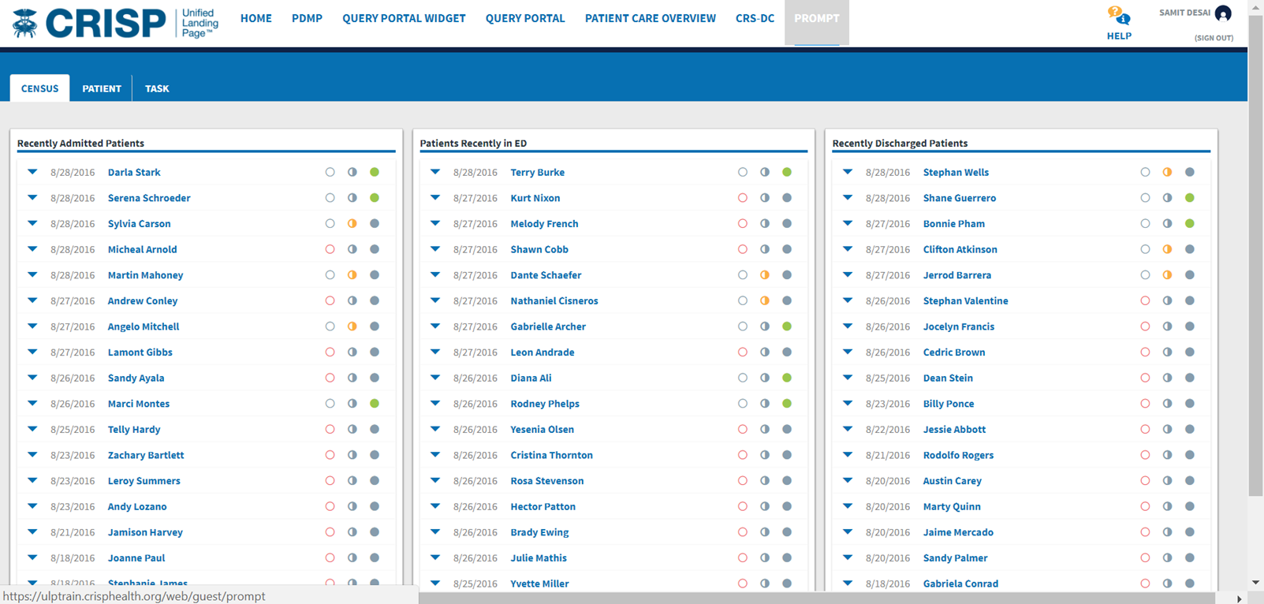
PROMPT Census View

Slide 15
Care Programs
Patient panels submitted manually or automatically in ADT feeds can include care program data such as care teams, contact information, and program enrollment
Program metadata, without PHI, can be submitted to CRISP to show services available to all patients enrolled in that program, ACO, or payer plan
Information can include services offered, 24hr support numbers, regions served, and other similar information
CRISP matches patients to panels to a program directory in real-time to display comprehensive information

Slide 16
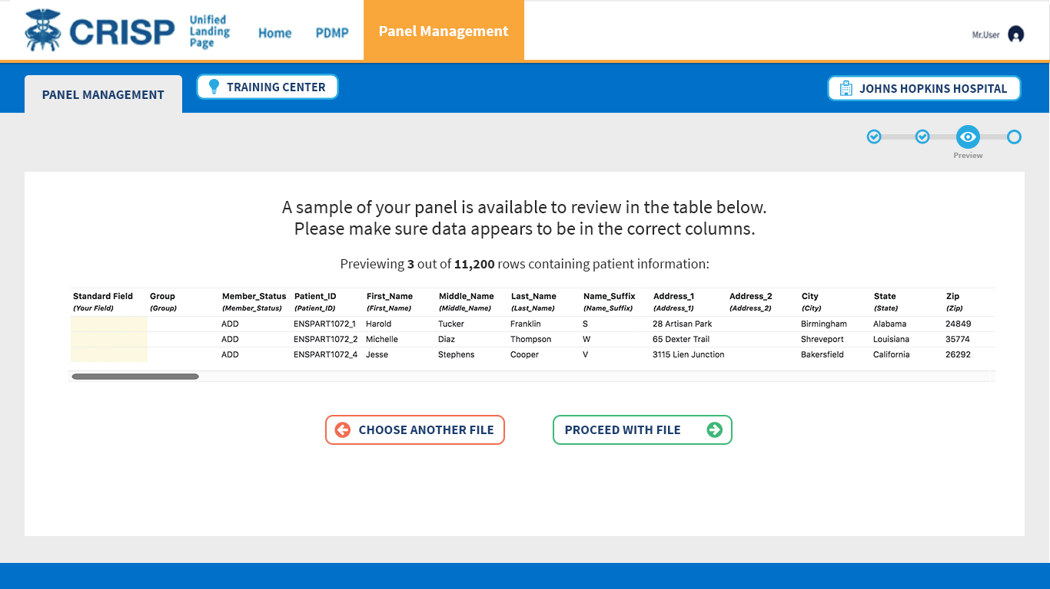
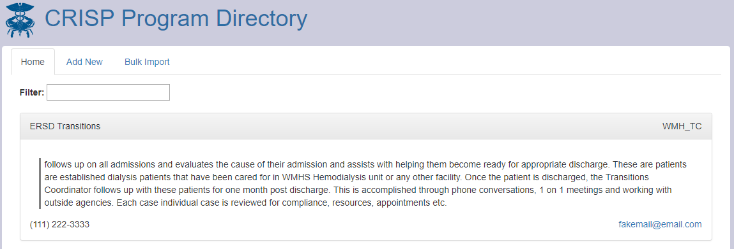
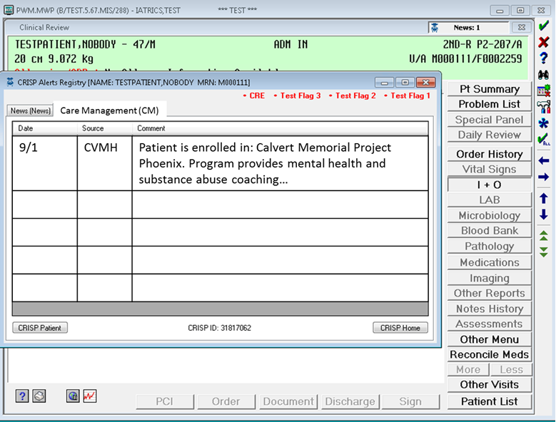

Slide 17
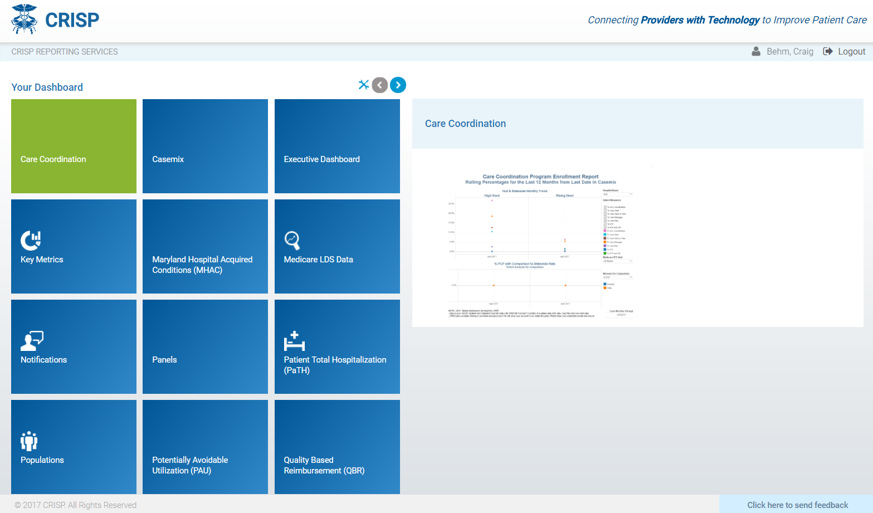
CRISP Reporting Services
Dashboards from casemix and Medicare data to support high-needs patient identification, care coordination, and progress reporting

Slide 18
User Stories

Slide 19
Sample User Story: Post-Acute Collaborative
“Our community has a partnership consisting of multiple hospitals and skilled nursing facilities. The hospital discharge planners and post-acute providers agreed to communicate at the time of a patient transfer. The SNFs that are able to also agreed to coordinate their short-term rehab patients’ return home.”

Slide 20
Sample User Story: Post-Acute Collaborative
Standard process for patients going from the hospital to the SNF
Discharge Planner uses DocHalo to text the SNF designee (varies by facility) to describe patient, indicate any key complications
Discharge planner also enters the key complications into EHR as a Care Alert
If SNF residents have to return to the hospital, the SNF texts the ED physician on-call
As a fallback, the care alert, subscribers, and prior visits are available through CRISP InContext
When residents leave the SNF, they are added to a panel for 90-days
ENS alerts give SNFs have more transparency into utilization post-discharge
If a patient goes to the ED, the SNF can text or call and share relevant information that may avoid a readmission

Slide 21
Sample User Story: Longitudinal Coordination
“My hospital refers patients to a third-party care coordination entity. When we see patients are potentially eligible for support, we notify our partners. They engage the patients to describe the program and enroll them in services. Patients are typically managed for 90-120 days, depending on their situation.”

Slide 22
Sample User Story: Longitudinal Coordination
CRISP Reporting Services created a panel of patients that would be eligible for the program if they had a hospital visit
ENS alert triggers for ED care managers to enroll patients
Care managers mark patients yellow in PROMPT
Care coordination team reaches out to patients for long-term support
Write care alerts about specific patient needs
Submit new panels with program information
If any of the newly enrolled patients are readmitted, the hospital sees the relationship
Program information is available at the point of care
Care coordinator reaches out, or can visit patients using PROMPT Census view

Slide 23
Sample User Story: High-Needs Beneficiaries
“I work for a Managed Care Organization. We have a program to support high-needs individuals by connecting them to their assigned primary care providers. It is frequently difficult to contact these beneficiaries and, when we do, they often need support navigating the health care system.”

Slide 24
Sample User Story: High-Needs Beneficiaries
The Payer submits 2 panels:
Panel 1 is beneficiaries who are assigned but unseen by primary care provider
Panel 2 is beneficiaries above a specific risk score
ENS messages come in for all patients
Panel 1 goes to PCP to trigger a transitional care visit
Panel 2 goes to Care Manager who will visit the ED
Practice and care manager both go into CRISP Unified Landing Page to view discharge summaries, lab results, and other information

Slide 25
Questions and Discussion
Craig Behm
Sr Director of Marketing & Product Development
Office: 410.872.0823
Cell: 410.207.7192
Email: craig.behm@crisphealth.org

