Slide 1
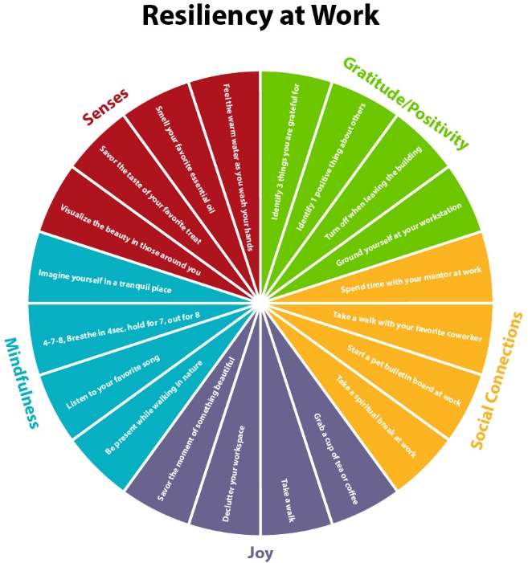
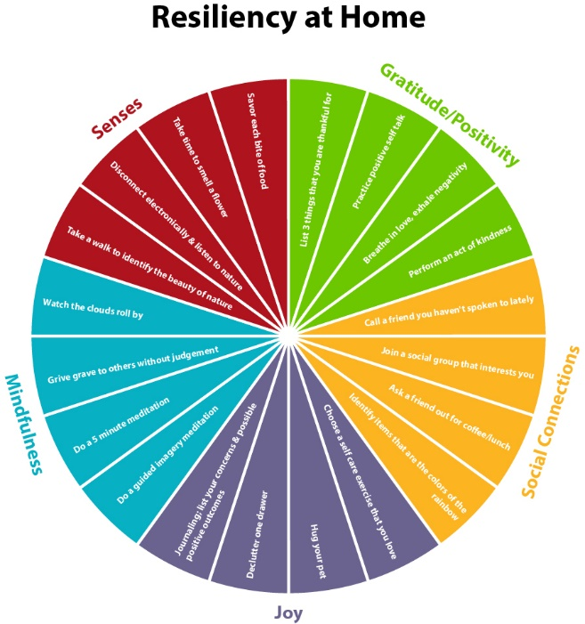
Resiliency Tool Kit at Work and at Home
Giovanna Robbins, MSN, RN; Dana Rose, BSN, RN; Heather Sauerwald, MSN, RN; Nicole Sedaka, MS, RN, CNL; Rebecca Shumaker, MSN, RN, NPD-BC
Background
Outcomes/Results
Nursing is a stressful and demanding profession that can be both physically and emotionally draining.
This environment paired with competing demands makes it challenging for nurses to take time to decompress and recharge which can lead to burnout and turnover.
When nurses neglect to take time for themselves while at work they are often exhausted. This can lead to issues with work-life balance and spill into the home environment.
The strategies identified to foster nurse resilience will not only impact the nursing staff but also improve patient outcomes.
Overall increase in resiliency
Decrease in unit turnover
Positive correlation in every domain of units’ engagement scores
Increase in patient satisfaction scores
Discussion/Conclusion
Questions
The resiliency toolkit is a first step in response to the need for implementing advanced strategies to assist nurses in the management and prevention of stress while at work, increasing job satisfaction and improving work life balance.
Resiliency toolkits should include a variety of strategies which are quick and simple.
Building nurse resilience through the support of a toolkit is an important focus for nurse leaders in forming a healthy work environment.
Highlighting the wellbeing of caregivers is necessary for maintaining a stable nurse workforce with reduced turnover.
Will nurses who utilize a simple toolkit be better equipped to deal with stressful situations in the workplace and home?
Will the use of a toolkit result in increased job satisfaction, improved work life balance and overall resiliency and retention of the novice nurse?
Method
Recommendation
Databases: Ovid, Pub Med, Welch Medical Library, Google Scholar, CINAHL
Key Words: resiliency, resilience, tool kit, burnout, new nurse, nurse graduates, nurse, mindfulness , self-care, meditation, resiliency training
Implementation of a Resiliency Tool Kit/Program
Training
Support
Recognition
Scan Barcode for References
Notes:
Talking Points:
Intro:
My name is __________ and I will be presenting on behalf of our group. Our group consists of nurse educators and nurse mangers from different institutions so when choosing a topic we wanted to focus on something that would be beneficial to both roles.
At first, we wanted to work on a toolkit that could be taught and implemented in various hospitals nurse residency programs. We brainstormed ideas of how we would get nursing leadership buy-in and support for the project, which proved to be a challenging task. We had planned on creating a rewards program for employees who utilized the toolkit to reinforce the positive behavior.
Our initial approach was too broad. Our group narrowed our focus and decided we needed a microburst resiliency tool kit that could be used quickly and timely especially at work. This was the basis of developing the Resiliency Tool Kit wheel.”
Background:
During the pandemic, the literature revealed a huge need for nurses to be more resilient to survive. We really didn’t need the literature to tell us this because we were living it. This was our starting point in asking what can we do and what methods are proven to be beneficial to help others be more resilient at home and at work? The literature showed that regular self-care, mindfulness and gratitude promoted resiliency. We needed a microburst resiliency tool kit that could be used quickly and timely especially at work. This was the basis of developing the Resiliency Tool Kit wheel.
Questions: The questions we focused on were, will nurses who utilize a simple toolkit be better equipped to deal with stressful situations in the workplace and home? Will the use of a toolkit result in increased job satisfaction, improved work life balance and overall resiliency and retention of the novice nurse?
Method: For the method we completed a literature review using the databases Ovid, Pub Med, Welch Medical Library, Google Scholar, CINAHL with key search words including resiliency, resilience, tool kit, burnout, new nurse, nurse graduates, nurse, mindfulness , self-care, meditation, and resiliency training
Outcomes/Results:
We found that organizations that have implemented resiliency programs have had positive outcomes in several areas.
Overall increase in resiliency
Decrease in unit turnover
Positive correlation in every domain of units’ engagement scores
Increase in patient satisfaction scores
Discussion/Conclusion: The ANA has made nurse well-being a national initiative. As we approach a post-COVID world in healthcare, research has begun to study the post-trauma and mental effects that the pandemic has had on clinicians. Our vision was to create this easy-to use toolkit to help decrease stress and increase resiliency at Work and at Home. Resiliency toolkits should include a variety of strategies that are quick and simple. Not all nurses experience stress in the same way and nor will they be able to use the same resiliency strategies effectively. For example in our small group, some of us do not feel comfortable with meditation and some love it. Some of us practice deep breathing and some do not see or feel the benefit of deep breathing.
Explain Tool Kit Wheel: For the design of our tool kit we broke it up into 5 sections Joy, Senses, Mindfulness, Gratitude/Positivity and Social Connections and created a resiliency wheel for work and for at home.
You should have received a handout with the Tool Kit Grid that includes descriptions on how to perform each resiliency strategy.
One example for a resiliency strategy at home is under the Senses category. The example focuses on taste. With each bite of food what flavors are identified? During dinner encourage others to take a bite of food and fully describe every sensation related to that food. How does it smell? Is it bitter or sweet? What is the texture? Etc.
The resiliency wheel for at work offers quick and easy strategies for resiliency. Here is a way nurses can escape to calm themselves during a stressful and challenging time during work to find their balance. We just need our cell phone, perhaps earbuds and find a quiet place, even if it is a bathroom. It is as simple as googling a 2 minute meditation to de-stress. If everyone could find this place now, lets come together and meditate to find that peaceful moment in time.
Advance to second slide and click play. Stop video at 2 minutes. Go back to slide 1.
Now we are ready to go back to work with a clearer mind ready to take on the challenge while giving ourselves a little more grace.
Recommendation: We recommend the implementation of a resiliency toolkit that includes simple, quick and easy resiliency strategies along with training, support and recognition. We are recommending that the Resiliency Took Kit Wheel be introduced to nurse residents during a Nurse Residency Program session. Training on how to utilize the resiliency tool kit needs to also occur for nursing leaders and experienced staff. We would also recommend identifying a valid and reliable measurement tool to assess resiliency in new grads to measure outcomes. One tool found in the literature is the CD-RISC, a 25-item instrument that seeks responses to situations including stress and a sense of control. This assessment tool could be provided pre and post implementation of the Resiliency Tool Kit in NRP sessions. The evidence shows that leadership role modeling and support of resilience strategies and recognition of tool kit utilization is key in the success of resiliency program.

