Slide 1
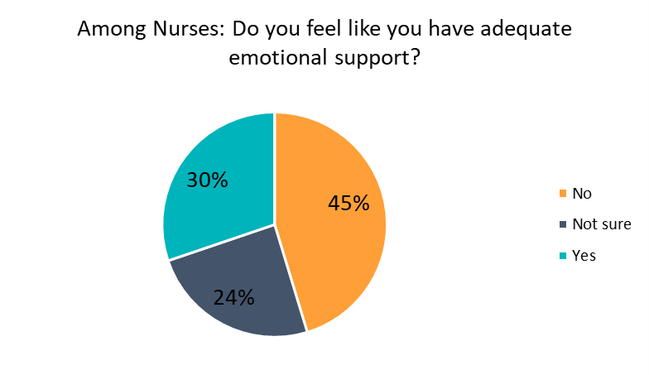
We Get Knocked Down, But We Get Up Again: Nursing Leadership Resiliency During a Pandemic
Katie Music, MSN, RN, Charlotte Nwogwugwu, DrPH, MPH, BSN, HIV PCP, CPH-BC, Stella Oloruntoyin, BSN, RN, CAPA, Kim Peterson, MSN, APRN-CNS, ACCNS-AG, OCN, Donna Pusey, MS, RN-ACM
Introduction
Literature review
Survey Results
Discussion
At the height of the COVID-19 pandemic U.S. healthcare workforce faced an unprecedented 33.7 million confirmed cases, 605,000 deaths, and daily use of 8,000 ventilators.
According to the AACN, nursing is the nation's largest healthcare profession with more than 3.8 million RNs nationwide and primary providers of hospital patient care.
Pre-pandemic, nursing was facing an increasing rate of nurse burnout and high turnover, which is expected to increase.
Resiliency is essential for effective leadership and Nurse Leaders must learn to foster and/or develop resiliency within themselves and within nurses they lead.
Innate resilience can be developed or enhanced through education, organization support and cognitive transformational practices
Understanding Resiliency:
Ability to bounce back from obstacles or resist disruption of normal functioning during distressing times
Common Characteristics of Resiliency:
Self-awareness
Strong support networks
Practicing self-care
Displaying self-control
Effective communication skills
Optimism
Motivation
Empathy
Vision
Building Resilience:
Change the narrative
Face your fears
Practice self-compassion and mindfulness
Cultivate forgiveness
Connect with family and friends
Make every day meaningful
Resilient individuals tend to have a strong Moral Compass:
An internal belief system guiding values and ethics
Nursing leadership surveyed across organizations identified common themes about pandemic experiences and resilience:
Burnout/exhaustion impacted staff and leadership resilience
Communication is key to staff engagement
New skills were developed to promote resilience and innovative thinking was required to identify resources not previously used
Identified a need to educate staff on building resilience and skills to enhance
Rapid development of technology
Flexibility became critical
Mindfulness and gratitude found to be essential
Focus on team achievements rather than losses
Leadership self-disclosure of vulnerabilities needed to build connections with team
Humility at the core of every leader
Need for resiliency is not unique to healthcare and has been studied across many fields under many circumstances.
It is not yet understood how the COVID-19 pandemic will impact nursing as a whole, but there is cause for concern.
Nursing has been on the frontlines and have witnessed unprecedented morbidity and mortality, shortages of resources and staffing.
Leadership resilience has been critical for organizations to survive and strengthen the capacity to overcome future challenges
Additional research is needed to evaluate how nursing leaders can maintain resilience within themselves and their teams during times of crisis.
Factors Associated with Resilience
Epigenetic
Developmental
Psychological
Genetic
Neurochemical
References
Barton, M.A., Christianson, M., Myers, C.G., Sutcliffe, K. (2020). Resilience in action: leading for resilience in response to COVID-19. BMJ Leader, 4, 117-119.
Hartwig, A., Clarke, S., Johnson, S., Willis, S. (2020). Workplace team resilience: A systematic review and conceptual development. Organizational Psychology Review, 10(3-4), 169-200.
Wei, H., Robers, P., Strickler, J., Corbett, R.W. (2018) Nurse leaders’ strategies to foster nurse resilience. Journal of Nursing Management, 27(4), 681-687.
Purpose
P
The purpose of this project was to gain a greater understanding of resilience in nursing leadership, review nursing leaders resiliency amidst the COVID-19 pandemic, and identify methods to build resilience.
Acknowledgements
Methods
Thank you to all of the Nursing Leaders and frontline staff that have remained resilient throughout the COVID-19 pandemic. A special thank you to the NLI leadership at the University of Maryland School of Nursing and our individual mentors for their unwavering support.
Conduct a literature review
Survey Nurse Leaders
Obtained from: https://mhanational.org/mental-health-healthcare-workers-covid-19#:~:text=The%20responses%20collected%20from%20the,75%25%20said%20they%20were%20overwhelmed

