Slide 1
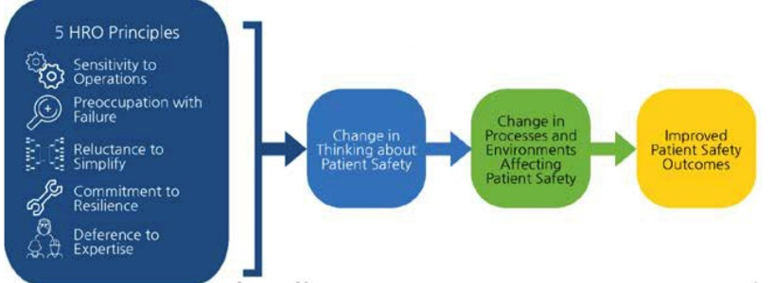


Perspectives of Nurse Leaders on High Reliability Organization (HRO) Principle: Preoccupation with Failure
Hannah Miller, MSN,RN,CNL,CPN; Charmaine McKie, PhD, MPH, RN,OCN; Sharon Mooney BSN, RNC-NIC;
Marceletta Mendoza, MSN,RN,CNOR,CPHQ; Candice Michael, MSN, RN, CPHQ, C-ONQS
University of Maryland School of Nursing
Background
Theoretical Framework
Sample Characteristics
High Reliability Organizations (HROs) are institutions that prioritize safety and transparency in methods and outcomes
Preoccupation with Failure is a conscious effort and fixation regarding the potential for failure
According to The Joint Commission, health care institutions must undergo three major changes in progressing to HRO status:
  Leadership’s commitment to zero patient harm
  Promotion of a safety culture
  Widespread adoption and deployment of the most effective process improvement tools and methods
To progress toward HRO, nursing leadership must understand the barriers and facilitators to implementing a culture of preoccupation with failure
N=31 nurse leaders
Mean= 11.3 years of nursing leadership experience
Conclusions
HRO Logic Model adapted from Veazie et al. (2019)
Overall, each hospital has a patient safety reporting system and process in place to review safety events. Nurse leaders are comfortable with HRO principles and their importance.
Recommendations for Improvement:
Bridge gap between leadership knowledge and staff knowledge of HRO principles
Determine best way to deliver HRO data
Address staffing issues
Include bedside nurse in case review for safety events
Identify nurse champions on each unit for HRO principles
Objectives
Results
Using the HRO Logic Model as a Framework develop questions to:
Explore barriers experienced by nurse leaders in implementing HRO principle: preoccupation with failure
Explore facilitators promoting HRO principle: preoccupation with failure
Identify improvement opportunities to achieve HRO principle: preoccupation with failure
Facilitators | Barriers
Event Reporting System Nurse leader confidence in HRO principles, specifically preoccupation with failure Dissemination of safety information through various communication methods Surveyed nurse leaders had on average over a decade of leadership experience Leaders not wiling to settle for status quo | Knowledge deficit of staff Staffing issues Lack of devoted time to HRO principles, both education and awareness Perceived punitive culture More emphasis of HRO is needed Goals greater than zero harm
Methods
Conduct literature search
Interview Nurse Leaders using questions developed from HRO Logic Model
Analyze data
Determine Conclusions
Create Action Items
Bibliography
Survey Questions:

