Slide 1
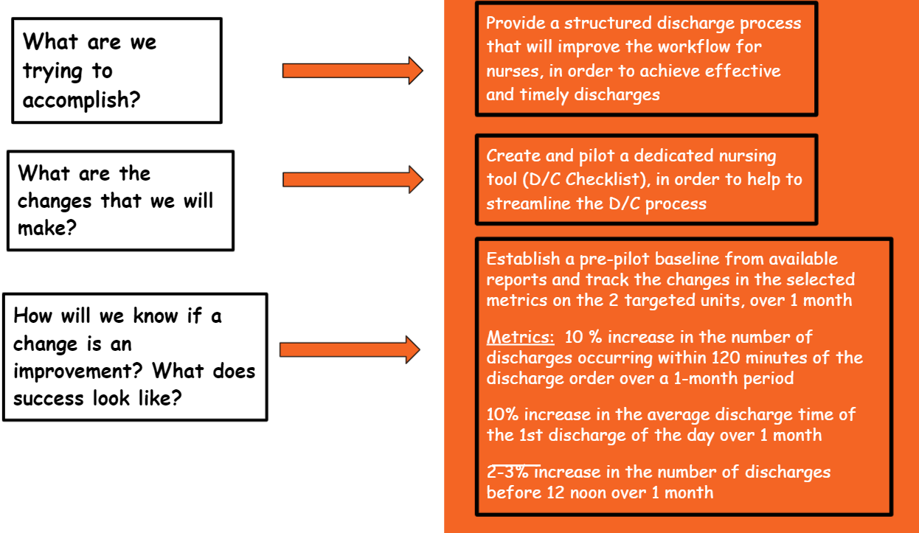
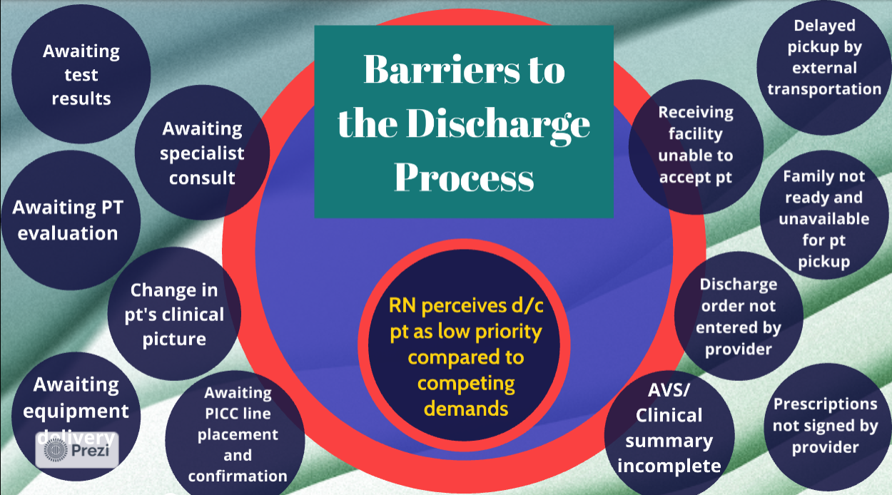
THROUGHPUT: Increasing Nursing Staff Awareness and Prioritization
Carol Holness DNP, RN- Montgomery College; Sarah Inman MSN, MBA, RN, CM-DN- Northwest Hospital; Ashley James BSN, RN- UM Upper Chesapeake Health; Dahlia Joseph MS, CRNP, ACNP-BC- UM BWMC;
Devika Kandhai MSN, RN, CMSRN- UM BWMC
Objectives
Methods
Conclusions/Discussion
Bridge the perception gap for staff nurses between effective hospital throughput (efficient flow of patients through the hospital from admission to discharge) as a concept, and effective hospital throughput as a priority.
Promote meaningful collaboration between nursing and hospital departments to achieve an effective discharge process.
Demonstrate how an effective discharge process can increase nursing perception of improved workflow, improved job satisfaction, and lead to better hospital throughput.
Literature review:
The overarching theme revealed that ineffective discharge processes and late discharges were the main factors affecting effective throughput.
Informal query of nurses:
21 staff nurses and 7 nurse leaders were queried. 22 of the 28 highlighted the nursing perception of throughput as a significant barrier to discharge.
Development/Implementation of a Discharge Checklist Pilot:
Med/Surg. unit - 2 different hospitals
Hosp. #1 26 beds RN/Pt ratio 1:4
Hosp. #2 24 beds RN/Pt ratio 1:4-5
Briefed all participants on the 30-day pilot of the new discharge checklist
Post-Pilot evaluation and nursing feedback
Continual discharge support for nursing staff is germane to the achievement of effective hospital throughput.
Relationship-building and partnership is key to a successful discharge process.
In engaging nurses and providing the support needed to effectively execute discharges we can:
Reduce nurse workload, decrease nursing burnout, decrease length of stay and ultimately increase hospital throughput.
Provide safe, efficient, high quality patient care
Buy-in from nursing staff and support from hospital administration is essential in establishing a successful partnership in order to meet the institutional goal of obtaining effective hospital throughput.
Identified opportunities for change that fell outside of the scope of the checklist.
LIMITATIONS:
- Shortened study period
- Small ‘n’ number
- Studied med/surg units only
Background
The national need for effective hospital throughput has been a challenge for many decades.
Delayed discharges have cost hospitals millions of dollars per year in lost revenue, increased nurse-patient ratios, and nursing staff burnout worldwide.
The state of Maryland has now included hospital throughput in the HSCRC reimbursement model for all hospitals.
Prioritization of effective throughput has been shown to be beneficial to the patient, staff, and institution.
Through collaboration, nurses are essential in this process and must be a part of creating the change.
Results
Next Steps
1. Incorporate educational modules regarding effective throughput in yearly competencies.
2. Consider implementation of an Admission/Discharge RN to facilitate the discharge process.
Knowledge Gap
3. Improve the preparation of nursing students and the orientation of new hires.
The nurse perceives throughput as low priority due to:
Competing demands
High nurse-patient ratios
High patient acuity
This results in a disconnect between effective Throughput as “THEORY” vs. effective Throughput as a “PRIORITY.”
4. Promote the perception of effective throughput as a “priority” through collaboration between nursing schools and health care institutions.
Post D/C Pilot Feedback From Nurses:
Streamlined/more organized workflow
Ease of use
Desire/willingness to continue use of the tool
References

