Slide 1
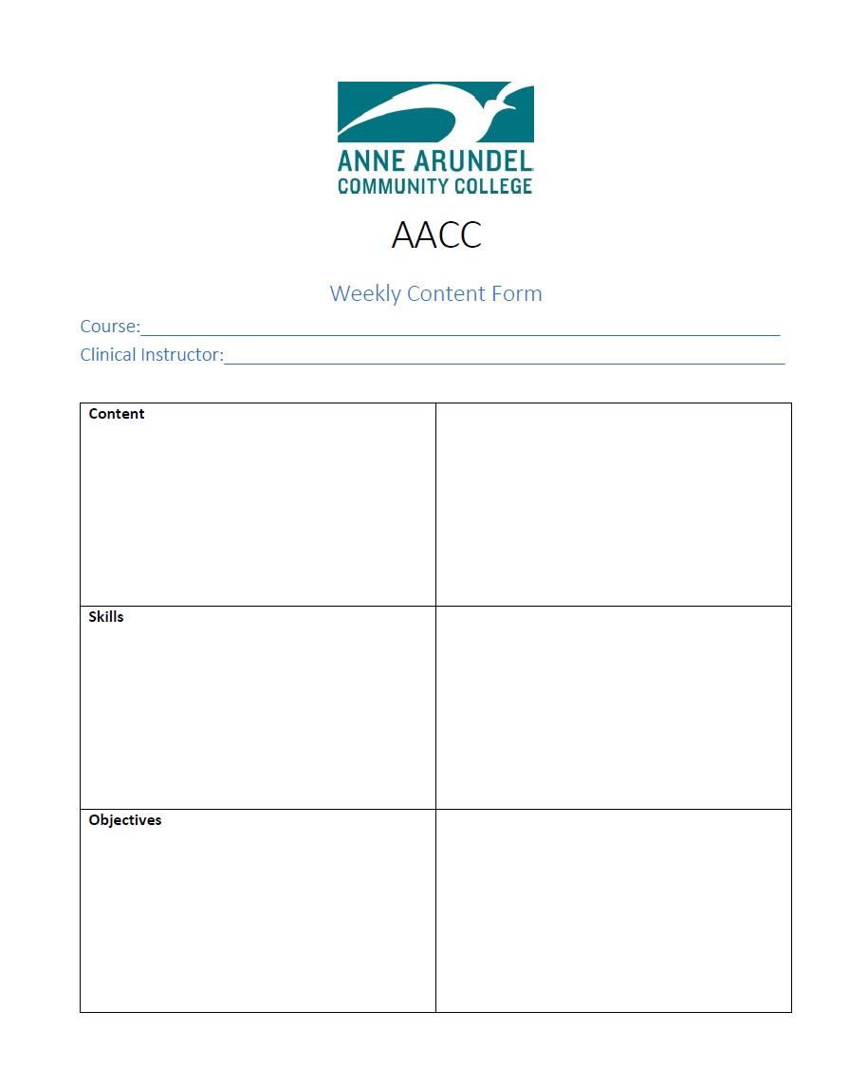
Enhancing the Critical Care Clinical Experience
Henderson, A., Cooke, M., Creedy, D., & Walker, R. (2012). Nursing students' perceptions of learning in practice environments: A review. Nurse Education Today, 32, 299-302. doi:10.1016/j.nedt.2011.03.010
Melincavage, S. (2011). Student nurses' experiences of anxiety in the clinical setting. Nurse Education Today, 31(8), 785-789. doi:10.1016/j.nedt.2011.05.007
Henderson, A., Cooke, M., Creedy, D., & Walker, R. (2012). Nursing students' perceptions of learning in practice environments: A review. Nurse Education Today, 32, 299-302. doi:10.1016/j.nedt.2011.03.010
Melincavage, S. (2011). Student nurses' experiences of anxiety in the clinical setting. Nurse Education Today, 31(8), 785-789. doi:10.1016/j.nedt.2011.05.007
Kathy Groody MSN, RN, CCRN, Critical Care Manager Anne Arundel Medical Center
Heidi Rayner MS, RN, Nurse Mentor and Retention Specialist Anne Arundel Community College
abstract
methods
Implementation
One of the key components of nursing education is the clinical experience.. The clinical environment is designed to increase students’ confidence in skills as well as begin to build the professional identity.. Clinical faculty rely on nursing staff to assist in this process. The purpose of this project is to develop a program that will enhance the critical care student clinical experience. This experience provides the connection between the classroom and practice.
Lunch and Learn sessions
Expectations
Talking points
Weekly content form
Course content overview form
Clinical learning environment questionnaire
Orientation/welcome session
Champion at the site to communicate to the staff for goals with students – expectations, limitations, concerns, etc.
Provide written information regarding schedule, expectations, skills, content etc. Discuss ways to encourage critical thinking and promote professional development.
Provide a welcome/orientation to the unit the first day of clinical including staff, unit manager, faculty, and students.
Present plan and information to clinical faculty and students.
Provide clear expectations for student, staff and faculty.
Training for students’ regarding communicating with staff, asking questions, and taking responsibility.
Utilizing a survey to determine effectiveness of the enhancements on learning and professional development of the student and staff perceptions of students’ learning.
Background
Clinical learning is one of the essential elements to preparing safe, competent and quality nurse graduates¹. A positive clinical learning environment prepares the student for professional practice by integrating them into the team¹, as well as creating a supportive and welcoming environment². Communication between faculty, staff, and students is necessary to define clear expectations and promote growth and independence. This communication should include clinical reasoning, discussion, and questioning about practice are encouraged¹. Therefore, the clinical learning environment should be designed to enhance problem solving, critical thinking, and professional development. Based on these fundamental ideas of clinical education a plan was devised to enhance the clinical experience for fourth semester students in the critical care setting.
Lunch and Learn Sessions | Presenter | Objective
Advanced Airway Management and Respiratory Therapy Education | Respiratory Therapy Educator | Discuss care and management of vent and other advanced respiratory care.
Transitioning to the Novice Nurse Role in Critical Care | 2 AACC graduates | Discuss orientation process and creating a work/school balance while pursuing the BSN
Preceptor’s Outlook | Primary New Grad Preceptor | Insight on how to prepare for orientation
Scheduler’s Advice to the New Grad | CCU Scheduler’s | What it means to work different shifts and how schedules are made
Interdisciplinary Teamwork | Speech, Care Management, PT/OT | Discus how colleagues can enhance outcomes. Each service discusses role in managing the critically ill client
framework
Future
Nurse Practice Act³
Clinical Learning Experience – faculty planned and guided learning activities designed to assist students to meet course objectives and apply nursing knowledge and skills in the direct care of the patient.
Direct care of patients within the relevant practice setting
Clinical support activities such as clinical conferences and simulation
Clinical preceptor – a RN employee of the supporting agency acting to facilitate student learning in a manner specified in a signed written agreement between the agency and the educational institution.
Clinical preceptorship – an organized system of clinical experience that allows a nursing student to be paired with a clinical preceptor for the purpose of attaining specific learning objectives.
Expand the initiative to other courses and units within AAMC
Discuss implementation at other clinical sites that AACC utilizes.
Develop the imitative to be utilized for all nursing programs that utilize AAMC as a clinical site.
Create additional lunch and learn opportunities based on didactic content and students’ needs.
Collect and analyze data related to clinical enhancements and student learning outcomes.
objectives
References
Develop strategies to enhance clinical experience through lunch and learn educational offerings
Create clear expectations for clinical faculty, nursing staff, and students
Develop clear process and form for disseminating lecture content to unit manager and educator
Create talking points for students and nursing staff to promote critical thinking
Pre and post survey to determine effectiveness of interventions
1. Henderson, A., Cooke, M., Creedy, D., & Walker, R. (2012). Nursing students' perceptions of learning in practice environments: A review. Nurse Education Today, 32, 299-302. doi:10.1016/j.nedt.2011.03.010
2. Melincavage, S. (2011). Student nurses' experiences of anxiety in the clinical setting. Nurse Education Today, 31(8), 785-789. doi:10.1016/j.nedt.2011.05.007
3. Nurse Practice Act (2016). Article, 8-205, 8-401, and 8-404, Annotated Code of Maryland
Course Content Form
Weekly Content Form

