Slide 1
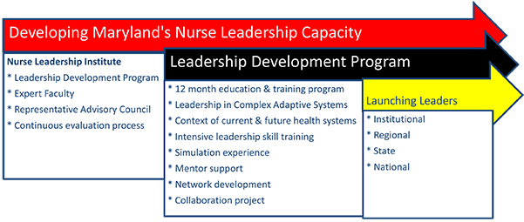
Journey from Darkness to Light: Child Abuse Awareness in Maryland
Versa Belton MSN, RN; Karen Scheu DNP, FNP-BC; Heather Westerfield DNP, RN, CMSRN
Introduction
Significance of Problem
Partnership
Future Goals
The Nurse Leadership Institute (NLI) was designed to:
Build leadership capacity within Maryland nursing faculty and clinicians.
Facilitate partnerships between faculty and clinicians for developing strategies that shape effective health care systems and prepare a nursing workforce to assume roles within these evolving health care systems.
Participants in the 12 month NLI leadership project were provided the opportunity to:
Attend three on-site sessions, including an intensive residential training program where fellows gain insight into their personal strengths, identify and strengthen their leadership competencies, and create a plan for continued development.
Participate in online learning and check-in sessions and individual follow up with expert coaches.
Work with selected mentors’ so they may help guide their mentee’s leadership development.
Leadership skills gained from this 12 month experience allowed emerging nurse leaders to partner with an established community organization to impact the State of Maryland in the area of child abuse and neglect.
3.6 million referrals are made to child protection agencies annually.
The U.S. has one of the worst records among developed nations for child abuse and neglect (losing 4-7 children per day).
A report of child abuse is made every 10 seconds.
In 2014, state agencies found 702,00 victims of child maltreatment (This would pack 10 football stadiums).
Life expectancy shortens by 2 decades for abused individuals related to increased incidence of mental health and sexual health disorders.
The goals of this leadership project are to:
Promote child abuse awareness and education in our communities.
Create and incorporate child abuse awareness and education into our various work settings, including nursing academia, and inpatient/outpatient clinical settings.
Positively Impact the nation-wide child abuse and neglect epidemic through a Maryland Community partnership.
Assist with community education of at risk children and families to increase awareness of child abuse and neglect.
The majority of this project will be aimed at primary prevention.
Leaders will participate in Darkness to Light Training at The Baltimore Child Abuse Center (BCAC)- empowering adults to prevent, recognize, and react responsibly to child sexual abuse.
Education on screening procedures in the academic setting and in the inpatient/outpatient settings.
The NLI leaders partnered with the BCAC and its Community outreach and education coordinator, in order to move forward with their goals.
The BCAC is located in Baltimore City and provides victims of adverse childhood experiences and their non-offending caretakers with comprehensive services that includes forensic interviews, medical treatments and mental health.
BCAC trains professionals, youth-serving organizations, and community groups to protect themselves, their organizations, and the children in their care.
Darkness to Light’s Stewards of children is a training program that empowers adults to become facilitators in the Stewards of children.
The purpose of this program is to raise awareness and educate adults on how to prevent, recognize and react responsibly to child sexual abuse.
The nurse leaders working on this project will attend training at BCAC in August 2016 in order to provide a foundation to move forward in our communities in educating others.
Train nursing students from Associates Degree to Graduate level on how to screen for abuse using the Darkness to Light Training provided from BCAC.
Provide training to other health care professionals on how to screen for abuse using the Darkness to Light Training provided from BCAC.
Educate the local community on ways to protect themselves.
Goals
References
Baltimore Child Abuse Center Retrieved July 18, 2016 from http://www.bcaci.org
Brown, D. ( 2009). Adverse Childhood Experiences and the Rick of Premature Mortality. American Journal of Preventative Medicine, (37)5
Centers for Disease Control and Prevention, Retrieved July22,2016 http://www.cdc.gov/violenceprevention/acestudy/#1
Children's Bureau, Child Maltreatment, 2014, Retrieved July 22, 2016
http://www.acf.hhs.gov/programs/cb/resource/child-maltreatment-2014
University of Maryland School of Nursing :Nurse Leadership Institute Retrieved July 18, 2016 https://www.nursing.umaryland.edu/academics/pe/nli/
Over the past year there have been several incidences of non-parental caregivers in Maryland killing and hurting children left in their care. In some of these cases the mother leaves their children in the care of their boyfriends so that they can go to work and not worry about the cost of daycare.
The boyfriends or other non-parental caretakers of these children are not only unfit to care for children, but sometimes end up abusing or killing these children.
This issue came to light for our group when the Director of the Emergency Department at Baltimore Washington Hospital was asked to attend a press release regarding this troublesome trend. This started a discussion and ultimately led to this project and partnership with the Baltimore Child Abuse Center.
Discussion and research started with the non-parental violence but led the group to the topic of child abuse and neglect in general, especially after meeting with Baltimore Child Abuse Center.
Background
Rosheda Harrell - Education & Outreach Coordinator
at The Baltimore Child Abuse Center
The NLI Institute and the Group Mentors
UM School of Nursing
Acknowledgements

