Slide 1
The Culture of Health in Maryland: Public Health Nurses Leading the Way
Pat McLaine, DrPH, MPH, RN Assistant Professor, University of Maryland School of Nursing
Carolyn Nganga-Good, MS, RN
Public Health Nurse Leader, Robert Wood Johnson Foundation

Slide 2
Outline
Background
Methods
Results
Next Steps
Local Culture of Health Exemplars
Q &A

Slide 3
Background
Public health nurses (PHNs) have traditionally delivered or ensured the delivery of comprehensive, population-focused care to communities
Significant changes in organization and delivery of health care
Focus on individuals obtaining coverage
Focus on improving access to care
Focus on triple aim – better care, lower cost, improved outcomes
New interest in community
Social determinants of health
Improving access to healthy food, recreation, housing
Keeping individuals out of hospitals
Notes:
Triple Aim – better care, lower cost, improved outcomes
Quad Aim added – improved workforce work life

Slide 4
Background
Significant changes in health services delivery by local public health departments
Focus on assurance, not direct service
Decreased support for health department funded safety net clinics – new focus on billing for services
Major cuts in funding to local and state public health agencies
What is the role for public health nursing?

Slide 5
Maryland’s PHN Workforce
No reliable or comprehensive PHN workforce data for Maryland
National survey includes data from one local health department
No chief public health nurse / director position
No nursing workforce data center
RWJF Public Health Nurse Leader Project: Enumerating and Characterizing Maryland’s PHN Workforce: Impact on Population Health, Wellness and Health Equity
WHO are the PHNs?
WHERE are they working?
WHAT are they doing to promote a culture of health?

Slide 6
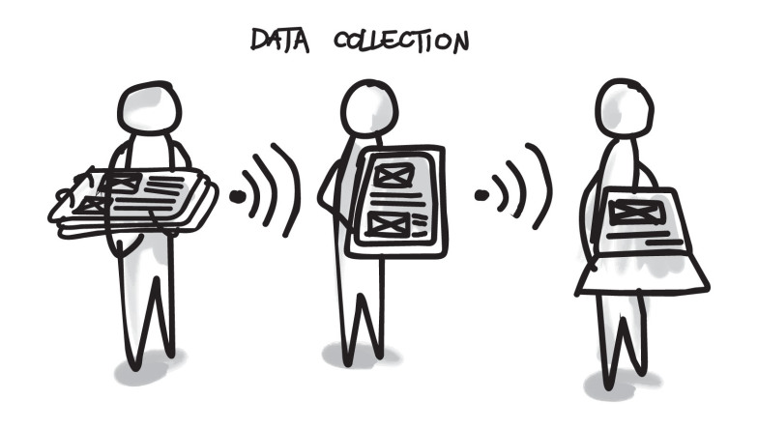
Methods
Interviews with PHN leaders from local health departments and school health
Online survey for Maryland PHNs working in local health departments and/or public schools
Study reviewed by IRB at University of Maryland, Baltimore – exempt 8/23/2016

Slide 7
Methods – Interview
Support from Maryland’s PHN Directors Council
Outreach to identified PHN leaders, local HD leaders, and SHN leaders
60-90 minutes interview focused on:
PHN workforce and program trends
Barriers to PHN practice
Efforts to promote PHN
Description of Culture of Health Initiatives
Future of Nursing Initiatives
Notes:
Awareness of “Future of Nursing: Call for Action” Campaign Initiatives
Culture of Health
Culture of Health Framework
Nurses on Boards
Action Coalitions

Slide 8
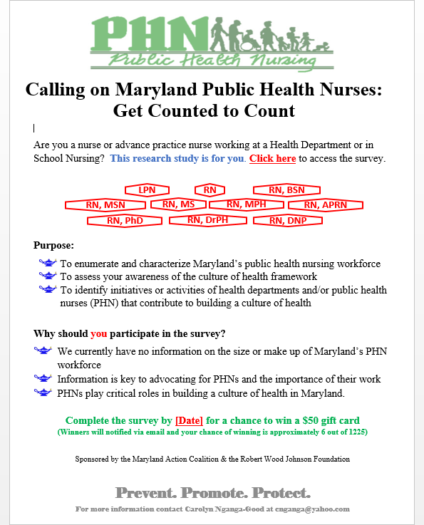
Methods – Online Survey
Demographic data
Level of education
Licensure and certification
Job status and level of effort
Salary range
Primary and secondary practice roles and settings
Future of Nursing Campaign Initiatives
Notes:
Awareness of “Future of Nursing: Call for Action” Campaign Initiatives
Culture of Health
Culture of Health Framework
Nurses on Boards
Action Coalitions

Slide 9
Results – Participation
Interviews
PHN leaders from 19 of the 24 local health departments (79%)
School health nurse leaders from two county school districts
Online Survey Respondents - 541
535 consented to participate (estimated 39% of PHNs)
468 participants responded to all the questions
*These results are preliminary, pending completion of analysis
*Missing data and declined to answer data are not included in this analysis
Notes:
Eligible to participate - 1303
Total reported number of nurses – 1361 (includes Caroline County -15 and Washington -43 that could not participate in the study)
**Baltimore City data is missing

Slide 10
Results

Slide 11
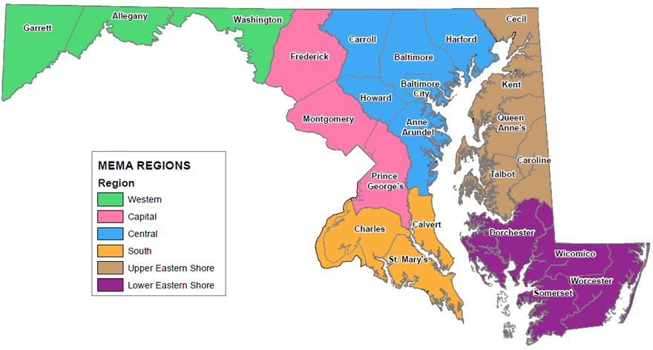
Results

Slide 12
Results – Age & Years Worked
Age
Average age: 49 years
Range: 24-89 years
Number of years worked as a nurse
Average: 27 years
Range: 2 – 56 years
Number of years worked as a public health nurse
Average: 25 years
Range: 1 - 55 years
Notes:
#5
??? Overlaid with years first certified as - LPN (#7) and RN (#9) –
??? Overlaid with # of years worked - #21

Slide 13
Results

Slide 14
Results

Slide 15
Results

Slide 16
Results

Slide 17
Results – Barriers to PHN Practice Examples - 1
Financial (25%): over-all public health budget, sustainability of funding
Salary (21%): “I make less per hour than I did nine years ago in a hospital setting.”
Workload and staffing (19%)
Access to resources (13%): transportation, supplies, educational material, housing, resources for youth in the schools and community
Lack of opportunity for advancement (8%): fewer positions, reduced funding, inability to hire/retain
Leadership (8%): non-clinical leadership, lack of consistency/coordination, no cross-training, no community awareness of public health, poor outreach, social marketing
Access to health care for clients (7%): mental health services, pediatric dental care, specialty care, immunizations, health insurance.
Notes:
315 PHNs identified barriers to practice in their local work setting, with 100 PHNs identifying 2 or more barriers.
Barriers included barriers for public health agencies, for public health nursing and for clients who needed services.
Concerns about over-all funding for public health and sustainability of funding were cited the most frequently.
Salary for PHNs is a clear barrier, as noted by one participant.
Workload and staffing are major barriers, as nurses wear many hats and direct many programs due to loss of positions.
Access to resources for PHN work and for clients was another major barrier.
Another barrier to practice is the lack of opportunity for advancement due to fewer positions and reduced funding. Several participants indicated there was limited incentive for higher education (master’s degree) as a result of the funding.
Leadership was also identified as a barrier to practice and included internal leadership practices and limited outreach to the community.
PHNs also identified limited access to health care for their clients, particularly in areas shown.

Slide 18
Results – Barriers to PHN Practice Examples - 2
Poor communication (5%): with external partners, the community and staff.
Poor record keeping systems (4%): out-of-date technology and equipment
Recognition/respect/morale (4%): lack of recognition or management support, work not valued
Education (4%): Lack of access to education and lack of incentives for advancing education
Language barriers (3%): few PHNs speak Spanish, lack access to interpreters
Notes:
Additional barriers to practice include
Poor communication with external partners and the community and internally with staff
Poor record keeping systems – with few electronic medical record keeping systems in place
4% of PHNs identified lack of recognition and respect for their work, noting their work was not values and that PHNs had little management support
Lack of access to education was another barrier, at all levels of education, a real concern for the majority of Maryland counties that are in designated rural areas.
Finally, PHNs identified language barriers, noting that few PHNs speak Spanish and programs lacked access to interpreters needed to work with refugee populations.

Slide 19
Results – Effort to Promote PHN Practice Examples
Salary and employee benefits
Value, recognition, respect
Advocacy and representation
Increase awareness
PHN engagement
Education and training opportunities
Funding and resources
Conducive Policies
Improved access and services
Community/stakeholder engagement

Slide 20
Future of Nursing Campaign Awareness
59% of the participants were familiar with the term “culture of health”
34% of the participants were familiar with the culture of health framework
11% of the participants were familiar with the Nurses on Boards Campaign
19% of the participants served on a board of directors, advisory board, or appointed task force

Slide 21
Next Steps
Summer/Fall 2017: Share data with PHN and SHN leaders
Summer/Fall 2017: Regional Meetings with PHNs and SHNs to discuss findings, identify next steps
Fall 2017: State-wide meetings with PHNs and SHNs to review findings and proposed next steps, identify 3-5 items for action and plan to move forward
Spring 2018: Publication of article summarizing findings of the study and actions to advance PHN in Maryland

Slide 22
Local Culture of Health Exemplars
Worcester County Health Department &
Calvert County Health Department

Slide 23
Community Based Chronic Disease Care Coordination
Program Update
May 22, 2017
Worcester County Health Department

Slide 24
Team and Van T Mitchell, Secretary DHMH
Notes:
This is us receiving an award from DHMH 2016 Team Innovation award for Care Coordination Team from Mr. Van T Mitchell, Md. Secretary of Health and Mental Hygiene.
Current CBCDCC team is RN, LCSW and CHOW. LCSW is 50% and CHOW is 80%
point out who is there

Slide 25
Worcester County……
Rural
HPSA and MUA
Aging
Notes:
Each county/jurisdiction has their own barriers to care. Worcester County is both Health Professional Shortage Area and Medically Underserved Area. Worcester has an older population and less diverse. In 2015 more than one in four residents in Worcester County were 65 years and older. Transportation, housing are problems in our county too.

Slide 26
How did we get here?
2013-LHIC
TRI-County LHIC awarded 1 yr grant MCHRC
1 diagnosis, 3 counties, 2 teams
Notes:
DHMH encouraged WCHD to apply for this grant because of high DM rates in the 3 lower counties of Md. WCHD applied on behalf of Tri-County Local Health Improvement Coalition and awarded 1 yr grant from Maryland Community Health Resources Commission
1 dx was DM, 3 counties-Wicomico, Somerset and Worcester. Teams made up of RN and SW

Slide 27
Outcomes: LHIC
52 Totalled enrolled
56 ER visits 12 mos prior to CM
8 ER visits since CM
8 clients highest users
38 ER visits 12 mos prior to CM
4 visits since CM
Notes:
LHIC ended. Building on our success in this program which we were awarded by (MCHRC) Maryland Community Health Resources Commission

Slide 28
Awarded HRSA Grant
In 2015 awarded 3 year grant.
1 county, 3 diagnoses- CHF, COPD and Diabetes
Improve disease self management
Reduce ER utilization and hospital admissions
Improve Worcester County resident’s health
Notes:
Building on our success with of the LHIC grant WCHD applied for HRSA( Health Resources Service Administration) grant. 8 were awarded this grant, but we were the only health department in the country

Slide 29
HRSA Grant
Implement evidence based care coordination
Home visits
Coordination with primary care and specialist
Personalized chronic disease education
Facilitated referrals
Notes:
We being guided by the JH Guided Care.

Slide 30
Assistance to Clients
15% Purchase of Care
Dentures, pill boxes, CO2 detector, RX, PCP Co-Pays, Scales
41% Applications
QMB, SLMB, MEAP, SPDAP, Renter’s Tax Credit, Housing, Food Stamps, ADA transportation
32% Referrals
Chesapeake Housing Mission-ramps, MNT, DSS for respite, AERS, MH, NFCG
Notes:
we do provide equipment for clients, not to mention assisting with payment for medication co-pays, MD visits
We assist with completing applications for Community programs with a lot of acronyms. Raise your hand if you know what all these acronyms mean. The point being how do we expect clients to navigate the system if unable to know what the acronyms mean. SICU

Slide 31
Coordination via CRISP
Notes:
Here’s another acronym….does everyone know what this one means? CRISP( Chesapeake Regional Information System for our Patients) is a mechanism in which we can all communicate. We have EHR’s, and they do not speak to one another. So Md State HIE(Health Information Exchange). We utilize CRISP ENS(electronic Notification System) We monitor PDMP, we’re able to view H&P, lab results, discharge summaries. We are on the cusp to be able to upload our CC notes.

Slide 32
Case Scenarios
Case #1- 59 yo, single C male, living alone in rural area. Recently moved to area.
Dx: T2D, COPD, HTN, Hyperlipidemia, seizures,CAD
Client graduated 12th grade in special education
Had MA on admission to CBCDCC, but switching to Medicare because on disability
Referred by local hospital PCMH

Slide 33
Interventions
Provided home deliveries for DM supplies.
Educated client on dx and doc. BS.
Medication reconciliation, observing client fill pill box, educate client on medications
Provide transport to medical appts and diabetic education
Assisted with applications for financial aid assist.,Medicare part D, MEAP, SLMB, Section 8, apartment applications, diabetic ID bracelet
Notes:
We visited this client weekly visits, CABG done (preop teaching done)
limited family support

Slide 34
Outcomes
Continued collaboration with local hospital PCMH
A1c 15 down to 6.2 2/9/2017
Able to fill own pill box
Able to make own appts. for medical f/u
Able to call for assistance with transport
Going to Diabetic ed. classes and received ed. from HD nutritionist
Lost weight, improved activity
Improved meal planning
Notes:
Increased independence, food choices, portion control

Slide 35
Case Scenarios
Case #2- 68 yo single AA male living alone.
Dx: COPD, Asthma, High Cholesterol, HTN
Admitted to hospital with Exacerbation of COPD and pneumonia. Client treated with antibiotics and discharged to home.
Client discharged with prescriptions for 3 inhalers, 3 oral medications and sent to pharmacy in hospital
Client without Medicare part D and limited income, unable to get needed meds.
Notes:
prior

Slide 36
Case Scenario cont’d
Client walked into our health department requesting assistance to purchase medications. He was sent to MAP.
Information and Referral worker @ MAP saw this client
Assisted with application for QMB. Unable to assist with medications because too expensive.
Client referred to our program
Notes:
QMB approved within approx. a month Intake worker referred to our program.

Slide 37
Intervention
Client approved for QMB and LIS/Extra Help.
Used LiNET to assist with receiving medications.
Enrolled in Medicare part D program
Home visit, med reconciliation done, educated about medications,COPD and vaccines. Stopped smoking
CHOW assisted with applying for MEAP, FS, Renter’s Tax Credit.
Notes:
LI NET-Limited Income Newly Eligible Transitions Program (or LI NET) CMS program , designed to eliminate gaps in coverage for low income individuals transitioning to Medicare part D. Client is able to get medications before being enrolled Medicare part D program.
Renter’s tax credit provides relief for eligible residents in the amount they must pay toward rent or property taxes. Eligibility is based on gross household income compared with the amount paid toward the rent or property taxes.

Slide 38
Outcomes
Client is taking his medication independently
Has Medicare part D and able to afford
Client has food stamps, energy assistance
Client has not been readmitted to hospital

Slide 39
Questions???
rjones@maryland.gov (Supervisor)
evelyn.hasson@maryland.gov (LCSW-C)
maureen.sharkey@maryland.gov (RN)
sara.boufalla@maryland.gov (CHOW)
Notes:
Eligibility for our program is they need to be a county resident and one or all 3 of the diagnoses. Any questions please ask during panel discussions or contact us.

Slide 40
Healthy Beginnings
Michael Bridgett CRNP
Betsy Bridgett MSN/Ed RN
Calvert County Health Department

Slide 41
Disclosure
Michael and Betsy have no relevant financial or nonfinancial relationships to disclose

Slide 42
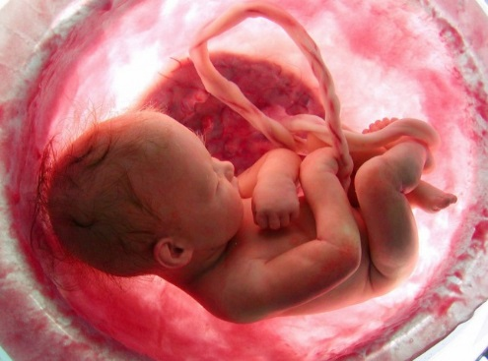
Scope of the Problem
5.4% of pregnant women used illicit drugs in 2013
~10% of pregnant women ages 15-25
>200,000 babies exposed each year in the U.S.
Relapse rates for opioid users >75% without medication assisted treatment (MAT)
1 baby born with Neonatal Abstinence
Syndrome (NAS) every 25 seconds in U.S.
Accounts for $1.5 billion in NICU cost (>$60,000/fullterm child; >$250,000/ preterm child)
>80% paid by Medicaid

Slide 43
FUNDING
Outreach
Case management
Behavioral Health Screening
Core Funding
Dr. Stacy Little
Office of Family and Community Health Services
Prevention and Health Promotion Administration
Maryland Department of Health and Mental Hygiene
Maryland Community Health Resource Commission

Slide 44
Comprehensive Women’s Health Services
Residential Substance Use Treatment
Outreach& LARC
Outpt Behavioral Health
Calvert Memorial Hospital
Domestic Violence Shelter
Health Department
Case Management One Stop Shop
Private Practice Obs and Peds
Transportation
Community Organizations
Education Vocational Training
Smoking Cessation
Social Services
WIC

Slide 45
Mountain to Mohamed a.k.a. Community Outreach
Similar to adolescent populations, expecting behavioral health patients in need of reproductive services to come to a central location results in missed opportunities
We began outreach to residential behavioral health programs in Calvert and at the St. Mary’s-Charles County border

Slide 46
Outreach
Impact of substances on pregnancy and baby
LARC
Overdose Prevention
STI
Hepatitis

Slide 47
Outreach Services March 2014-February 2016
Reproductive Health and Overdose Reduction Education
103 recruitment visits
1,397 people educated
Blood-borne infection and STI screening
39 (+) screens for hepatitis
2 (+) screens for syphilis
Long-acting reversible contraception (LARC)
190 LARC placed
Smoking cessation services

Slide 48
Reproductive Health Center
Behavioral Health Screening
Mental Health
Substance use disorders
Linkage to care
Onsite Crisis Center and Behavioral Health Treatment

Slide 49
Case Management/Subutex Clinic
Outcomes | Total
Median # of prenatal visits kept | 11
# and % of pregnant/HR substance abusing women enrolled in case management during 1st trimester who access 1st trimester prenatal care | 24/36-75%
# and % of infants <2,500g among substance abusing/HR women enrolled in case management | 5/55-9%
# and % of pregnant women received TDAP vaccination per CD guidelines | 40/55-73%
# of LARC placed in high risk women | 190
% of babies born transferred to a NICU for NAS caused by a non-prescribed or illegal substance | 16%
% of women had a negative toxicology screen at delivery | 64%

Slide 50
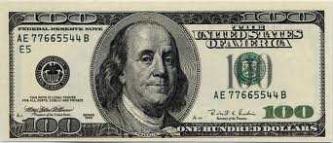
Outreach and Prenatal Case Management
Likely prevention of 19-37 cases of NAS ($1.7 million savings) and 6 low birth weight babies requiring NICU services ($100,000+/baby).
Likely prevention of >100 unintended pregnancies in women with active substance use disorders ($2.3-3.9 million).
Total savings (conservative)= $4.6 million
Cost of CHRC grant with Nexplanon= $250k
“Public health is public wealth.” B. Franklin
Notes:
Cost of Nexplanon $315 with 340B discount. Net’s $18 savings for every $1 invested. Does not take into account savings from Social Services, Head Start, Public Schools, etc.

Slide 51
Calculations
100 pregnancies (63% pregnancy rate) @ $17,257 for prenatal, delivery, child’s medical care to age 1 for average Medicaid pt = $1,725,700
(British study showed conception rates of 85% in their substance use population)
50 pregnancies complicated by drug use assuming 50% relapse (relapse rate would likely be closer to 70%)
35 cases of NAS assuming 70% incidence @ $60,000 per NICU stay = $2,100,000
10 cases of NAS assuming 20% incidence @ $60,000 per NICU stay = $600,000

Slide 52
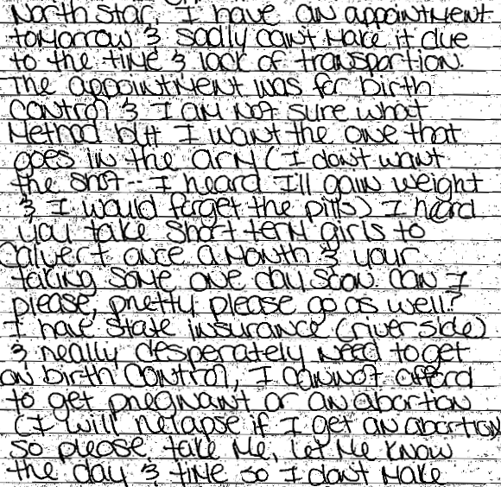
Letter from a patient enrolled in a 28 day drug treatment program, but unable to access contraceptive services.

