Slide 1
Faculty Development: Preparing Clinical Nursing Instructors
Maryland Action Coalition Summit
May 2017
Susan L. Bindon DNP, RN-BC, CNE
NSPII-#14-113

Slide 2
Learning Outcomes
Participants will:
Identify four key content areas for clinical faculty development
Discuss potential teaching strategies to encourage application of content
Describe the process of working with standardized participants

Slide 3

Background
Nursing faculty shortage persists
Shortages may limit enrollment or affect group size
Large #s of adjunct clinical faculty needed
Clinical faculty influence student learning
Strong clinical expertise
Little to no formal teaching experience

Slide 4

Wanted: Great Clinical Faculty!

Slide 5
Overview
Series of 2-day workshops
ANCC continuing education contact hours offered
Focused information and skills practice for new/novice adjunct clinical faculty
Statewide effort
Follow-up support planned to match learners’ needs

Slide 6
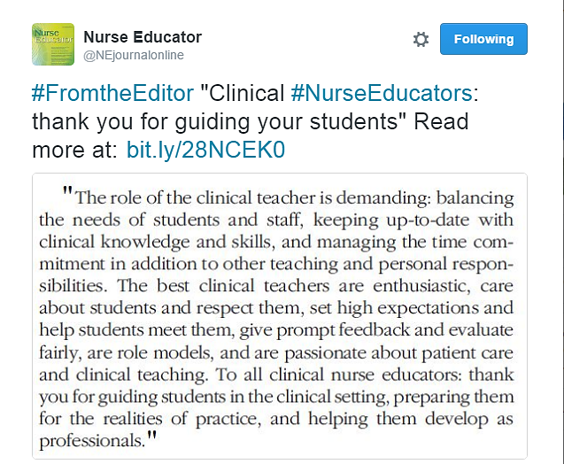
Clinical faculty matters
  Tweet 6/21/16. Oermann, M. (2016). Reflections on clinical teaching in nursing. Nurse Educator, (41)4, p. 165

Slide 7
Process
Support of MHEC’s NSP II Grant funds
Needs assessment and faculty survey
Collaborative effort with:
  national clinical teaching expert
  clinical teaching lab coordinator
  nurse attorney
  student services leader
Three SON faculty with focused areas of expertise
  Teaching and learning, professional development
  Clinical teaching
  Simulation and debriefing
Creative teaching/learning strategies*

Slide 8
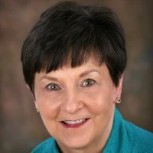
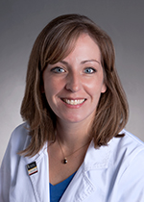
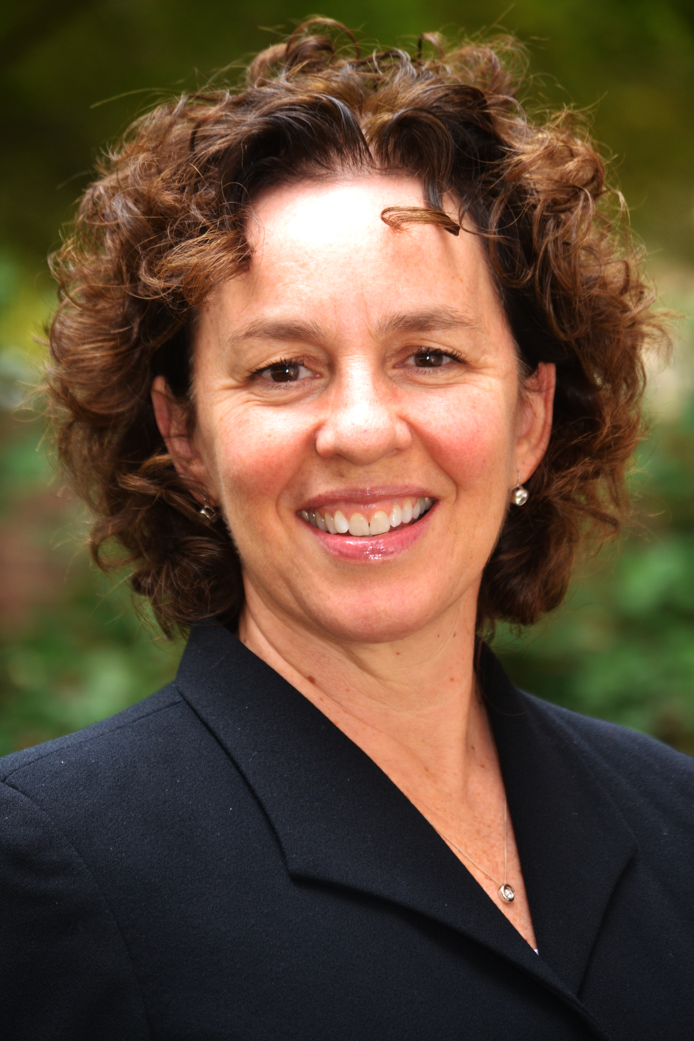
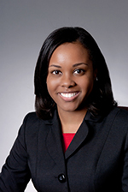
Faculty

Slide 9
Learning Needs: The 4 Rs
Role
Resources
Realities
Responsibilities

Slide 10
Learning Needs: The 4 Rs
Role
Resources
Realities
Responsibilities

Slide 11
Role
  Faculty vs. clinician role
  Teaching skills
  School representative
  Student advocate

Slide 12
Learning Needs: The 4 Rs
Role
Resources
Realities
Responsibilities

Slide 13
Responsibilities
  Organization
  Communication
  Student assessment and evaluation
  Safety!

Slide 14
Learning Needs: The 4 Rs
Role
Resources
Realities
Responsibilities

Slide 15
Resources
Course director
School resources
Hospital partners
Peers
Formal education
Evidence

Slide 16
Learning Needs: The 4 Rs
Role
Resources
Realities
Responsibilities

Slide 17
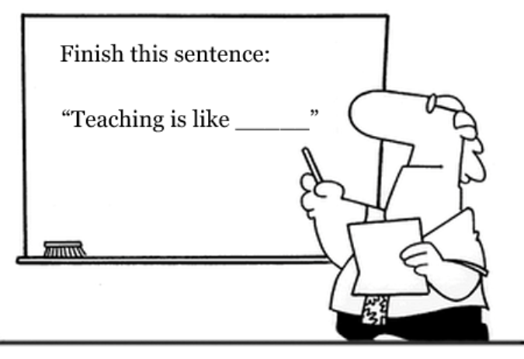
Realities

Slide 18
Intended Outcomes: The 3 Cs
1. Confidence- to perform in clinical faculty role
2. Competence- to facilitate learning and assess performance
3. Connection- to peers, SON faculty and other resources

Slide 19
Program
Didactic
  “What & How to” morning sessions
  General role and responsibilities
Application
  “Hands on” afternoon sessions
  Extend and apply concepts/tools
  Use of standardized students, group work, discussion

Slide 20

Philosophy of clinical teaching
I think…..

Slide 21
Topics
Feedback strategies
Readiness
Assessment and evaluation tools
Faculty support
Making assignments
Alternate learning activities
legal and ethical aspects
Q & A

Slide 22
Standardized students
Standardized participants trained to portray students
Realistic scenarios developed by faculty
Learners work from basic description of student and issue
SS work from more detailed information and “back story”
Learners work in small groups to uncover “frames” via conversation with students
Time in, time out!
Goal is to identify underlying issues and help student progress toward learning outcomes

Slide 23


Slide 24
Standardized students
Challenging
Exciting
Emotional
Realistic
Meaningful
Memorable
Applicable
Exhausting
Design/development
Neutrality/diversity
Cost
Availability
Time
Space
Facilitation
Debriefing

Slide 25


Slide 26
Outcomes/ evaluation
Networking, resources, mentoring, collective wisdom
New 3-credit graduate elective offered Summer semester: Introduction to Teaching Nursing in the Clinical Setting
Evaluations are consistently strong
Interest building for August 2017 course based on previous attendees

Slide 27

The student feedback sessions were great . I learned and it provided introspection.
New instructors need this training!
I just wanted to say thank you also! Awesome workshop!
This was an excellent, well-thought out program. I think that we are fortunate that you share this program with other colleges! Loved the role-playing.
Very useful workshop!
Excellent conference and I highly recommend it for all instructors.
Please provide this training again to others.
Excellent conference! When we think we have arrived, we are no longer teachable! We all can continue to learn.

Slide 28
Follow up and future steps
4 Rs and 3Cs
Goal of offering 3 times/yearly with semesters
Continue to market to broad audience
Extend support post-workshop and gather data
Update content as practice evolves
Online clinical instructor course
Dissemination

Slide 29
Learning Outcomes
Participants will:
Identify four key content areas for clinical faculty development
Discuss potential teaching strategies to encourage application of content
Describe the process of working with standardized participants

Slide 30
Thoughts, comments, questions?

