Slide 1
Crucial Elements in Developing Maryland’s Simulation Education Leaders
Sabrina Beroz, DNP, RN, CHSE
Maryland Clinical Simulation Resource Consortium
authorized under the auspices of the Nurse Support Program II (NSP II) and jointly approved by the Health Services Cost Review Commission (HSCRC) and the Maryland Higher Education Commission (MHEC).

Slide 2
disclosures
Conflict of Interest :
Sabrina Beroz (Nurse Planner, Content Expert and Faculty) reports no conflict of interest.
This work is authorized under the auspices of the Nurse Support Program II (NSP II) and jointly approved by the Health Services Cost Review Commission (HSCRC) and the Maryland Higher Education Commission (MHEC). Hosted by Montgomery College

Slide 3
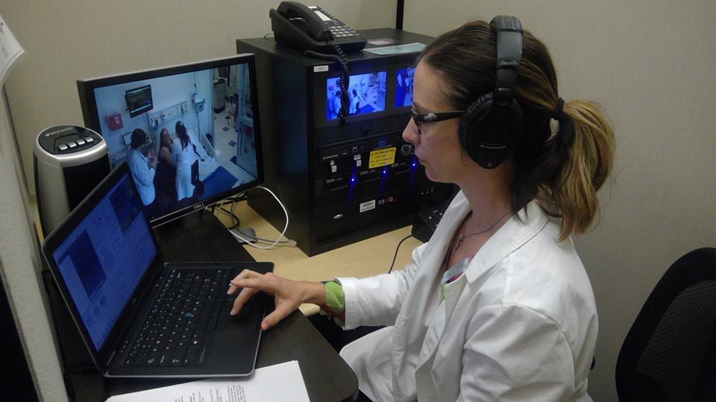
objectives
Upon completion of the presentation, the participants will be able to:
Discuss salient factors impacting the quality of simulation practices.
List the key findings from the survey of simulation programs in Maryland.
Identify the crucial elements in developing simulation education leaders.

Slide 4
Background
Development of commercially available high fidelity simulators
NLN Jeffries Simulation Framework → NLN Jeffries Simulation Theory
INACSL Standards of Best Practice: SimulationSM (2011, 2013, 2015, 2016)
NCSBN National Simulation Study (Hayden et al., 2014)
NCSBN Simulation Guidelines for Prelicensure Nursing Programs (Alexander et al., 2015)

Slide 5
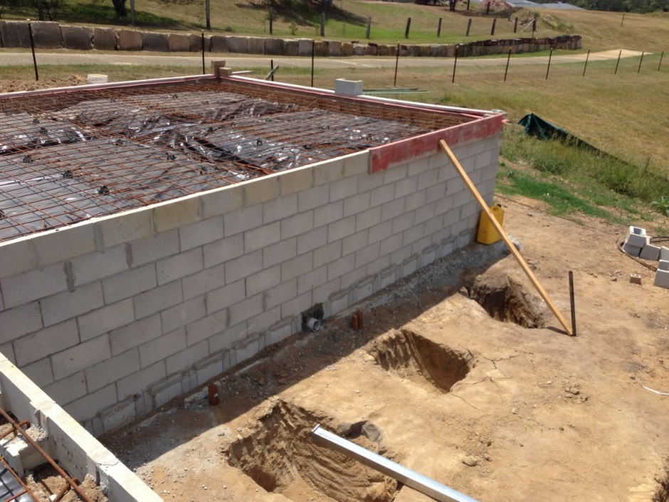
Descriptive Mixed Method Study
Purpose: Identify faculty and program development needs in simulation-based education.
Method: Structured interview process with a survey for data collection.
Survey: NCSBN simulation guidelines for faculty and program preparation (checklists).
“The Foundation”
(Beroz, 2017)

Slide 6
GUIDELINE | KEY RESULTS
Administrative | Budgetary plan for sustainability: 30% (Human, fiscal and materials) Plan for curriculum integration and evaluation of simulation: Curriculum integration → 59% Evaluation process for quality improvement → 59%
Faculty Development | Dedicated-trained simulation faculty → 22% Simulation based on educational theory → 33% INACSL Standards of Best Practice: Simulation Formal debriefing training → 44% Use of theory-based debriefing method → 37% Debriefing competence assessed → 26%
Beroz, 2017
Notes:
Plan for curriculum integration and evaluation of simulation:
Curriculum integration → 59%
Evaluation process for QI → 59%
Dedicated-trained simulation faculty →22%
Simulation based on educational theory → 33%
INACSL Standards of Best Practice: Simulation
Formal debriefing training →44%
Use of theory-based debriefing method →37%
Debriefing competence assessed: →26%
Space, Time and Material/Equipment

Slide 7
Crucial Elements in Developing Simulation education leaders
EXPERT
SEL III: Leadership
SEL II: Advanced
SEL I: Foundations
Train the Trainer Program

Slide 8
Simulation Education Leader (SEL) Building Sustainability in Academia and Practice
SEL I (Novice)
Foundations
Theory
Standards
Methods
Curriculum Integration
Advanced Debriefing
Evaluation
SEL III (Expert)
Leadership
Scholarship
Certification
SEL II (Competent)
Three Day Train the Trainer Program
http://cms.montgomerycollege.edu/mcsrc/
Benner, 2001

Slide 9
Outcomes Six Months post Train the Trainer

Slide 10
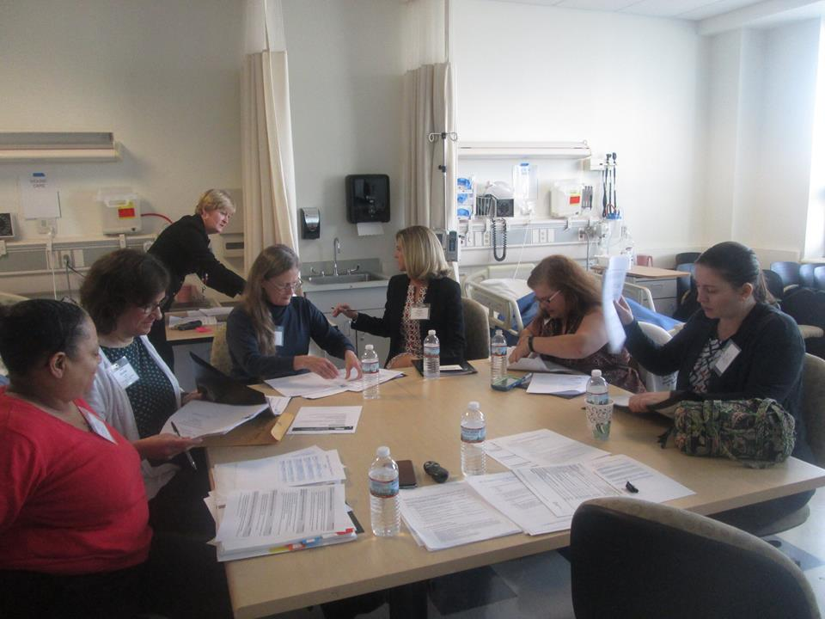
Qualitative Data
SEL II
Standardized prebriefing
Establish safe environment
Training faculty
Curriculum integration of simulation
SEL III
Developing curriculum maps
Evaluating simulations
Evaluating debriefing competence
Simulation Committee formation
Developing policies/procedures

Slide 11
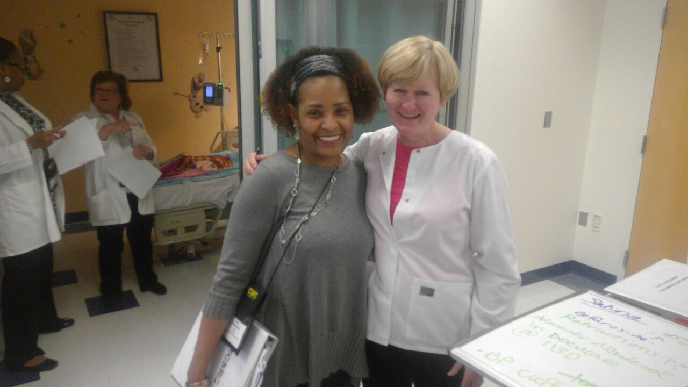
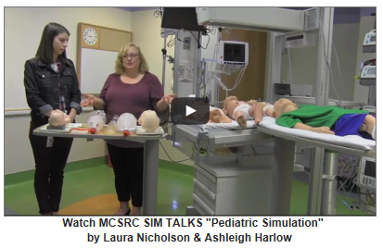
Developing Sustainability
Scholarship → Train the Trainer program and workshops
Leadership and Teamwork → SIM-Talks and SIM-Teach
Certification → Certified Healthcare Simulation Educator

Slide 12
QUESTIONS

Slide 13
references
Alexander, M., Durham, C., Hooper, J., Jeffries, P., Goldman, N., Kardong-Edgren, S.,… Tillman, C. (2015). NCSBN simulation guidelines for prelicensure nursing programs. Journal of Nursing Regulation, 6, 39-42.
Benner, P. (2001). From novice to expert: Excellence and power in clinical nursing practice. Commemorative Edition. Upper Saddle River, NJ: Prentice-Hall Health.
Beroz, S. (2017). A statewide survey of simulation practices using the NCSBN simulation guidelines. Clinical Simulation in Nursing, 13, 270-277.
Hayden, J., Smiley, R., Alexander, M., Kardong-Edgren, S., & Jeffries, P. (2014). NCSBN national simulation study: A longitudinal, randomized, controlled study replacing clinical hours with simulation in prelicensure nursing education. Journal of Nursing Regulation, 5, S1-S64.

Slide 14
contact
Sabrina Beroz
Montgomery College
Sabrina.beroz@montgomerycollege.edu
240-567-5547

