Slide 1
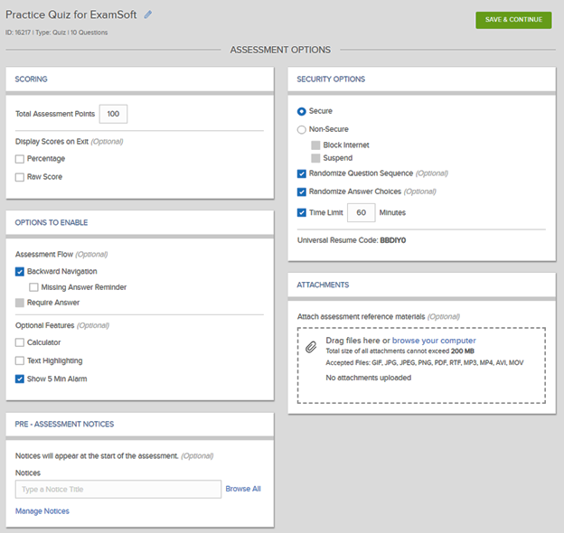
ExamSoft Assessment Options

Slide 2
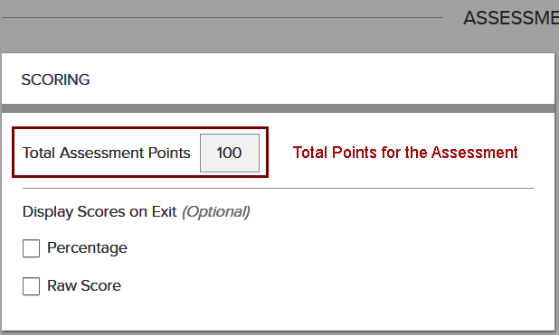
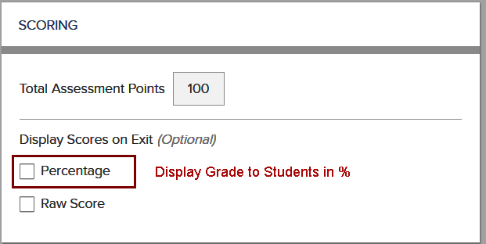
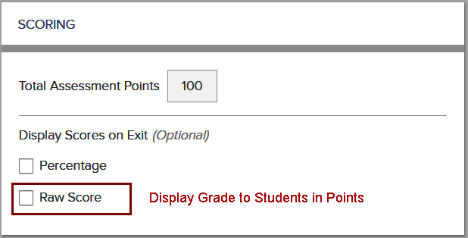
Option 1 - Scoring
NOTE: Display Scores on Exit is an option.
If neither Percentage and or Raw Score is chosen,
the students will not see any results.

Slide 3
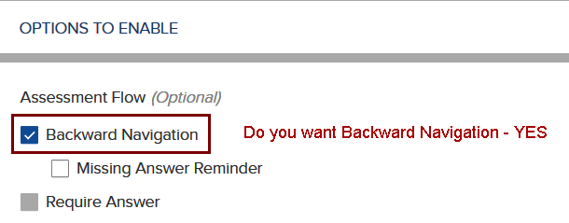
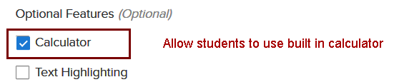
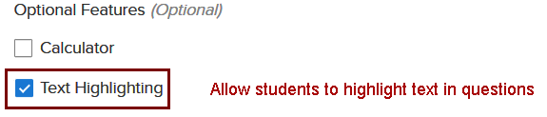
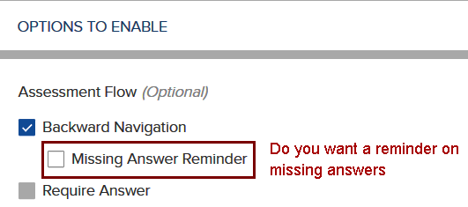

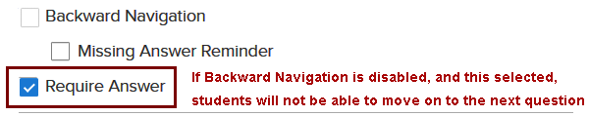
Option 2 - Exam Options

Slide 4
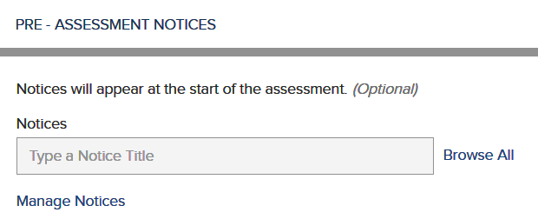
Option 3 - Pre-Assessment Notices
This notice content will be seen by students and agreed to before the exam will be visible to them.
Here you can display:
Academic Integrity Notification
Exam instructions

Slide 5
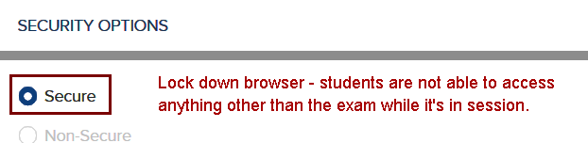
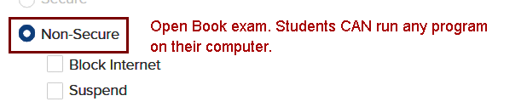

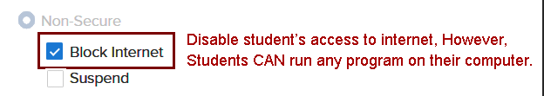
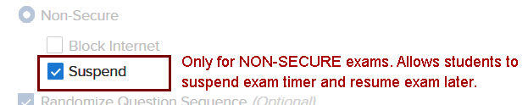
Option 4 - Security Options A

Slide 6




Option 4 - Security Options B
Note: Universal Resume Code is NOT
to be released unless an event occurs,
such as a fire drill.

Slide 7
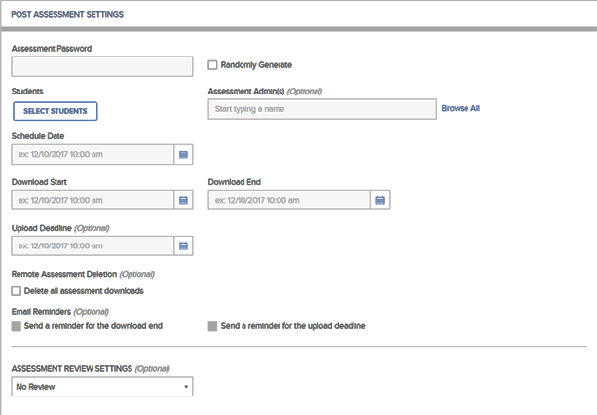
Post Assessment Settings

Slide 8
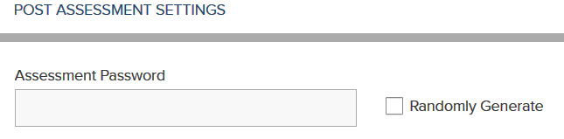
Settings 1 – Assessment Password
You may randomly generate a password for your course or you may create a password yourself.
To create a password you must:
6 to 60 alphanumeric characters
At least 1 – letter
At least – number
NOTE: Password is case sensitive

Slide 9
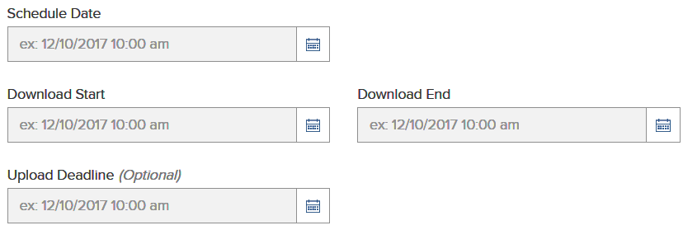
Settings 2 – Download/Upload Exam
A
B
C
D
A - Schedule Date – When you plan to open your exam to students (date of exam)
B - Download Start – When you want the students to start downloading the exam.
NOTE: Recommendation 24-48 hours prior to exam opening, if the student will be using
their own computer..
C - Download End – When you want to stop the ability to download exam
D – Upload Deadline - When the student must upload the exam
NOTE: If deadline passes the student will not be able to upload exam without
changing the date and time

Slide 10

Settings 3 – Remote Deletion
Time and date of which a downloaded assessment will be
removed from student’s computer
NOTE: Remote Deletion must occur after the Scheduled Date, Download End, and Upload Deadline

Slide 11
Settings 4 – Email Reminders
A
B
A – Email alert to students that the ability to Download is ending
B – Email alert to students that the ability to Upload is ending

Slide 12
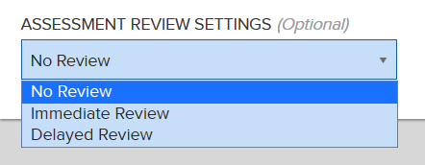
Settings 5 – Review Settings
Immediate Review (Assessment Review Password is Required):
Generate a review password – 4 word password
Time Limit – dictates how long students can spend on a review
Incorrect Answers and Rational are options as well
Delayed Review (Assessment Review Password is Required):
Review Start Time and End Date
(Must be after Download End Date and Upload End Time)
Time Limit – dictates how long students can spend on a review
Incorrect Answers and Rational are options as well
Note: Students must have internet connection to review

