Slide 1
ClinicalTrials.gov Registration & Reporting Requirements
University of Maryland School of Nursing
Noon Lecture
February 12, 2019
Presented by: Anthony Keyes, MBA, PMP
Director
Aliya Lalji, MD
Clinical Research Compliance Specialist

Slide 2
ClinicalTrials.gov
Protocol Registration & Results System (PRS)
https://register.clinicaltrials.gov
Public Site
https://clinicaltrials.gov

Slide 3
Why is this necessary?
Commitment to research participants (including recruitment)
Scientific validity/transparency
Ethical standards
Responsible stewardship of federal funds
Help IRB assess value of new studies
Required for journal publication (ICMJE)
Required by law (FDAAA) and regulations (42 CFR Part 11)
Required for all NIH-supported clinical trials (including NCI)
Required for CMS
Required by WHO
Required by grantor foundations, such as Bill & Melinda Gates Foundation

Slide 4
ClinicalTrials.gov Overview
Year | Entity | Event
1997 | Congress | 1st U.S. law to require trial registration (FDAMA)
2000 | NIH | Releases ClinicalTrials.gov website
2005 | ICMJE | Requires registration before enrollment
2006 | WHO | All clinical trials should be registered
2007 | Congress | Expanded registration, submission of results and adverse events, civil penalties (FDAAA)
2008 | NIH | Releases results database
2015 | CMS | Mandatory Reporting of Clinical Trial Number on Claims
2015 | NCI | Policy Ensuring Public Availability of Results from NCI-supported Clinical Trials
2016 | FDA/NIH | Final Rule and Companion Policy (effective January 18, 2017)
2017 | FDA | Final Rule compliance date (April 18, 2017)
FDAMA: Food and Drug Administration Modernization Act
NIH: National Institutes of Health
ICMJE: International Committee of Medical Journal Editors
WHO: World Health Organization
FDAAA: Food and Drug Administration Amendments Act
CMS: Centers for Medicare & Medicaid Services
NCI: National Cancer Institute

Slide 5
Federal Regulations
“Applicable Clinical Trials” per FDAAA
Trials of drugs/biologics: Controlled clinical investigations, other than Phase 1 trials of drugs/biological products subject to FDA regulations.
Trials of devices:
Controlled trials with health outcomes of devices subject to FDA regulation (other than feasibility studies)
Pediatric post-market surveillance required by FDA
Trial has one or more sites in the U.S.
Trial is conducted under an FDA IND/IDE application
Trial involves a drug, biologic or device that is manufactured in the U.S. or its territories and exported for research
ACT Wizard: http://grants.nih.gov/clinicaltrials_fdaaa/docs/Flow_chart-ACT_only.pdf
Identifying an ACT under FDAAA http://grants.nih.gov/ClinicalTrials_fdaaa/ACTs_under_FDAAA.htm

Slide 6
Federal Regulations
Trials that meet the NIH Definition of a Clinical Trial
If you answer “yes” to any of the following questions, your study meets the NIH definition of a clinical trial and registration IS required.
Does the study involve human participants?
Are the participants prospectively assigned to an intervention?
Is the study designed to evaluate the effect of the intervention on the participants?
Is the effect being evaluated, a health-related biomedical or behavioral outcome?
If you answered YES to all 4 the NIH Criteria (on the left), your study is a clinical trial even if it is one of the following scenarios:
Studying healthy participants
Do not have a comparison group
Only designed to assess the pharmacokinetics, safety, and/or maximum tolerated dose of an investigational drug
Behavioral intervention

Slide 7
Penalties
Penalties outlined in the FDA Final Rule Final Rule (42 CFR Part 11) Released: 09/2016, Effective: 01/2017, Compliance date: 04/2017
Under FDAAA an organization can be fined up to $11,805 per study, per day* for any issue of non-compliance, not only late results.
NIH may consider compliance as a term and condition of individual awards
NIH can withhold funding to organizations that are out of compliance
“In addition, NIH will withhold clinical trial funding to grantee institutions if the agency is unable to verify adequate registration and results reporting from all trials funded at that institution.”
- Francis Collins, NIH Director (published viewpoint in JAMA)
*https://www.federalregister.gov/documents/2018/10/11/2018-22005/annual-civil-monetary-penalties-inflation-adjustment
JAMA: Toward a New Era of Trust and Transparency in Clinical Trials

Slide 8
Funding Stipulations
Studies that are supported by a foundation who is a signatory to the May 18, 2017 WHO, International Clinical Trials Registry Platform (ICTRP)
“It’s a 21st century best practice – and an essential part of the social contract that underlies medical research – that clinical trial data should be made publicly available less than one year after a clinical trial’s completion. We strongly support WHO’s effort to establish a global standard for reporting data within this timeframe, which is a practice we require of our grantees as well.”
- Dr. Trevor Mundel President, Global Health, Bill & Melinda Gates Foundation
http://www.who.int/ictrp/results/jointstatement/en/

Slide 9
CMS Requirements
Qualifying clinical trials which will render claims for items and services to the Centers for Medicare and Medicaid Services (CMS):
The National Clinical Trial (NCT) number must be included on claims for items and services provided in clinical trials that are qualified for coverage as specified in the “Medicare National Coverage Determination (NCD) Manual,” Section 310.1
https://www.cms.gov/Outreach-and-Education/Medicare-Learning-Network-MLN/MLNMattersArticles/Downloads/SE1344.pdf

Slide 10
Publication Recommendations
Trials that meet the clinical trial definition of The International Committee of Medical Journal Editors (ICMJE) that the investigator may wish to publish...
ICMJE journals will consider [for publication] trials beginning on or after July 1, 2005 only if registration occurred before the first patient was enrolled (“prospective registration”)
Many journals follow the ICMJE criteria for publication.
There have been cases within our institution where a manuscript was rejected for publication simply because the study was not registered on ClinicalTrials.gov before enrolling participants!
http://www.icmje.org/about-icmje/faqsclinical-trials-registration/

Slide 11
Summary of Requirements
Entity | Registration | Results Reporting | Penalties
Health and Human Services (HHS) | Within 21 days of enrollment | Within 365 days of primary completion date for ACTs | $11,805/study/day Criminal proceedings
National Institutes of Health (NIH) | Within 21 days of enrollment | Within 365 days of primary completion date for clinical trials receiving NIH funding | Loss of grant funding (to include the institution)
National Cancer Institute (NCI) | Within 21 days of enrollment | Within 365 days of primary completion date of NCI-supported clinical trials (in a peer-reviewed journal and/or ClinicalTrials.gov) | Loss of grant funding
Veterans Health Administration (VHA) | Prior to release of funding. Prior to enrollment | Within 365 days of primary completion date | Loss of grant funding

Slide 12
Summary of Requirements
Entity | Registration | Results Reporting | Penalties
Centers for Medicare & Medicaid Services (CMS) | All qualifying clinical trials | Study-specific | Coverage denial Costs and fraud investigations
International Committee of Medical Journal Editors (ICMJE) | Prior to enrollment |  | Ineligibility to publish
Foundations (ie: Gates) | Study-specific | Study-specific | Loss of grant funding

Slide 13
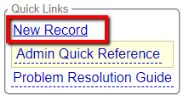
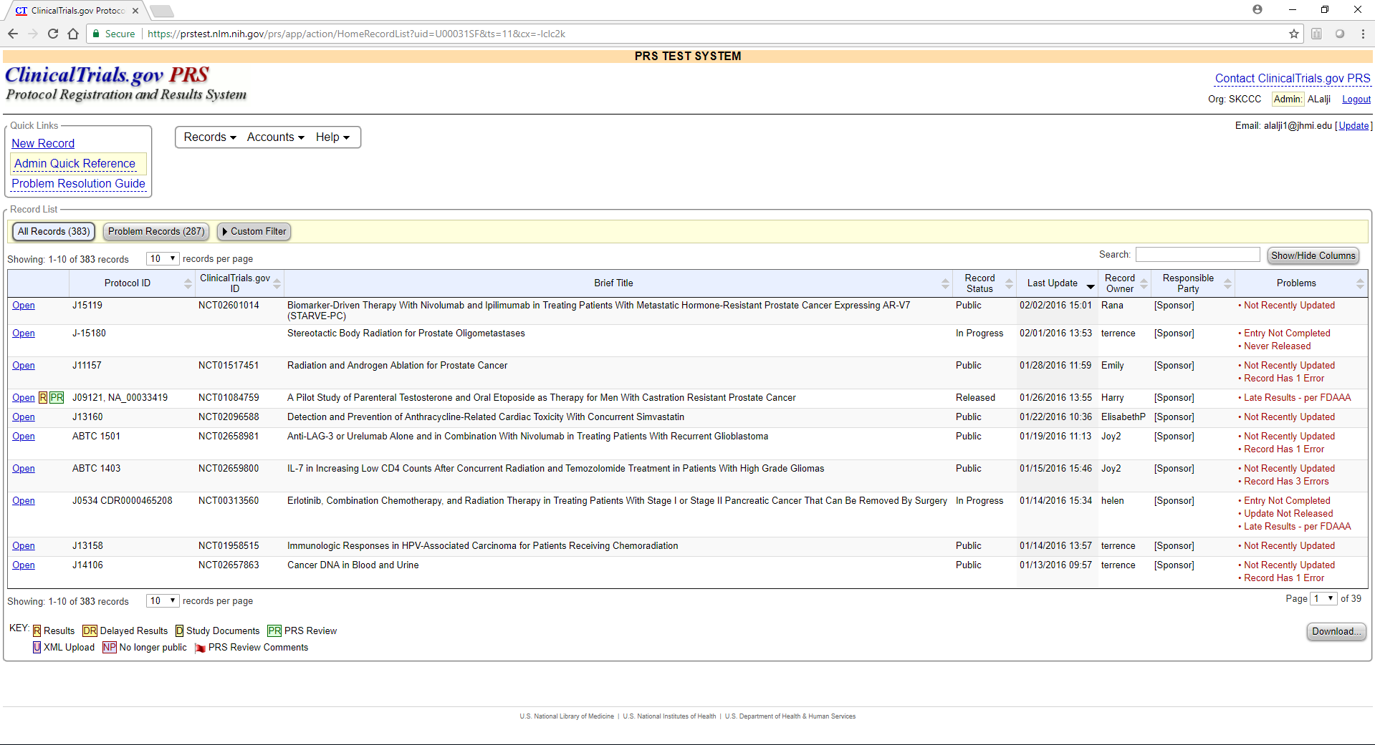
How do I register?
Protocol Section
Study Identification
Study Status
Sponsor/Collaborators
Oversight
Description
Conditions
Study Design
Arms/Interventions
Outcome Measures
Eligibility
Contacts/Locations
References
*If you need clarification about a term within the application, you may refer to the “Help” and “Definitions” links towards the top of the page.
Request a new account (if you don’t already have one)
Login to https://register.clinicaltrials.gov
Click on “New Record” under the Quick Links at the top left

Slide 14
How do I register?
Protocol Section
Study Identification
Study Status
Sponsor/Collaborators
Oversight
Description
Conditions
Study Design
Arms/Interventions
Outcome Measures
Eligibility
Contacts/Locations
References
*If you need clarification about a term within the application, you may refer to the “Help” and “Definitions” links towards the top of the page.
Please refer to the checklist provided for details on what elements are required for registration.
Consider:
The individual who creates the new record, automatically becomes the Record Owner. If this needs to be changed, contact Martina/Latoya
Assign necessary individuals to the access list
When determining anticipated completion dates, consider the time frames for outcome measures and intervention durations (per protocol)
Define each arm, then assign individual interventions as specified in the protocol
Make sure all study sites are listed
Make sure accurate contact information is listed

Slide 15
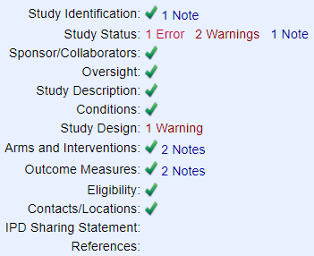
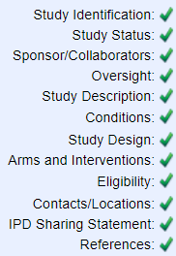
How do I register?
Protocol Section
Study Identification
Study Status
Sponsor/Collaborators
Oversight
Description
Conditions
Study Design
Arms/Interventions
Outcome Measures
Eligibility
Contacts/Locations
References
*If you need clarification about a term within the application, you may refer to the “Help” and “Definitions” links towards the top of the page.
Finalizing and Submitting the Record
Once you have completed all sections of the record using your new checklist, and verified that all errors and warnings have been addressed, you must release the record. This will now enter the CT.gov PRS review.

Slide 16
I submitted my new record, now what?
Protocol Section
Study Identification
Study Status
Sponsor/Collaborators
Oversight
Description
Conditions
Study Design
Arms/Interventions
Outcome Measures
Eligibility
Contacts/Locations
References
*If you need clarification about a term within the application, you may refer to the “Help” and “Definitions” links towards the top of the page.
Next steps…
ClinicalTrials.gov PRS Review (up to 2-7 business days)
Reply to Reviewer Comments (if applicable) within 15 calendar days
Record will be made public after it clears PRS Review
Update your record within 30 days of any changes to the study
Verify your record at least once a year
Results entry within 12 months of the Primary Completion Date

Slide 17
How often do I need to update my record?
Protocol Section
Study Identification
Study Status
Sponsor/Collaborators
Oversight
Description
Conditions
Study Design
Arms/Interventions
Outcome Measures
Eligibility
Contacts/Locations
References
*If you need clarification about a term within the application, you may refer to the “Help” and “Definitions” links towards the top of the page.
Record should be updated within 30 days of any study change
Study status must be verified at least once-a-year
Must be updated within 30 days of change in status
Primary Completion Date: the date that the last data point for the primary outcome measure was collected from the last enrolled participant.
Study Completion Date: the date that the last data point for all remaining outcome measures was collected from the last enrolled participant.

Slide 18
What do I need to update?
More rapid updating is required for several data elements to help ensure that users of ClinicalTrials.gov have access to accurate, up-to-date information about important aspects of an applicable clinical trial or other clinical trial
The following data elements must be updated not later than 30 calendar days after a change occurs
When do I upload my ICF?
As per the Common Rule, your informed consent form (ICF) must be uploaded within 60 days of the last enrolled participant. This would be at the same time that you update your study status from “Recruiting” to “Active, not recruiting”.
Study start date
Intervention name(s)
Availability of Expanded Access
Expanded Access status
Overall recruitment status
Explanation for change in status
Actual enrollment data
Individual site status
IRB status
Completion Date
Responsible Party
Official Title
Contact Information

Slide 19
When do I upload the Consent Form?
According to the revised Common Rule, effective January 21, 2019…
Important considerations regarding the uploading of the informed consent form (ICF):
Applies to clinical trials conducted or supported by a Federal department or agency
The consent form must have been used in enrolling participants
Should be uploaded no later than 60 days after the last study visit by any subject, as required by the protocol
Must be uploaded to either ClinicalTrials.gov or a docket folder on Regulations.gov
§46.116 General requirements for informed consent.

Slide 20
When do I enter results?
Results for the primary outcome measure are due within 12 months of the Primary Completion Date. All remaining results must be reported within 12 months of the Study Completion Date.
Estimated time to enter results: up to 40 hours (depends on proficiency and quality of data sets available)
It may take multiple review cycles to post your results
Primary Completion Date: the date that the last data point for the primary outcome measure was collected from the last enrolled participant.
Study Completion Date: the date that the last data point for all remaining outcome measures was collected from the last enrolled participant.

Slide 21
How do I enter results?
Protocol Section
Results Section
Participant Flow
Baseline Characteristics
Outcome Measure Results
Report Adverse Events
Other Information
Documents Section
Protocol
Statistical Plan
Informed Consent Form (optional)
Cover page (each doc)
*If you need clarification about a term within the application, you may refer to the “Help” and “Definitions” links towards the top of the page.
Login to https://register.clinicaltrials.gov
Open the record for which you will be entering results
Update the Protocol section if necessary
Verify that the study status and all study dates are accurate
On the Record Summary page, scroll down to the Results Section and click on “Enter Results”

Slide 22
How do I enter results?
Protocol Section
Results Section
Participant Flow
Baseline Characteristics
Outcome Measure Results
Report Adverse Events
Other Information
Documents Section
Protocol
Statistical Plan
Informed Consent Form (optional)
Cover page (each doc)
*If you need clarification about a term within the application, you may refer to the “Help” and “Definitions” links towards the top of the page.
Outcome Measures Primary Outcome Measure results must be reported within 12 months of the Primary completion date, regardless of publication status. All other outcome measures must be reported within 12 months of the Study completion date.
Data must be reported per Arm
Population Analysis Description should include explanation why “Number of Participants Analyzed” is different from number of participants who completed
Number & Type of Units Analyzed is indicated if, other than “participants” (For example, if analyzing lesions rather than individual participants)
Specify unit of measure (ie: “percentage of participants,” “ng/mL,” “months”)
There should NOT be any placeholders within the data tables
Statistical Analysis is optional

Slide 23
How do I enter results?
Protocol Section
Results Section
Participant Flow
Baseline Characteristics
Outcome Measure Results
Report Adverse Events
Other Information
Documents Section
Protocol
Statistical Plan
Informed Consent Form (optional)
Cover page (each doc)
*If you need clarification about a term within the application, you may refer to the “Help” and “Definitions” links towards the top of the page.
Outcome Measures
Title: A detailed title describing WHAT is being measured INCORRECT – “Communication” CORRECT – “Patient verbal activity”
Description: A detailed description of HOW this outcome measure is being assessed. You must make sure to include applicable units of measure. If you’re using a scoring scale, you must include the name and description of the scale being used, including the possible score range, the significance of a high/low score. INCORRECT – “proportion of visit statements by patient” CORRECT – “Patient verbal activity is the proportion of visit statements contributed by the patient in relation to overall visit statements, including statements by the companion and primary care provider.”
Time Frame: This must be a specific point in time when data for this outcome measure will be assessed or a change between 2 time points*. INCORRECT – “at start of study” CORRECT – “During enrollment visit, up to 77 minutes” *For outcome measures that are assessing a change between different time points, you must report the results as different outcome measures for each pair of time points (For example, one outcome for “change from baseline to Day 28”, a separate outcome for change from Day 1 to Day 60”

Slide 24
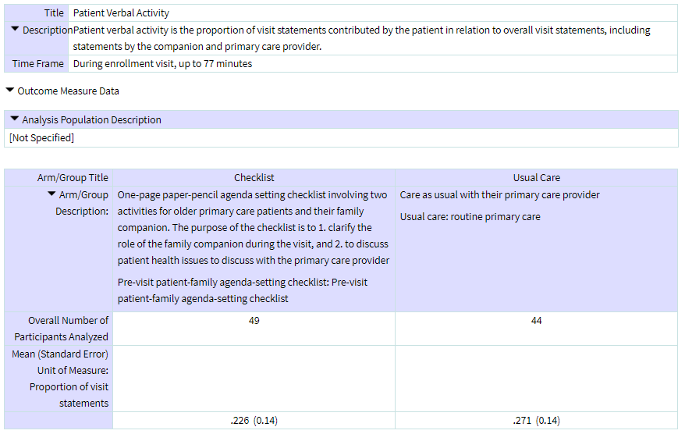
How do I enter results?
Protocol Section
Results Section
Participant Flow
Baseline Characteristics
Outcome Measure Results
Report Adverse Events
Other Information
Documents Section
Protocol
Statistical Plan
Informed Consent Form (optional)
Cover page (each doc)
*If you need clarification about a term within the application, you may refer to the “Help” and “Definitions” links towards the top of the page.
Outcome Measures
Title clearly states WHAT is measured
Description clearly explains HOW it is being measured (ie: how measures are being quantified to assess the outcome)
Time Frame is specific
Results reported per Arm
If number of participants analyzed is different from total participants who started the study, you must explain under “Analysis Population Description”
Unit of measure matches what is in description

Slide 25
How do I submit my results?
Protocol Section
Results Section
Participant Flow
Baseline Characteristics
Outcome Measure Results
Report Adverse Events
Other Information
Documents Section
Protocol
Statistical Plan
Informed Consent Form (optional)
Cover page (each doc)
*If you need clarification about a term within the application, you may refer to the “Help” and “Definitions” links towards the top of the page.
Finalizing and Submitting the Record
Click on “Record Summary” at the top left of the screen
Make sure to clear ALL errors and warnings (flagged in red)
Perform spell-check by clicking on the “Spelling” link on the left top third of the page. Make sure to expand all acronyms within each section of the record.
Confirm that all sections within the Protocol, Results, and Document sections are complete (indicated by )

Slide 26
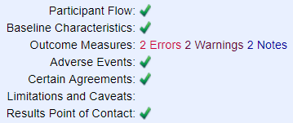
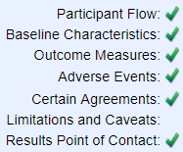
Done!
Protocol Section
Results Section
Participant Flow
Baseline Characteristics
Outcome Measure Results
Report Adverse Events
Other Information
Documents Section
Protocol
Statistical Plan
Informed Consent Form (optional)
Cover page (each doc)
*If you need clarification about a term within the application, you may refer to the “Help” and “Definitions” links towards the top of the page.
Finalizing and Submitting the Record
Once you have marked the record as complete, you must release the record for PRS review.

Slide 27
I submitted my results, now what?
Protocol Section
Results Section
Participant Flow
Baseline Characteristics
Outcome Measure Results
Report Adverse Events
Other Information
Documents Section
Protocol
Statistical Plan
Informed Consent Form (optional)
Cover page (each doc)
*If you need clarification about a term within the application, you may refer to the “Help” and “Definitions” links towards the top of the page.
Next steps…
ClinicalTrials.gov PRS Review (up to 30 business days)
Reply to Reviewer Comments (if applicable) within 25 calendar days
Record will be Posted after it clears PRS Review
Results entry for additional outcomes and adverse events (if applicable) within 12 months of study completion date

Slide 28
Special Considerations
If a PI is leaving the institution, then you must update your ClinicalTrials.gov record:
If there is a Change in PI, update this information in the record
If the study is being transferred to the PI’s new institution, you must transfer this record to the new institution and it must be accepted by the new institution
If the study is being closed or terminated, you must update the Study Status.

Slide 29
Questions?
Please visit our website for tutorials and more detailed information:
https://ictr.johnshopkins.edu/clinicaltrials-gov
See us on YouTube at “JohnsHopkinsCTgov”
Email us with any questions at
registerclinicaltrials@jhmi.edu

