Slide 1
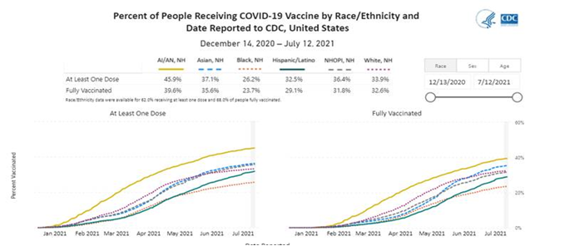
Interventions to Increase COVID-19 Vaccination Rates in Adult African American Groups Eileen Skaarer, Erika Simms, Dyshekia Strawberry, Mark Walker, Kelly Wilson
Introduction
Review of the Literature
Interventions
The coronavirus, also known as SARS-CoV-2 or Covid-19, has specifically had a higher incidence in the African American population. Although the data demonstrates the disproportionate effects of Covid-19 amongst African Americans, Black ethnic groups are the most hesitant to obtain the Covid-19 vaccination (Razai, Osama, McKechnie & Majeed, 2021).
EBSCO and Ovid database search using “vaccine hesitancy”, “Blacks”, “Covid”, “pandemic”, “African Americans” and “covid vaccine” – 8 results with 2 articles used.
Recent research has exposed many factors that contribute to vaccine hesitancy and lack of trust amongst the African American population such as:
Concerns about side effects and long-term effects
Previous unethical healthcare research
Underrepresentation of minorities in health research and vaccine trials
Cultural insensitivity in the healthcare system
Fear and anxiety
Failure or lack of public health messaging
Government mistrust
Negative healthcare experiences
Access barriers
Identify communities that may be less likely to receive a COVID 19 vaccine
Ensure that community leaders and healthcare workers acknowledge the vaccine hesitancy among minorities related to historical injustices among these groups.
Community health leaders must monitor and address vaccine misinformation
Healthcare providers must develop personal relationships to increase overall trust with vaccination.
Communities should empower local role models, faith leaders and social networks to disseminate information about vaccines.
Reduce barriers such as transportation, registration and digital divide through community based approaches.
Continuously evaluate the effectiveness of community based programs to adapt to new and evolving information about the COVID-19 Vaccine.
In early 2020, the novel coronavirus, COVID-19, was noted to reach the United States as widespread transmission and infection reached pandemic level. This prompted urgent and necessary global collaboration to address the effects of the pandemic, including efforts to effectively and expeditiously create a vaccine. Although there was success in achievement of the emergency use authorization of the COVID-19 vaccine, African American adults have shown vaccine hesitancy. This hesitancy has a contributing effect that has increased morbidity and mortality of this population during this pandemic. Healthcare leaders are compelled to gain increased understanding of the historical nature of vaccine hesitancy within the African American communities and address possible mitigation efforts to increase trust in accepting the COVID-19 vaccine.
Research Question
What interventions are effective for increasing trust in receiving the COVID19 vaccine in adult African American groups?
References
Bogart, L. M., Ojikutu, B. O., Tyagi, K., Klein, D. J., Mutchler, M. G., Dong, L., Lawrence, S. J., Thomas, D. R., & Kellman, S. (2021). COVID-19 Related Medical Mistrust, Health Impacts, and Potential Vaccine Hesitancy Among Black Americans Living With HIV. Journal of acquired immune deficiency syndromes (1999), 86(2), 200–207. https://doi.org/10.1097/QAI.0000000000002570
Centers for Disease Control. (16 June 2021). Covid data tracker. https://covid.cdc.gov/covid-data-tracker/#demographicsovertime
Razai, M. S., Osama, T., McKechnie, D., & Majeed, A. (2021). Covid-19 vaccine hesitancy among ethnic minority groups. BMJ (Clinical research ed.), 372, n513. https://doi.org/10.1136/bmj.n513

